Slide 1
Institute for Organization Management
2025 Graduates

Slide 2
Alabama

Slide 3

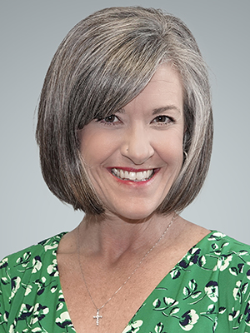
Ashley L. Engles-Ross, IOM
Vice President Small Business
Huntsville Madison County Chamber of Commerce
Alabama

Slide 4
California

Slide 5
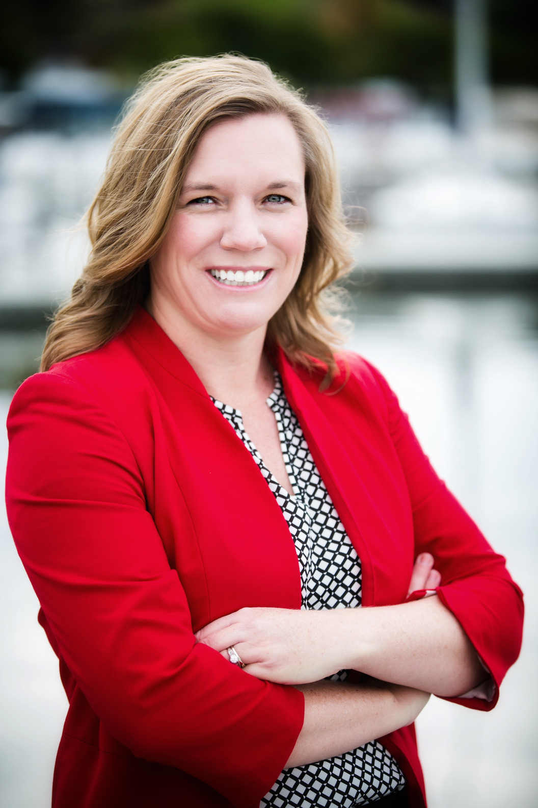
Danielle Borja, IOM
President/CEO
Greater Conejo Valley Chamber of Commerce
California

Slide 6
District of Columbia

Slide 7
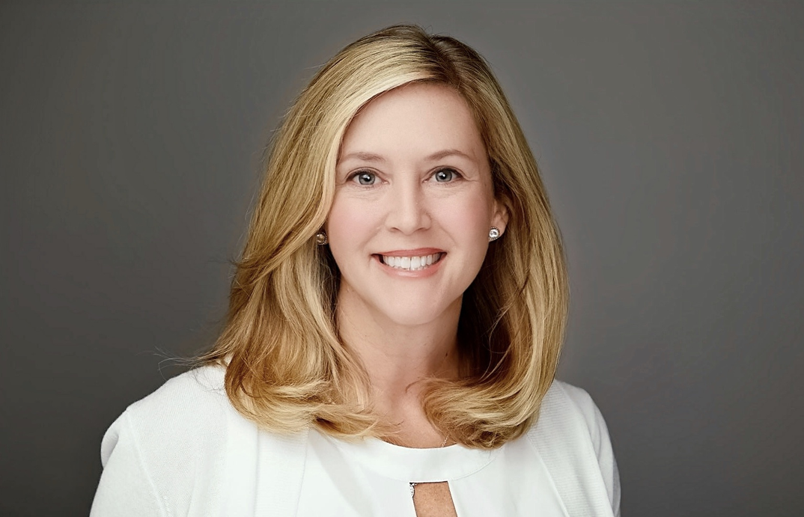
Kathryn Anderson, IOM
Senior Vice President, Growth & Strategic Partnerships
Financial Services Institute
District of Columbia

Slide 8
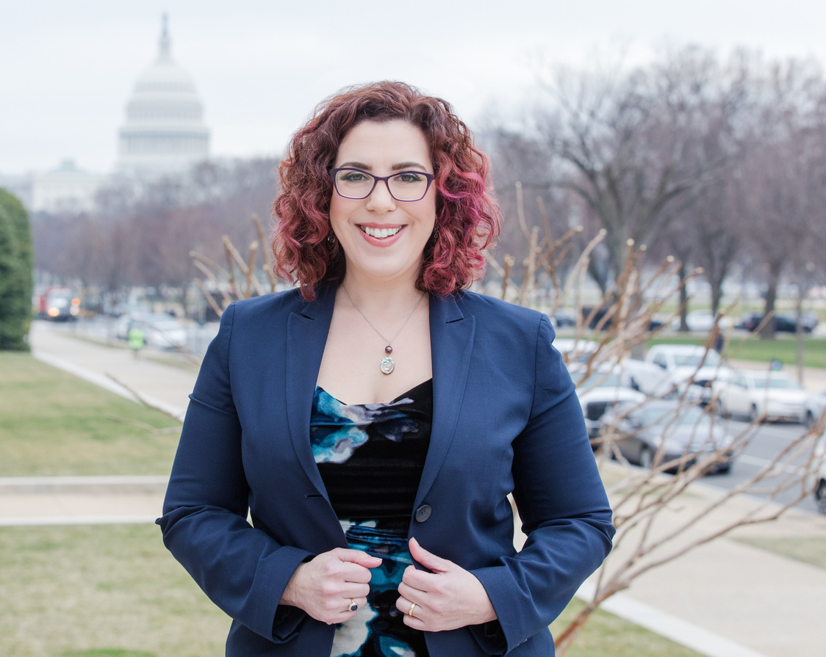
Allison L. Dembeck, IOM
Head of Policy
Save the Children
District of Columbia

Slide 9
Idaho

Slide 10
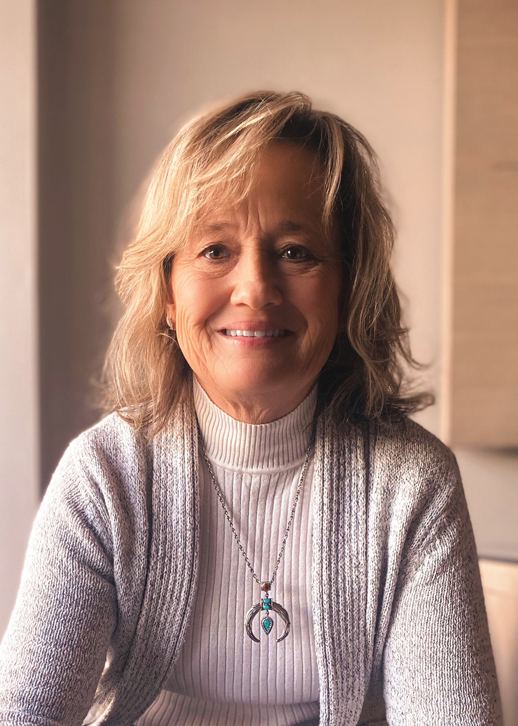
Kathleen Diederich, IOM
Operations and Finance
Twin Falls Area Chamber of Commerce
Idaho

Slide 11
Iowa

Slide 12
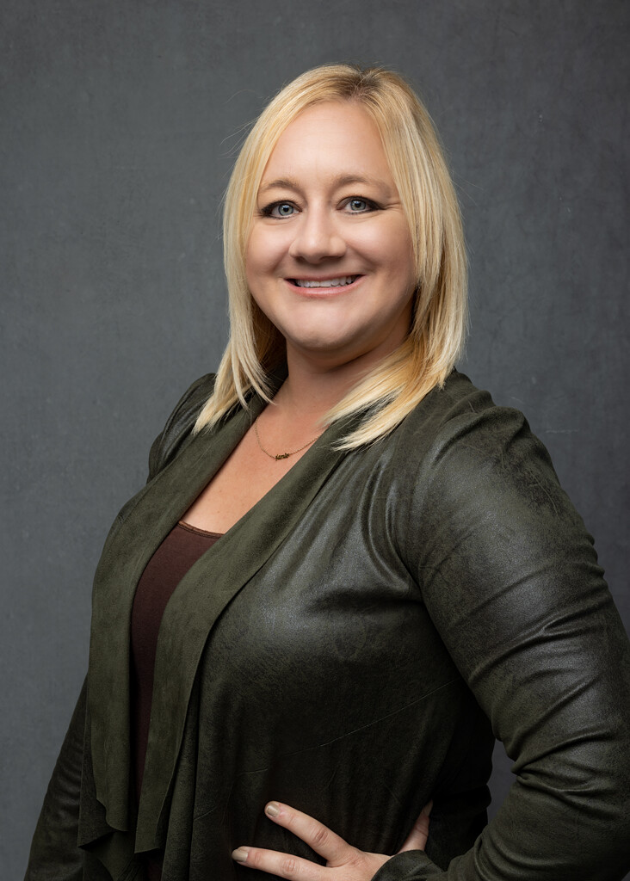
Jamie Lynn Anderson, IOM
Sr. Director of Membership and Partnership
Ankeny Area Chamber of Commerce
Iowa

Slide 13
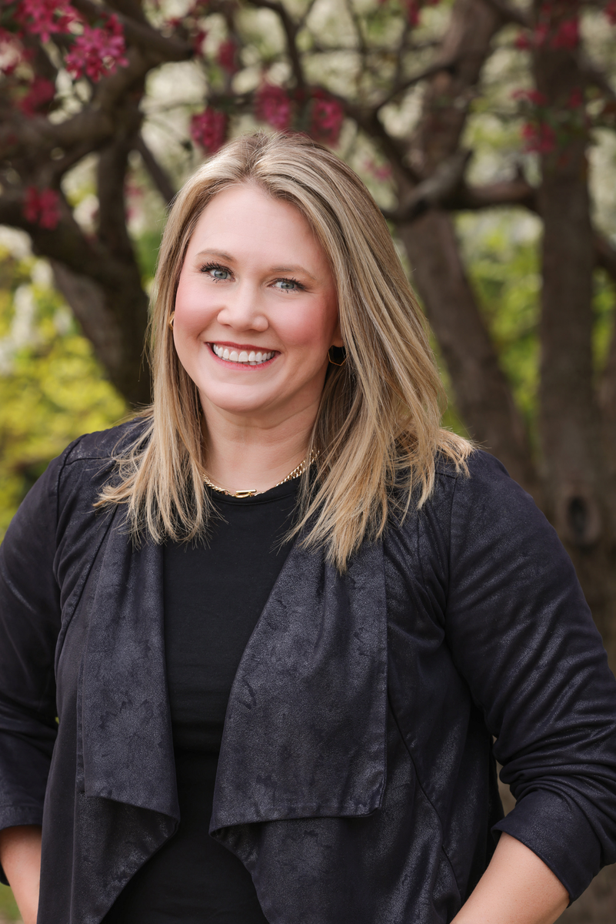
Stacy Doughan, IOM
President & CEO
Clear Lake Area Chamber of Commerce
Iowa

Slide 14
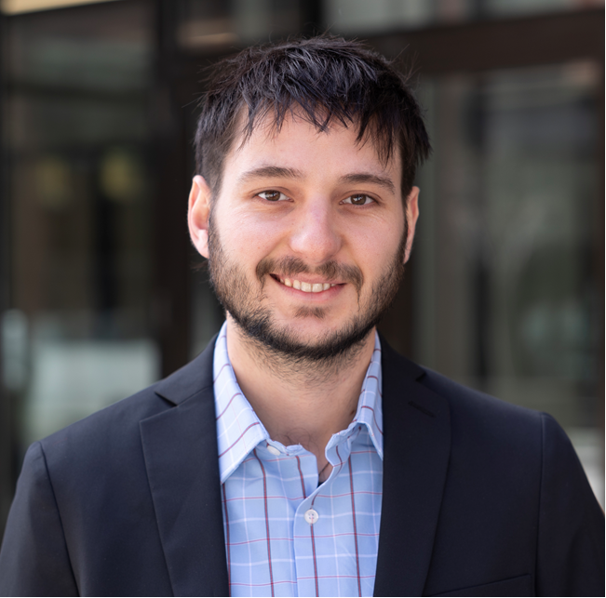
Noah Harris, IOM
Investor Relations Specialist
Greater Des Moines Partnership
Iowa

Slide 15
Kansas

Slide 16
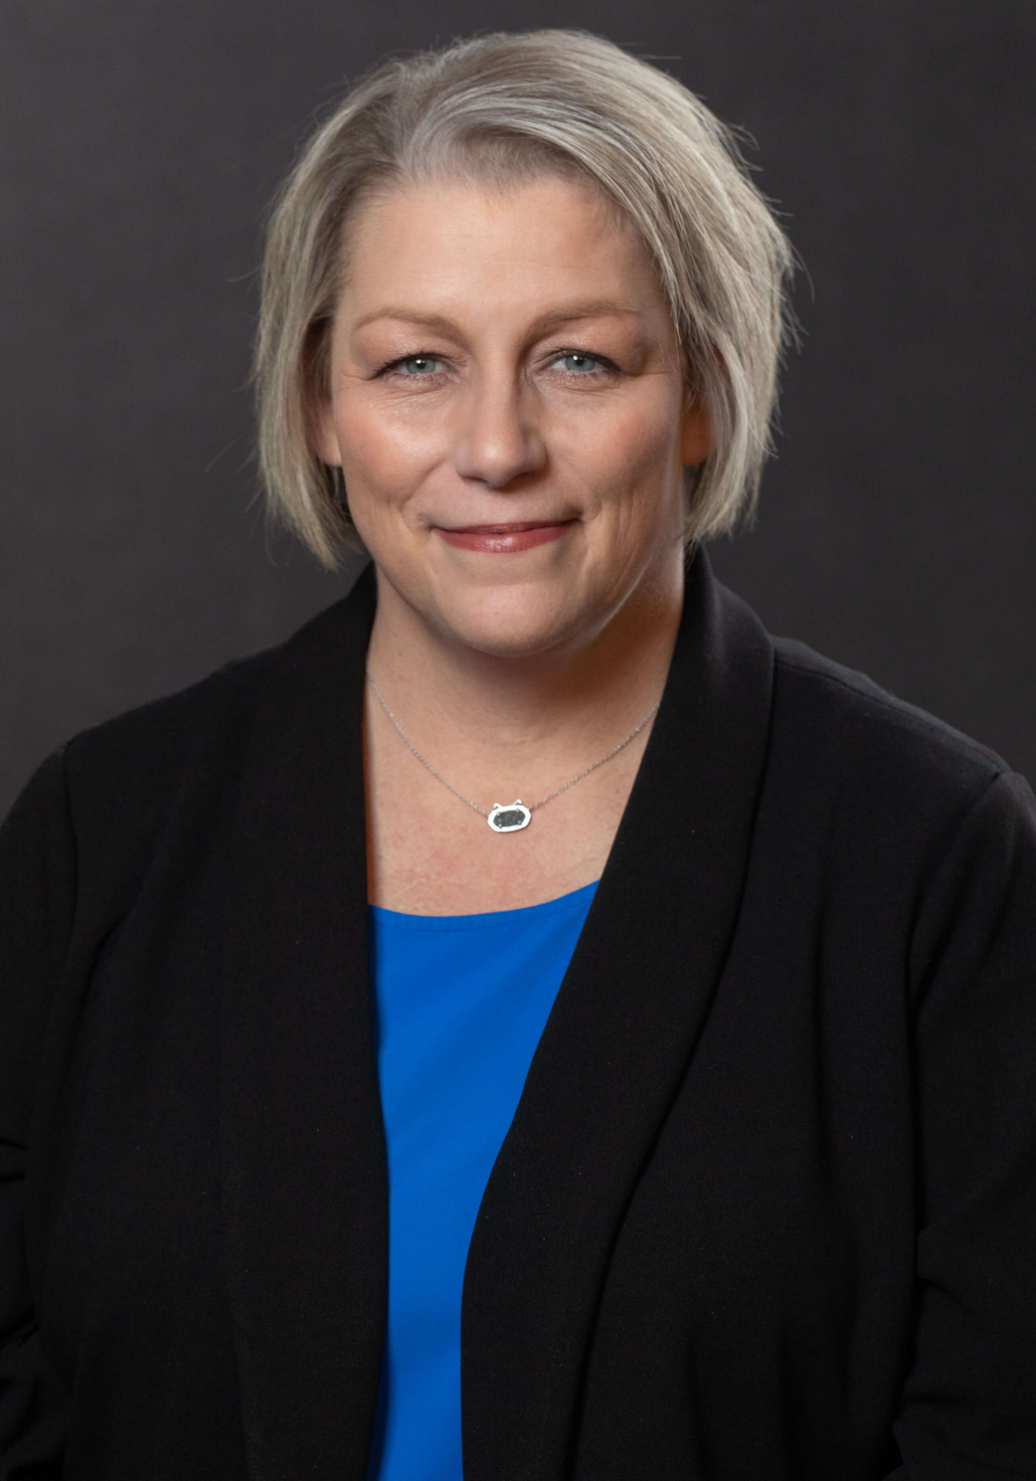
Myca J. Bunch, IOM
President
Garden City Area Chamber of Commerce
Kansas

Slide 17
Kentucky

Slide 18

Lauren Biddle, IOM
Executive Director
Public Media Business Association
Kentucky

Slide 19
Michigan

Slide 20
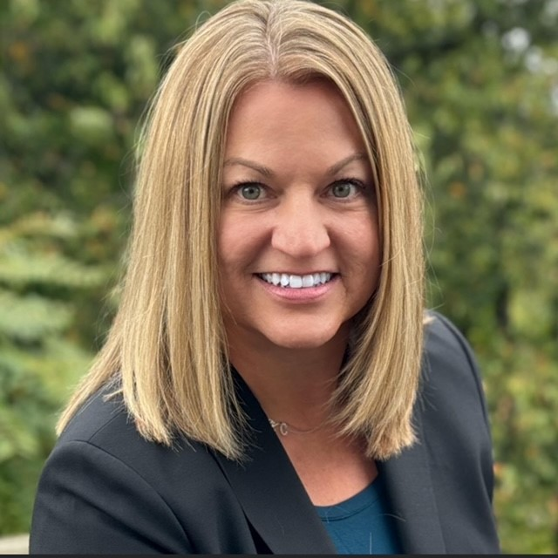
Jennifer Heinzman, IOM
President and CEO
Barry County Chamber and Economic Development Alliance
Michigan

Slide 21
Minnesota

Slide 22
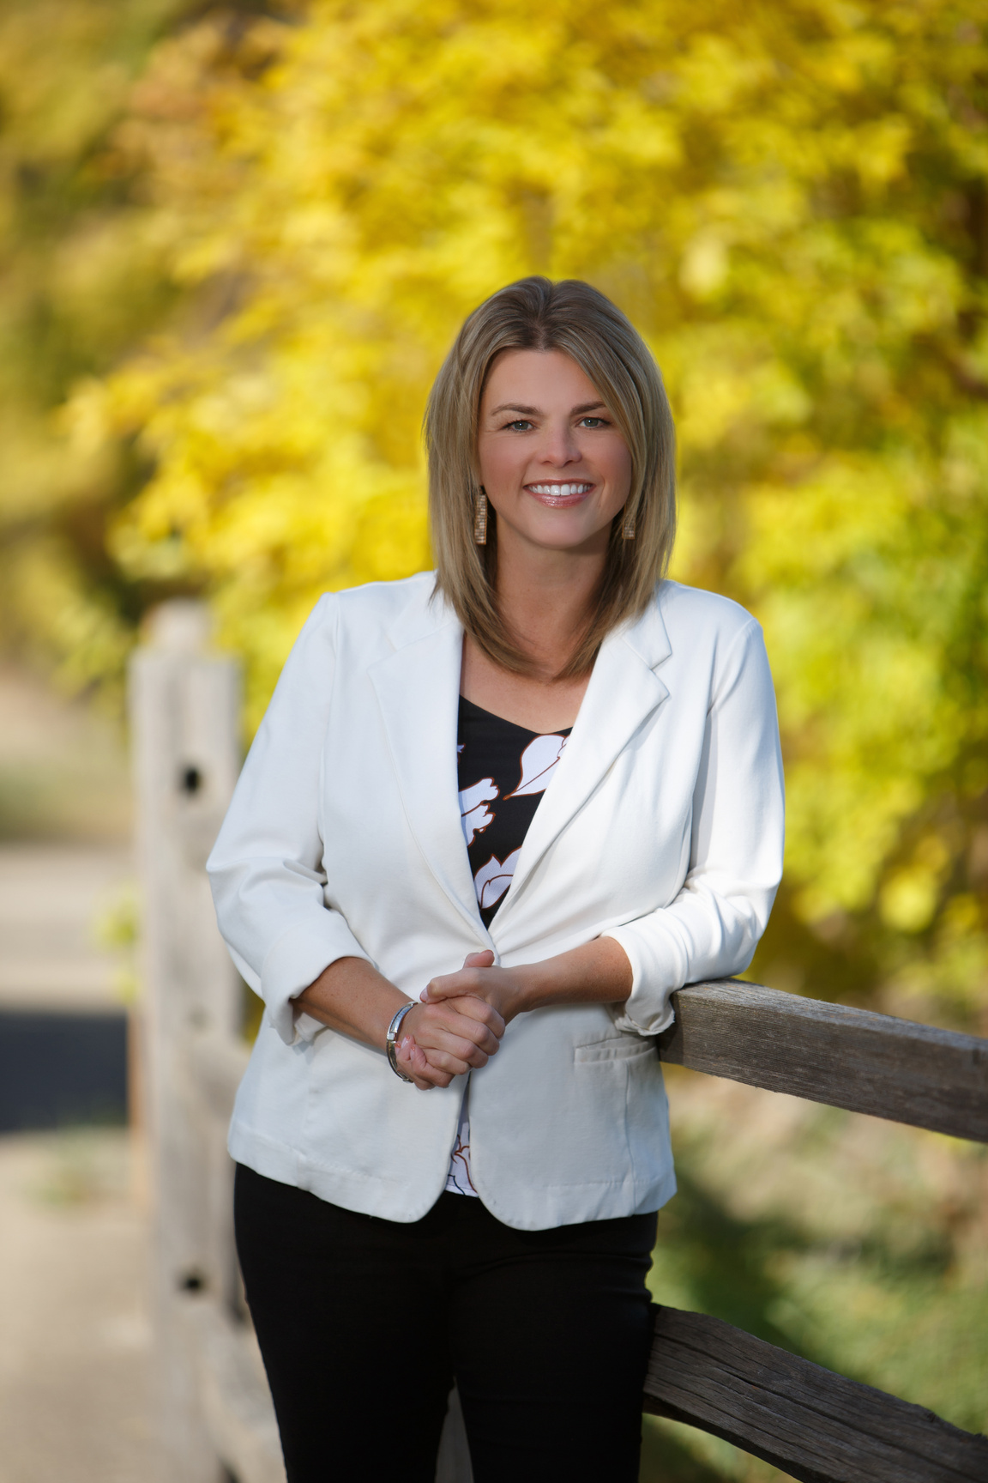
Christine Fenner, IOM, MBA
President
Waconia Chamber of Commerce
Minnesota

Slide 23
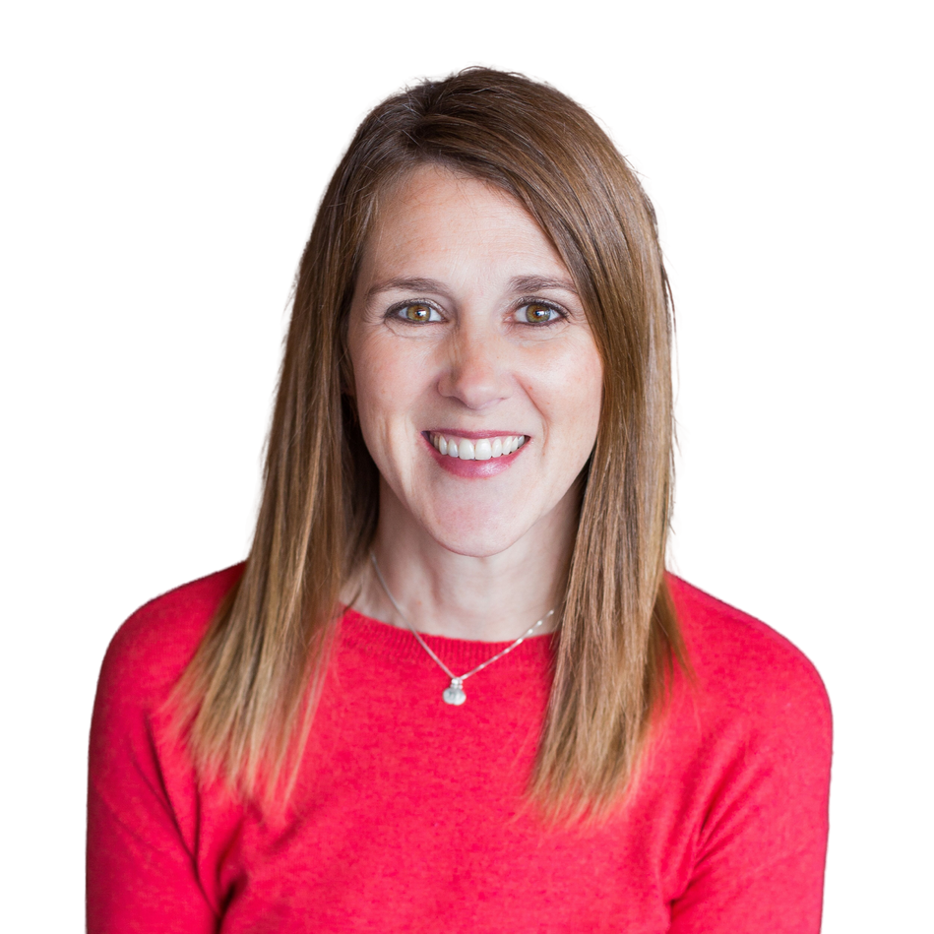
Krista Jech, IOM
President
Lakeville Chamber of Commerce
Minnesota

Slide 24
New Mexico

Slide 25
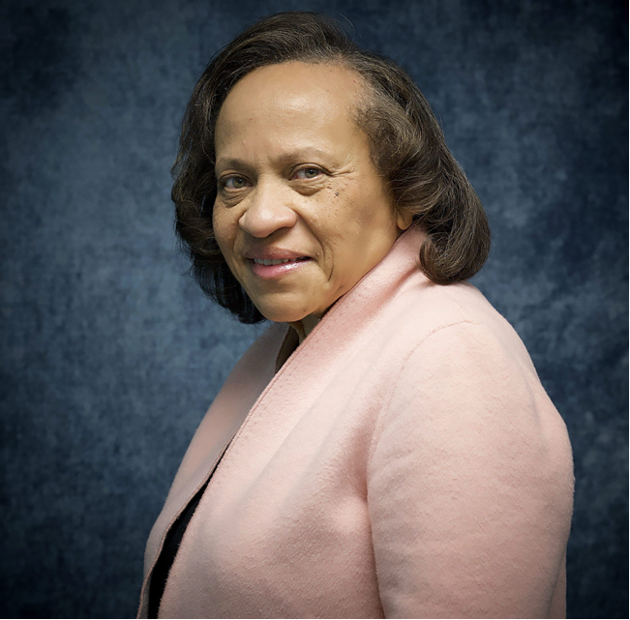
Karla Kern Causey, IOM
President & CEO
Black Chamber of Commerce of New Mexico
New Mexico

Slide 26
Texas

Slide 27
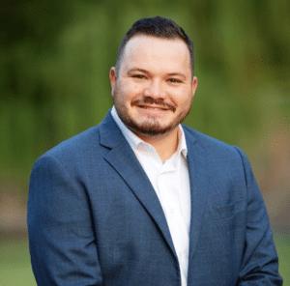
Hayden Austin, IOM
Director of Development
Metrocrest Services
Texas

Slide 28
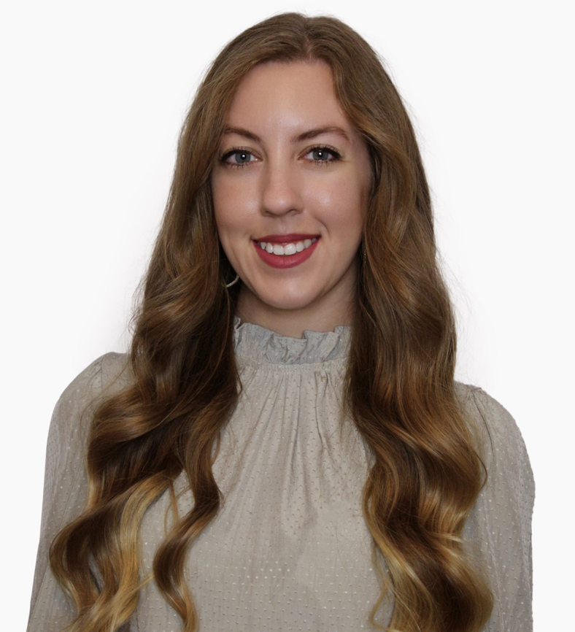
Kendall Carlson-Phalen, IOM
Director of Advancement Communications
University of North Texas, G. Brint Ryan College of Business
Texas

Slide 29
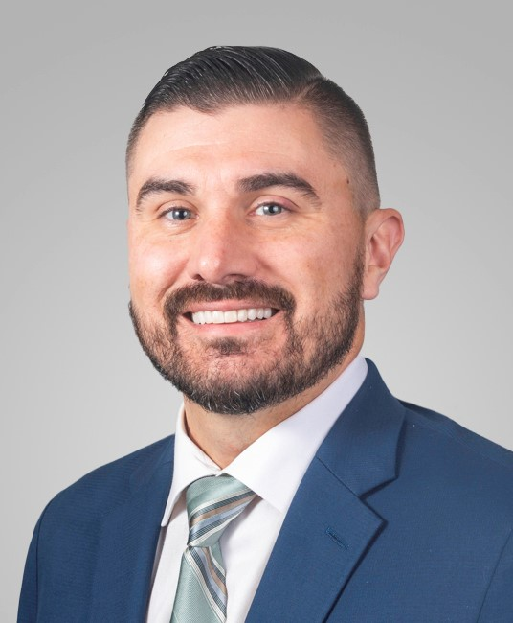
Bradley Elliott, IOM, MBA, CAE
Chief Executive Officer
Houston Building Owners and Managers Association
Texas

Slide 30
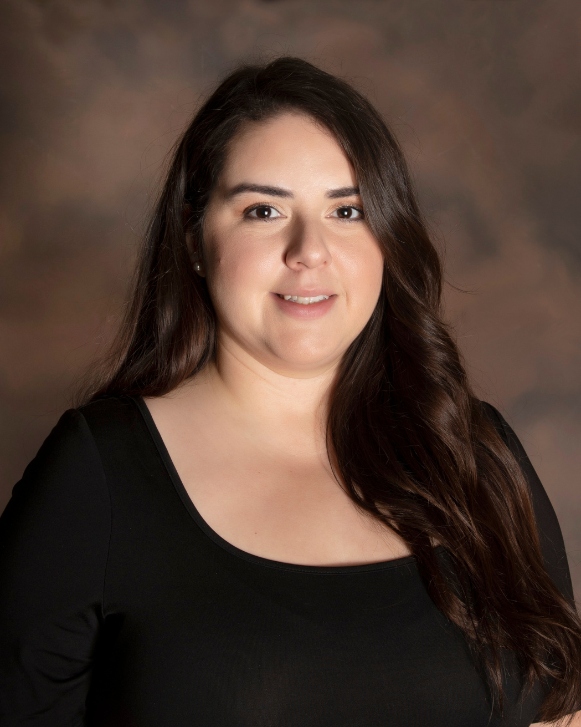
Leslie Esqueda, IOM
Director of Events
Pearland Chamber of Commerce
Texas

Slide 31
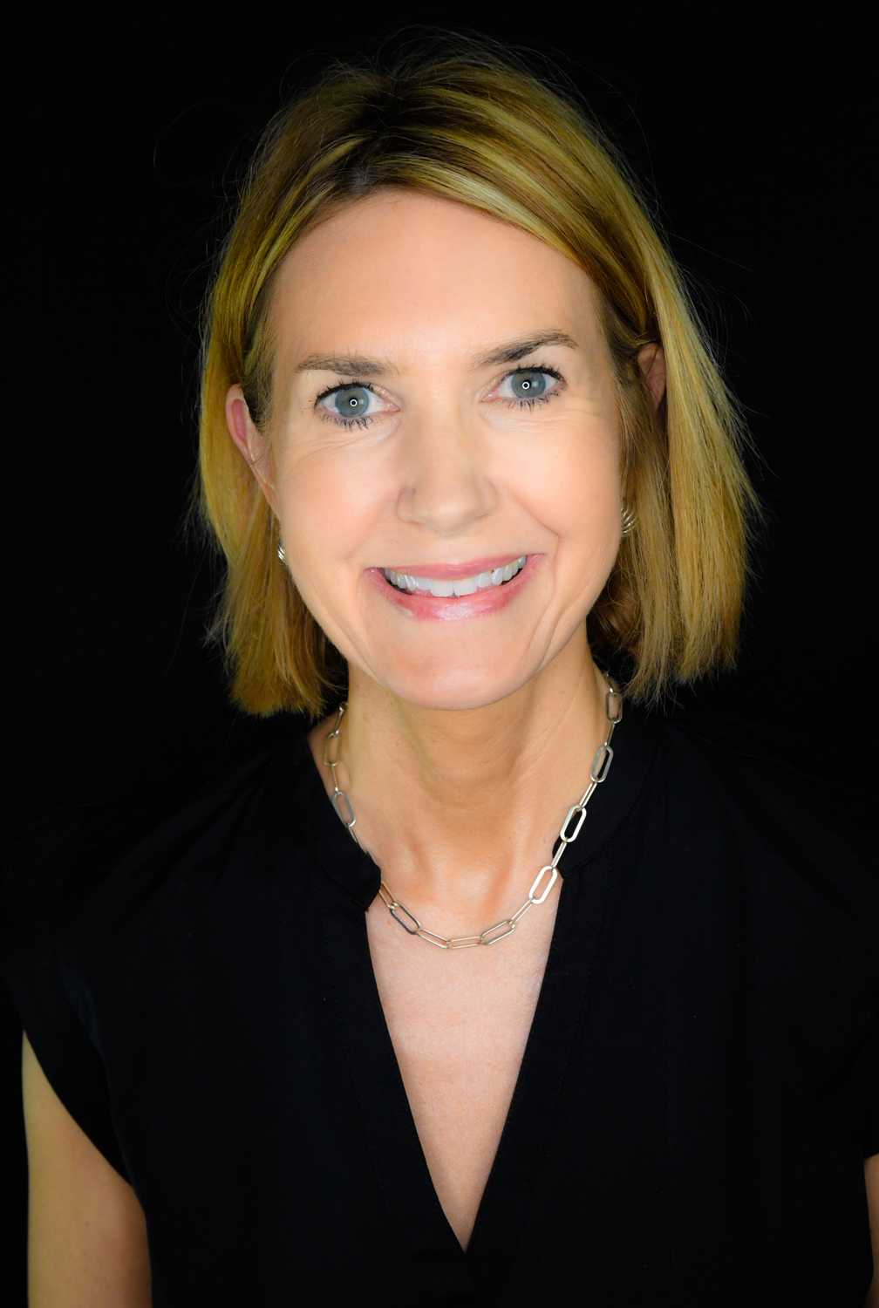
Rebecca Hancock, IOM
Executive Director
Wimberley Valley Chamber of Commerce
Texas

Slide 32
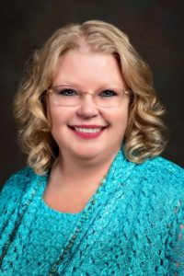
Carla Hartwig, IOM
Events & Programs Specialist
Odessa Chamber of Commerce
Texas

Slide 33
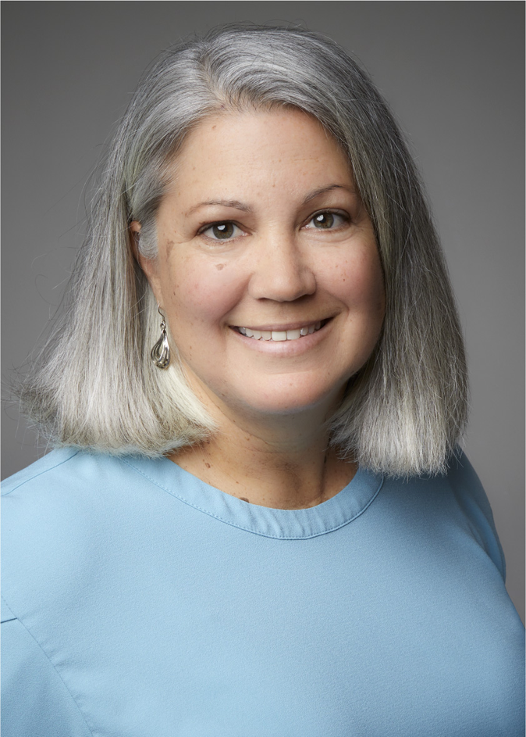
Lisa Howe, IOM
Vice President, Membership & Programs
North Texas LGBTQ Chamber of Commerce
Texas

Slide 34
Wisconsin

Slide 35
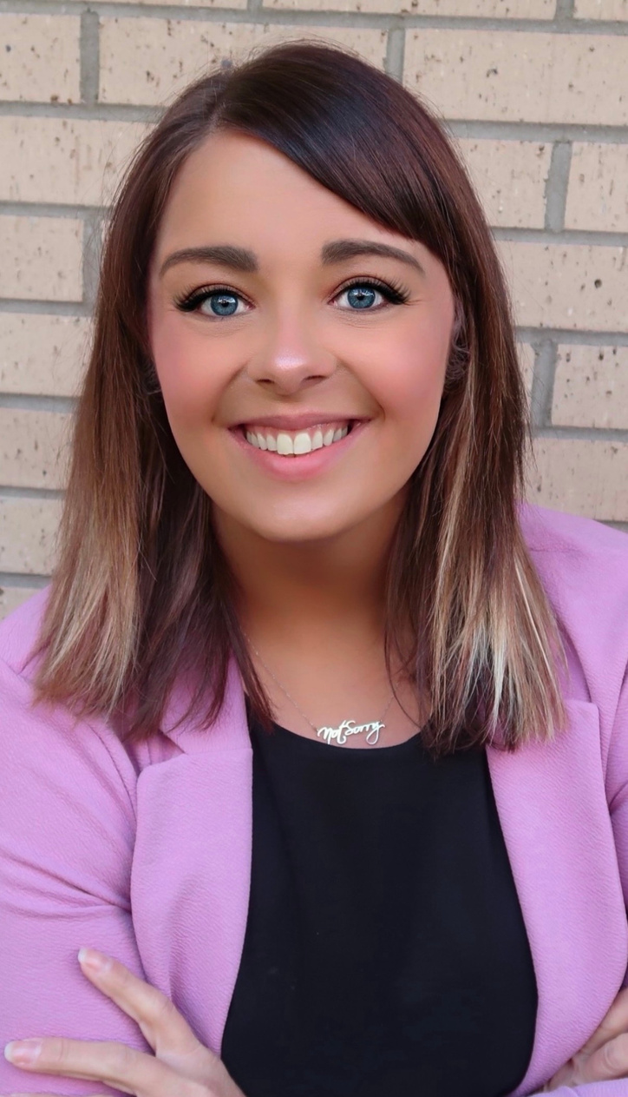
Ashley DeMuth, IOM
CEO
Menomonie Area Chamber & Visitor Center
Wisconsin

