Slide 1
Lung Ultrasound
Alok Moharir, M.D.
Department of Anesthesiology
Nationwide Children’s Hospital
Columbus, OH

Slide 2
Clinical Uses of Lung Ultrasound
Assessment of Ventilation
  Two lung ventilation
  Lung Isolation: Thoracic Surgery
Diagnosing and Monitoring Pathology
  Pneumothorax
  Pleural Effusion
  Interstitial Lung Disease

Slide 3
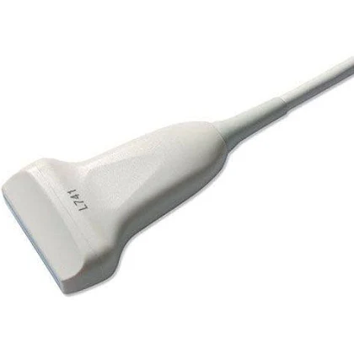
Probe Selection
Linear Transducer
  High frequency: 14-6.5 MHz
  Detailed images of superficial structures
    Chest wall
    Pleural line
  Diagnoses
    Two lung ventilation
    Pneumothorax

Slide 4
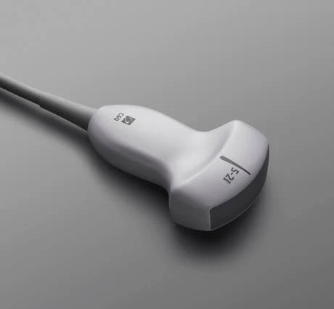
Probe Selection
Curved Array Transducer
  Lower frequency: 5-2 MHz
  Deeper penetration
    Past chest wall
    Pleural Fluid Evaluation

Slide 5
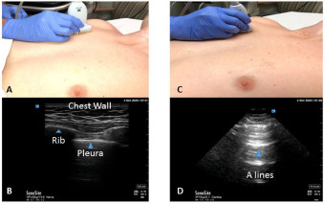
Image Acquisition: Anterior Lung Fields
Linear Probe
  Higher frequency
  More detailed superficial structures
B Mode (2-D Mode)
Longitudinal View
Second Intercostal Space
Mid-Clavicular Line
Transducer Marker points cranially

Slide 6
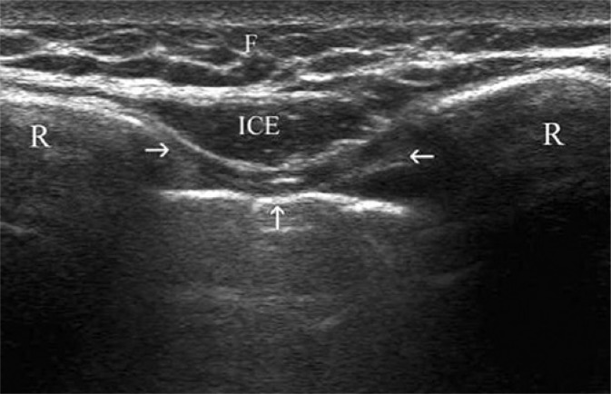
Sonoanatomy of the Chest Wall
Glossary
  F: Subcutaneous Fat (Skin above)
  ICE: Intercostal Muscles
  R: Ribs
  Upwards Arrow: Pleura
Note
  Ultrasound resolution cannot distinguish between the parietal and visceral pleura
  Presents as a white pleural line
Smereczynski A, Kolaczyk K, Bernatowicz C. Chest Wall: Underappreciated Structure in Sonoanatomy. Journal of Ultrasonography. 2017; 29.

Slide 7
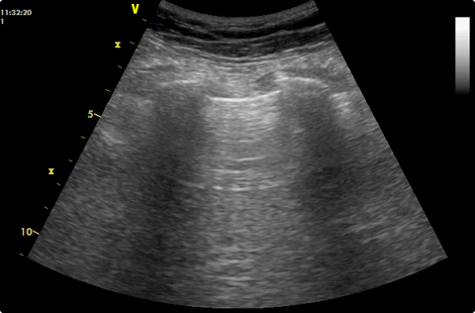
Bat Sign
Should be obtained before pleura evaluated
R: Ribs
  Hyperechoic (white) surface
  Hypoechogenic (black) shadow below costa
Arrow: Pleura
  Hyperechogenic linear structure
  Located between the ribs
R
R

Slide 8
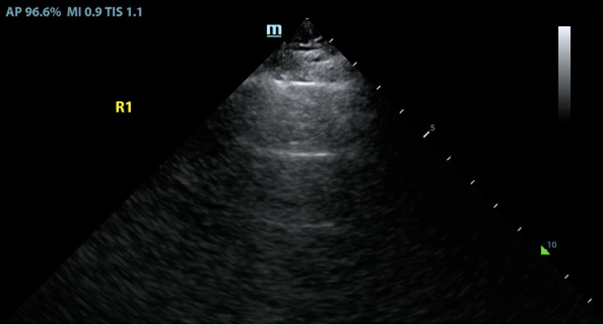
A-Lines
Reverberation artifact of pleural line
  Indicates well aerated lungs
Horizontal
Echogenic
Separated by equal distances
Fades as moving deeper

Slide 9
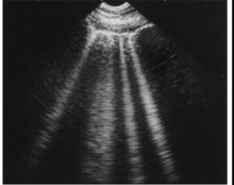
B-Lines
“Comet Tails”
Lung artifact
  Indicates increased density of lung tissue
Hyperechoic
Vertical
  Emanates from pleural line to the bottom of the screen
  Widens as it descends
Few B-Lines are a normal finding
Pathology:
  3 or more B-lines in an interspace
  One large consolidated B-line
  Will often obscure A-Lines
Can be used to rule out Pneumothorax

Slide 10
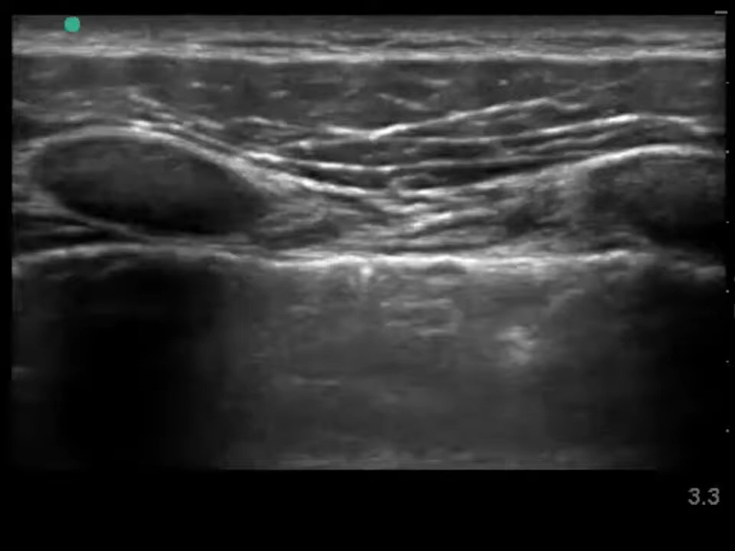
Lung Sliding
Movement of pleural line
In synchrony with respiratory cycle
Visceral pleura sliding against parietal pleura
  Disappears when separated by air
  E.g. Pneumothorax
Will also see A and B Lines sliding horizontally
Video Source: Sonosite. Lung Sliding with Linear Transducer. March 13, 2020. Retrieved from https://www.youtube.com/watch?v=p3g6bW2XzAo&t=1s

Slide 11
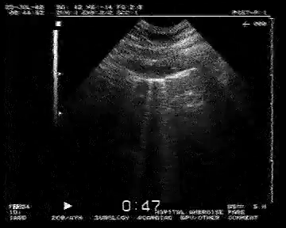
Lung Pulse
Pleural line moves with cardiac pulse
  Force of cardiac pulse transmitted to lungs
  In between respirations
Visceral and Parietal pleura juxtaposed
  Not seen in PTX where air splits layers
During lung isolation
  Lung pulse present
  No lung sliding
Video Source: Springer Videos. The Lung Pulse: an early ultrasound sign of complete atelectasis. November 28, 2010. Retrieved from https://www.youtube.com/watch?v=2fl0YvGvDSU&t=3s.

Slide 12
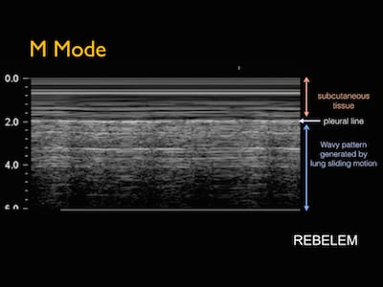
M-Mode: Seashore Sign
Normal lung sliding at point of recording
Upper part of recording
  Closest to probe
  Skin, tissue superficial to the pleura
  “Sea” part of Seashore sign
Distal part of of recording
  Lung below the pleura
  “Shore” part of Seashore sign
  Appearance of a “Sandy Beach”
Pleural Line

Slide 13
Pneumothorax
Can be identified in 2D Mode
Signs which exclude PTX
  Lung Sliding
  B-Lines
  Lung Pulse
  Presence of even one of these signs excludes a PTX
Confirmatory signs
  Lung Point

Slide 14
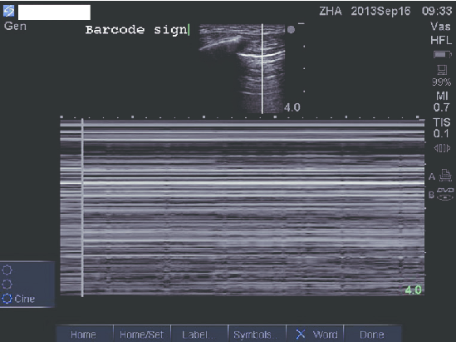
Pneumothorax: M-Mode
Stratosphere or Bar Code Sign
Absence of lung sliding
  Can also be found with lung isolation
Loss of the “shore”

Slide 15
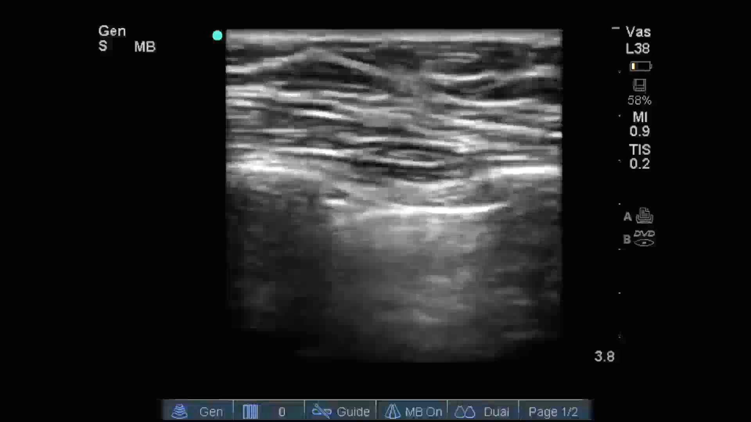
Pneumothorax: Lung Point
Diagnostic for Pneumothorax
Transducer position
  Interface of PTX and normal lung pleura
Lung point moves in synchrony with respiration
Video Source: Neurocritical Care Ultrasound. Lung Ultrasound “Lung Point.” September 10, 2013. Retrieved from: https://www.youtube.com/watch?v=nAXQrkL3teE&t=9s

Slide 16
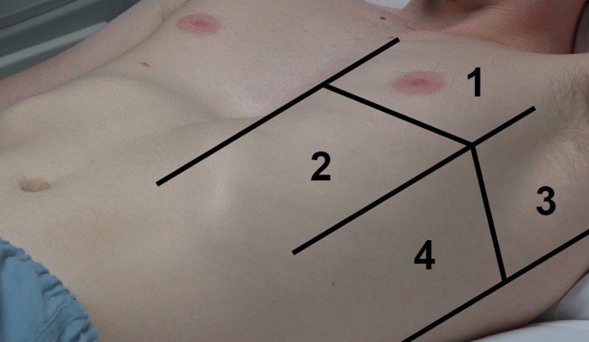
Pneumothorax: Lung Point
Lung point may not be visible in anterior field
  Zones 1 and 2
If still with clinical suspicion
  Absence of Lung Sliding and Lung Pulse
  Move probe laterally, posteriorly, inferiorly
    Zones 3 and 4
Glossary
  PSL: Parasternal Line
  AAL: Anterior Axillary Line
  PAL: Posterior Axillary Line
PSL
AAL
PAL

Slide 17
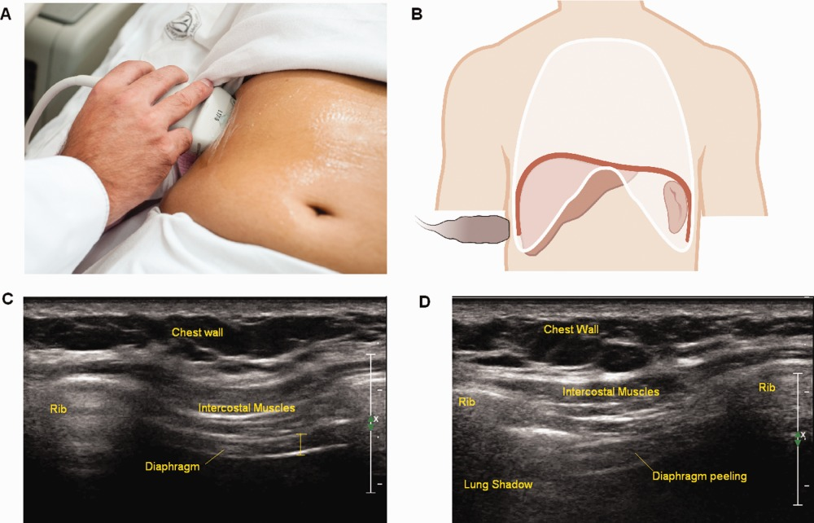
Posterolateral Lungs: Image Acquisition
Curvilinear Probe: Visualizes deeper structures
Location: Posterior Axillary Line
Orientation Marker directed cranially
Solid organs to right of the screen
  Lungs located to the left of the diaphragm
  Orientation Indicator (OI) on the left side of the screen with the Curvilinear Probe

Slide 18
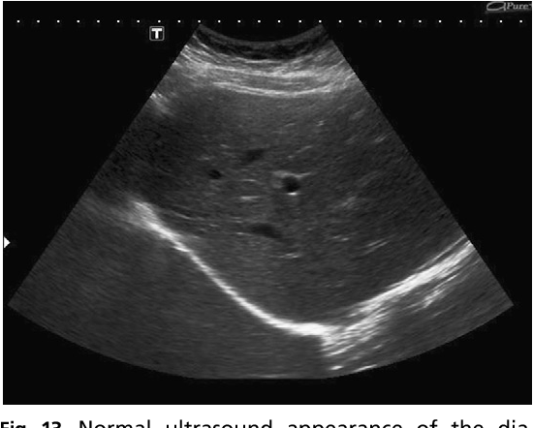
Posterolateral Lungs: Sonoanatomy
3 Step Process
  Find the abdominal reference point
    Liver on the Right side of body
    Spleen on the Left side of body
  Move transducer cranially to identify diaphragm
    Marked by thick hyperechoic white line
  Continue to move cranially to get lungs into view
  Check for hypoechoic (black) areas between diaphragm and pleura
Spine (Vertebral Column) deep to the Diaphragm
Liver
Lung
Diaphragm
Vertebral Column

Slide 19
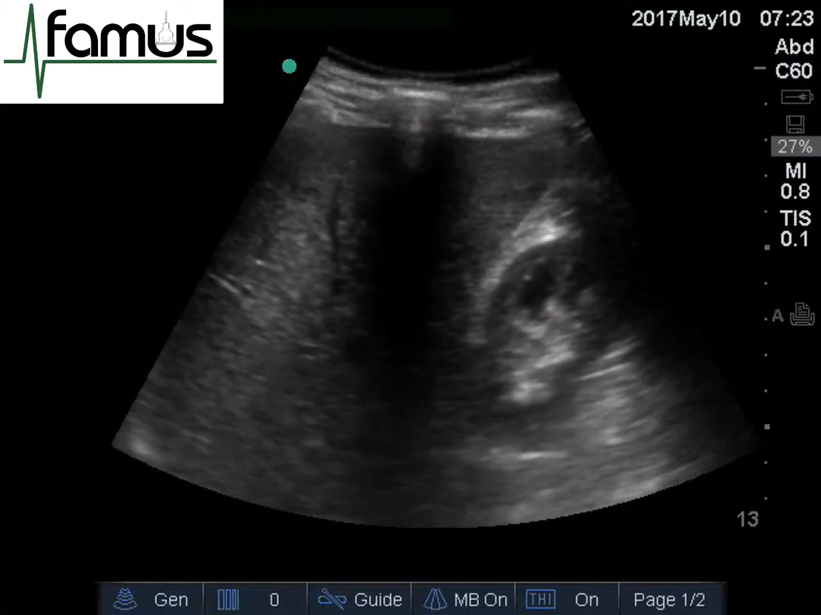
Curtain Sign
Sign of healthy, aerated lungs
Transducer placed in costophrenic sinus
During inspiration
  Lungs will caudally displace abdominal structures
  Appears as “Curtain” being drawn on abdominal structures
During exhalation
  Curtain is removed
  Abdominal structures again visualized
Absence of Curtain Sign in pleural effusion
Video: FAMUS Ultrasound. Lung Curtain. June 23, 2017. Retrieved from https://www.youtube.com/watch?v=LKDI0Dwj0wA&t=13s

Slide 20
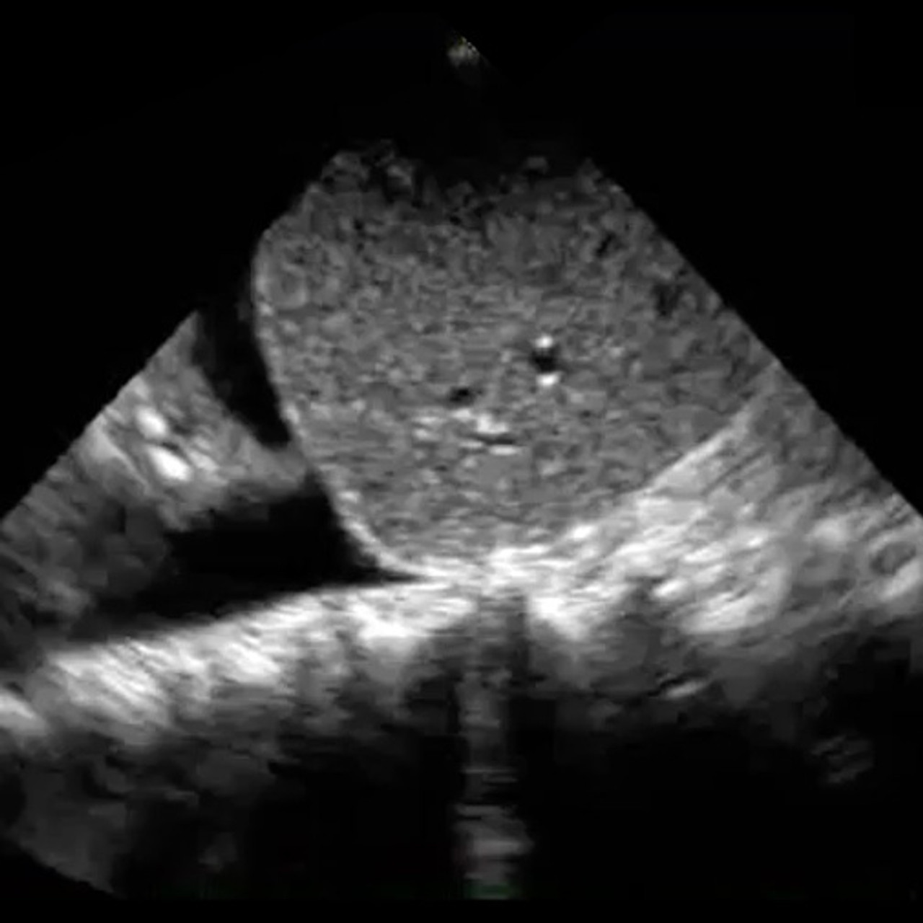
Pleural Effusion
Liver on the right hand side (inferior)
Diaphragm: Hyperechoic bright white line
Anechoic (black) pleural fluid above the diaphragm
Spine Sign
  In normal lung the thoracic spine is obscured by lung tissue and air
  In pleural effusion
    Black, hypoechoic fluid→
    Enhances ultrasound waves
    Can visualize thoracic spine
      Hyperechoic
    Continuous with subdiaphragmatic spine
Lung
Liver
Diaphragm
Pleural Fluid
Thoracic Spine

Slide 21
Interstitial Syndrome
Indicates increased density in the lungs
Common Causes
  Cardiogenic Pulmonary Edema
  Non-Cardiogenic Pulmonary Edema
  Interstitial Lung Disease
  Pneumonia
  ARDS
  Lung Contusion

Slide 22
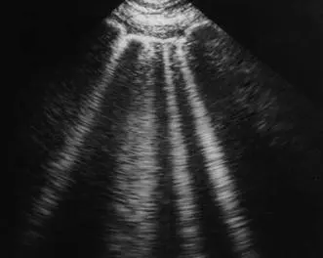
Interstitial Syndrome
3 or more B-Lines between ribs
  Or 1 large consolidated B-Line
Clinical correlation always necessary
B Lines

Slide 23
Questions to ask
Anterior Lung fields
  2D Mode
    Lung Sliding
    Lung Pulse
    A-Lines
    B-Lines: Pathologic vs Normal
    Lung Point
  M-Mode
    Seashore Sign
    Barcode Sign
Posterolateral lung fields
  Curtain Sign
  Evaluate for Pleural Fluid/Effusions
    Anechoic in the Pleural Sinus
    Spine Sign

