Slide 1
Gastric Ultrasound
Peter Shapiro, MD
Updated 2/26/25

Slide 2
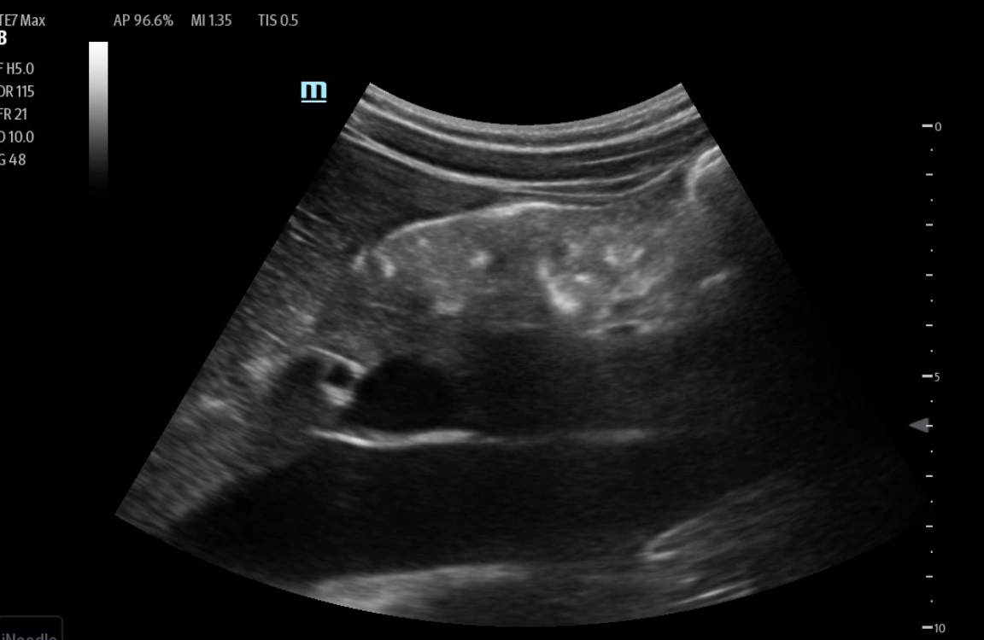
88 year-old female with DM1 scheduled for ORIF hip fracture sustained 36 hours ago. Relative contraindication to neuraxial given severe aortic stenosis. Concern for high risk of aspiration because she ate yogurt and banana six hours (or is it five) ago. The surgeon’s previous two cases were cancelled. He is angry. Postpone, cancel, slow “cardiac” induction with LMA or RSI with ETT?

Slide 3
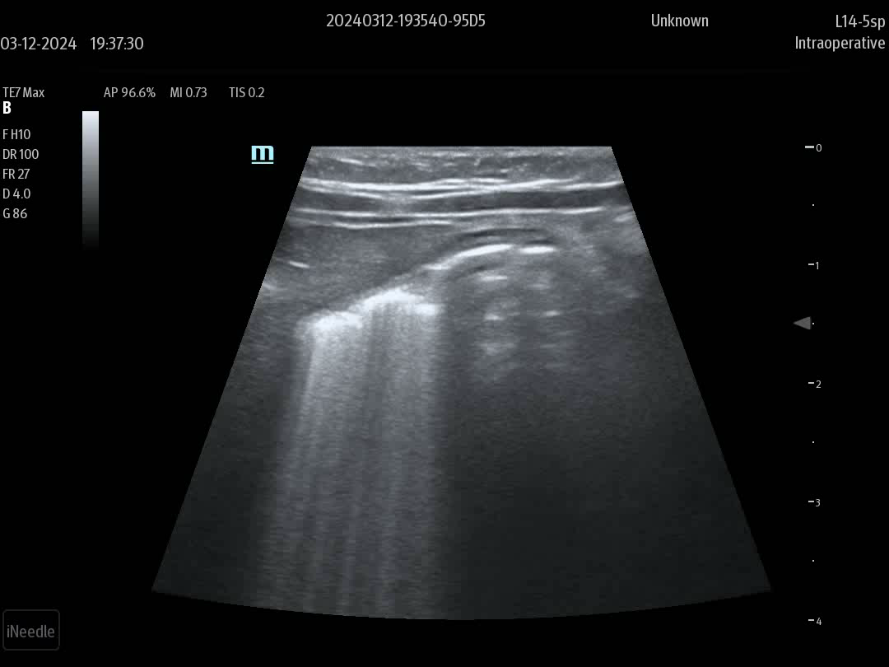
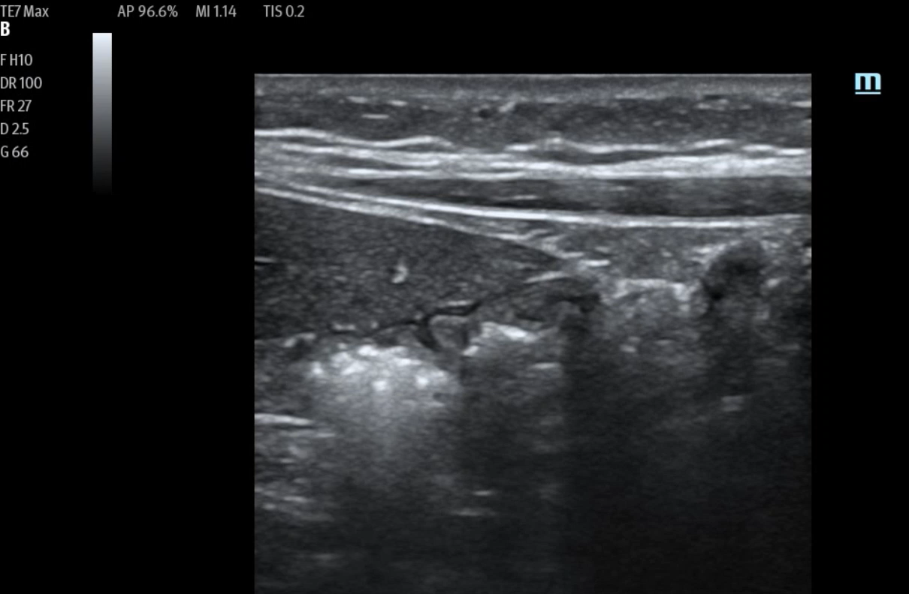
Two month-old infant of Spanish speaking mother presents for excision of extra digit. Cursory interview by attending in his half-broken Spanish elicits NPO past midnight. Resident conducts proper interview with Spanish interpreter and learns that infant given 1 ounce of Pedialyte 30 minutes ago. Proceed, postpone or cancel?
Thirty minutes after ingestion
Two hours after ingestion

Slide 4
Indications and Uses
Bedside ultrasound can be used clinically to distinguish between a stomach that is empty, filled with fluid or solids
Findings used to decide timing of surgery (proceed or delay) and airway management (standard or RSI)
Particularly useful when patient is poor historian, a language barrier exists, emergent procedures/trauma, and conditions that delay gastric emptying
Notes:
Conditions that delay gastric emptying: DM, neuromuscular disorders, laboring patients, gastroparesis/dysmotility, severe GERD, hiatal hernia, Zenker’s diverticulum, achalasia, stricture

Slide 5
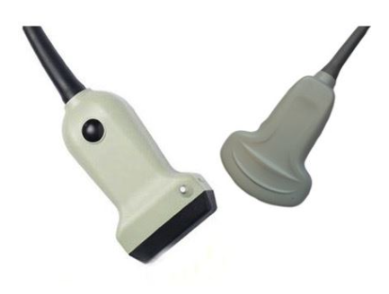
Equipment and Positioning
Curvalinear low frequency (3-5 MHz) probe for adults
Linear High frequency (6-15 MHz) for young children < 40 Kg
Gastric study performed in supine and right lateral decubitus position
RLD position more sensitive and supine position under-estimates gastric volume and may lead to false negative result
Exam performed in supine position alone only useful if it shows solid content but exam otherwise INCOMPLETE

Slide 6
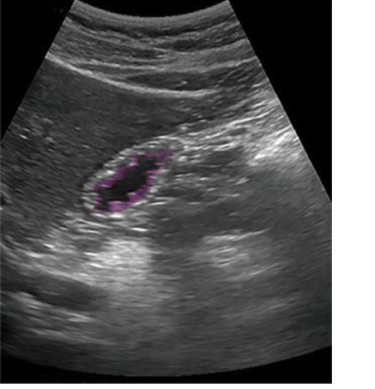

Sonoanatomy of the Stomach
Stomach immediately posterior to the left lower border of the liver
Thick walls with characteristic internal folds
Transverse colon located caudal/inferior to stomach and has thinner walls and no internal folds

Slide 7
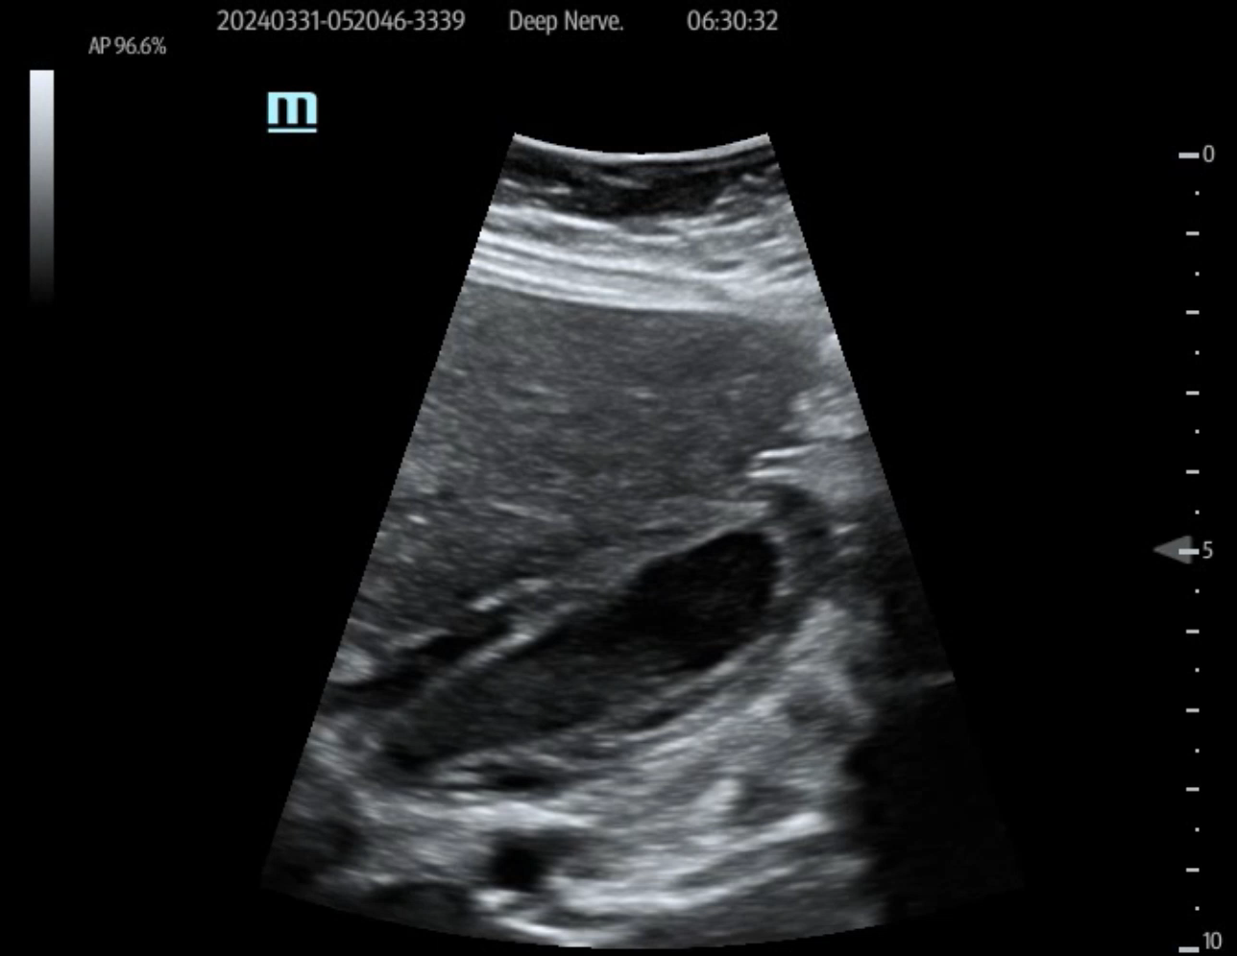
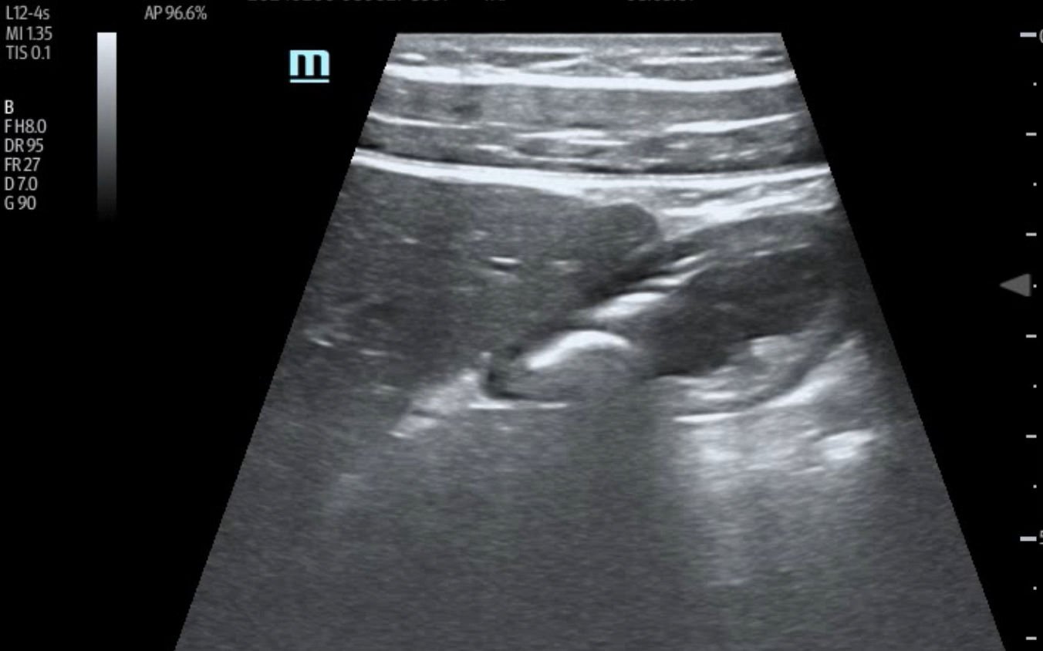
Transverse Colon vs Stomach
Notes:
The transverse colon and gastric antrum can be easily confused but look different.
Transverse colon (on the left) can be seen superficially positioned in the abdomen but caudal to the stomach
Unlike the stomach (right) the transverse colon is thin walled and does not have rugae (ridges formed by stomach wall)

Slide 8
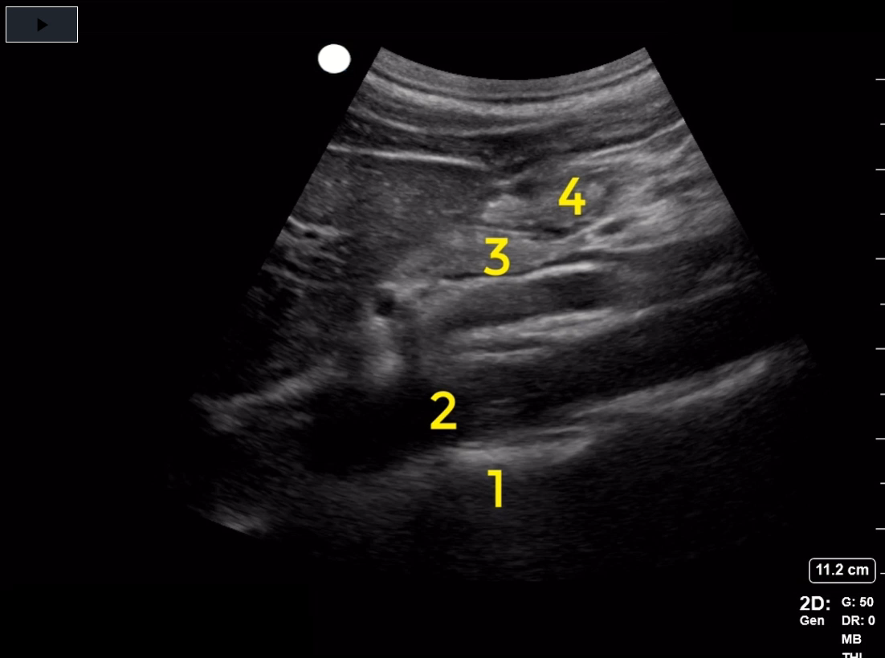
Gastric Antrum
Gastric antrum (4) imaged at the level of the aorta (2) posterior to the left lobe of the liver
If IVC is seen, then stomach is visualized too distal at level of pylorus
Imaging at the level of IVC may lead to underestimation of gastric volume
4: stomach. 3: pancreas. 2: aorta. 1: thoracic spine
Notes:
The gastric antrum is visualized in cross-section, usually immediately posterior to the left lobe of the liver, when a curvilinear ultrasound probe is placed just caudad to the xiphoid process in a sagittal plane, with the aorta imaged in a long-axis view in the ultrasound far field (at the bottom of the image). The pulsating aorta serves as a landmark for visualizing the gastric antrum in cross section, as it runs directly posterior to the antrum in long-axis, but at a greater depth from the surface than the antrum. The aorta is identified in this image lying directly over the thoracic spine, with its thick vessel walls and prominent pulsation during systole. Hyperechoic reflections arising from the bony thoracic vertebrae can be seen posterior to the aortic wall, with intervening hypoechoic spaces corresponding to the intervertebral discs. In contrast, if the inferior vena cava were visualized in long-axis instead of the aorta, the gastric cross-section is usually obtained distal to the antrum, most likely at the level of the pyloric canal. The vena cava can be recognized by the appearance of liver tissue on the anterior and posterior aspect of the vena cava; in contrast, the liver will always be anterior to the abdominal aorta. Additionally, the vena cava has a thinner wall than the aorta, and usually pulsates in systole and diastole, although the pulsations are less prominent than aortic pulsations. Mis-identifying the pylorus for the antrum may lead to underestimation of gastric volume, as the diameter of the pylorus is smaller than the antrum, and the mathematical model used to determine gastric volume is based on insonating the antrum in cross-section. The transverse colon, while not imaged in this video, can be easily confused with the gastric antrum, particularly when the gastric antrum contains air, or when it is not seen directly under the lobe of the liver. At the end of this video, air can be appreciated in the antrum creating a prominent hyperechoic reflection with a drop-off shadow. In contrast, hyperechoic reflections associated with air in the transverse colon are usually visualized caudad to the level of the antrum and caudad to the liver. The pancreas is normally seen as an indeterminate hyperechoic structure immediately deep to the antrum, frequently between the superior mesenteric artery and antrum. ,

Slide 9
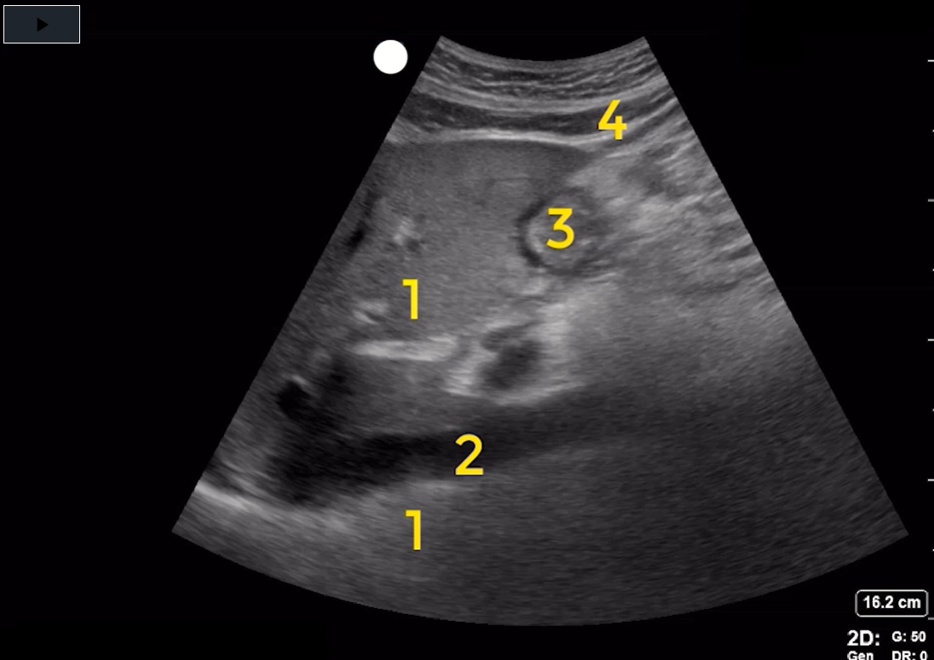
Stomach at Level of IVC
Pylorus (3) visualized at the level of the IVC (2)
Unlike the abdominal aorta, the IVC has thin walls, is pulsatile during diastole and systole, and has hepatic tissue anterior and posterior
Sliding the transducer towards the left side of the patient by a few centimeters to avoid underestimation of gastric content
Notes:
4) Rectus abdominus, 3) antrum 1) liver 2) IVC
If the inferior vena cava is visualized in long-axis instead of the aorta, the gastric cross-section is usually obtained distal to the antrum, as the vena cava lies posterior to the pylorus. The vena cava can be recognized by the appearance of liver tissue on the anterior and posterior aspect of the vena cava; in contrast, the liver will always be anterior to the abdominal aorta. Additionally, the vena cava has a thinner wall than the aorta, and usually pulsates in systole and diastole, although the pulsations are less prominent than aortic pulsations. Mis-identifying the pylorus for the antrum may lead to underestimation of gastric volume, as the diameter of the pylorus is smaller than the antrum, and the mathematical model used to determine gastric volume is based on insonating the antrum in cross-section at the level of the aorta. When the vena cava is imaged instead of the aorta, liver tissue posterior to the vena cava tends to obscure the hyperechoic reflections arising from the bony thoracic vertebrae that are normally prominently displayed posterior to the aortic wall. When the IVC is identified, sliding the transducer towards the left side of the patient by a few centimeters is recommended to localize the aorta and a better plane to assess the antrum. The transverse colon, while not imaged in this video, can be easily confused with the gastric antrum, particularly when the gastric antrum contains air, or when it is not seen directly under the lobe of the liver. Hyperechoic reflections associated with air in the transverse colon are usually visualized caudad to the level of the antrum and caudad to the liver. The pancreas is normally seen as an indeterminate hyperechoic structure immediately deep to the antrum, frequently between the aorta and antrum. The hypoechoic structure immediately anterior to the surface of the liver is the rectus abdominus muscle.

Slide 10
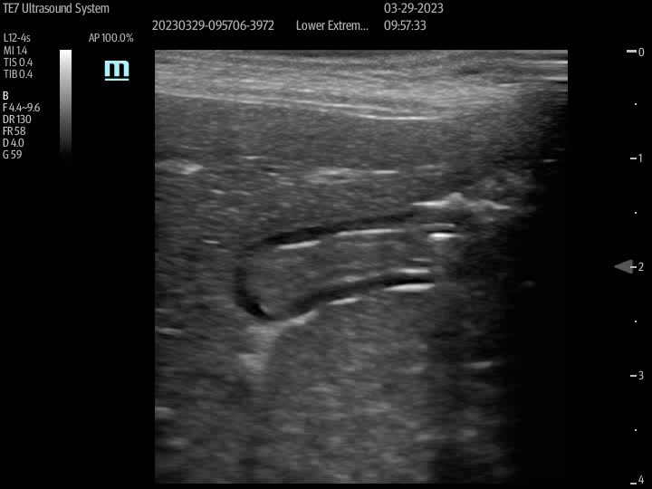
Empty Stomach
Antrum appears small or collapsed
Round or oval shaped
Empty if anterior and posterior gastric walls are juxtaposed.
Thick internal folds best appreciated when stomach empty

Slide 11
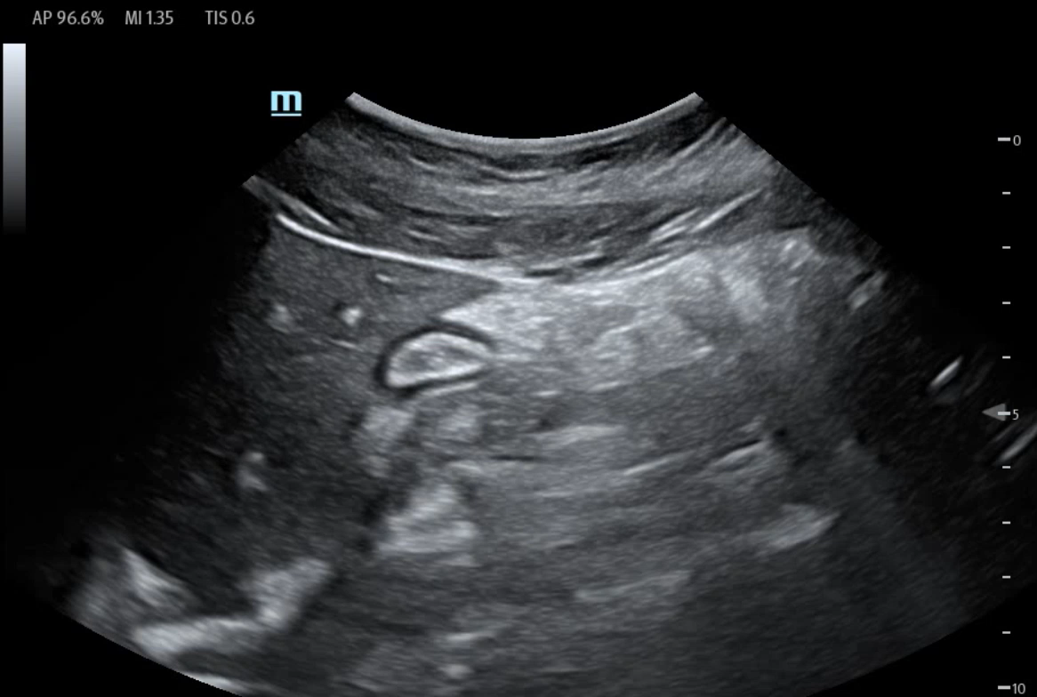
Empty Stomach

Slide 12
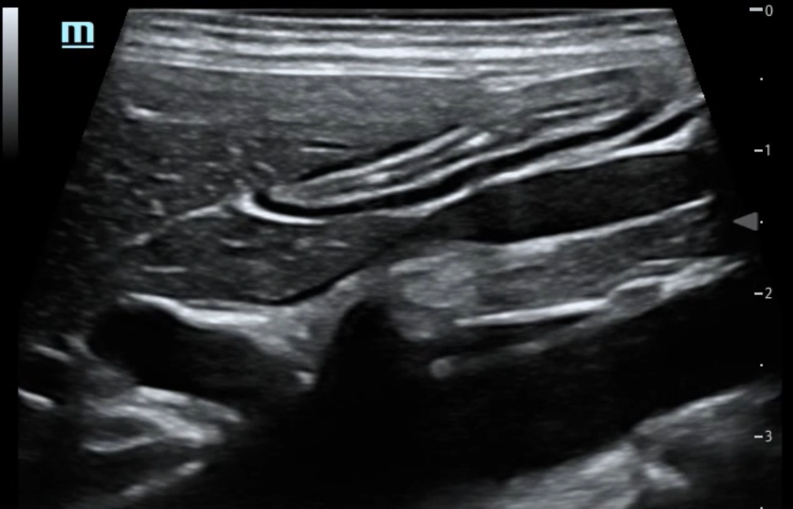
Empty Stomach
Notes:
Superior mesenteric artery seen

Slide 13
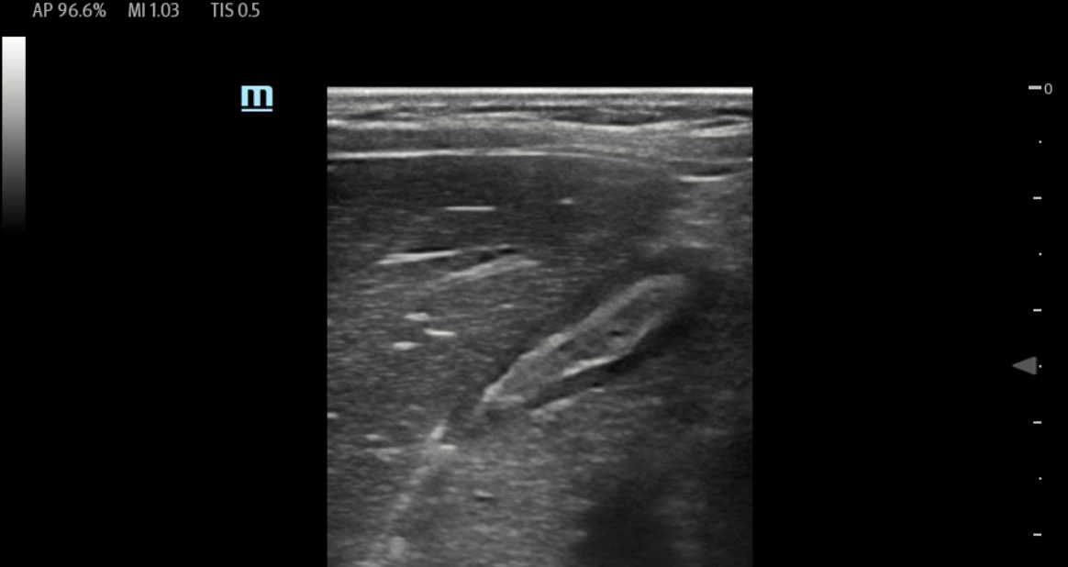
Empty Stomach

Slide 14
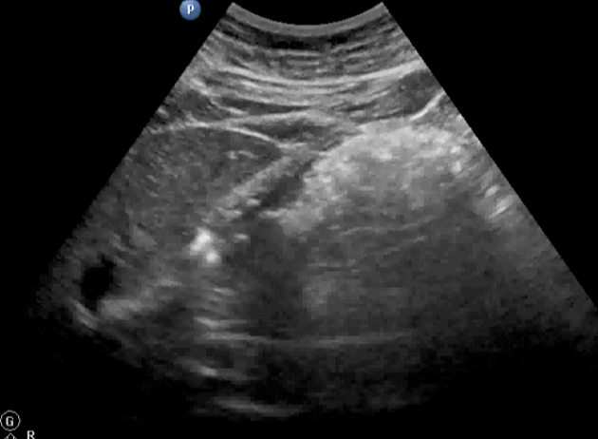
Antrum With Solid Food
Solid food will appear as hyperechoic coarse or fine particles
Shortly after a meal, ingested air along the anterior wall of antrum will appear hyperechoic and cast a shadow
“Frosted glass” pattern
Notes:
What does solid look like?

Slide 15
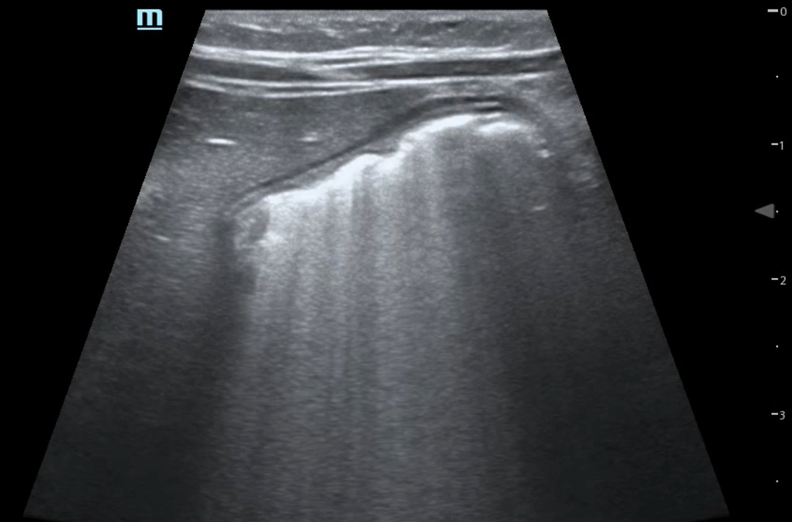
“Frosted Glass Pattern”
Notes:
An example of a frosted glass pattern seen after recent food ingestion
Air in the supine position casts and acoustic shadow and obscures objects in the far field in when imaged in supine position
When the patient is rolled to the RLD position, air layers anteriorly and the rest of the stomach is visualized

Slide 16
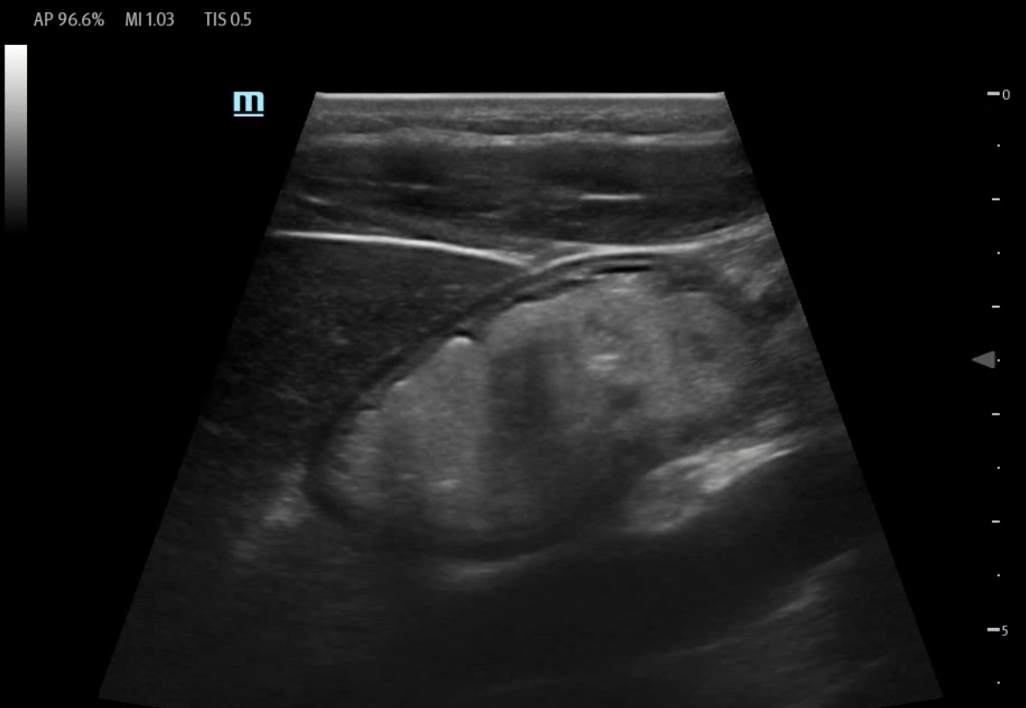
Solids in Gastric Antrum

Slide 17
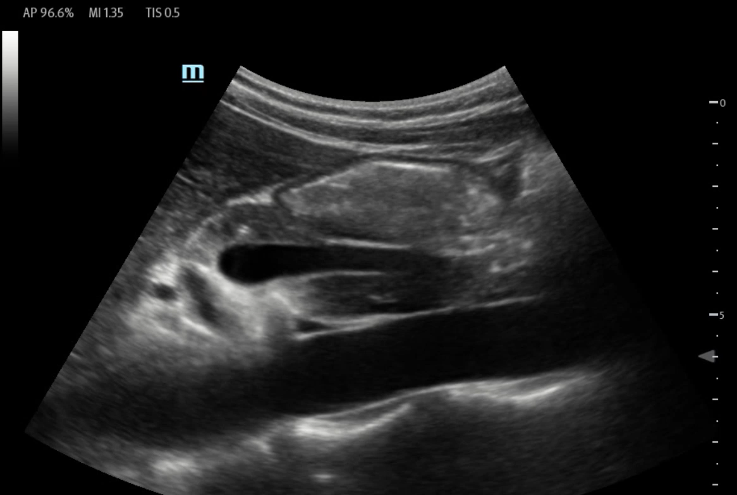
Solids in Gastric Antrum

Slide 18
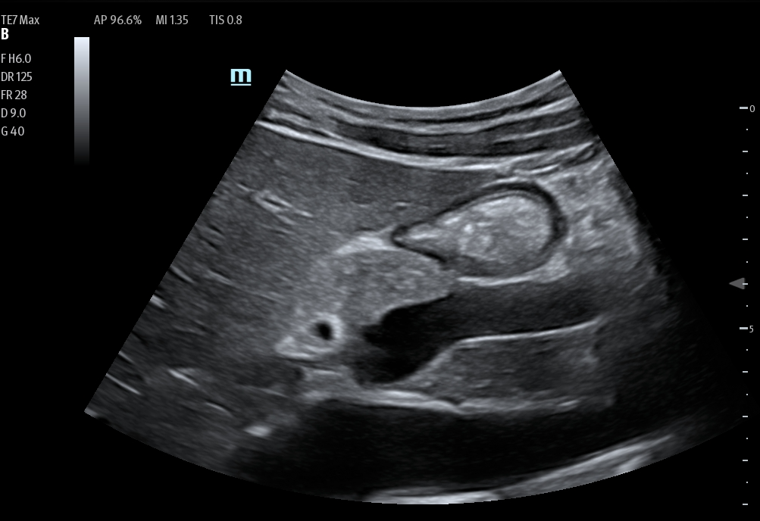
Stomach with Thick Fluid
Thick fluid (i.e. yogurt or milk) will appear hyperechoic and homogenous
Higher than average aspiration risk
Notes:
Thick fluid looks like solids.
For the sake of the risk of aspiration, its all the same to us!

Slide 19
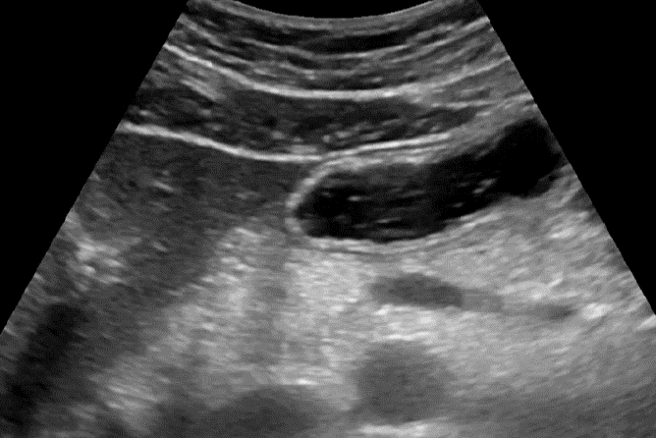
Stomach with Clear Fluid
Clear fluid often seen in stomach of properly fasted patients
Normal finding seen in 50% of fasted patients in the supine position and poses no aspiration risk
Appears hypoechoic and homogenous
Recently ingested fluid may have air bubbles with a mobile hypoechoic punctate appearance
Notes:
So, what are we to make of or how are we to interpret a stomach that contains clear fluid, which will often be seen in properly fasted patients.
This clear fluid is produced by physiological gastric secretions and poses no aspiration risk
A Grade 1 antrum as seen here is a normal finding (about 50% of cases) in fasting healthy elective surgical patients with a low aspiration risk.
Clear fluid will appear as hypoechoic and homogenous

Slide 20
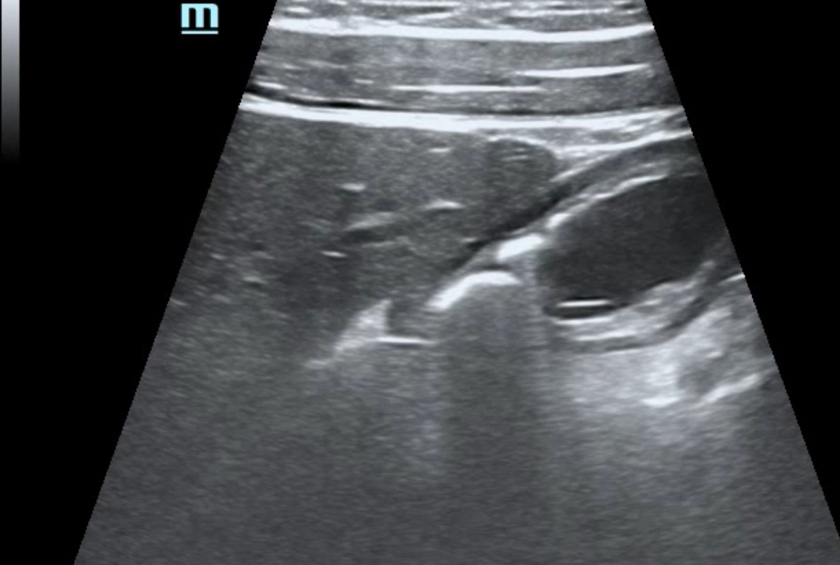
Clear Fluid

Slide 21
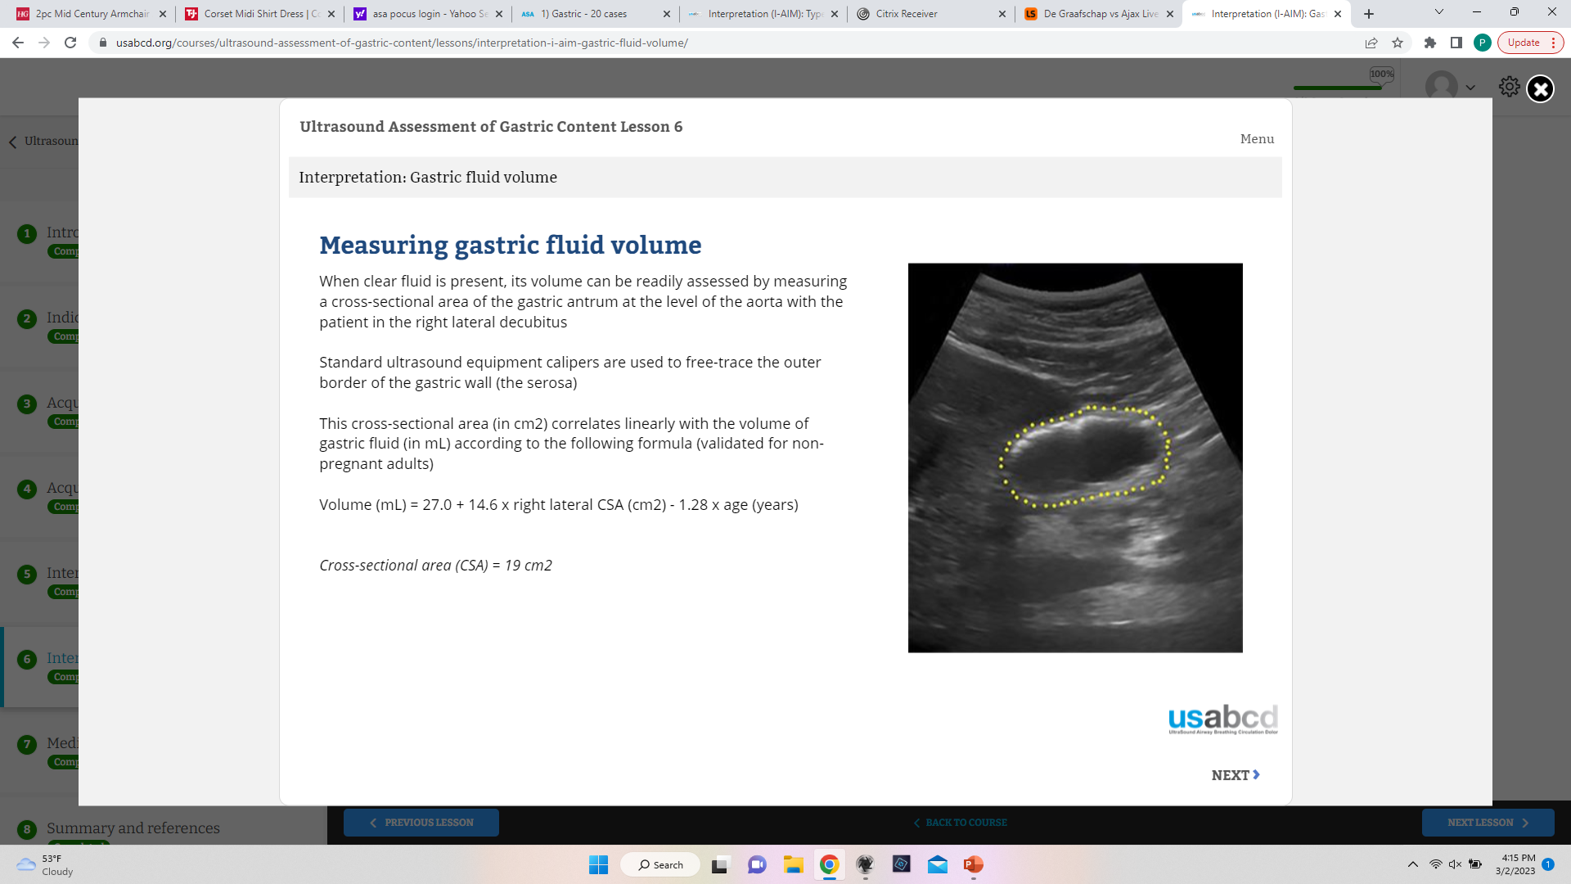
Clear Fluid: How Much is Too Much?
Upper limit of normal gastric volume in fasted patients is 1.5 mL/kg but higher volumes pose risk of aspiration
Volume fluid calculated from measuring cross-sectional area (CSA) of gastric antrum at level of aorta with patient in RLD
Average of three measurements of CSA in RLD
Perlas formula volume (mL) = 27 + 14.6 x right lateral CSA – 1.28 x age
*
* Non-pregnant and BMI < 40. Not applicable in patients with lower esophageal surgery, abnormal upper gastrointestinal anatomy
Notes:
Question is, how much clear fluid is too much?
The upper limit of physiologically normal gastric secretions is 1.5 mL/kg.
Volume of gastric fluid can be calculated knowing the CSA of the gastric antrum in RLD position
Three measurements of the CSA are taken and then averaged.
CSA are then used to calculated the gastric volume using the Perlas formula, with age the other variable

Slide 22
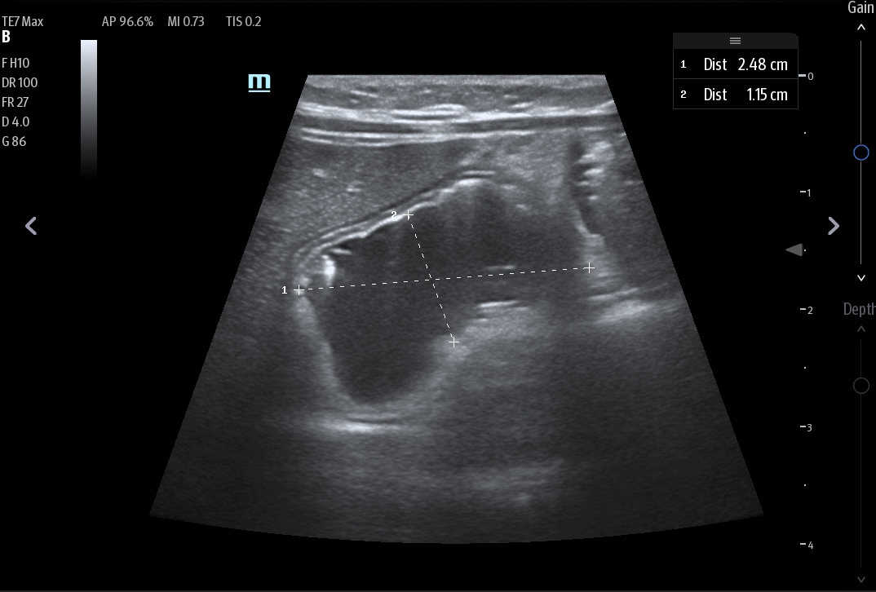
Measuring CSA: Free Caliper Method
Measure the longitudinal diameter (D1) and anteroposterior diameter (D2) of the antrum from serosa to serosa between peristaltic contractions
CSA = (π × D1 × D2)/4
High intra- and inter- rater reliability
Notes:
There are two ways to measure the CSA.
One is using the calipers on our ultrasound machine to measure the anterolateral and longitudinal diameter of the gastric antrum as measured from seroasa

Slide 23
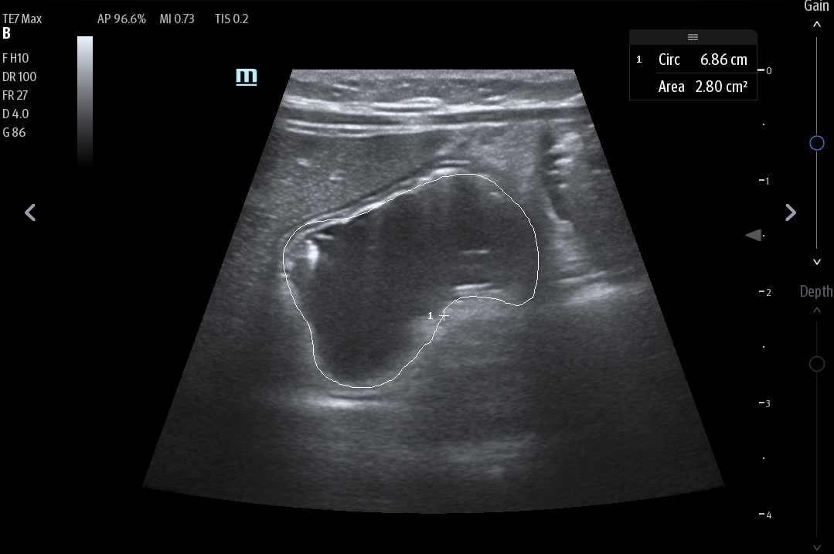
Measuring CSA: Tracing Method
Trace outer border of the stomach and U/S machine estimates CSA
Equivalent to previously described free-caliper method
Formula Volume (mL) = 27 + 14.6 x right lateral CSA – 1.28 x age
*
* Non-pregnant and BMI < 40. B=Not applicable in patients with lower esophageal surgery, abnormal upper gastrointestinal anatomy
Notes:
Our Mindray ultrasound machines will estimate the CSA if the outer serosal border of the stomach is traced.

Slide 24
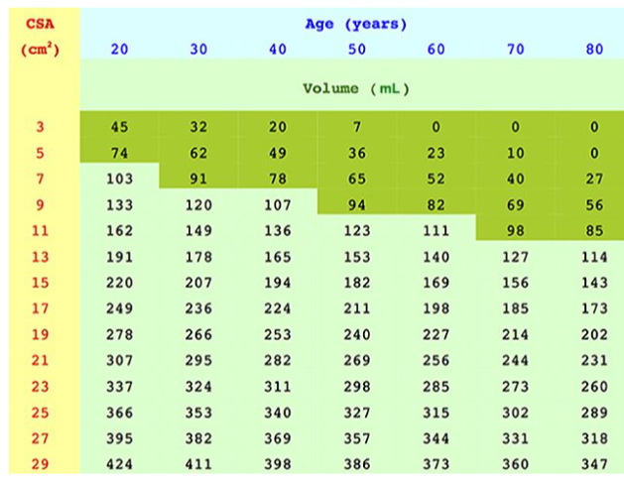
Gastric Fluid Volume Nomogram
Nomogram showing gastric volume as a function of antral CSA (RLD position) and patient age
Dark green areas represent baseline gastric sections and low-risk of aspiration
CSA calculation still required
Notes:
Alternative, you can use this nomogram to the right, which shows gastric fluid volume as a function of CSA and patient age.
Still need to measure the CSA, but don’t need to do the Perlas formula calculation.
Dark green areas = baseline gastric secretions = low risk of aspiration

Slide 25
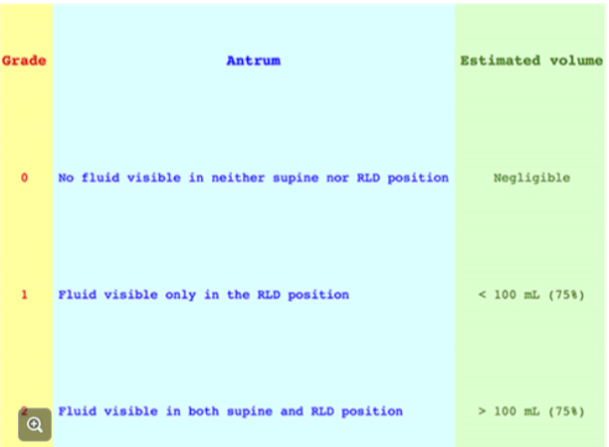
Three-Point Grading System
Notes:
If all this seems a little cumbersome and quantitative, a simpler three-point grading system can be used to differentiate between low and high volume states (and I would suggest that this be the starting point for assessing risk of aspiration)
In a grade 0 antrum, no fluid is seen in either the supine or RLD position
In a grade 1 antrum, fluid is seen in the RLD but not the supine position
In a grade 2 antrum, fluid is seen in both RLD and supine scans
In a grade 0 antrum, the amount of fluid is negligible
In a grade 1 antrum, the estimate gastric volume is less than 100 mL and presumably poses a low risk of aspiration
In a grade 2 antrum, on the other hand, the majority of patients (75%) have more than 100 mL of fluid in the stomach and this poses an increased risk of aspiration

Slide 26

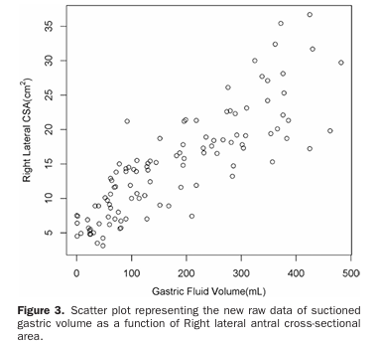
Patients undergoing elective UGE randomized to ingest one of six predetermined volumes of apple juice (as much as 400 mL) after an 8 hour fast
Cross-sectional area of gastric antrum in RLD position measured immediately after ingestion of fluid
Gastric fluid subsequently suctioned during UGE performed under minimal/trivial sedation
Perlas formula for estimating gastric volume constructed from measured CSA:
*
* Maximum of 2 mg of midazolam and 100 mcg fentanyl!
Notes:
How reliable is the simplified three-point grading system?
It’s worth looking at the study that validated the Perlas formula for calc. gastric volume because the authors went on to validate the three-point grading system.
In the original Perlas study, patients undergoing elective UGE…..

Slide 27
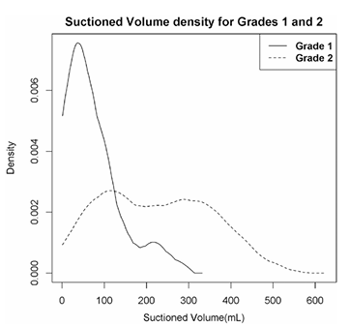
Evaluated 3-point grading system of the gastric antrum and its correlation with gastric fluid volume
Less than 25% of subjects with a grade 1 antrum (solid line in histogram) had a gastric volume > 100 mL
75% of subjects with a grade 2 antrum (dotted line) had a volume > 100 mL, and more than 50% had volumes greater than 250 mL
Authors concluded that three-point grading system alone can be used as a screening tool to differentiate between low and high-volume states.
Histogram of frequencies of gastric fluid volume for grade 1 and 2 antrums
Notes:
The authors then went on to evaluate the three-point grading system and see if it correlates with gastric volumes
Findings are nicely illustrated in the histogram on the right.
…Authors were careful with their wording. Model differentiates between low and high volumes states, but the authors did not go so far as to differentiate between high and low risks of ASPIRATION

Slide 28
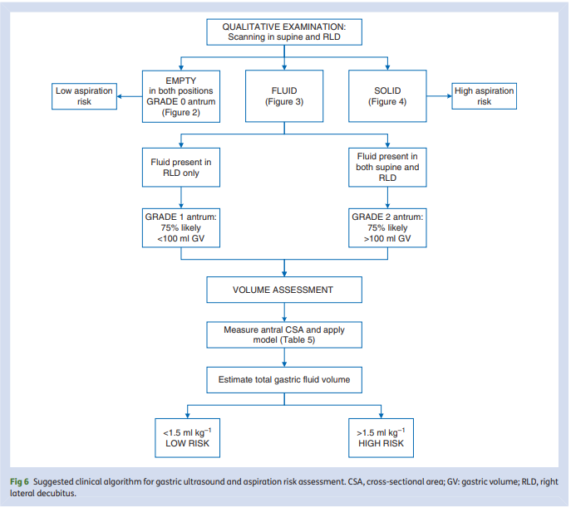
Clinical Decision Making
Van de Putte et al. Ultrasound assessment of gastric content and volume. British Journal of Anaesthesia 113 (1): 12–22 (2014)
Notes:
So, bottom line, the clinical decision tree looks something like this.
If either solid or thick liquid are seen in the stomach, regardless of position, the patient is a high aspiration risk.
If fluid is seen in only the RLD position (grade 1 antrum), the patient is likely a low aspiration risk, with 75 percent of subjects having less than 100 mL in the stomach
If fluid is seen in both supine and RLD positions (grade 2 antrum), they are a high aspiration risk, with 75 percent of subject having greater than 100 mL in the stomach
A quantitative volume assessment can be done by calculating the CSA
Low risk of aspiration:
Empty stomach
Less than 1.5 mL/Kg of clear fluid
Increased risk of aspiration:
Thick fluid or solid
Greater than 1.5 mL/Kg of clear fluid

Slide 29

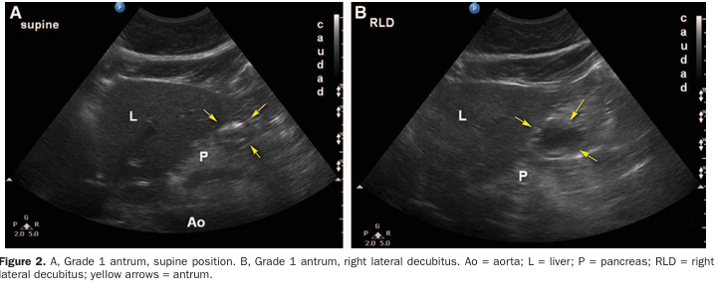
GUS feasible in obese patients with BMI between 35-50
Success rate of 95% for subjects in RLD position and 90% in supine position
Median acquisition time of 3.5 minutes
Volume of gastric content per kg similar to non-obese subjects
Obese patients had a similar distribution of antral grade using the three-point grading system as non-obese subjects
Notes:
Original studies done in non-obese patients, but turns out that gastric ultrasound is just as feasible in patients with a BMI greater than 35 and even 50This study suggests that GUS is feasible in obese patients with a BMI between 35-50
GUS was successful in 95% of subjects in the RLD and in 90% of subjects in the supine position.
The median image acquisition time was 3.5 minutes
Similar distribution using the three-point grading system compared to non-obese subjects

Slide 30
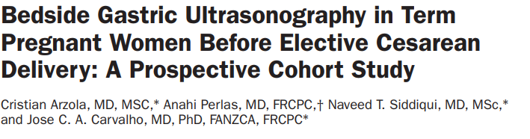
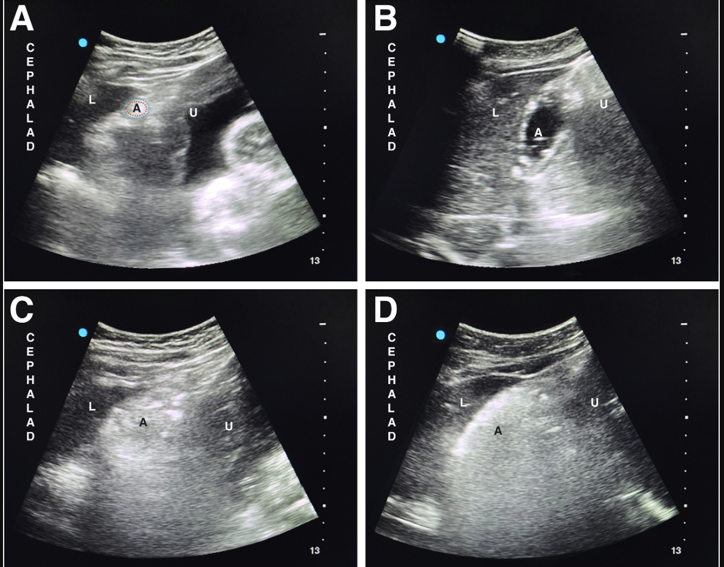
Ultrasound used to quantitatively and qualitatively assess gastric content in fasted term non-laboring patients
Overwhelming majority of women (n = 103) had an empty stomach (grade O or 1) after routine fasting
Ninety-five percent of subjects had estimated gastric volumes of less than 1.5 mL/kg
Qualitative assessment of gastric volume with three-point grading system similar in pregnant (non-laboring) and non-pregnant woman
Notes:
This is a study that used ultrasound to quantitatively and qualitatively assess gastric content in fasted non-laboring term women scheduled for non-emergent c/s.
Turns out that the overwhelming majority of term women have and empty stomach after routine fasting.

Slide 31
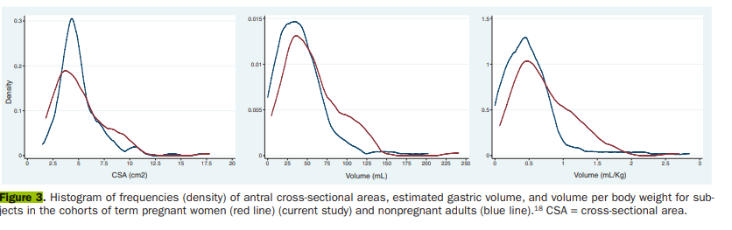
Histograms of the frequencies (distribution of data) of CSAs, gastric volumes and volume/kg of pregnant (red) and nonpregnant (blue) women
Study implies that gastric emptying time is NOT delayed in non-laboring term women
Notes:
Histograms of the frequencies (distribution of data) of CSAs, gastric volumes and volume/kg of pregnant (red) and nonpregnant (blue) women nicely illustrates the study finding
These distribution look similar
That the overwhelming majority of women had empty stomachs after routine fasting suggests that gastric emptying time is NOT delayed in non-laboring term women.
Nevertheless, we continue to treat women as full-stomachs when they are past the second trimester even though there is substantial evidence that gastric emptying is not delayed in non-laboring parturients

Slide 32

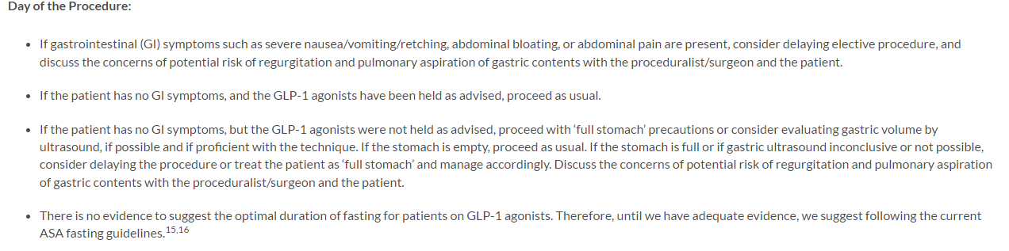
Notes:
The ASA released a consensus based guidance on preoperative management of patients on GLP agonists
On the day of the procedure, if a patient has no GI symptoms but GLP1 agonist was not held as advised (one week for weekly dosing and the night before for daily), the recommendation is to evaluate the gastric volume by ultrasound if possible and if proficient in the technique.

Slide 33
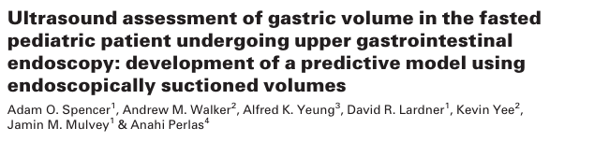

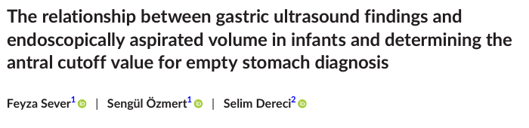
Pediatrics: Estimating Gastric Fluid Volume
Notes:
Gastric ultrasound now widely used and validated for infants and older children.
Although formulas for calculating gastric volume do exist for infants and older pediatric patients, they are cumbersome to use
As with adult patients, the three-point grading system is the easiest to use and the most applicable.

Slide 34
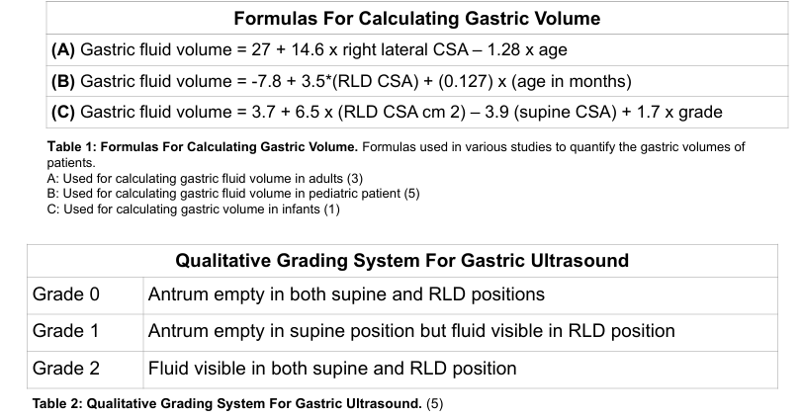
Estimating Gastric Fluid Volume
Notes:
Gastric ultrasound now widely used and validated for infants and older children.
Although formulas for calculating gastric volume do exist for infants and older pediatric patients, they are cumbersome to use
As with adult patients, the three-point grading system is the easiest to use and the most applicable.

