Slide 1
FOCUSED ASSESSED TRANSTHORACIC ECHOCARDIOGRAPHY (FATE)
Peter Shapiro, MD
Update: 2/25/25
Notes:
Stethoscope of the future
Wide variety of cardiac pathologist (e.g biventricular size and function, LA size, pericardial effusion, IV size and collapsibility, gross structural valve abnormalities, intracardiac masses)
Even among providers without formal training, US is superior to physical exam for detection of cardiac abnormalities
Physicians with limited ultrasound training can detect LV dysfunction with sensitivies of 73-100% and specificities of 64-96 percent)
Little training required
- acceptable skill level to perform and interpret cardiac ultrasound exams after 20-30 repititionsa

Slide 2
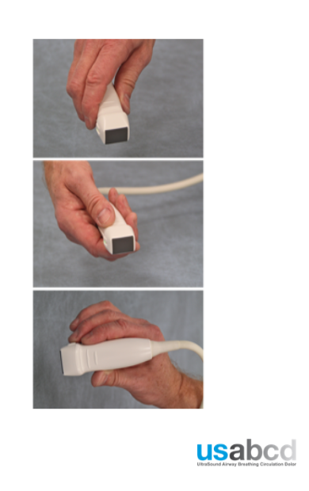
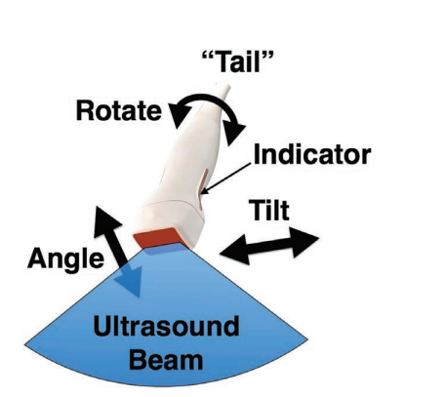
EQUIPMENT
Phased Array cardiac probe
Hold the probe either using a ‘screwdriver’ grip or pencil grip
Manipulate probe only along one axis at a time:
Sliding (or ‘window shopping”)
Tilt
Angulation
Rotation
Instruction will be given relative to the tail of the transducer

Slide 3
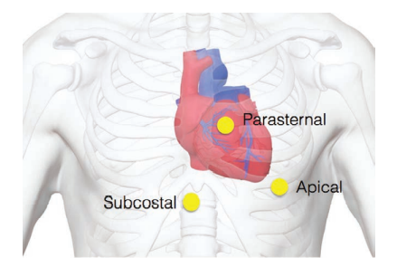

STANDARD VIEWS
Standard exam consists of four views:
Subcostal 4-chamber view.
Apical 4-chamber view
Parasternal (short and long axis)
Pleural views

Slide 4
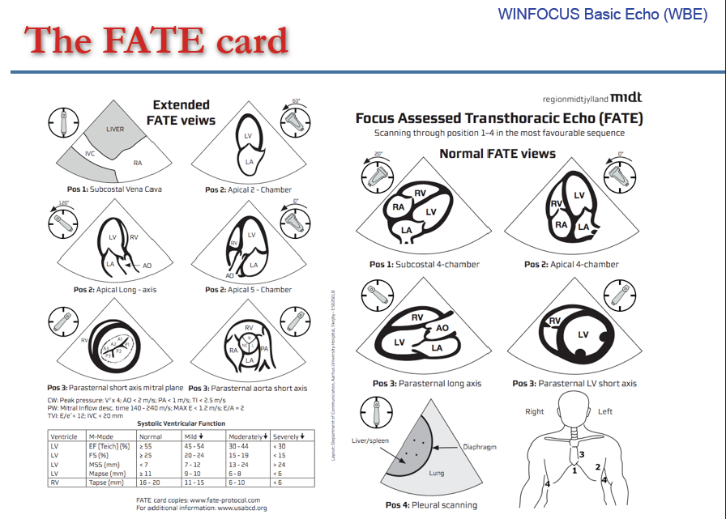
STANDARD VIEWS

Slide 5
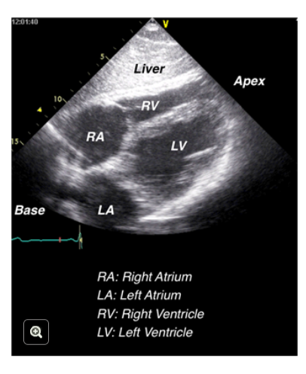
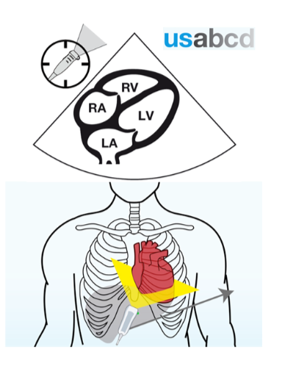
POSITION 1: SUBCOSTAL 4-CHAMBER VIEW
Suitable for evaluation of:
Biventricular function
Wall thickness
Pericardial effusion/tamponade
Mitral/tricuspid pathology
Pulmonary embolism
Perfect during cardiac arrest as avoids interference with CPR

Slide 6
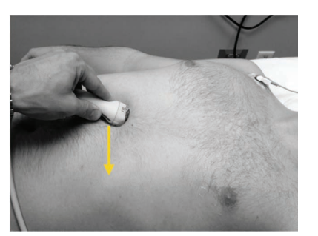
POSITION 1: SUBCOSTAL 4-CHAMBER VIEW
Transducer placed in subcostal space to the right of midline
Orientation marker (OM) directed to patient’s left
Hold transducer like screwdriver
Probe must be pressed down firmly to look underneath the rib cage
Rotate transducer approx. 20 degrees counterclockwise
Image improves with partial inspiration as heart moves towards the probe

Slide 7
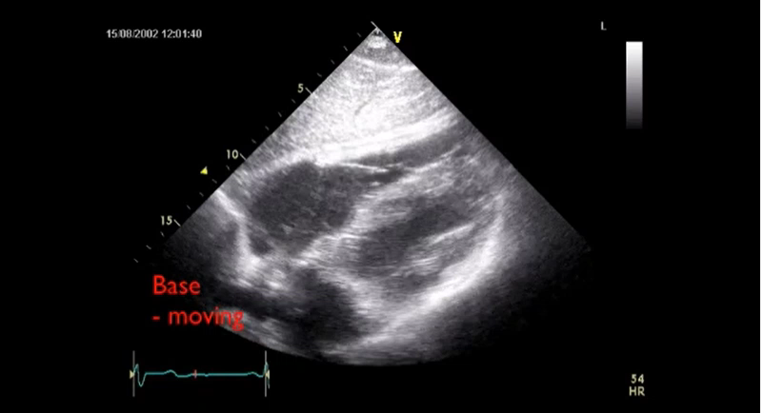
POSITION 1: SUBCOSTAL 4-CHAMBER VIEW
Notes:
RV size can be underestimated since imaging plane is not through the middle of the RV

Slide 8
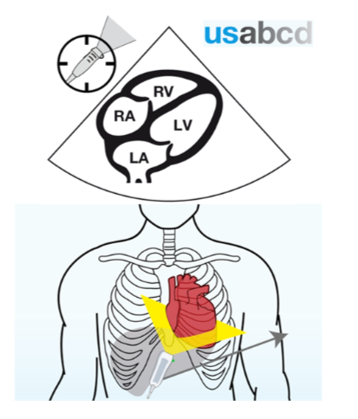
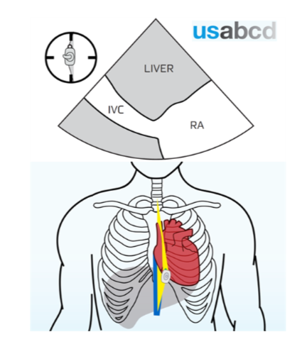
POSITION 1: IVC VIEW
Suitable for evaluation of:
IVC dimension
Estimating fluid status and fluid responsiveness

Slide 9
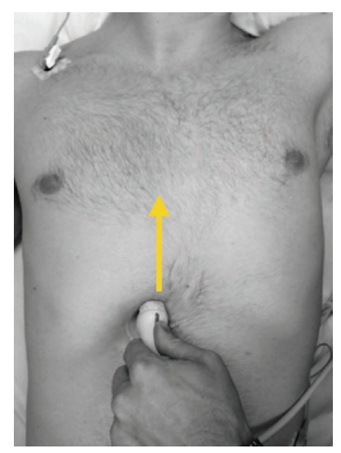
POSITION 1: IVC VIEW
View obtained by starting with the subcostal 4-chamber view
Orientation marker pointed to patient’s left shoulder
Elevate base of transducer to image back of the heart and right atrium
Once IVC entry into RA identified, rotate transducer approximately 20 degrees counter-clockwise to get longitudinal view IVC

Slide 10
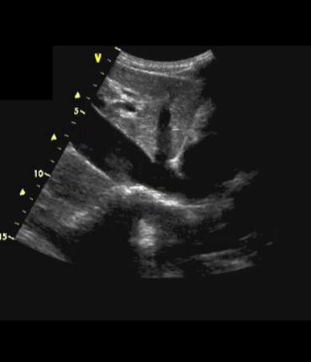
POSITION 1: IVC VIEW

Slide 11
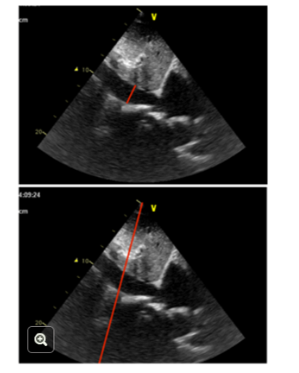
MEASURING IVC DIAMETER
Measuring IVC diameter and collapsibility gives an imperfect assessment of volume status and fluid responsiveness
IVC diameter < 2.1 cm and > 50% collapsibility suggest normal RA pressures (0-5 mm Hg)
IVC diameter > 2.1 cm and < 50% collapsibility suggest elevated RA pressures (10 – 20 mm Hg)
In severe hypovolemia, the IVC may be totally collapsed
Under what condition would you expect IVC to be distended?

Slide 12
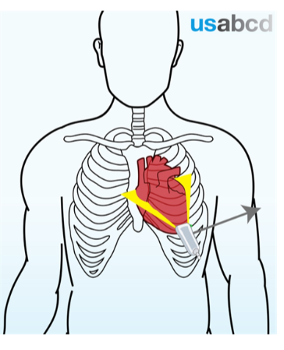
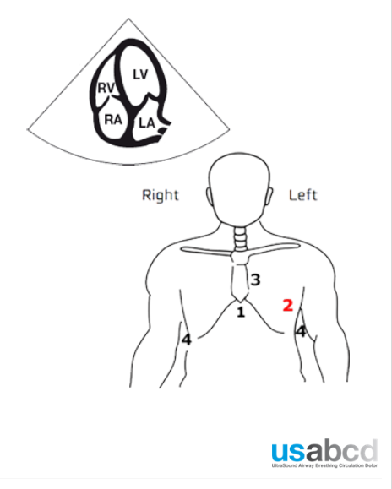
POSITION 2: APICAL 4-CHAMBER VIEW
Suitable for evaluation of:
Biventricular function
Wall thickness
Pericardial effusion
Mitral/tricuspid pathology

Slide 13
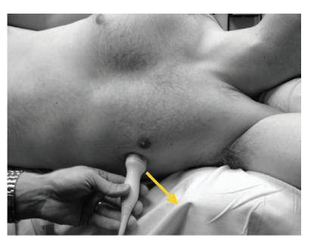
POSITION 2: APICAL 4-CHAMBER VIEW
Hardest view to obtain
Patient ideally placed left lateral decubitus
Orientation marker pointed to patient’s left
Probe placed at location of cardiac apex (inferolateral to left nipple in men and inferolateral quadrant of left breast in women)
View may be obtained by sliding inferolaterally from the parasternal short-axis view towards the apex
View improves with expiration
IV septum should be in center of screen
Avoid foreshortening

Slide 14
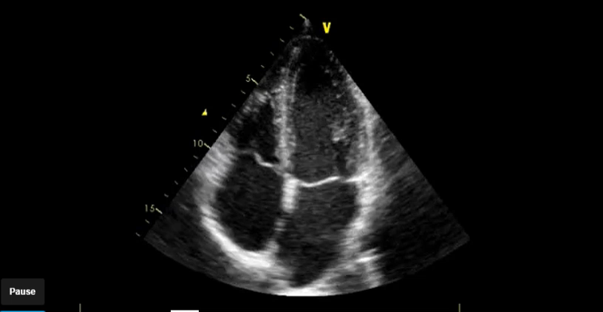
POSITION 2: APICAL 4-CHAMBER VIEW

Slide 15
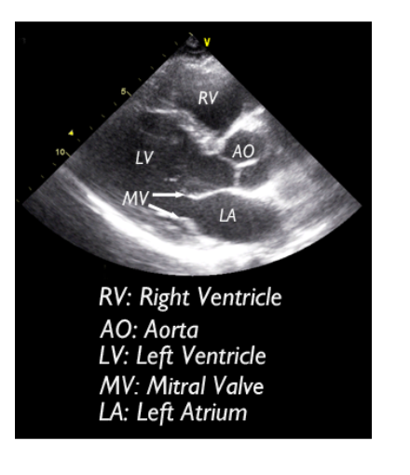
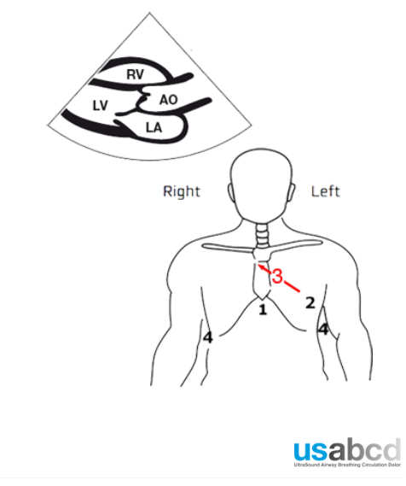
POSITION 3: PARASTERNAL LONG-AXIS
Parasternal window is starting point of most studies (high quality images regardless of patient position)
Suitable for evaluation of:
LV function
Wall thickness
Chamber dimensions
Aortic and mitral valve pathologies
LVOT obstruction (e.g SAM)

Slide 16
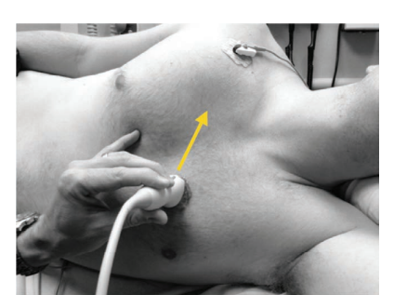
POSITION 3: PARASTERNAL LONG-AXIS
Left lateral decubitus optimal, but supine good enough
Probe placed in 3rd to 5th intercostal space immegiately to left of sternum
Orientation marker (OM) pointed to patient’s right shoulder
Image quality best at end- exhalation
Foreshortening of the LV cavity will overestimate LV function prevented by slight rotation and tilting of probe

Slide 17
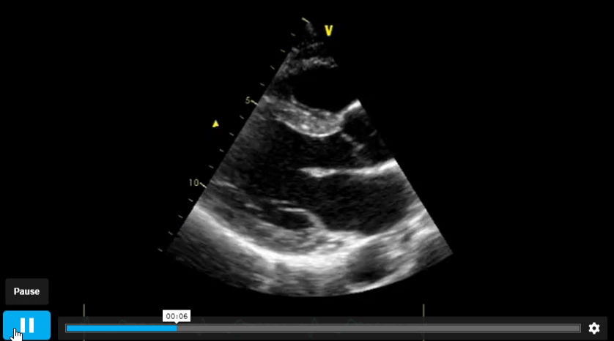
POSITION 3: PARASTERNAL LONG-AXIS

Slide 18
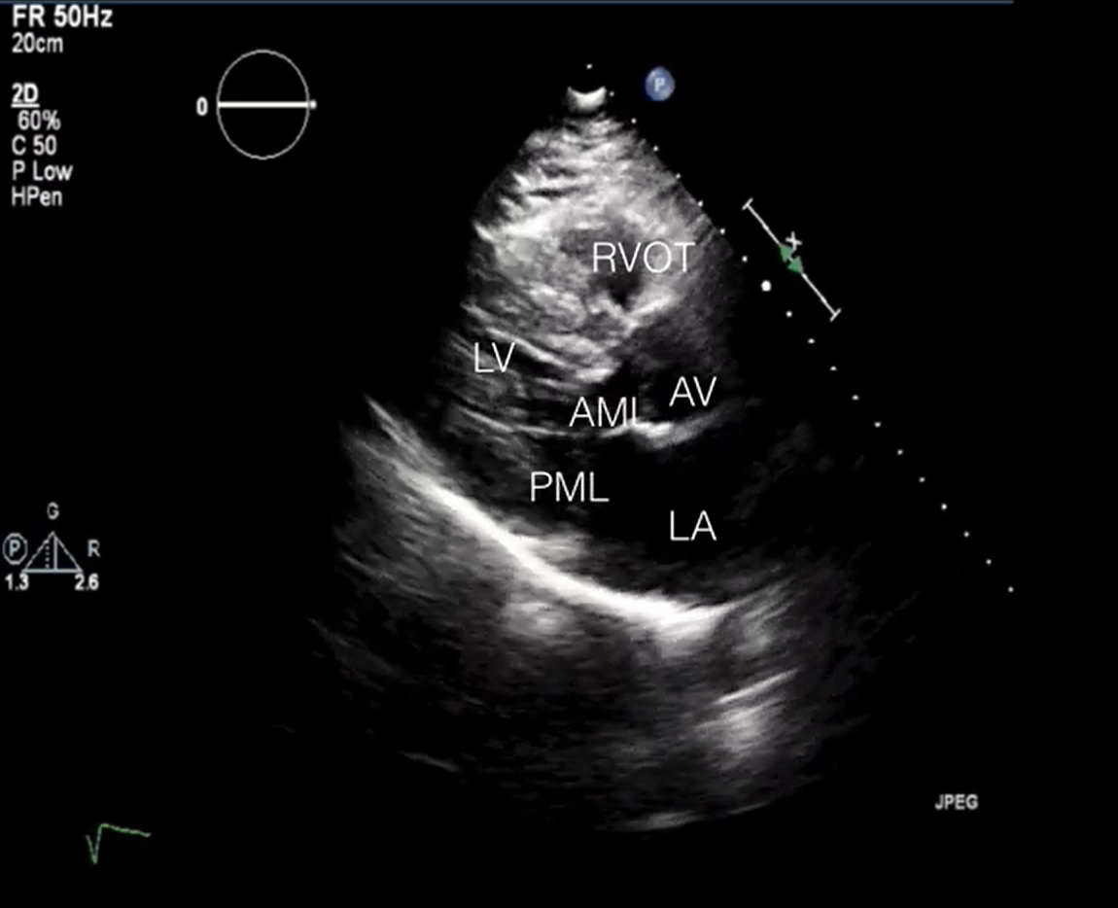
WHAT’S WRONG WITH THIS HEART?

Slide 19
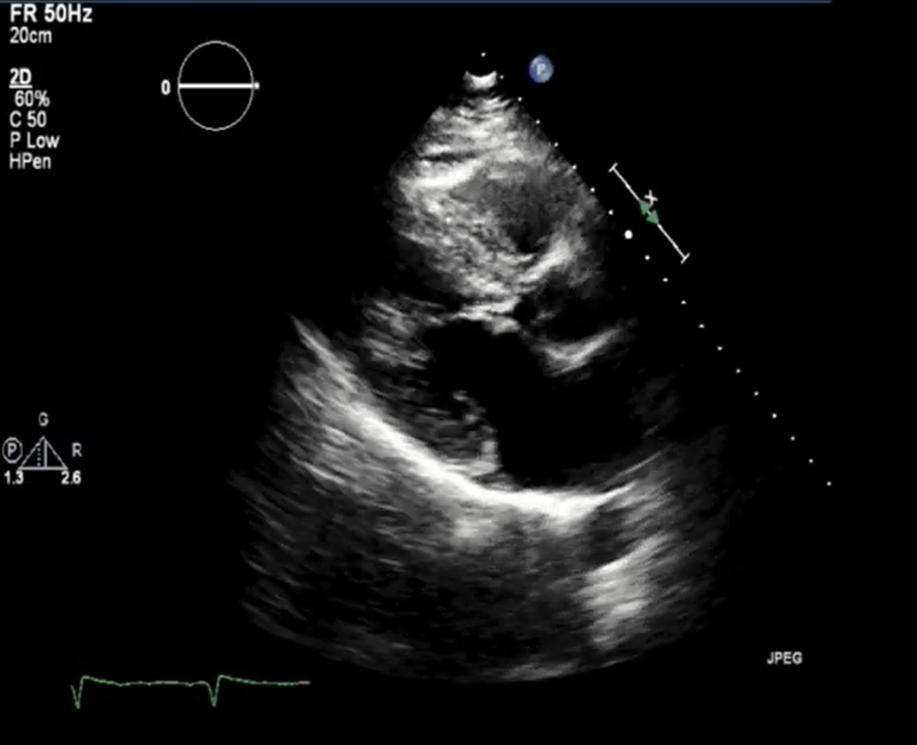
WHAT’S WRONG WITH THIS HEART?
Notes:
Systolic anterior motion of the mitral valve

Slide 20
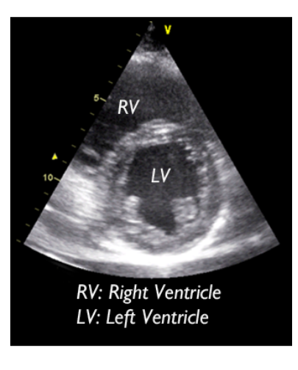

POSITION 3: PARASTERNAL SHORT-AXIS (“Donut”) VIEW
Suitable for evaluation of:
Global LV function
Regional LV wall motion
LV and RV dimensions
Intraventricular septum
Pericardial space

Slide 21
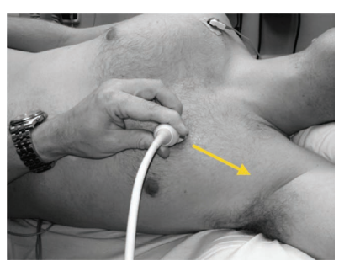
POSITION 3: PARASTERNAL SHORT-AXIS
Probe placed in 3rd or 4th intercostal space left of sternum
Orientation marker (OM) pointed to patient’s left shoulder
Image improves with exhalation
Supine position is fine

Slide 22
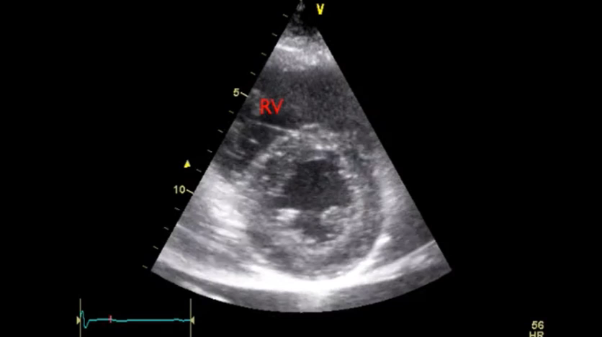
POSITION 3: PARASTERNAL SHORT-AXIS

Slide 23
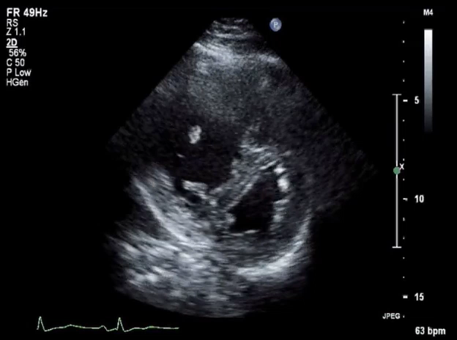
WHAT’S WRONG WITH THIS HEART?

Slide 24
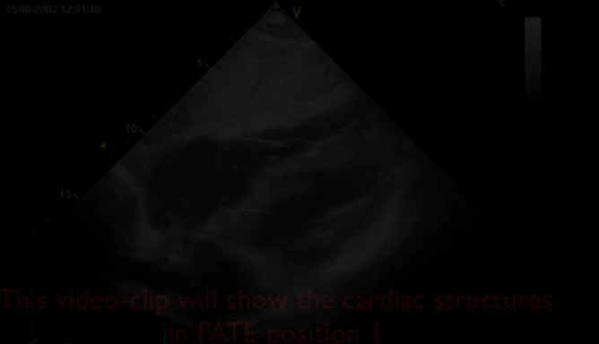
QUESTIONS
Identify the view:
A) Subcostal
B) Parasternal long axis
C) Parasternal short axis
D) Apical

Slide 25
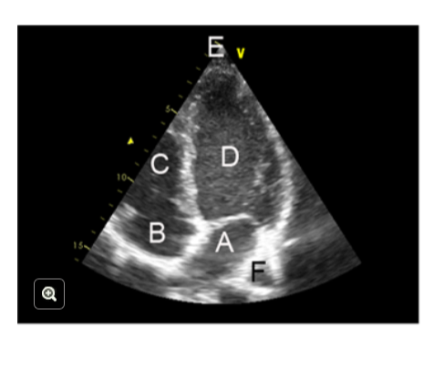
QUESTIONS
Identify D:
1) RV
2) LV
3) LA
4) RA

Slide 26
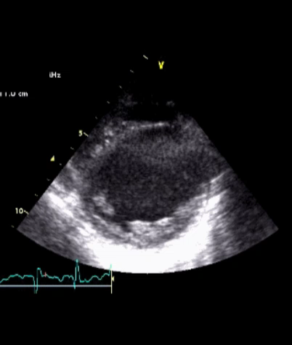
What’s Wrong With This Heart?

Slide 27
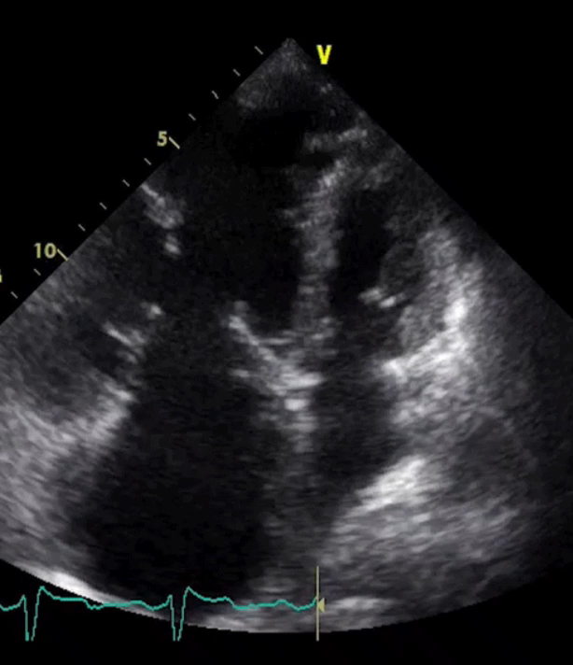
WHAT’S WRONG WITH THIS HEART?

Slide 28
References
USABCD FATE Course- Basic Cardiac Ultrasound
Zimmerman et al. Nuts and Bolts of Performing Focused Cardiovascular Ultrasound (FoCUS).
Anesth Analg 2017;124:753–60

