Slide 1

Cross-Cultural Communication Strategies American English Webinar 2.4
Melissa A. Mendelson

Slide 2
Webinar Goals
In this webinar we will attempt to…
Recognize how cultural and linguistic differences affect communication
Discuss the importance of preparing learners to communicate across cultures successfully
Share activities that raise cultural and linguistic awareness among English Language Learners

Slide 3

Cross-Cultural Incident
Clara is an American attending a university in Norway. She has made a few friends. One morning, on her way to class, she sees her friend Johann walking ahead of her. She shouts and runs to catch up with Johann.
Clara smiles and attempts to make conversation, but Johann doesn’t smile or say much except that he must get to class.
Clara says good-bye feeling confused and hurt. She thought they were friends and wonders if she did something to upset Johann.

Slide 4
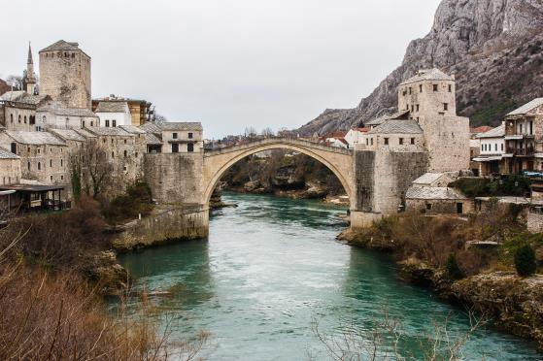
Bridging Cultures: Elements of Culture and Communication
Nonverbal communication
Verbal communication
Identity
Values
Social norms

Slide 5
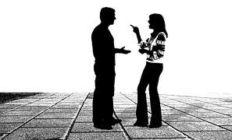
Culture and Nonverbal Communication
Nonverbal communication differs among cultures
The way that we understand nonverbal codes differs among cultures

Slide 6


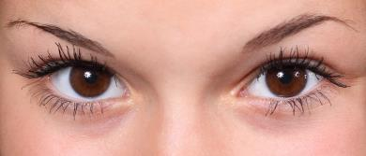
Types of Nonverbal Communication
Gestures
Body Movement
Eye Movement

Slide 7


Types of NonVerbal Communication
Clothing and Dress
Um…
Time
Vocalics

Slide 8
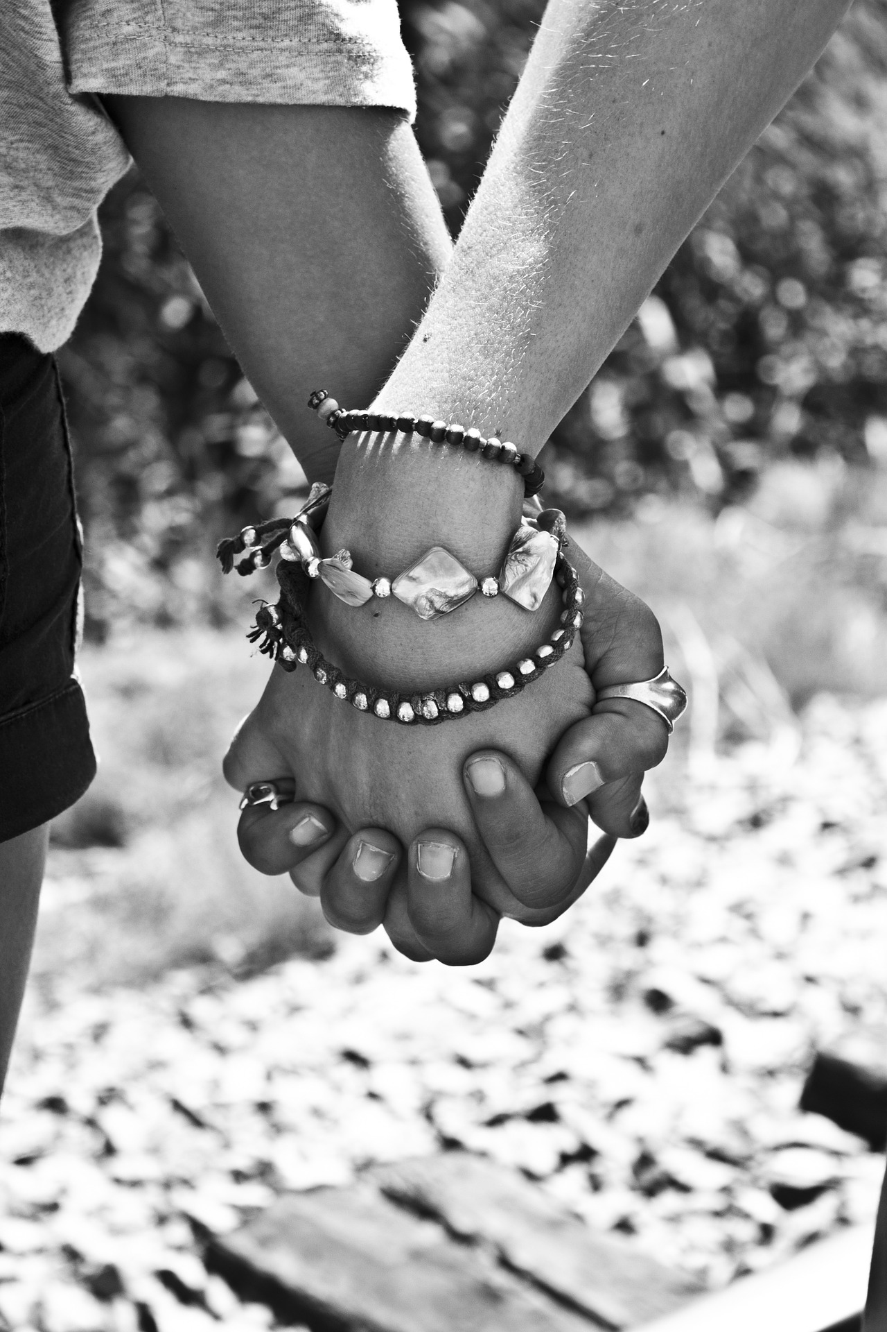
Types of Nonverbal Communication
Space
Touch

Slide 9
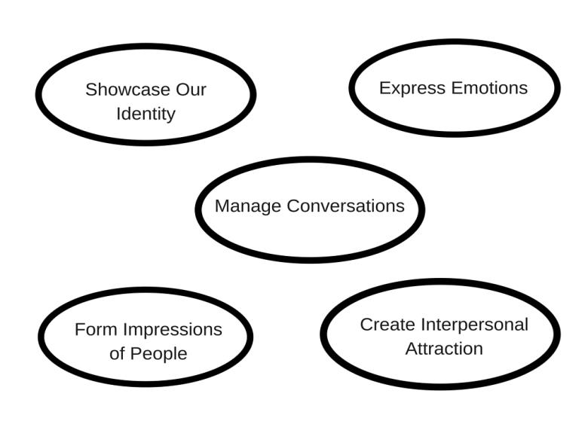
Functions of Nonverbal Communication

Slide 10
Cross-Cultural Incident
Clara is an American attending a university in Norway. She has made a few friends. One morning, on her way to class, she sees her friend Johann walking ahead of her. She shouts and runs to catch up with Johann.
Clara smiles and attempts to make conversation, but Johann doesn’t smile or say much except that he must get to class.
Clara says good-bye feeling confused and hurt. She thought they were friends and wonders if she did something to upset Johann.

Slide 11
Teaching Nonverbal Communication
Testing gestures
Space exercise
Vocalics of English and first language

Slide 12

Sharing Gestures
Goal: To highlight the differences in some simple
nonverbal codes
Students stand in a circle
Teacher calls out a word/phrase
Students must perform the associated movement or gesture

Slide 13
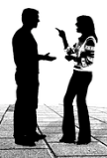
Using Space and Touch
Goal: To recognize that people use and value space
differently
Send half of the students out of the room
The remaining students are told this:
You will have a conversation with a student when they return
As you talk you will move closer and closer to your partner
Observe your partner’s reaction and your own
Bring the other students back to find a partner

Slide 14

Vocalics as Communication
Goal: To identify some of the nonverbal sounds used in English to communicate meaning
The teacher will make sounds in English that relate to particular phrases/words
Example: uh-huh, hmmm (with rising intonation)
Students must try to identify what these sounds mean

Slide 15

Verbal Communication
Theory of Linguistic Relativism or Sapir-Whorf Hypothesis
Language shapes and influences how we view the world
We can learn to use and understand new languages and cultures
Think about this:
The way we think is filtered
through our own language,
so what relationship is there
between culture and language?

Slide 16


Culture and Verbal Communication
Oral
Written
Language Rules (Sounds, Grammar, Meaning)

Slide 17
Cross-Cultural Incident
Clara is an American attending a university in Norway. She has made a few friends. One morning, on her way to class, she sees her friend Johann walking ahead of her. She shouts and runs to catch up with Johann.
Clara smiles and attempts to make conversation, but Johann doesn’t smile or say much except that he must get to class.
Clara says good-bye feeling confused and hurt. She thought they were friends and wonders if she did something to upset Johann.

Slide 18
Teaching Verbal Communication
Language of relationships
Making requests
Writing appropriate emails
Extension: Prepare an email request and a spoken request; ask students to identify differences

Slide 19
Language of Relationships
Goal: To practice the language of relationships and show how language might create different beliefs about relationships across cultures
Ask students to generate family vocabulary
Work as a large group to determine how the word in English differs from the word in the L1
Give students time to do a few in small groups or pairs
Ask students why these differences might exist
Mother Father Aunt Uncle

Slide 20
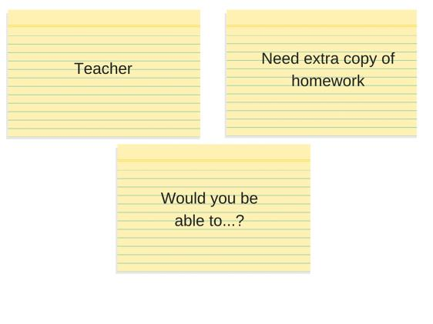
Making Requests
Goal: To recognize the appropriate way to make a request in English
Working in groups have students arrange the cards so that the person, request, and phrase work together to be pragmatically appropriate
Then students must complete the request

Slide 21
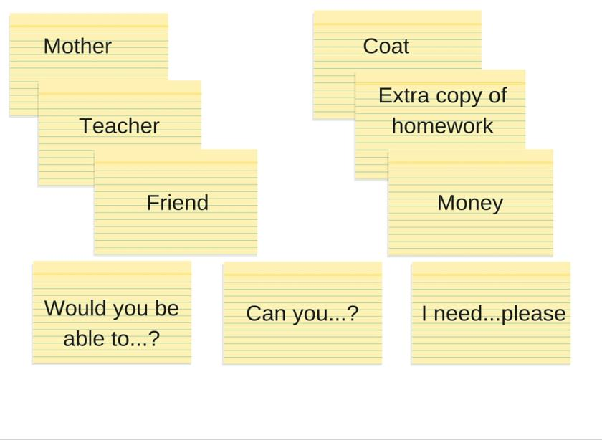
Mom, I need some money please?

Slide 22
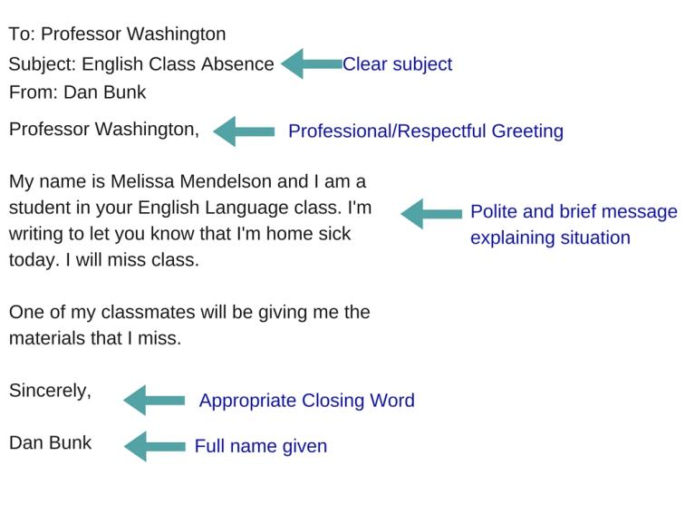
Writing Emails
Goal: To practice writing polite emails in English

Slide 23
Culture and Identity
Personal identity within each of us is formed by different aspects joining together. These can include:
Personalities, goals, and interests
Religious beliefs
Social class and status (income, education, family)
Language
Gender
Social roles
Ethnicity

Slide 24
Cross-Cultural Incident
Clara is an American attending a university in Norway. She has made a few friends. One morning, on her way to class, she sees her friend Johann walking ahead of her. She shouts and runs to catch up with Johann.
Clara smiles and attempts to make conversation, but Johann doesn’t smile or say much except that he must get to class.
Clara says good-bye feeling confused and hurt. She thought they were friends and wonders if she did something to upset Johann.

Slide 25

Teaching Culture and Identity
Who am I?
How are we different? (Peace Corps Lesson)
Girls and boys (Gender Identity)
Clothing and impressions

Slide 26

Who Am I?
Goal: To support self-discovery through brainstorming and self-reflection through writing and discussion
Ask students to list or think of ten words in English about themselves
Pair or group students and have them share there lists
Once they’ve shared, put them to work writing the information into a paragraph to share
When they’ve finished they can return to their groups to share their description.

Slide 27

How are we different?
Goal: To extend the conversation on identity and generate empathy as students recognize differences in others
This activity comes from U.S. Peace Corps website:
http://www.peacecorps.gov/wws/lesson-plans/everyone-has-culture-everyone-different/

Slide 28
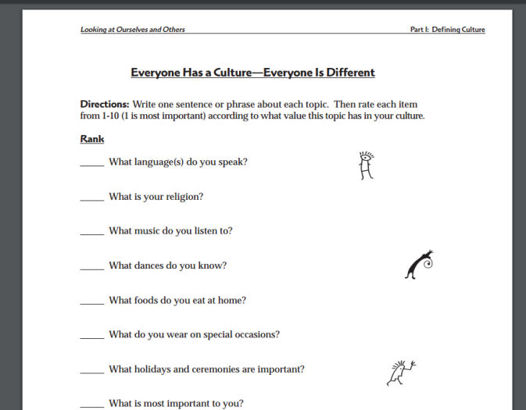
Peace Corps Lesson Handout

Slide 29
Clothing and Impressions
Goal: To recognize and develop knowledge about how we use clothing to give people details about ourselves
Have students look around the room
What can they tell about each other based on what they are wearing/carrying?
Give students a list of people. Have them work in groups to generate the clothing each person might wear to show who they are
When finished, bring students back together and ask them to reflect on what their own style says about themselves. What do they want to say about themselves through appearance?

Slide 30
Culture and Values
Fairness
Not Doing Harm
Authority
Purity
Community/Group Loyalty
Me ≠ You
Identity shapes values; both influence behavior
An older friend, Sam, meets you for coffee dressed in an outfit that you think is too informal. In fact, your friend is wearing a swimsuit. How do you respond?

Slide 31
Culture and Cultural Norms
Cultural norms = Behavior and rules
They are learned early and reinforced often
These rules make us very ethnocentric (our rules are the only rules) and are the cause of many cultural miscommunications
Learning that other cultural norms exist can help us be more accepting and reduce instances of cultural miscommunication

Slide 32
Cross-Cultural Incident
Clara is an American attending a university in Norway. She has made a few friends. One morning, on her way to class, she sees her friend Johann walking ahead of her. She shouts and runs to catch up with Johann.
Clara smiles and attempts to make conversation, but Johann doesn’t smile or say much except that he must get to class.
Clara says good-bye feeling confused and hurt. She thought they were friends and wonders if she did something to upset Johann.

Slide 33
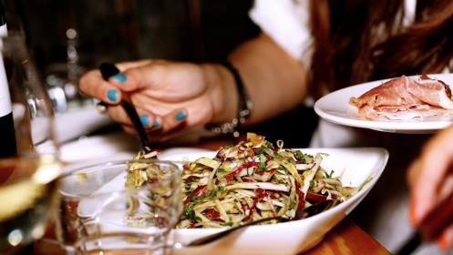
Teaching Values & Cultural Norms
Greetings across cultures
Spot the difference
Cross-cultural incidents

Slide 34

Spot the Difference
Goal: To recognize that everyday activities, living arrangements, and habits vary around the world and generate discussion on how to handle those differences
Show drawings or pictures of everyday
activities taking place in the U.S.
How are these different from their
own daily activities?
What would they do if they were in
the U.S. and were asked to act in a
different way?

Slide 35
Cross-Cultural Incidents
Goal: To use a cross-cultural incident as a way to prompt discussion about communicating across cultures
Readily available on the Internet
Provide students with a case study as a way to work through cross-cultural communication and generate possible solutions

Slide 36

Final Thoughts
Teach students to…
Ask questions
Observe
Make mistakes
Teach people about new ways and cultures
www.americanenglish.state.gov
American English for Educators Facebook Page

Slide 37
Thank You
References
NorQuest College (2007). Critical incidents for intercultural communication: An interactive tool for developing awareness, knowledge, and skills. https:// www.norquest.ca/NorquestCollege/media/pdf/centres/intercultural/ CriticalIncidentsBooklet.pdf
Pinker, S. (2008, January 13). The moral instinct. The New York Times Magazine. http://www.nytimes.com/2008/01/13/magazine/13Psychology-t.html
Robson, D. (2013, January 14). There really are 50 Eskimo words for ‘snow’. The Washington Post Retrieved from https://www.washingtonpost.com/ national/health-science/there-really-are-50-eskimo-words-for-snow/ 2013/01/14/e0e3f4e0-59a0-11e2-beee-6e38f5215402_story.html
Samovar, L. A., Porter, R. E., McDaniel, E. R., & Roy, C. S. (2013). Communication between cultures (8th ed.). Boston: Wadsworth/Cengage Learning.
Schaeffer, K. M. (2014). Verbal Communication [PowerPoint Slides]. Salt Lake City, UT.
Wintergerst, A. C., & McVeigh, J. (2011). Tips for teaching culture: Practical approaches to intercultural communication. White Plains, NY: Pearson Longman.

