Slide 1
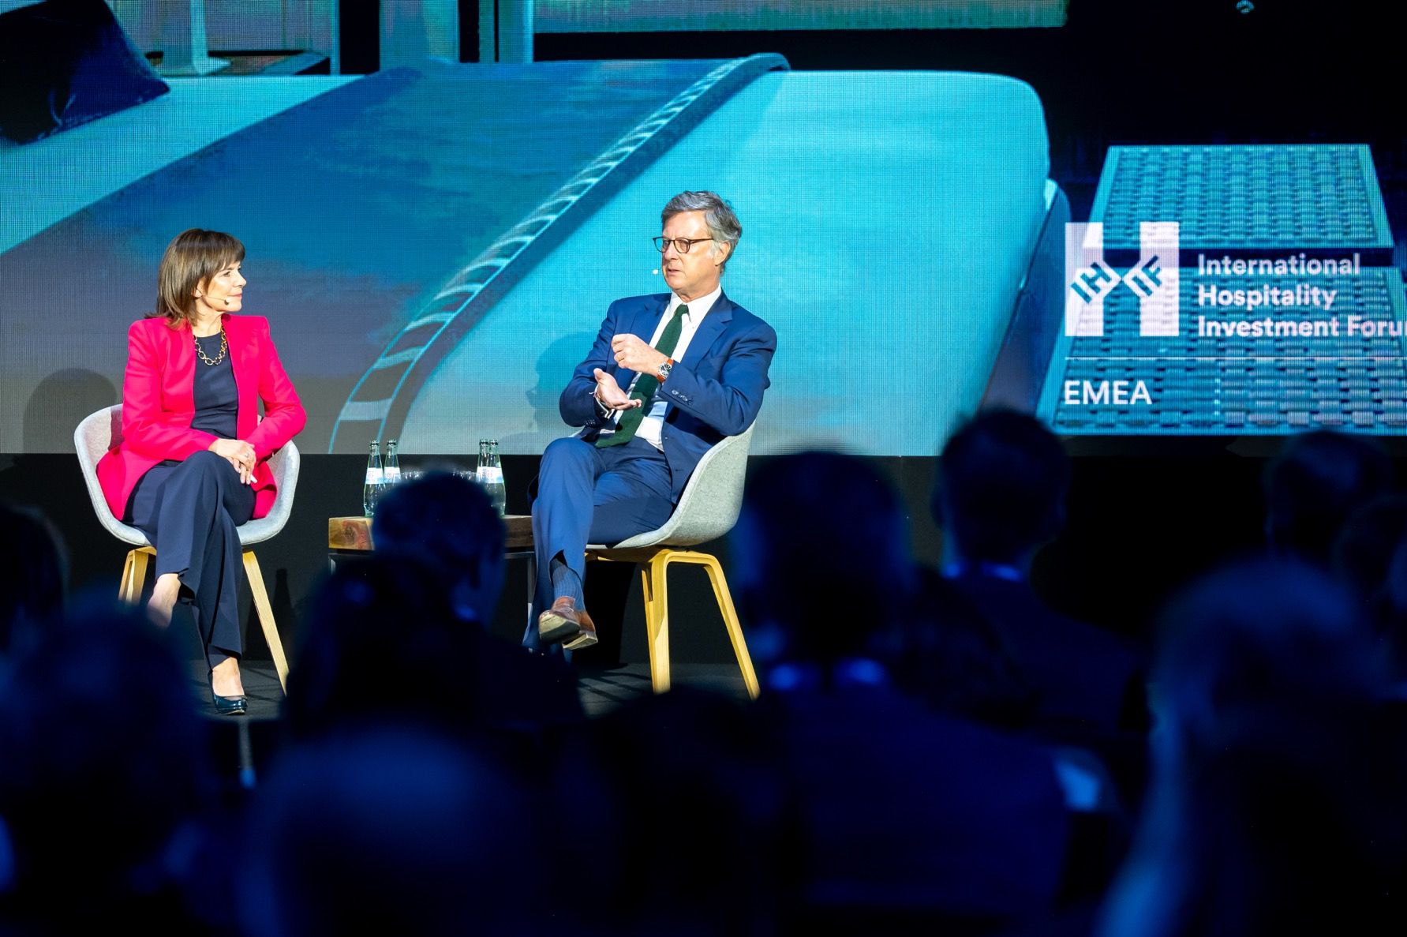

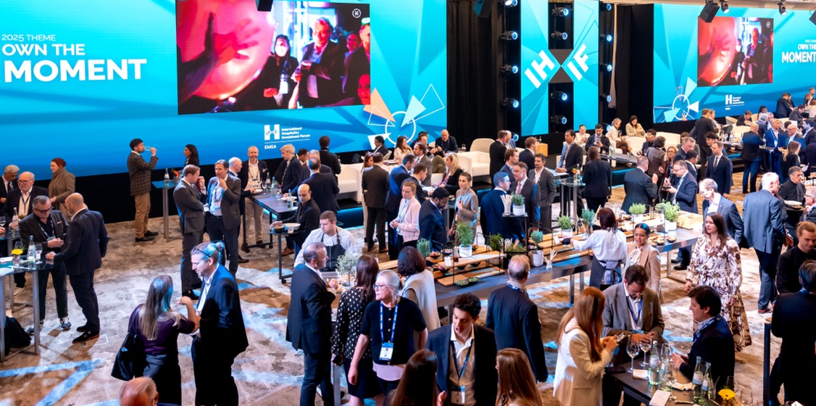
2026 Sponsorship Information Pack
This following pack contains everything you need to know about your sponsorship benefits including information
on dates and deadlines and how to submit your assets.
23–25 March 2026
InterContinental | Pullman | Berlin, Germany
ihifemea.com

Slide 2
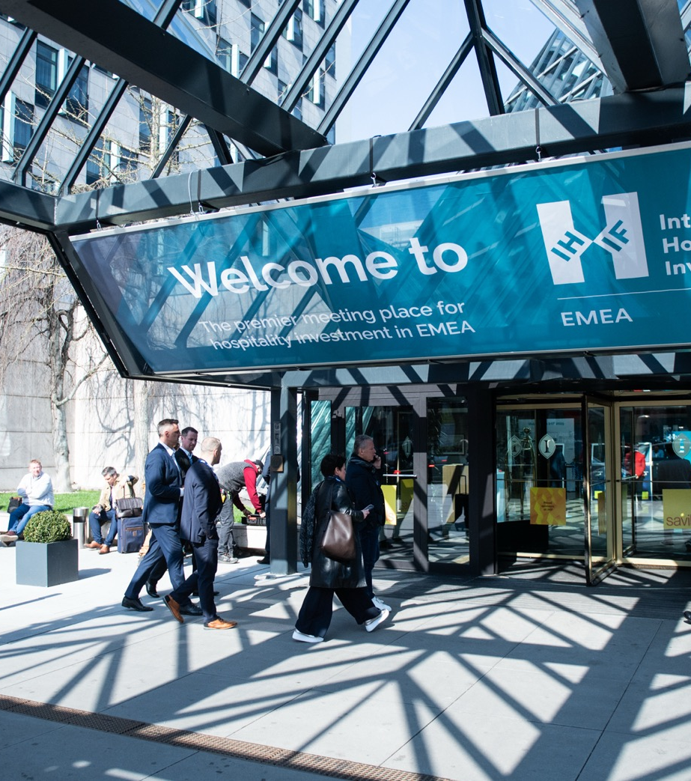
Welcome
We are delighted that you are sponsoring the 28th International Hospitality Investment Forum (IHIF) EMEA held at the InterContinental and The Pullman, Berlin. This information pack contains important information in relation to your IHIF EMEA sponsorship and how to make the most of the sponsorship opportunities that are available to you, including some great new value-added benefits to your sponsorship.
Contents
Event Schedule 03
Event Contacts 04
Exhibition Venue 05
Sponsorship Benefits 06
Sponsorship Key Deadlines 07
Sponsorship Packages 2026 08
Silver Sponsor Stand 09
Gold Sponsor Stand 10
Platinum Sponsor Stand 11
How to Provide Artwork 12
Onsite Exposure 13
App Key Benefits 14
Social Media & PR Amplification 16
The Exhibition 18
Sponsor Set Up and Dismantle Times 19
Health & Safety and Stand Build 20
Insurance & Security 21
Stand Extra's, Shipping & Storage 22
Shipping & Deliveries 23
Sustainability 24
Floor Plan 25

Slide 3
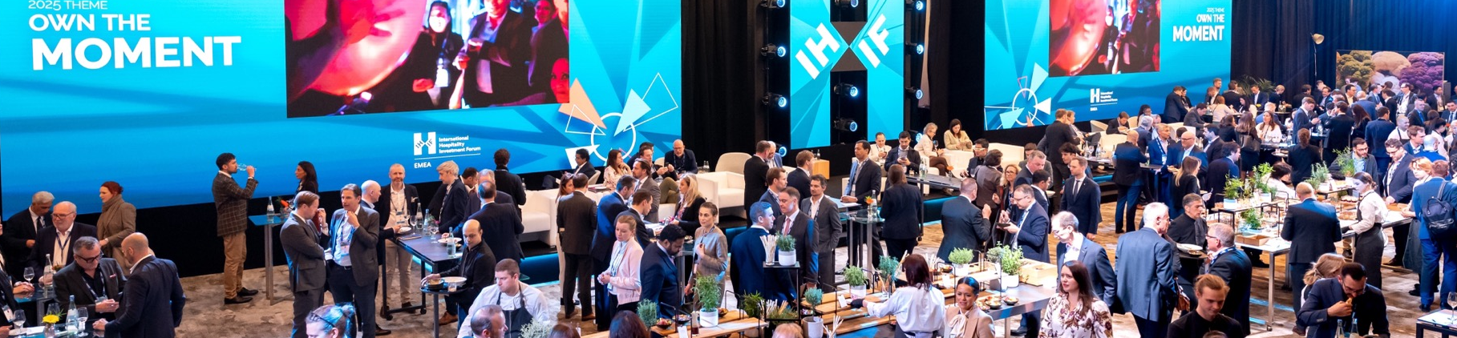
Event Schedule
Saturday 21 March 26
All heavy construction of Space Only builds (Diamond/Platinum) 11:00 – 22:00
Please refer to page 21 for exact timings for your area
Sunday 22 March 26
Sponsor/Exhibitor Access to exhibition From 08:00 or 11:00
Please refer to page 21 for exact timings for your area
All space only builds MUST be completed by 22:00 hrs
Monday 23 March 26
Space only builds stand dressing 07:00 – 09:00
Registration and Exhibition Open 10:00 – 18:00
Content Fuelled Networking 10:00 – 14:00
BxR (Pullman) 10:00 – 16:00
MENA Investment Focus 11:30 – 13:00
Lunch + Networking – in Exhibition 12:15 – 13:15
Welcome from Questex 15:00
Vision Stage Sessions* 14:30 – 17:30
Welcome Reception 18:30 – 20:30
Tuesday 24 March 26
Breakfast Roundtables 08:00 – 08:45
Vision Stage 09:00 – 11:00 & 16:30 – 17:30
Destination Hub 11:00 – 15:45
Breakout Stages 12:00 – 16:00
Wednesday 25 March 26
Breakfast Roundtables 08:15 - 09:00
Exhibition Open 09:00 – 14:00
Converse + Connect 09:15 – 11:00
Destination Hub 08:15 – 11:00
Vision Stage 11:30 – 13:00
Closing Lunch 13:00 – 14:20
Hall clear of delegates / guests 15:00
De-rog /dismantle 15:00 – 18:00 & 22:00
Please refer to page 21 for exact timings for your area
*Please note the programme timings may be subject to change, please check the website or the networking App for the most up to date timings.

Slide 4
Event Contacts
Below are your key IHIF EMEA 2026 contacts who remain on hand to assist with all topics throughout the planning stage and whilst onsite.
Event Management | Nina Aufderheide Sponsor Operations Manager ihifemeaoperations@questex.com
Digital Marketing | Donna Preston Digital Marketing Manager opremarketing@questex.com
Registration | Taylor Bennet Ltd. Dedicated registration team ihif@eventbooking.uk.com
Exhibition Stand Art Work, Print, Stand Build Accessories, Furniture and Electricity | TEM Festival GmbH Technical Event Management ihif@t-e-m.de Exhibitor Shop
Content | Olga Andreevskikh Senior Conference Producer oandreevskikh@questex.com
Food + Beverage, Waste Disposal, Cleaning, Meeting Rooms & IT/LAN | Olga Moellermann Senior Event Sales Manager olga.moellermann1@ihg.com
Editorial | Patrick Whyte Editor in Chief pwhyte@questex.com
Health & Safety Stand approval and phased load in | Tine Kuckhoff H&S Consultant tine.kuckhoff@pcma.de

Slide 6
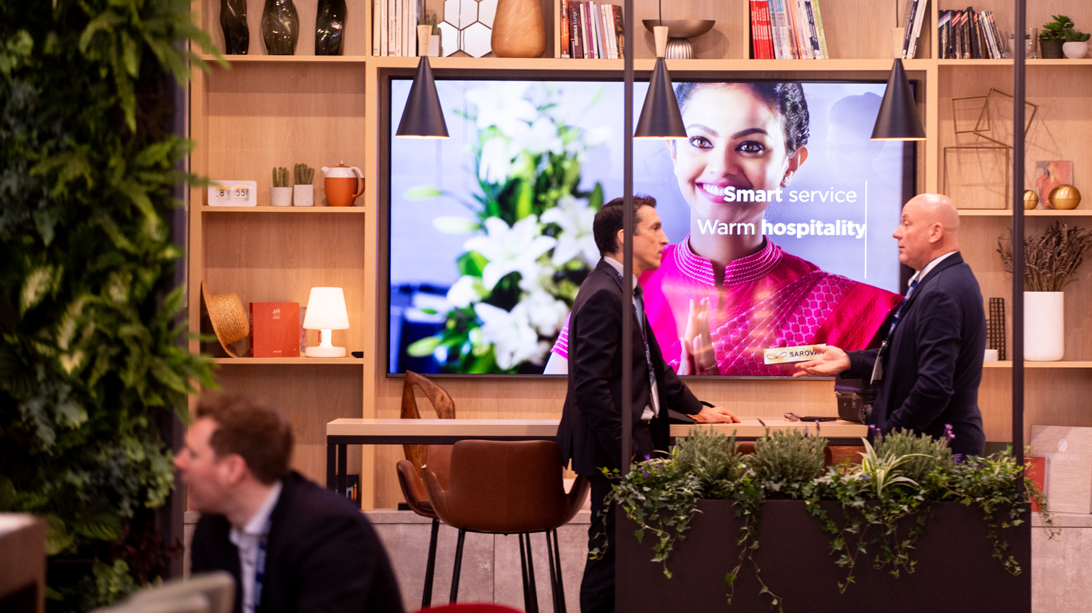
Sponsorship Benefits

Slide 7
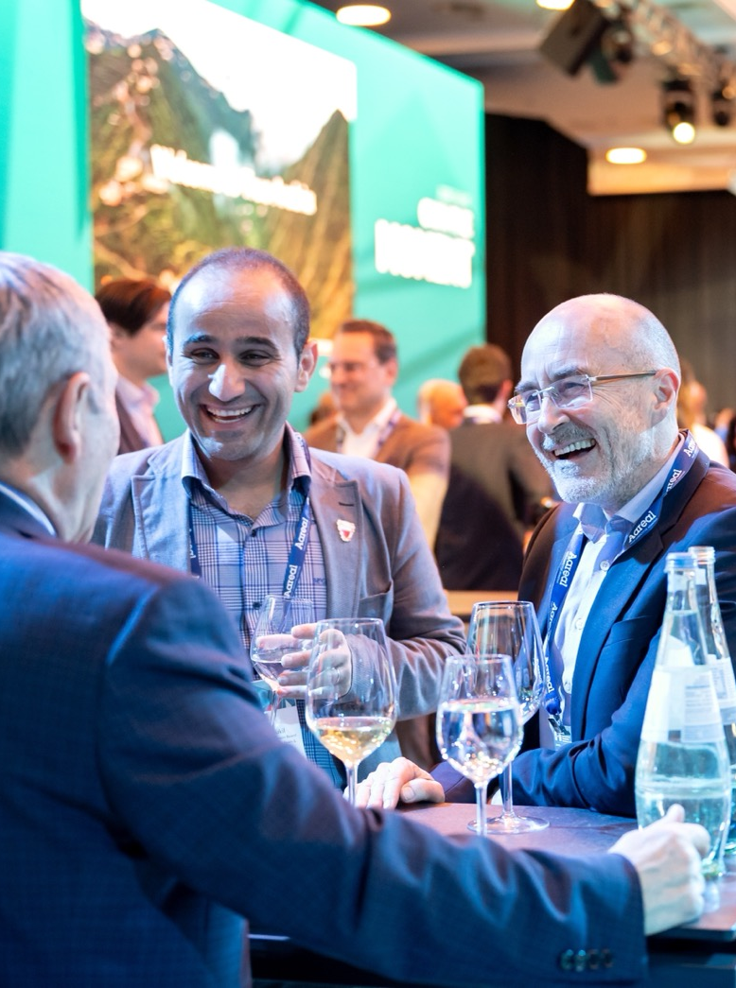
Sponsorship Key Deadlines
ASAP
ASAP
ASAP
ASAP
21st February
28th February
28th February
4th March
13th March
2nd March
2nd March
Register your delegates for the event
Submit assets for social media amplification
Build virtual stand on Networking and Event Platform (App launches 26th January)
Book accommodation for your delegates at the InterContinental
Early bird discount for Exhibitor orders ends
Submit stand contractor submission form and risk assessments to health & safety consultant
Static Digital Advert Sponsors to submit artwork
Submit 30 second video advert (Diamond and Platinum only)
Place orders with hotel for any internet and catering (stands and meeting rooms) etc.
Place final orders with TEM for any electricity, furniture and any additional extras (surcharges may apply)
Stand artwork deadline with TEM due

Slide 8
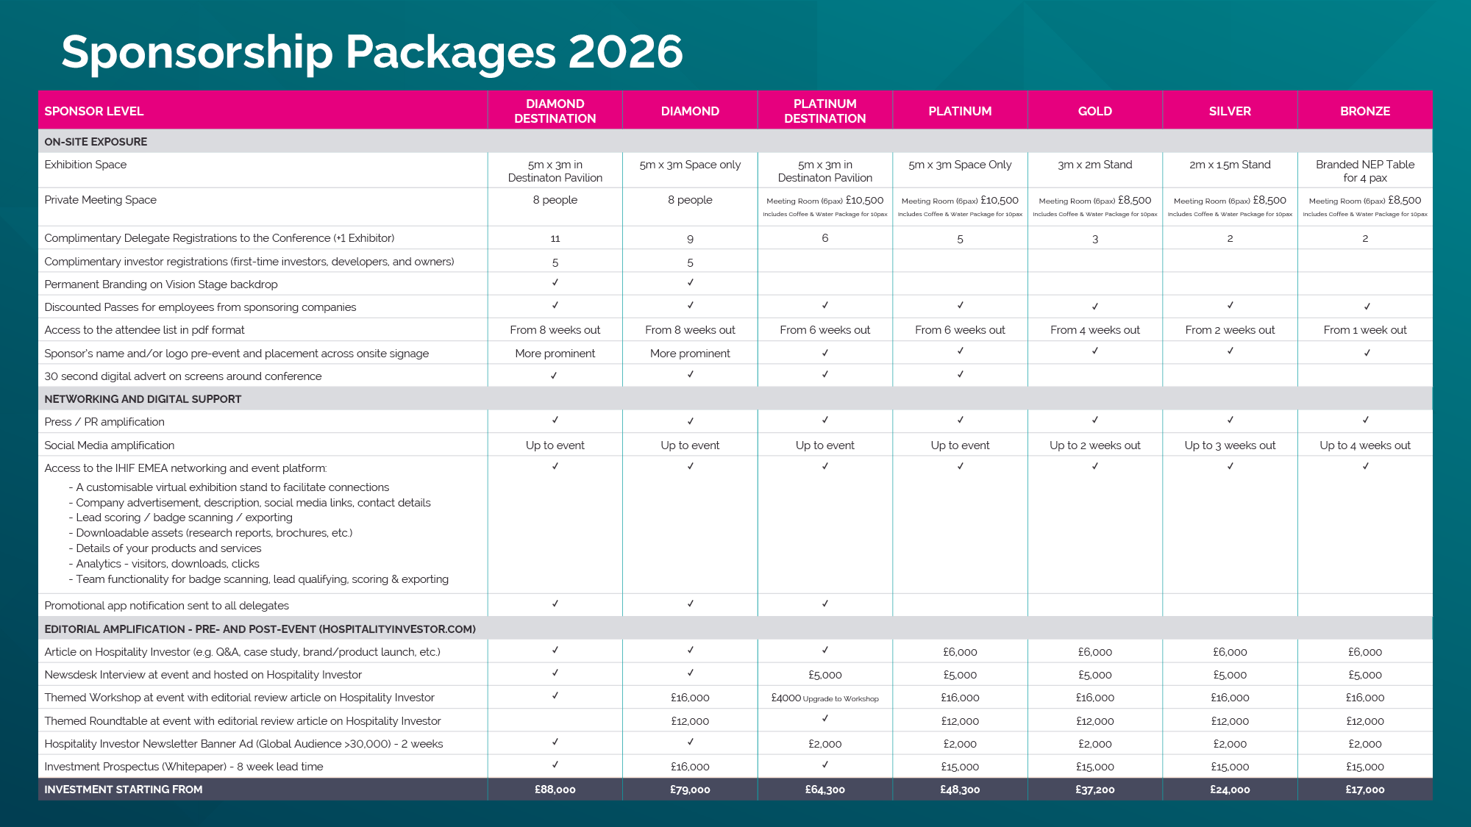

Slide 9
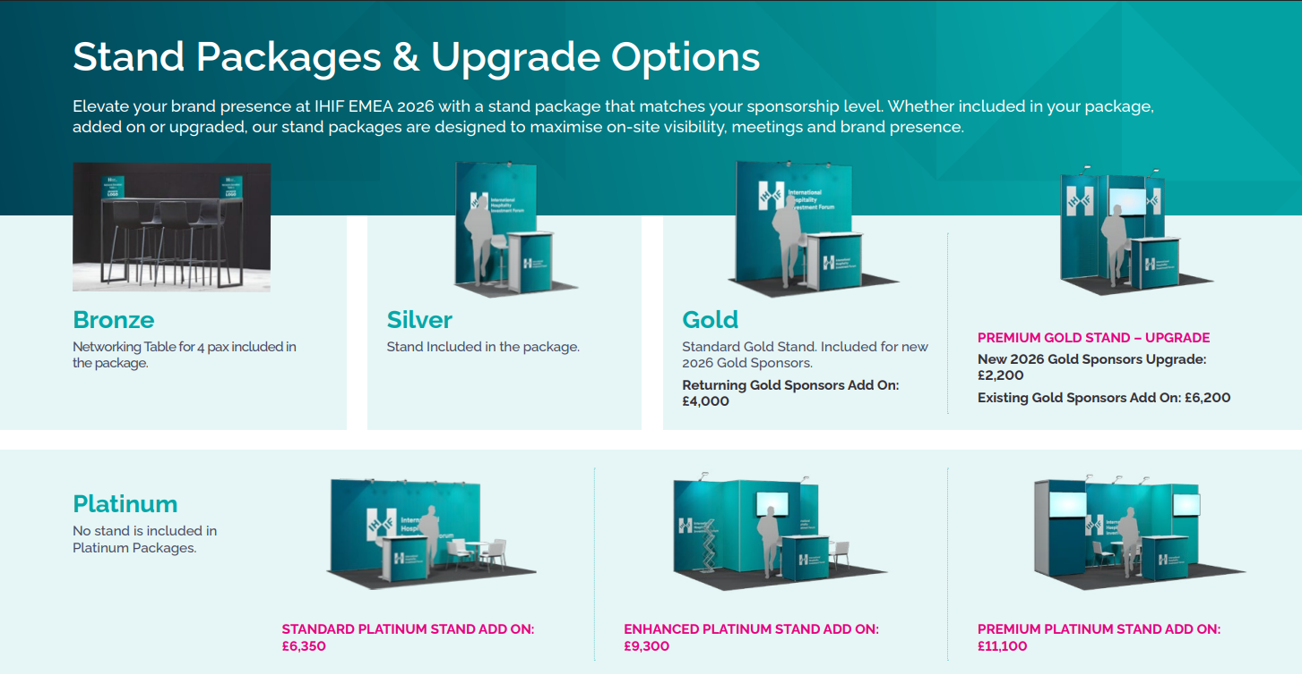

Slide 10
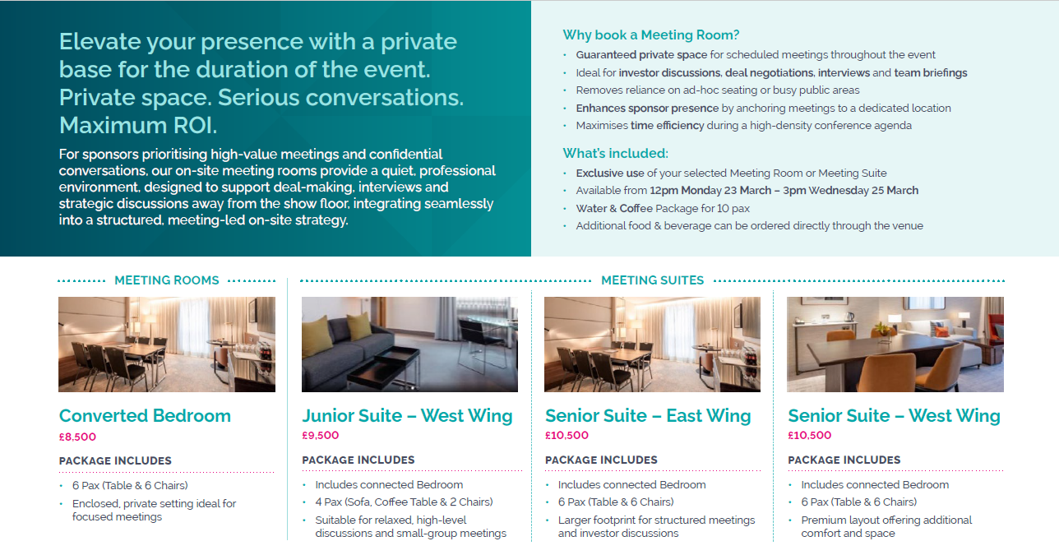
Platinum Sponsor - Add on/Upgrade

Slide 11

How to provide artwork
Creation of the print file
All print dimensions given by us are net dimensions of the visible print without bleed.
Unless otherwise specified, please add 30mm bleed to each edge of your print. The bleed must contain print data, a white bleed if the background is not white is not helpful in any way.
When scaling the template, please scale the bleed accordingly.
File format
Please always provide PDF ready to print files.
When exporting PDF files, make sure that you do not display any cropmarks, colour bars and other overheads in the print file that are not to be printed. Only data to be printed should be displayed, as there are no cross-system compatibilities that automatically remove this information when printing.
Outline (vectorize) all fonts and objects. Please only embed fonts if an outline is not possible.
Please always include a 30 mm bleed on all sides for fabrics / canvas with round- and rubber lip piping and for flags and banners
In exceptional cases a 5 mm bleed on all sides for panels or foils is possible, 30mm bleed is preferred.
Do work in proportions of if necessary: 10%, 20%, 25%, 50%, 100% and specify the desired size of the final image into the name of the file. Scale the bleed accordingly.
Background with bleed
Visible print
Trim line (cut)
Bleed
30 mm
30 mm

Slide 12
Onsite Exposure
Company Logo
Deadline: ASAP
Submission: ihifemeaoperations@questex.com
Your company name and/or logo will appear on the IHIF EMEA website and Networking and Event Platform, as well as other marketing materials, where appropriate. If you haven’t already done so, please submit a vector file (AI or EPS), with all fonts outlined as well as a PNG or JPG file.
If you have already submitted your logo then please check the correct one is displayed on the IHIF EMEA website. Should you need to refresh or update your logo then please email ihifemeaoperations@questex.com.
Complimentary Investor Registrations
(first-time investors and owners)
Diamond Sponsors (x5 invitees) and Platinum Sponsors (x2 invitees) ONLY.
Deadline: ASAP but no later than 2 weeks out from the event 6th March 2026. We invite our Diamond and Platinum Sponsors to invite Investors who have not visited IHIF EMEA (within the last 5 years) to attend on a complimentary basis. Please email your invitee names to ihifemeaoperations@questex.com. Once approved we will then send the unique complimentary registration invite links.
30 Second Digital Video Advert
Diamond/Platinum Sponsors only
Deadline: 18th March 2026
Submission: ihifemeaoperations@questex.com
Specs: 1920 x 1080px - 16:9, MP4 motion video
As a diamond/platinum sponsor only exclusive benefit we encourage you to submit a 30 second digital advert which will be played in rotation on screens throughout the exhibition area.
Delegate Attendee Lists
These will be automatically emailed to you in Excel format within the below given time frames. Please note this list must only be used prior to the event and must not be passed on outside of your company, used for promotional purposes, or downloaded into any database. If you do use this list in any other way, you will be breaking the data protection act. This list remains the property of Questex, LLC. This list does not contain the details of attendees who opted out of having their name on the delegate list.
The delegate lists will be sent out from the below dates:
Diamond Sponsors: from 8 weeks out, 26th January 2026
Platinum Sponsors: from 6 weeks out, 9th February 2026
Gold Sponsors: from 4 weeks out, 23rd February 2026
Silver Sponsors: from 2 weeks out, 9th March 2026
Bronze Sponsors: from 1 week out, 16th March 2026

Slide 13

App Key Benefits
The IHIF Networking & Event Platform
App will launch exclusively to Sponsors 26th January. You will be invited to access the platform.
A customisable virtual exhibition stand to facilitate connections
Company advertisement, description, social media links, contact details
External links to showcase your downloadable assets (research reports, brochures, etc.)
Badge scanning – scan visitors to your stand and automatically form connections with delegates
Analytics – Export your teams' connections & meetings post event
Virtual Stand Features
Company name and logo, description, website, social media links, video link & company contact details plus more detailed below.
Company logo: Logo must be 1:1 ratio. 1000x1000 pixels and in either JPG or PNG format.
300-word company description: Please provide a 300-word description of your company’s products and services. This will be included on the website and in the networking and event platform. Descriptions any longer than 300 words may be edited without approval.
Header image: Add a banner image to enhance the look of your virtual stand – The cover image should be 1476x634 pixels with a maximum file size of 500 KB.
Embedded links for video or download documents – Add an embedded video promoting your brand, products and services.
YouTube & Vimeo
Download forms and documents: You will need all documents and forms hosted on a platform such as AWS. Then you will use the link and add it to products in Teams.

Slide 14
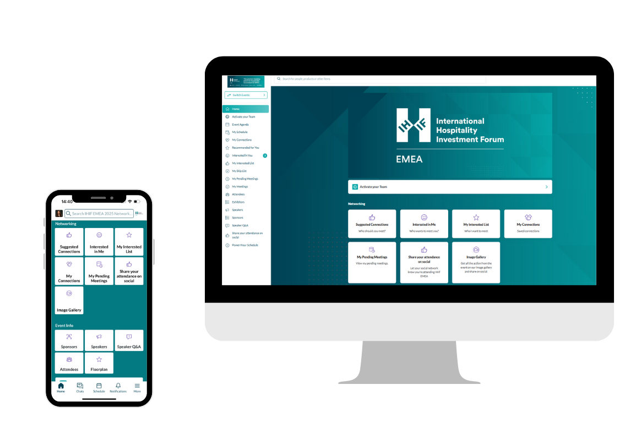
App Key Benefits
Further features include:
Live chat
Stand members will receive notifications of any enquiries; you can view all your teams' meetings and chats in Teams.
Analytics
Teams is your central hub for you and your colleagues. Use the app to connect with delegates, schedule meetings, and chat with delegates. After the event, you can export all the meetings and connections for your full team.
Connections/Recommendations/Badge Scanning
Search the attendees and use the filters to refine your search. To connect with an attendee, you can show interest or request a meeting. When you are connected, they will be added to your leads.
The app will recommend attendees based on your profile. You can connect and request meetings in the same way and they will be added to your leads.
Badge scanning onsite at the event instantly connects you with attendees. All badges scanned will automatically be added to your leads.
Instant chat and lead scoring
Once you have made a connection you can chat instantly through the platform.
You can review and manage your leads within the platform and add lead qualification questions to help you score and prioritise your teams' connections.
Remember IHIF EMEA 2026 is not just about the three days onsite in Berlin, we encourage you to make connections and network throughout the year!

Slide 15
Social Media & PR Amplification
About: Should you have any announcements, research, news, or any content including images and videos, that you would like to share across our IHIF EMEA LinkedIn & our X accounts, please send all content to opremarketing@questex.com.
Benefits for you: Exposure on our social channels to a highly engaged audience
Content you need to supply: We will need copy, images, links and tags and your *preferred publish dates. Refer to the submission guidelines on the right-hand side for your submission and publishing deadlines.
*Please note we will try our best to meet your chosen date/time, but we can’t 100% guarantee this. Timeslots will be available on a first come, first served basis.
Full guidelines on how to submit are available here.
Specs are as follows:
Images - Must be smaller than 5MB, 1200 x 627pixels
Video LinkedIn - 16:9, minimum 3seconds, max 3minutes but 30secs-1min is the recommended in terms of engagement.
Video X (formerly known as Twitter) - 16:9, File size must not exceed 512 mb. Duration must be between 0.5 seconds and 140 seconds.
Documents/whitepapers - PDF format only.
Don’t forget to mention our pages (LinkedIn and X) and use #IHIFEMEA26 when posting anything related to IHIF EMEA.
Submission guidelines by sponsorship level:
Diamond & Platinum:
Up to 3 posts
Content submission deadline: 16th March
Publish dates: Anytime from now until 27th March
Gold:
Up to 2 posts
Content submission deadline: 6th March
Publish dates: Anytime from now until 13th March
Silver:
1 post
Content submission deadline: 27th February
Publish dates: Anytime from now until 6th March
Bronze:
1 post
Content submission deadline: 20th February
Publish dates: Anytime from now until 27th February
If you do have any questions, please reach out to opremarketing@questex.com.

Slide 16


Social Media & PR Amplification
PR Amplification
As part of your sponsorship, we are committed to helping you get your stories, news and announcements out to press. Press will be notified of sponsor announcements before, during and after the event.
Please send us any press releases and/or news articles you wish for us to add to the press page on the website (this page will go live in advance of the event). Ideally these should be in a format we can hyperlink to – i.e hosted on a webpage. You can send us up to 3 to include before, during and/or after the event.
Personalised Social Media Banners
We’re proud that you’re supporting IHIF EMEA, and we’ve created your Sponsor banner to promote this.
Sponsor Social Media Banners.xlsx
In just one click you can share it on social media and make sure everyone knows how to connect with you at the conference.
It’s easy and quick to post:
Find your link here. Click the link to post your personalised banner with your logo on your chosen social channels, as many times as you wish.
Please also remember to tag our page (https://www.linkedin.com/showcase/
international-hospitality-investment-forum-ihif) and use #IHIFEMEA26
All of your team can participate and amplify your attendance at IHIF EMEA 2026

Slide 17
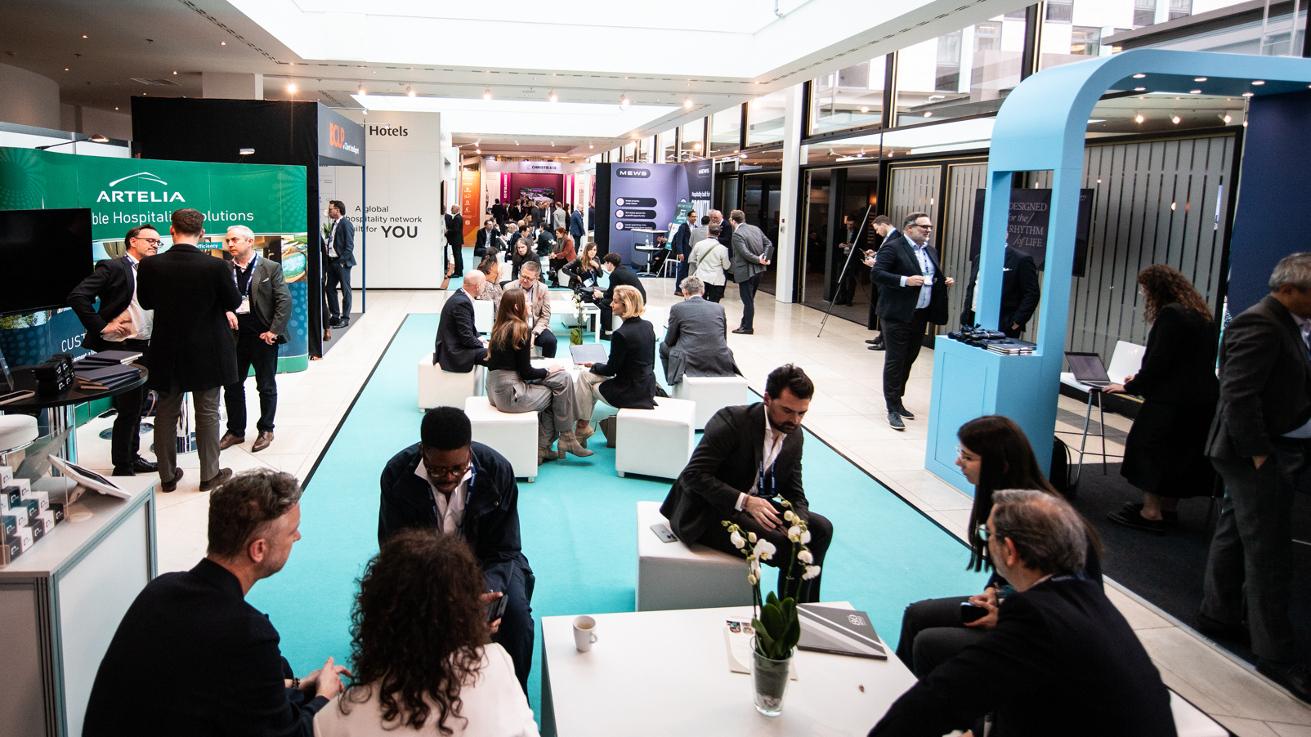
The Exhibition

Slide 18
Sponsor Set Up and Dismantle Times
Location | Build – 21st March | Build – 22nd March | Dismantle – 25th March
Lobby - | 11.00/13.:00 to 16:00/17:00 | From 13:00 t0 22:00 | 15:00 to 18:00
Lobby – D1, L10, L12 | 11:00 – 17:00 | 13:00 – 22:00 | 15:00 to 18:00
Corridor to Breakfast /West Wing | NO BUILD | 13:00 – 22:00 | 15:00 to 18:00
Potsdam I /II/III/1V/Foyer | 08:00 to 22:00 | 08:00 to 22:00 | 15:00 to 22:00
Pavillon | 08:00 to 22:00 | 08:00 to 22:00 | 15:00 to 22:00
Wintergarden | 11:00 to 22:00 | 11:00 to 22:00 | 15:00 to 22:00
Garden Lounge I/II | NO BUILD | 11:00 to 22:00 | 15:00 to 22:00
Marlene | NO BUILD | 08:00 to 22:00 | 15:00 to 21:00
Zoo Terrace | NO BUILD | 11:00 to 22:00 | 15:00 to 22:00
Kaminzimmer | 07:00 to 08:00 (Load In) 11:00 to 22:00 | 11:00 to 22:00 | 15:00 to 22:00
Glienicke | 11:00 to 22:00 | 11:00 to 22:00 | 15:00 to 22:00
Tegel | NO BUILD | 11:00 to 22:00 | 15:00 to 22:00
Havel, Wuhle, Panke, Spree, Dahme | 08:00 to 22:00 | 08:00 to 22:00 | 15:00 to 22:00
Dahlem | 11:00 to 22:00 | 11:00 to 22:00 | 15:00 to 22:00
Business Centre (Mitte) | 08:00 to 22:00 | 08:00 to 22:00 | 15:00 to 22:00
Pavilion Lounges (east + west) | 11:00 to 22:00 | 11:00 to 22:00 | 15:00 to 22:00
LA Café (Sunset) | NO BUILD | 11:00 to 22:00 | 15:00 to 22:00
Bellevue | NO BUILD | 11:00 to 22:00 | 15:00 to 22:00
Monday 23 March | 07:00
Stand dressing
Monday 23 March| 09:00
Exhibition Show Ready
.
Monday 23 March | 10:00
Exhibition Open
Monday 23 March | 14:30
Vision Stage Commences
Wednesday 25 March | 15:00 – 22:00
Exhibition Breakdown

Slide 19
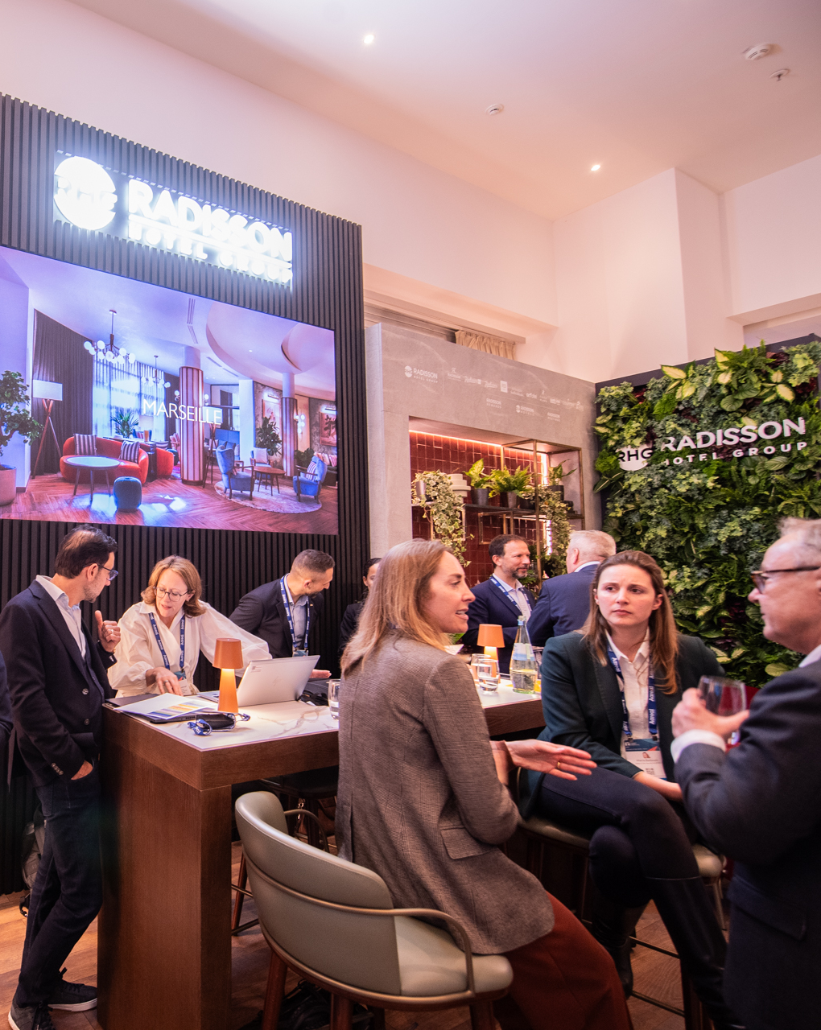

Health & Safety & Stand Build
H&S tick-list: COMPULSORY for ALL Exhibiting Companies — Stand and Product Information/Health & Safety Declaration
It is a compulsory requirement for all exhibitors to complete and return this form. Please do so ASAP, but no later than 28th February 2026 and send to our H&S Consultant Tine via: tine.kuckhoff@pcma.de or ihifemeaoperations@questex.com
Please also note the following important updates regarding access and stand build
There is no parking around the venue for large vehicles so alternative arrangements will need to be made. Only dropping off materials and equipment is permitted Suggested parking can be found along the Straße des 17. Juni, close to the park called Tiergarten, along both sides of the road.
No stands are permitted to have a roof due to the venues inhouse sprinkler system
There is no storage for stands on the show floor, any packing boxes or materials must be put into pre-arranged storage with the venue or removed from the venue until breakdown commences. Costs for storage can be found in detail on page 24.
It is important that as a sponsor you are responsible for sharing all the above information with you stand builder. For general queries on any of the above please contact ihifemeaoperations@questex.com
Full stand regulations for IHIF EMEA can be found here

Slide 20
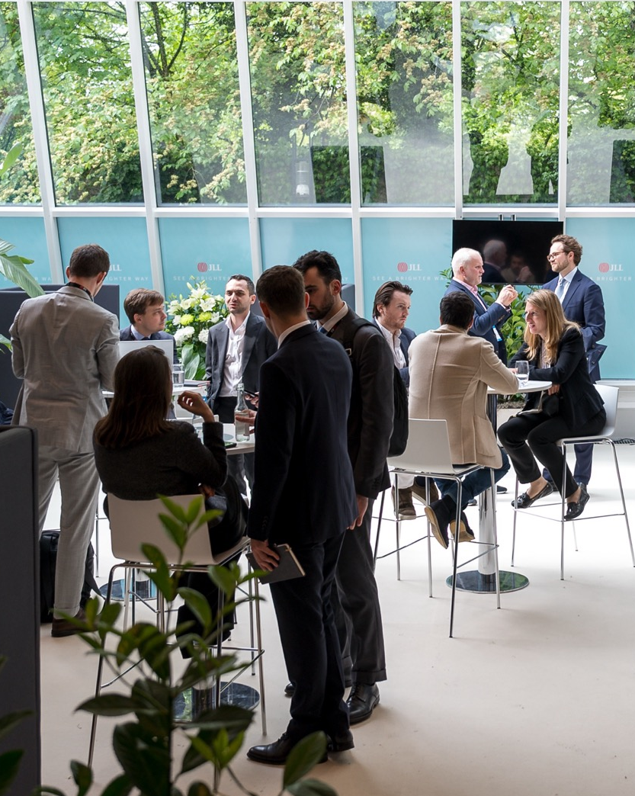

Insurance & Security
Insurance & Security –
exhibitors to organise own
Insurance
The organisers have no insurable interest in the property, staff or actions of exhibitors. Exhibitors must ensure that they have sufficient insurance to cover claims associated with their staff and have property and third-party liability coverage. All contractors and exhibitors, without exception, must hold valid Public Liability Insurance, which covers them and indemnifies for all activity involving stand construction, operation and deconstruction, at the event and in the country to which this information pertains.
The liability is a compulsory minimum of £2m Sterling or the equivalent in another currency. If you are in doubt as to what your cover is, please contact your underwriter or broker for clarification. Please note that we do NOT require your Employers Liability Insurance. Temporary insurance can be obtained from the following website.
Security
The exhibition hall is not locked overnight and although there is security on site, you should not leave valuables unattended at any time. The organisers will not be responsible for anything that is lost, damaged or stolen at any time.
Security quotes can be obtained from our Health and Safety Consultant via Tine at tine.kuckhoff@pcma.de

Slide 21
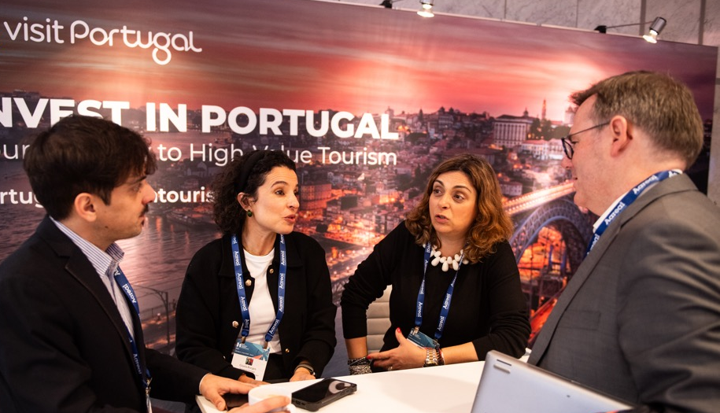
Stand Extra's, Shipping & Storage
Recommended Stand Builder
TEM Festival
Contact email: ihif@t-e-m.de
Exhibitor Shop
Please contact TEM for stand extra’s such as furniture, electricity, additional power and any additional stand extras
Shipping/Storage
Shipping should arrive at the hotel between Thursday 19th March to Wednesday 25th March
Exhibitors may send materials, stands or backdrops to the venue, Exhibitors are responsible for organising their own shipping to and from the hotel. Please note, we encourage the use of and sharing of digital assets instead of printed materials
All items sent to the hotel must use the postage form (found on page 22 of this booklet) for shipping. The name of the event, stand number, number of packages and sender must be clearly visible on the delivered items / packing list. The hotel will not accept any deliveries that cannot be clearly assigned to a specific event or purpose.
The loading bay for delivery of any goods, shipments is located on the Katharina-Heinroth-Ufer, 10787, Berlin. There is no loading ramp. There is no unloading equipment, such as forklifts or pallet trucks on the hotel’s premises, however, upon request the equipment can be ordered from a third party. The hotel is not liable for the completeness and condition of delivered items. The same applies to damage that occurs during storage at the hotel, unless the damage is the result of intent or gross negligence on the part of the hotel.
The use of non-hotel pallet trucks and forklifts inside the hotel must be coordinated with the hotel prior to use.
Please note: All items brought in for the event must be removed immediately after the event, unless different pick-up times have been agreed with the hotel in advance and in writing. If unexpected materials remain at the hotel after the event, the hotel reserves the right to either store these materials at the owner’s expense or to dispose of them at the owner’s expense. The storage fee is €107.50 per day and per m³. It is up to the hotel to decide whether to store the items or dispose of them.

Slide 22

Shipping & Deliveries
Postage Label
Please ensure this label is attached to every package that is sent to the venue, please share this label if you are using a freight company to send you packages.
Deliveries of more than 1 cubic metre in volume must be coordinated with the Hotel.
Deliveries will be accepted from Thursday 19th March at the earliest. Monday to Friday 7.00 –15.00.
DELIVERY FOR:
Intercontinental Hotel Berlin, IHIF EMEA,
Budapester Strasse 2,
Warenannahme Via Katharina-heinroth-ufer,
10787 Berlin
CONTACT IN THE HOTEL: Event Services
NAME OF EVENT: International Hospitality Investment Forum / IHIF
STAND NAME (if applicable):
NUMBER: PACKAGE NO. OF SENT
THE DELIVERY WILL BE PICKED UP BY:
TELEPHONE NO. OF PERSON ON SITE:
SENDER OF PACKAGE:
DELIVERY FOR:
Intercontinental Hotel Berlin, IHIF EMEA,
Budapester Strasse 2,
Warenannahme Via Katharina-heinroth-ufer,
10787 Berlin
CONTACT IN THE HOTEL: Event Services
NAME OF EVENT: International Hospitality Investment Forum / IHIF
STAND NAME (if applicable):
NUMBER: PACKAGE NO. OF SENT
THE DELIVERY WILL BE PICKED UP BY:
TELEPHONE NO. OF PERSON ON SITE:
SENDER OF PACKAGE:

Slide 23

Sustainability
At Questex, we’re committed to running the IHIF EMEA 2026 in an environmentally and socially responsible manner. As an exhibitor, we encourage you to take steps to impact on the sustainability of the event. Here are just a few ways you can play your part:
Stand Build & Design
Please consider the materials used in the construction of your stand. Try to focus efforts on ensuring the core elements of your stand are reusable rather than made to be used only once and then disposed of post-event
We recommend all non-reusable materials should be recyclable, and that you put steps in place to ensure they are recycled correctly post-event
Hire elements where possible rather than building bespoke
Use LED lighting where possible
Consider using suppliers with credible sustainability policies
Go Digital
Reduce your paper output by switching to digital assets instead of printed materials.
Send digital assets via email to contacts you make onsite
Display a QR code prominently on your stand which links to your website or products of interest
Run a competition that allows you to collect data and promote your product.
Run a social media competition on your stand – this creates photo opportunities and highlights your brand
Where printed materials are unavoidable ensure they are made from eco-friendly or previously recycled materials.
Sustainability Certificates from the hotel are available on request.
All food leftovers at IHIF EMEA will be picked-up by Refood. We try to purchase (depending on customers wishes) from local producers and offer seasonal food as much as possible.
Materials
We recommend using compostable, biodegradable or recyclable materials for samples or giveaways.
Reduce Waste
Follow the advice above to reduce waste in order to positively support the sustainability of the event. Ensure all booth materials are removed from site and disposed of/recycled correctly, stored for reuse or donated to charities/ initiatives where they can be reused.
Travel
We recommend the use of public transport to travel to and from the event.
Transparency
Promote the steps you have taken to ensure your presence at the event is sustainable and promote your company’s sustainability credentials.
Planning
Member of Isla, an action-based network creating standards for the event industry through expertise, training and tools.
Action
Using TRACE to measure event emissions. Click here for further information.

Slide 24
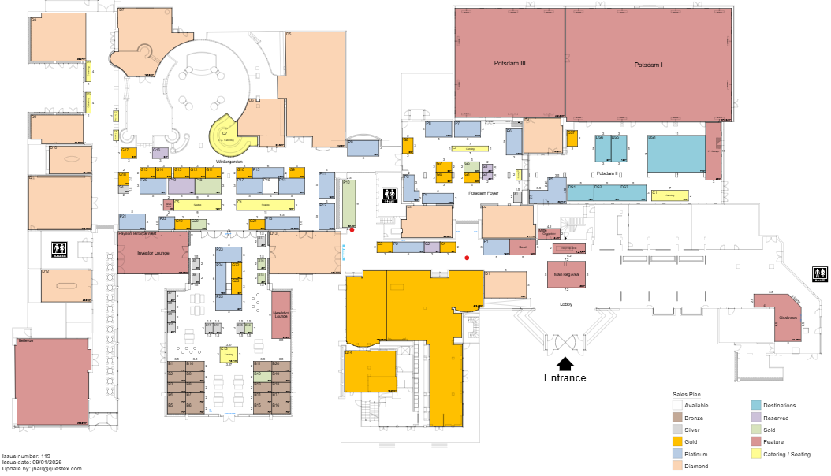
Floor Plan

Slide 25
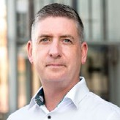
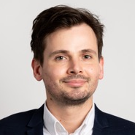
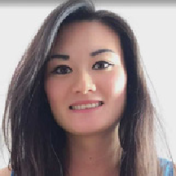




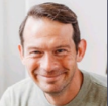
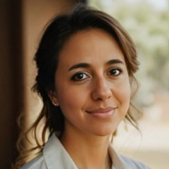
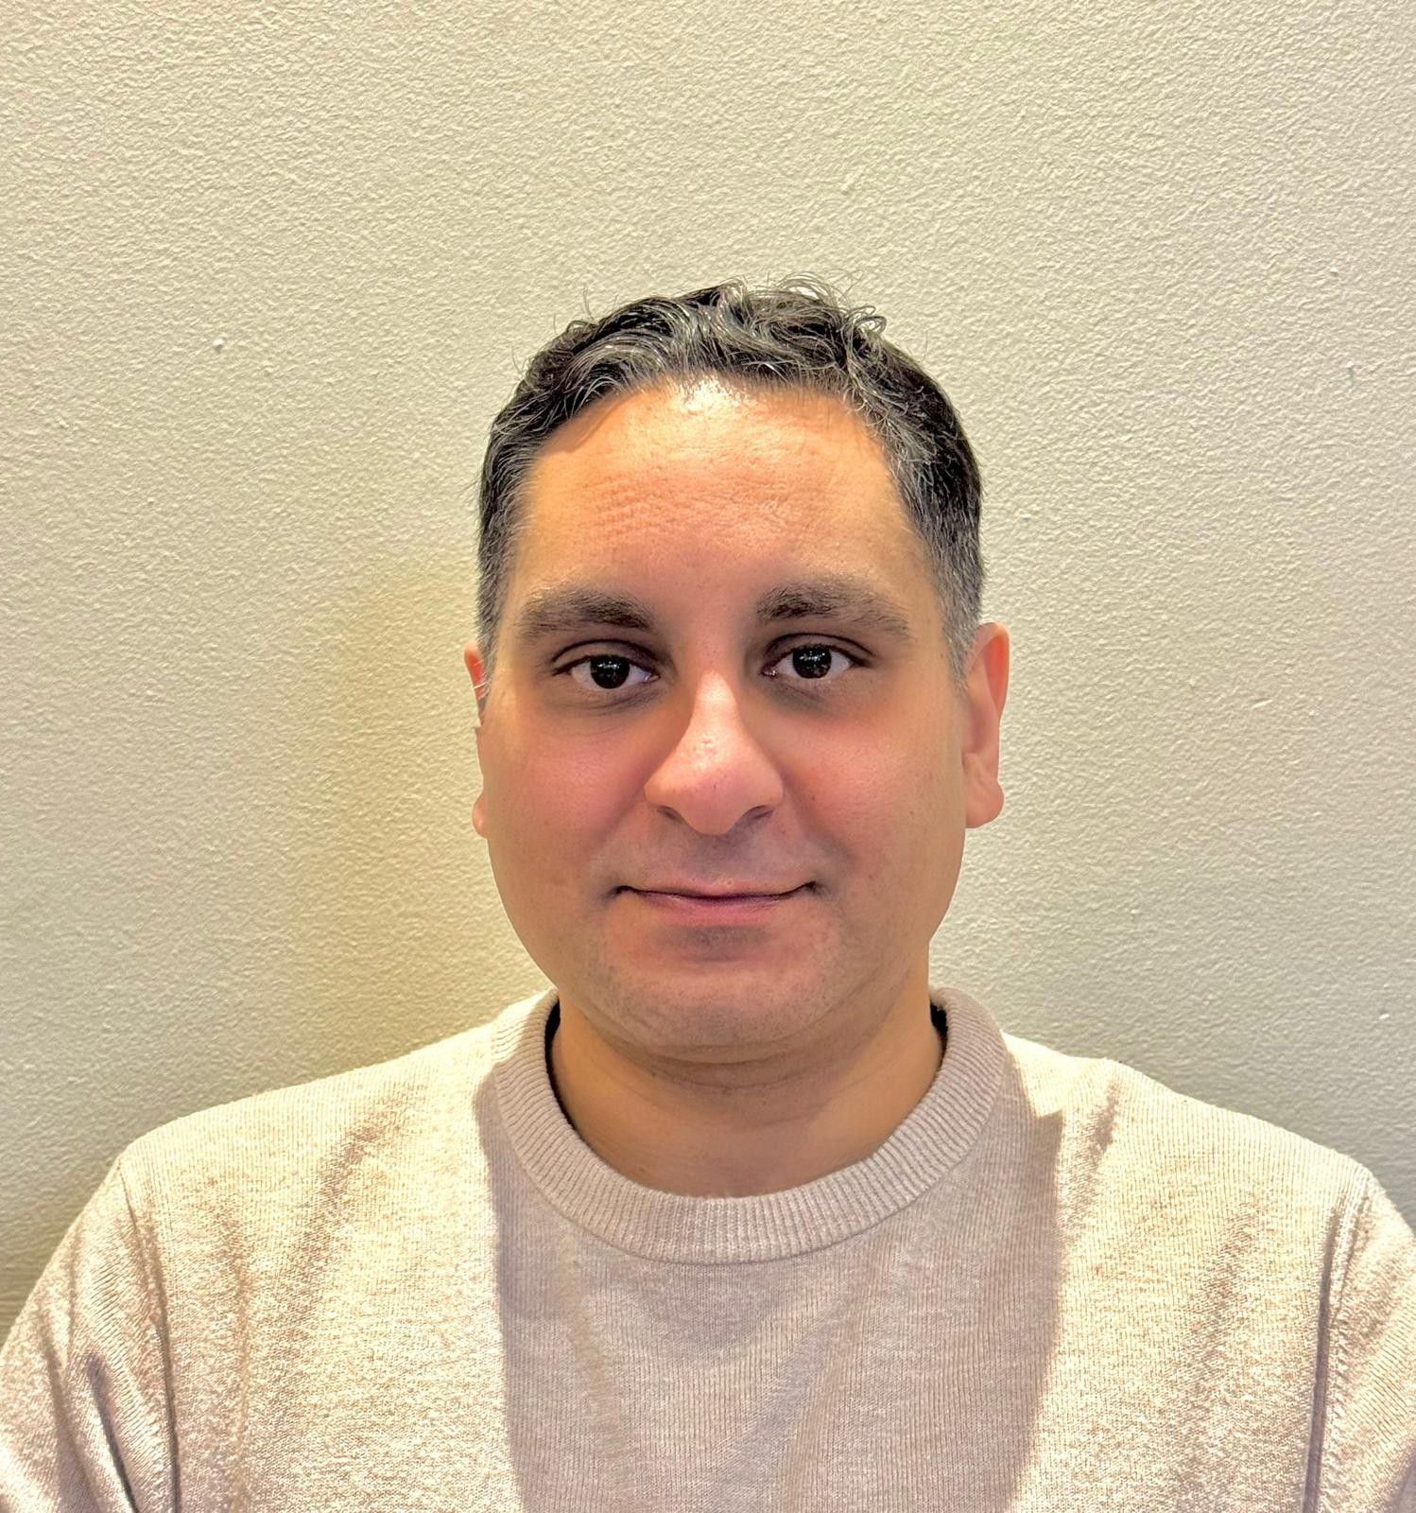

Interested in joining another of our events? Reach out today.
31 May – 2 June 2026
New York City, USA
ihifamericas.com
16–18 September 2026
Hong Kong, China
ihifasia.com
Andrew Walmsley
Sales Director
+44 (0)20 4506 5966
awalmsley@questex.com
Jack Hall
Business Development Manager
+44 (0)20 3941 7388
jhall@questex.com
Kitty Wong
Business Development Manager
+44 (0)20 4506 8101
kwong@questex.com
14–15 September 2026
Manchester, UK
theahc.co.uk
October/November 2026
Athens, Greece
randrforum.com
Stuart Dacre
Business Development Manager
+44 (0) 204 506 8133
sdacre@questex.com
Natalia Javkin
Business Development Manager
+44 (0)20 4506 6931
ext. 83465
njavkin@questex.com
Nabil Eldin
Business Development Manager
+44 (0)20 4505 2707
neldin@questex.com
The only editorial platform focused exclusively on
hospitality capital markets, with a global perspective.
hospitalityinvestor.com

