Slide 1
Chapter Resources:
Empower, Grow, Succeed
January 2025

Slide 2
Develop – Support – Promote
Extension of NIGP Mission
Local Face
Promote Program and Membership
Visual Consistency with NIGP (logo, etc.)
Expectations for Members
Educational opportunities – Plan ahead!
Networking and Social Events
Member Retention and Recruitment
Gather feedback to develop new programs or modify existing
Expectation for Leaders
Train and recruit new leaders
Leader calls -
Academy - Awards
Incentive Programs
Annual reporting
Notes:
Mission
Members
Leaders

Slide 3
NIGP Mission

Slide 4

Chapter Principles and Operating Framework - March 2021
(Chapter Affiliation Agreement)
Guiding Principles of Alliance - provides a perpetual set of guiding principles that capture the intent and spirit of the partnership within the NIGP framework. These principles serve to clarify roles and govern our behavior as we serve the organization over time.
Operating Framework – focuses directly on activities undertaken by NIGP and its network of Chapters. It defines areas of accountability, responsibility, and authority and promotes the appropriate collaboration necessary to meet shared goals.
Have your Board Review Annually!
Request a copy chapters@nigp.org

Slide 5


Chapter Web Hosting
Get Started with a site today!
Dedicated Support: For prompt assistance, NIGP provides chapter admins with a dedicated support team that specializes in addressing the unique needs of NIGP chapters.
Bi-Monthly Office Hours: Virtual help-sessions for all chapter admins, led by our ClubExpress support team. Bring your questions or simply observe and learn from the questions of others.
New in 2025: FREE customized training session designed to onboard new volunteers or upskill your existing team.

Slide 6


Special thanks to Sourcewell
Supporting your professional development when and where it's needed most.

Slide 7
Chapter Members

Slide 8
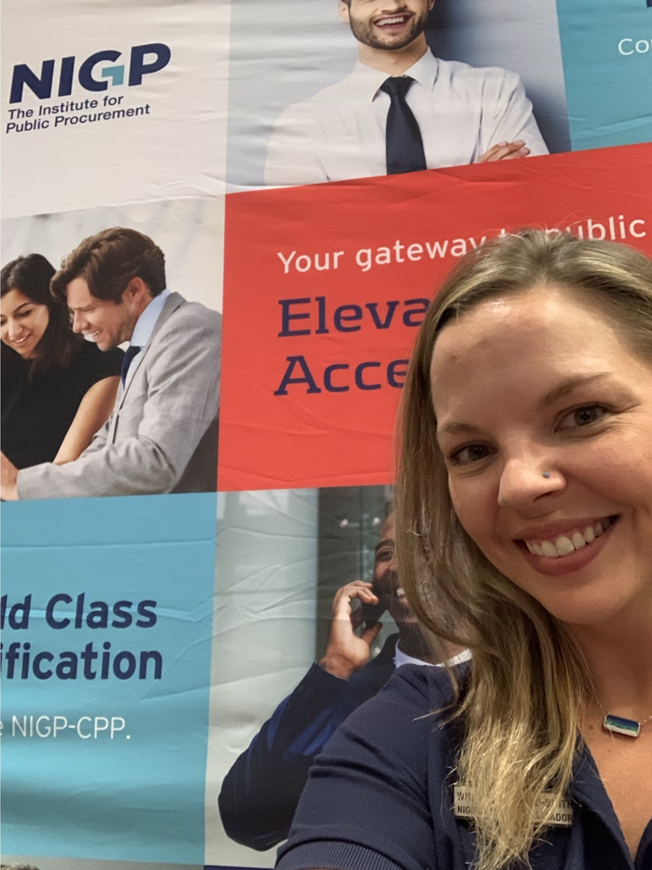
Chapter Visit Program
CHAPTER AMBASSADOR (9 Areas, 24 Ambassadors)
Every other year Face-to-Face
Every year if Virtually
Presentations/Opportunities:
Procurement Profession and Benefits of NIGP
NIGP Pathways
NIGP-CPP Certification
Swearing in Officers
Participate in Sessions or Roundtables
Meet with Chapter Board
Supply an NIGP Booth
Chapter Pop-Ins
Fill out Chapter Visit request Form or
contact your Ambassadors

Slide 9
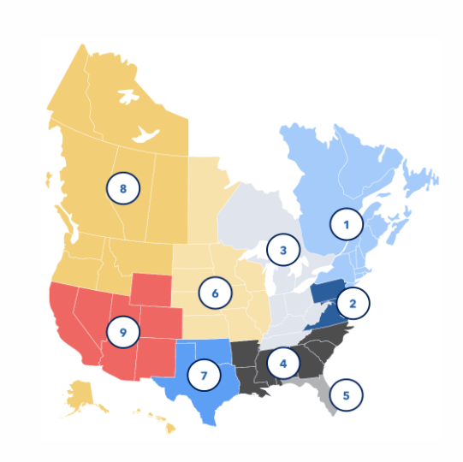
Your Chapter Ambassadors
Direct connection to NIGP to ensure their chapter’s
voice is heard giving you access to the latest resources,
training and updates.
An advocate for their chapter's success. Help to
navigate challenges to strengthen their chapter and
help advance their mission.
Resource to help you grow. Assist with member
engagement and building strong leadership that
will align with NIGP.

Slide 10
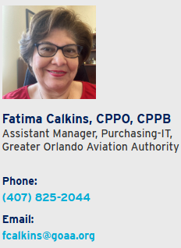
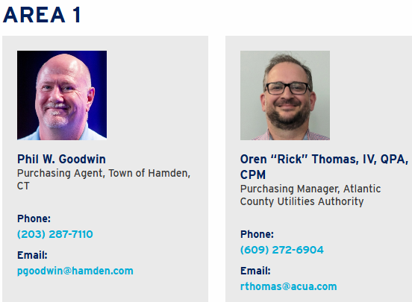
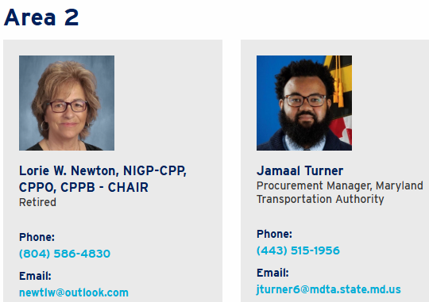
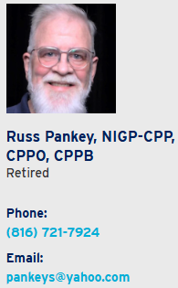
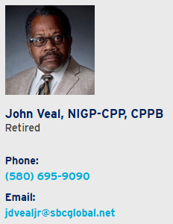
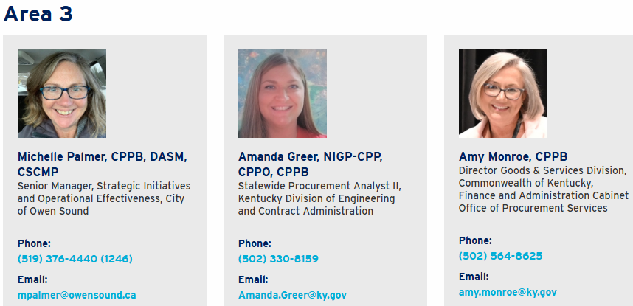
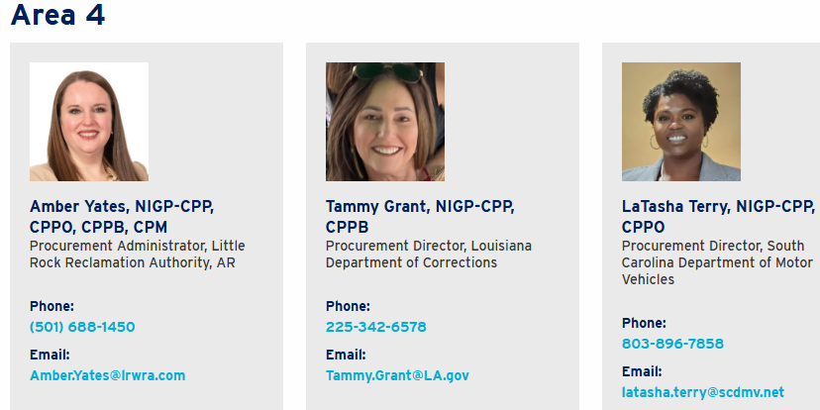
Contact Your Chapter Ambassador
At Large:

Slide 11
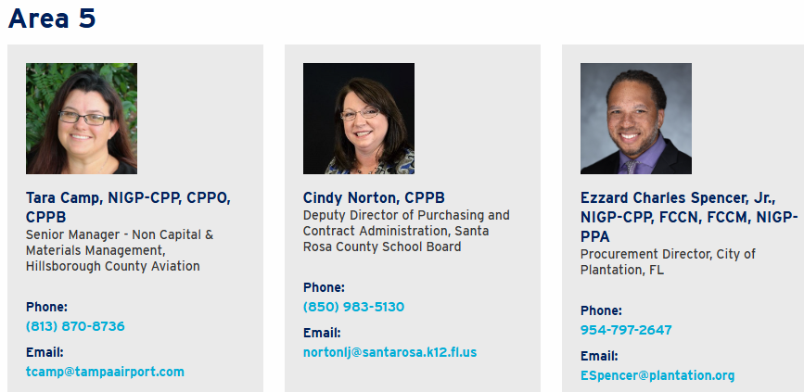
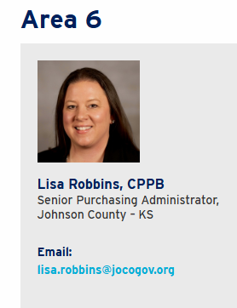
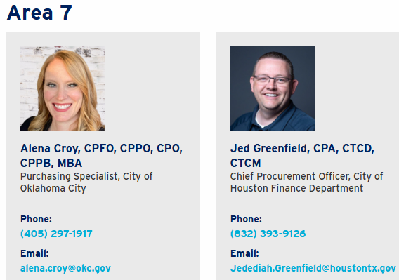
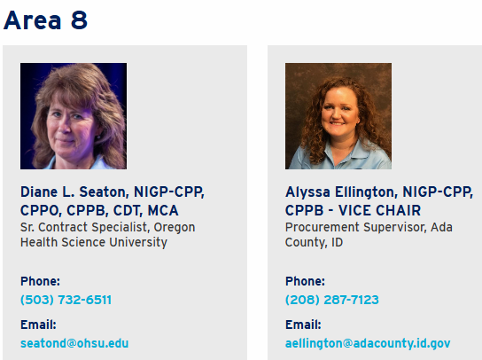
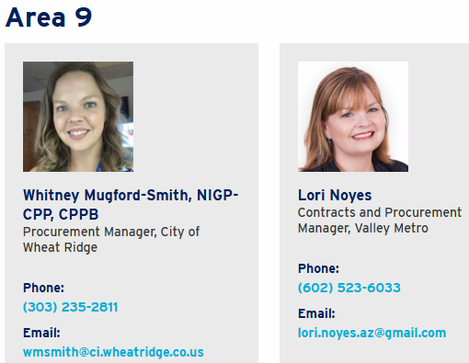
Contact Your Chapter Ambassador

Slide 12

Chapter Visit Program
NIGP STAFF
Presentations/Opportunities:
NIGP Business Council
CEO – Welcome video, State of the Profession, NIGP-CPP
NIGP Professional Development: Pathways
NIGP-CPP Certification
Swearing in of Officers
Fill out Chapter Visit Request Form
Notes:
Send picture of booth???

Slide 13
Host an NIGP Course
CHAPTER REBATE
For every course your Chapters hosts, you’ll earn 10% of gross revenue
Step 1
Signed Seminar Agreement
Step 2
Survey your members on education needs (NIGP can survey for you)
Review Seminar Check List and Chapter Timeline Documents
View NIGP Course catalog
Complete Course Request Form
Step 3
Market and Promote the Course!
Questions, email:
Karen Robinson at events@nigp.org or visit https://www.nigp.org/chapters/host-an-nigp-course

Slide 14

Notes:
Easy way for your chapter to earn money to fund your programs
Every time you register for a NIGP-hosted course, be sure to include the name of your chapter during registration
Your chapter will earn 5% of the gross revenue for each registration
Payments are issued quarterly to chapters for the revenue earned

Slide 15


Slide 16
Chapter Leaders

Slide 17




Chapter Recognition and Awards – Due in May https://www.nigp.org/chapters/awards-and-recognition
Webinar coming soon!
Chapter Performance Standard SEAL
A standard in which Chapters can strive to follow and advance opportunities offered to their members.
Meet a minimum score to earn a virtual SEAL
4 tiers
Outstanding Chapter Award
Recognize outstanding chapter practices in the categories of:
Operations
Membership
Advocacy & Outreach
Professional Development
Intent to share best
practices – not only just
the winning applications!

Slide 18

Leadership Summit: Chapter Academy
February 20-22, 2025 – Chicago, Illinois
FREE registration and housing (3 nights) for one chapter leader
Send a second person for $1050 (registration and housing)
Networking with nearly 100 of your fellow chapter leaders
What you will experience:
Collaborative Problem Solving
Innovative Idea Generation
Peer-Led Sessions
Team Activities and Networking

Slide 19
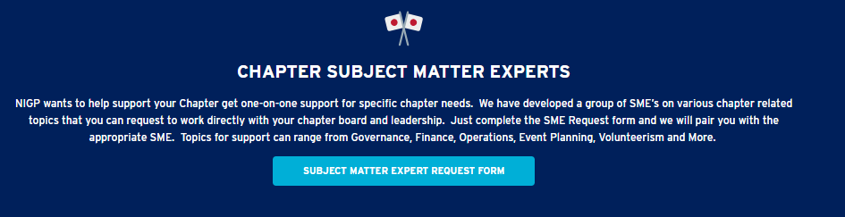
Chapter SME Program
https://app.smartsheet.com/b/form/4d7633a4dec94516aeed146fb54cb653

Slide 20
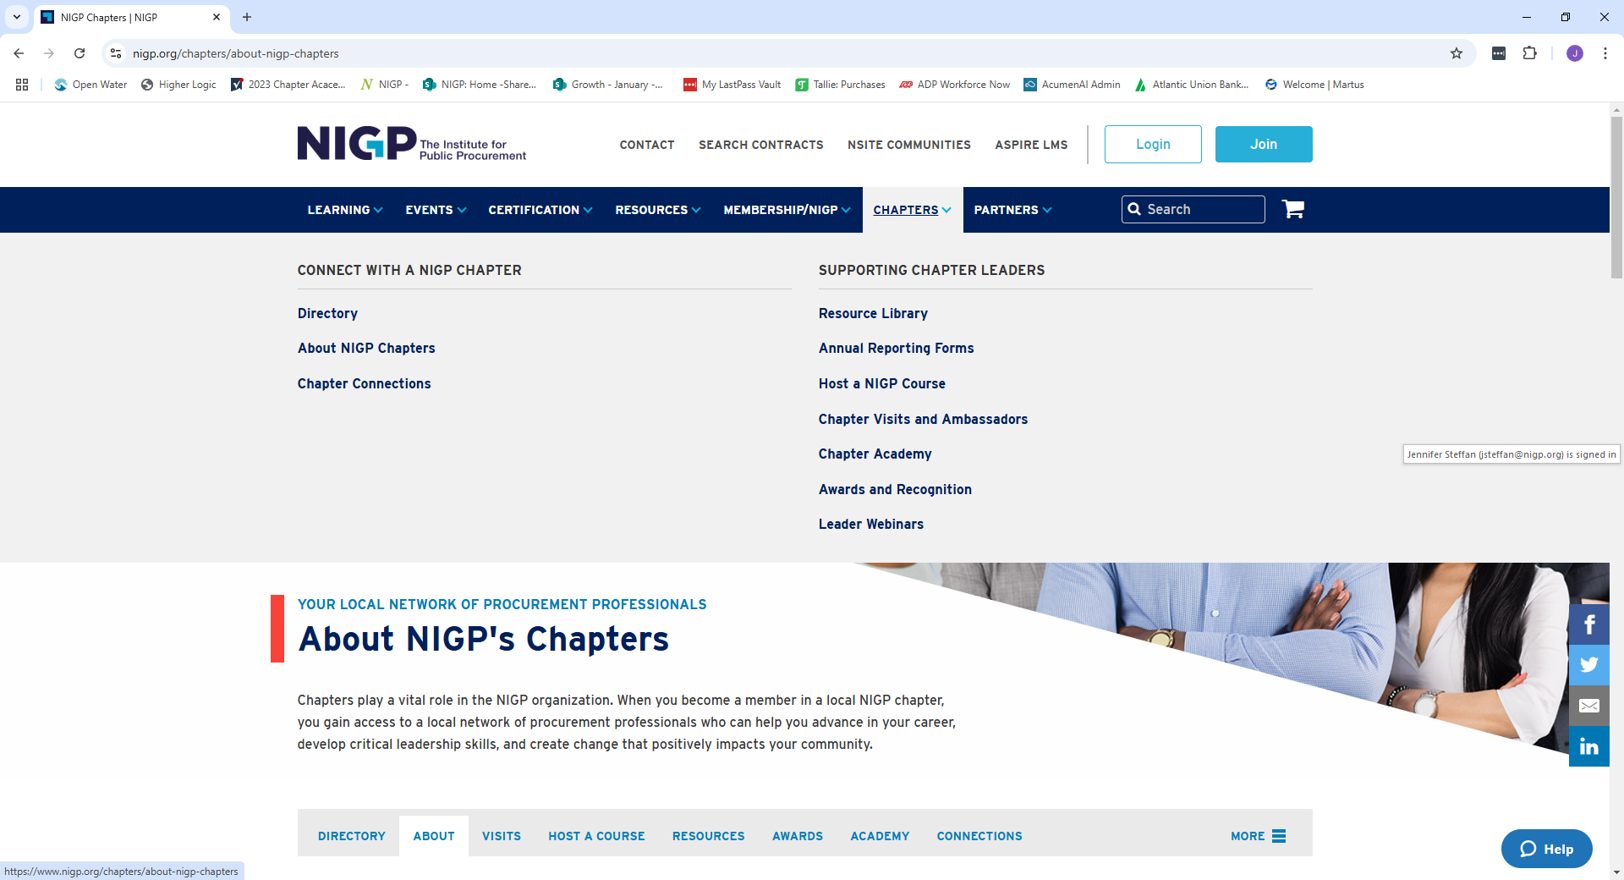



NIGP Website for Chapters
Listing of all Chapter sites and leaders
Here you will find: Newsletters, Upcoming Chapter Events, LITL, Huddles

Slide 21

Online Chapter Resource Library
Governance
Chapter Bylaws: NIGP to review prior
to membership
Position Descriptions
Board Transitions – Webinar
Successful Board Meetings
Strategic Planning – Webinar
Chapter Bylaws – NIGP Review
Chapter Policy Manuals
Installation of Officers Script

Slide 22
Online Chapter Resource Library
Financial Management
Chapter Banking
Chapter Budgets
Debt card Procedures
Record Retention Schedule
Internal Financial Controls
Treasurer’s PD’s and Procedures
Legal, Taxes and Insurance
Legal Duties of Boards
Chapter Insurance
General Liability – FREE
Legal/Tax Webinar
990 Links
*Legal consultation when needed

Slide 23

Online Chapter Resource Library
Membership
Membership Brochures
New Member Packets
Recruitment and Retention
Scholarship Programs
Mentoring Programs
Recognizing Members
Member Engagement
*Ask for a listing of
NIGP Members*

Slide 24

Online Chapter Resource Library
Marketing
Social Media
Legislation
Procurement Month
Chapter Marketing Tool Kit
  Chapter use of NIGP Logo’s
  Current Promotions
  Pathways
  NIGP-CPP Certification
Events and Conferences
Sponsorships – VIDEO
Reverse Trade Shows Planning
Hosting A Virtual Event
Golf Tournaments
NIGP Code of Conduct
Certificate of Attendance

Slide 25

Other Resources
Chapter Connections
  Chapter Newsletters
  Upcoming Chapter Events
  Leaders-in-the-Loop
NSite Chapter Leader Community
Chapter Webinars
Chapter Leader Calls

Slide 26

Required Reporting Forms
Leadership Reporting Form – Due January 31
Member Data Form - Due January 31
Financial Form – Due March 1
Group Exemption Update Form – Due March 1
IRS 990 – Due May 15th or November 15th
Chapter Seminar Agreement - Due June 30
https://www.nigp.org/chapters/annual-reporting-forms

Slide 27
Required Reporting Forms
Leadership Reporting Form
NIGP policy requires that the President, Vice President and either the Secretary or Treasurer hold an NIGP individual or agency membership
All leaders indicated on the form will receive monthly Leaders-in-the-Loop emails and be invited on Chapter Leader Calls/Huddles/Academy Webinars
WHAT IS A LEADER: Officer, Board Member, Committee Chair
Member Data Form
Indicates total Chapter members for previous year (broken down by: dual membership with NIGP, Chapter only members and retired members)
NIGP will send assessment based on the Chapter only members
Provide NIGP Chapter Roster (NIGP to provide list of NIGP Members in your area)

Slide 28

Chapter Reporting Forms
Chapter Financial
For internal use only
Providing snapshot of yearly finances
Upload year-end balance sheet - no longer a form to fill out
Group Exemption Update Form
To stay current on NIGP’s Federal Group Exemption (need to be current to be able to file your required IRS tax forms)
Canadian Chapters do not need to complete this form
Per NIGP policy each Chapter must belong to the Group Exemption or have individual tax exemption

Slide 29

Chapter Reporting Forms
Seminar Agreement
A signed copy must be on file prior to hosting an NIGP course
An addendum will be issued each year
Agreements run July 1 – June 30

Slide 30

IRS and State Requirements
IRS-990
All Chapters must file an IRS 990 (990, 990N, or 990EZ)
Once submitted to IRS, a copy must be sent to NIGP
Not filing will loose tax exempt status
STATE Filings – must complete on your own
Incorporation – make a priority with chapter, NIGP covers initial fees to file
State Tax Exemption – can request documentation to verify status with NIGP

Slide 31

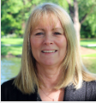


NIGP Support Staff
Chapter Relations Manager – Jennifer Steffan
jsteffan@nigp.org
Chapters@nigp.org
703-429-2606
Program Support Specialist - Merveille Basue
mbasue@nigp.org
Chapters@nigp.org
Hosting NIGP Courses – Karen Robinson
krobinson@nigp.org
events@nigp.org
703-429-2609
Web Hosting - Ronnie Levine
rlevine@nigp.org
703-429-2587

Slide 32


QUESTIONS?
Email: chapters@nigp.org

