Slide 1
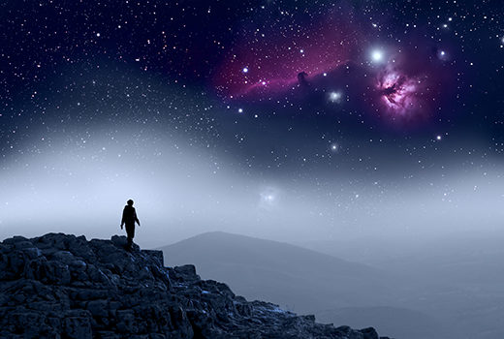
Marks, Seals & Cults 7
The Sovereignty Principle
Ephesians 1:11
In whom also we have obtained an inheritance, being predestinated according to the purpose of him who worketh all things after the counsel of his own will:

Slide 2

Birthdays, Anniversaries & Events
Aug. 23rd Ron Knoblauch
Aug. 26th David Whitlock
Aug. 17th Emma Harwell, Ashly Koplau
Aug. 29th Lorien Cockman
Aug. 30th Jeremiah & Kaitlyn Sheffield
Sept. 1st Caroline McIntosh
Sept. 2nd Abigail McCafferty
Sept. 5th Karen Mourglea
Sept. 28th No Service at HBT
Oct. 25th Fall Festival
Oct. December 13th The Final Dinner

Slide 3
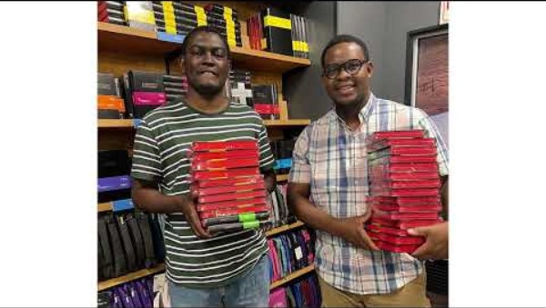

Slide 4
Marks, Seals & Cults 7
The Sovereignty Principle
Ephesians 1:11
In whom also we have obtained an inheritance, being predestinated according to the purpose of him who worketh all things after the counsel of his own will:

Slide 5
THEN.JESUS.CAME.AND.CALLED
31 The Bible is in continuity. Every Word blends together. There's no contradiction in It. It all runs together.
If you get a contradiction, you got out of the Bible, because the Bible doesn't contradict. It's in continuity, completely.
64-0417

Slide 6
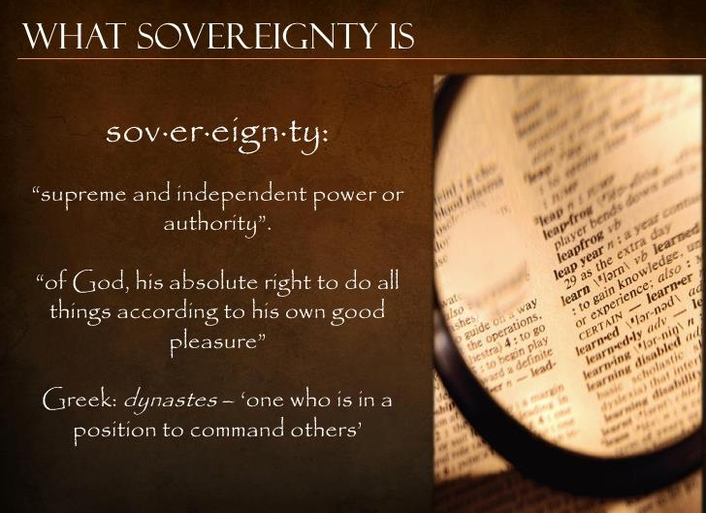
Sovereignty of God is the Christian teaching that God is the supreme authority and all things are under His control. God's Sovereignty is His "absolute right to do all things according to his own good pleasure."

Slide 7
ACTS 2:22-24
Men of Israel, listen to these words: Jesus of Nazareth, a man confirmed by God through miracles, wonders, and signs performed among you—as you yourselves know—was delivered according to God’s deliberate plan and foreknowledge. You took him and, with wicked hands, crucified and killed him. But God raised him from the dead, releasing him from the agony of death, for it was impossible for death to hold him.
(John 1)

Slide 8
EARLY SPIRITUAL EXPERIENCES
2 Finally, when [Abraham] was in his eighties, God, in His boundless mercy, spoke to him and transformed him into a missionary. This exemplifies God's work—His infinite mercy, sovereignty, and will. It serves as a fitting introduction to my message, emphasizing that all of this unfolds through God's grace alone, without any action required on our part.
52-0713

Slide 9
ROMANS 1:1
Paul, a servant of Jesus Christ, called to be an apostle, separated unto the gospel of God, 2 (Which he had promised afore by his prophets in the holy scriptures,) 3 Concerning his Son Jesus Christ our Lord, which was made of the seed of David according to the flesh; 4 And declared to be the Son of God with power, according to the spirit of holiness, by the resurrection from the dead: 5 By whom we have received grace and apostleship, for obedience to the faith among all nations, for his name: 6 Among whom are ye also the called of Jesus Christ:

Slide 10
IDENTIFIED.MASTERPIECE.OF.GOD
58 Man that was made in the image of his Creator, and was given a wall to stand behind, that Word could never fail. You must never get from behind That. He has a purpose in your life, that no one else on the face of the earth can take your place.
God has got something for you. You was did that way for a purpose. God is sovereign in His work. We different, one from another. 64-1205

Slide 11
COLOSSIANS 1:16-17
For by him were all things created, that are in heaven, and that are in earth, visible and invisible, whether they be thrones, or dominions, or principalities, or powers: all things were created by him, and for him: 17 And he is before all things, and by him all things consist.

Slide 12
THOU.KNOWEST.ALL.THINGS
11 Philip left Samaria to go out into the desert in the midst of a big meeting, left thousands and the city was rejoicing. God said, "Go out and stand in the desert." The Holy Spirit caught him away, and the eunuch didn't see him no more. The eunuch taken that message down into Africa.
See, God knows what to do. Many times we guess at it, but God knows just exactly what's right… how I love Him, His sovereignty, His goodness, His mercy. 52-0716

Slide 13
INDIA.TRIP.REPORT
15 Reason I stuck with the Baptist church was the sovereignty of the local church, what I think is apostolic. I don't even attend the fellowships, but in the Baptist church is not a denomination. It is now, but it was not supposed to be a denomination.
It's a brotherhood. And it's the sovereignty of the local church.… According to the Bible, the highest office in the local church is the elder.
57-0126

Slide 14
CHURCH.AGE.BOOK
258-1 …That is why I said the Bible called it [Sardis] Reformation--not restoration. It had started out in the doctrine of justification which meant salvation was all of God. Oh, how Luther preached the sovereignty of God and election. He knew it was all of grace. He separated the church from rule by ecclesiastical hierarchy.

Slide 15
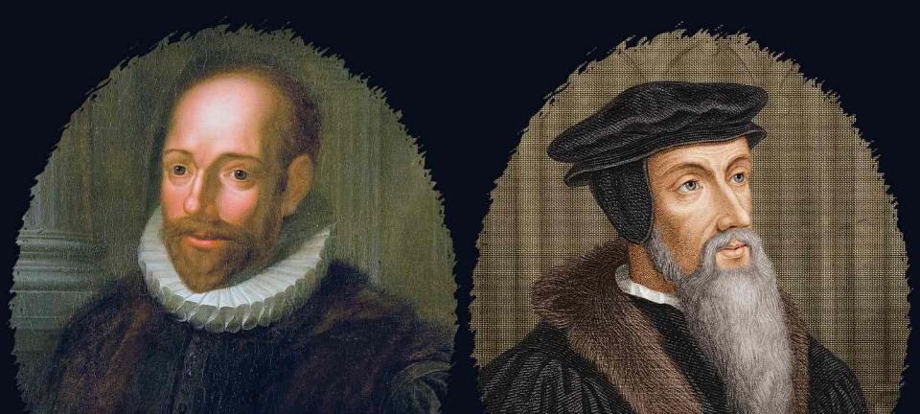
Arminianism emphasizes human free will to accept God's offer of salvation, as a choice made by a person responding to God's universal offer;
Calvinism asserts that God's sovereign election determines who receives salvation, it teaches salvation as God's decisive act, chosen from eternity.

Slide 16
Why Pray?
“Prayer is not overcoming God's reluctance.
It is laying hold of His willingness.”
Martin Luther

Slide 17
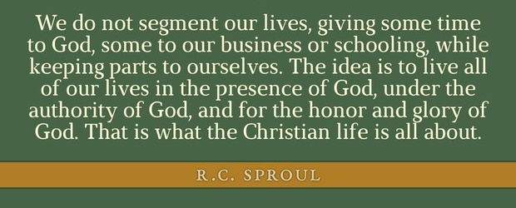

Slide 18
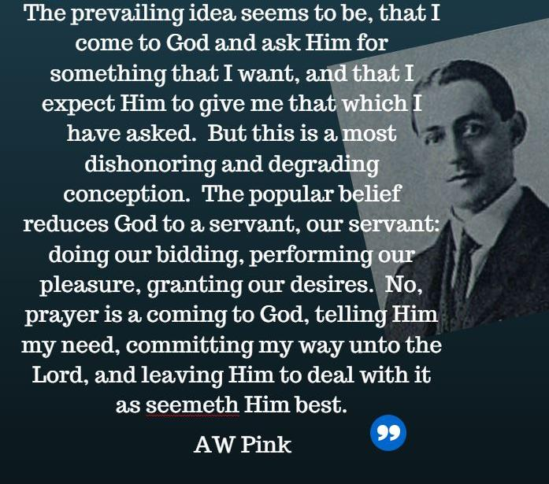

Slide 19
II TIMOTHY 2:15
Study to shew thyself approved unto God, a workman that needeth not to be ashamed, rightly dividing the word of truth. 16 But shun profane and vain babblings: for they will increase unto more ungodliness.

Slide 20

Example:
EXODUS 22:18
Thou shalt not suffer a witch to live.
DEUTERONOMY 18:10
There shall not be found among you any one that maketh his son or his daughter to pass through the fire, or that useth divination, or an observer of times, or an enchanter, or a witch…

Slide 21
THE.PLACING.OF.DEACONS
1 Our little church here is sovereign. It doesn't have any denomination, it elects its own deacons. It elects its pastor; its trustees; everything that comes in and out of the church. No one person has the say-so over anything; it's the church.
And the church are those who come and support the church with their presence, with their tithe and offerings, are always the ones that has legal say-so in the placing of such. 58-0720

Slide 22
II TIMOTHY 4:5
But watch thou in all things, endure afflictions, do the work of an evangelist, make full proof of thy ministry. 6 For I am now ready to be offered, and the time of my departure is at hand. 7 I have fought a good fight, I have finished my course, I have kept the faith:
14 Of these things put them in remembrance, charging them before the Lord that they strive not about words to no profit, but to the subverting of the hearers. 15 Study to shew thyself approved unto God, a workman that needeth not to be ashamed, rightly dividing the word of truth.

Slide 23
HEBREWS.CHAPTER.FIVE.AND.SIX.1
24 Let a man go where God leads him to go. I like that. I believe in the supreme authority of the local assembly.
Let each church choose its pastors, deacons, whatever. That way, the man in there has no bishop over him. The Holy Spirit wants to speak something to that church, they don't have to ask anybody about whether they could do this or do that. It's the individual in contact with the Holy Spirit. the sovereignty of the local church. Now, brotherhood, that's wonderful. All churches ought to be in a brotherhood like that, together. But the sovereignty of local church! 57-0908

Slide 24
A.TRUE.SIGN.THAT'S.OVERLOOKED
37 We find out here, Ezekiel… How he tortured himself. One place he laid on his left side for 390 days. God told him to get some beans and pottage, put it all together, cook it up, lay it down by his side…. Then, "Turn over on the right side and lay there forty days again." Ezekiel said, "Because you're bearing the iniquity of the people. Each day will I count a year for them."

Slide 25
40 But the torture that that man had to go through, why would that be necessary? Many has wondered why would such a thing be necessary for a man to do. It's because that people won't read the Word and they won't pray. So God is sovereign, and He sends His prophet to be a sign. The people won't read; they don't care to read. They won't pray, because they got other things to do. They can't take time to pray. And the Bible is boresome to them, hasn't got enough action for these modern days or any day. 61-1112

Slide 26
1. Anger: (Heb.) kah’-as
Vexation, grief, frustrate, a desire to harm.
I SAMUEL 1:6-7
And her adversary also provoked her sore, for to make her fret, because the LORD had shut up her womb. 7 And as he did so year by year, when she went up to the house of the LORD, so she provoked her; therefore she wept, and did not eat.

Slide 27
2. Anger: (Heb.) aneph
Sorrow, grief, heartbreak, loss of relationship.
NUMBERS 25:3-4
And Israel joined himself unto Baalpeor: and the anger of the LORD was kindled against Israel. 4 And the LORD said unto Moses…

Slide 28
“Brothers and sisters, you better wake up if you’re following a pastor that is just preaching and quoting the Word, which is wonderful and IS EXACTLY what he should be doing, but is not telling you, and most importantly, DOING, by playing the VOICE OF GOD ON THE TAPES IN YOUR CHURCH.”

Slide 29
JESUS.CHRIST.THE.SAME.
11 (I Cor. 12) There’s 5 ministering gifts which are the foreknowledge of God. First of those are apostles, prophets, teachers, evangelists, and pastors. Those are God sent gifts to the church… Then the pastor who should be the head of the church with the wisdom of God to have that church set in order so no fanaticism, no nothing takes place wrong, just everything proven purely the Spirit of the Holy Ghost working among the people, then you got a real church that's an example church to all the regions around about. It's like a hive where the bees come, a lovely church. 58-0223

Slide 30
BE.NOT.AFRAID.IT.IS.I
12 He sends gifts in the church. I Cor. 12 says there is nine spiritual gifts in every body, and there's also five spiritual offices in the church; First, there's apostles or missionaries. (means "one sent.“) Apostles, prophets, teachers, pastors, evangelists, they are all God's ordained gifts to the church.
61-0414

Slide 31
