Slide 1

Electric Vehicles (EVs) as Distributed Energy Resources (DERs) - Grid Impacts
Clay Koplin, CEC
Virtual Alaska Electric Vehicle Workshop
Tuesday June 17th; 10:45AM (Alaska Time)
Sunrise over the Copper River Delta
June 13, 2020 Photo by Clay Koplin

Slide 2

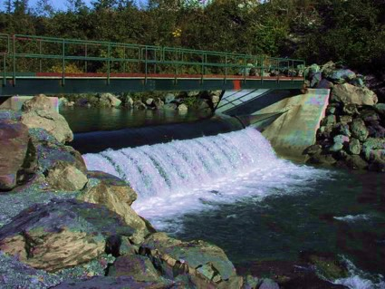
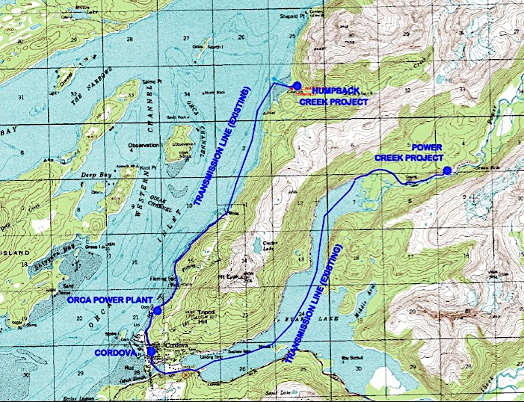
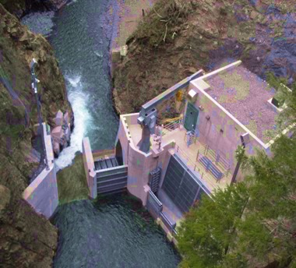
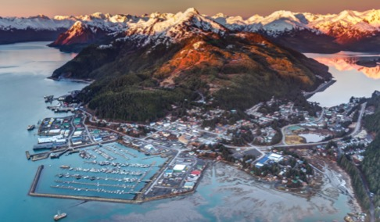
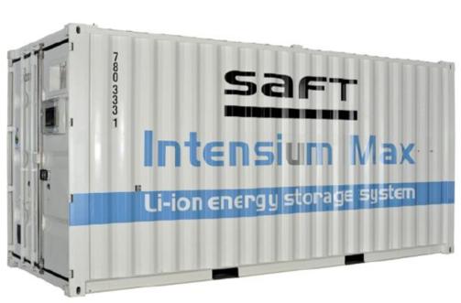
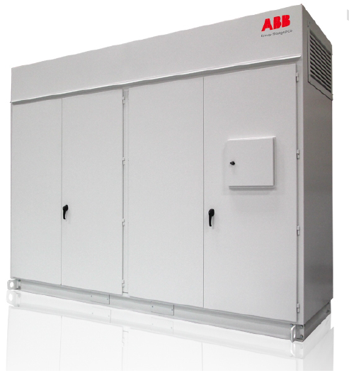
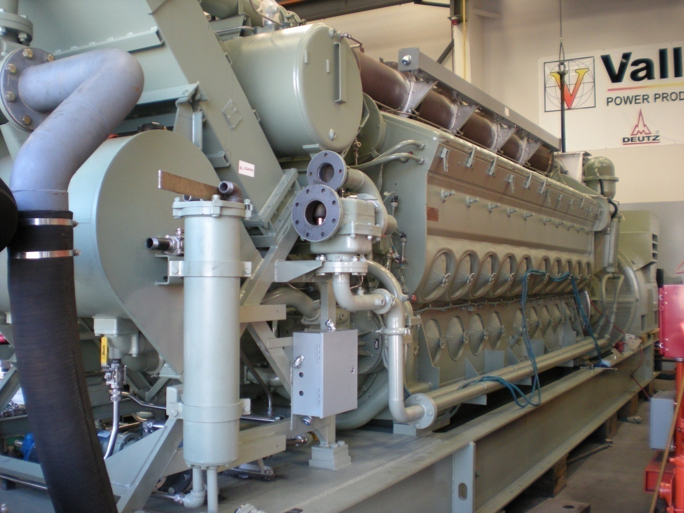
CEC GRID ARCHITECTURE
Humpback Creek Hydroelectric Plant
1250kW (2 x 500 kW + 1 x 250 kW)
17,000 foot UG and submarine transmission line
Power Creek Hydroelectric
6278kW (2 x 3124 kW)
25 kV transmission ties to Eyak Substation, Inflatable dam
City of Cordova
1,566 customers, 18MW
One Substation
78mi UG distribution lines
Orca Power Plant
10.8 MW Diesel
Control Center, CEC
Battery Energy Storage System
1 MW, 1MWh
ABB/SAFT at
Eyak Substation
Notes:
The Current CEC Grid and Operations:
2 run-of-river hydroelectric plants; 1 diesel plant, one BESS (battery storage system)
100% underground distribution system
Spill 3-4 gWh of hydro per year at unpredictable times
Supplement with 5-6 gWh of diesel per year
Bad fishing results in less demand thus a better hydro percentage but lower sales
Storage in multiple forms- snow/ice, big snow year = more storage in the mountains
Rain Rain Rain is fuel - but too much causes problemswith flooding, gravel, debris
Opportunity for community solar (BESS helps)
Opportunity for stored hydro and water for winter seafood processing (Raging Creek)

Slide 3

CEC Energy Conundrum – No Storage
CEC Controls System Frequency by Deflecting up to 750kW of water, a waste of energy (orange), and there is excess in summer (green), and not enough in winter (black/diesel)
Notes:
More on modelling: A graphic illustration of the 2012 base year used for model in phase 1.
CEC doesn’t have the technical resources to model and right-size energy storage ourselves; we knew we needed storage but not which kind and how to size and install it. ACEP submitted a proposal to DOE for help and DOE funded a study with ACEP and Sandia to model our system to evaluate different storage technologies, Flywheels, ultra caps, pumped hydro, and BESS. BESS rose to the top as a technology that could provide the frequency support of Flywheels and Ultra Caps, while also providing enough energy storage to deliver the spinning reserve necessary to balance the system along with some measure of diesel-hydro arbitrage.

Slide 4
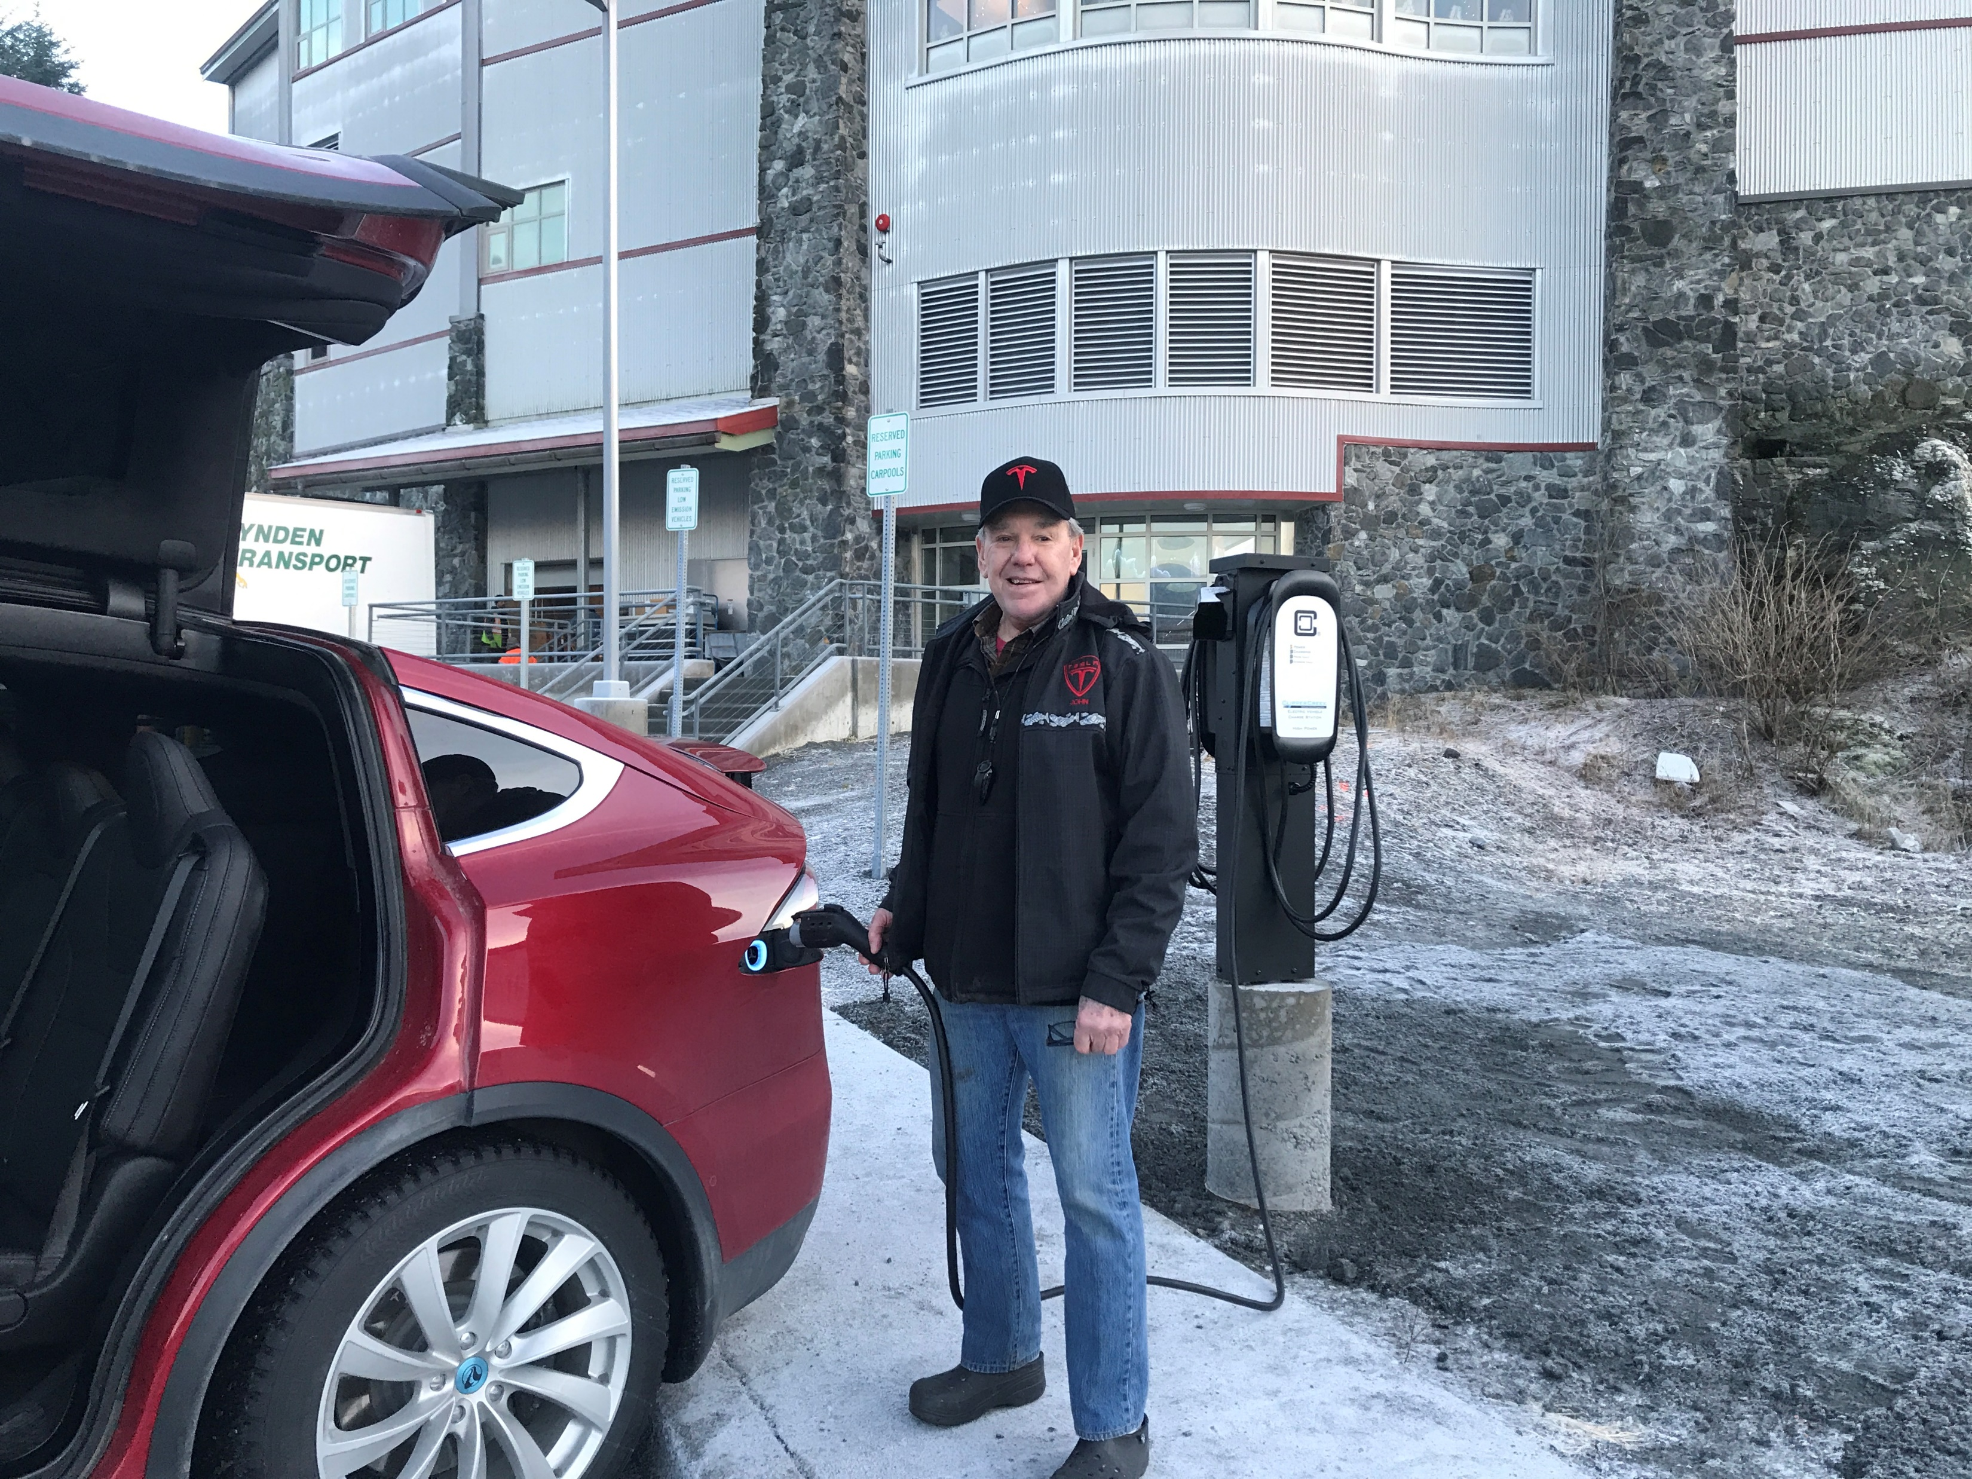
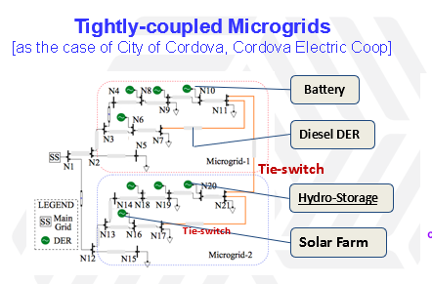
Grid Balancing with Battery Energy Storage Systems
Notes:
A few of our initiatives include battery energy storage which we will use to provide a high value use case of spinning reserve and frequency stability that unlocks 500 kilowatts of hydro capacity that are currently wasted to provide these services. We have installed more free electric vehicle charging stations than we have electric vehicles (so far), but are working with the US Department of Energy via the RADIANCE project to automate the delivery of excess hydroelectricity to electric vehicle charging stations when it is available - for a fraction of the cost of gasoline. The RADIANCE project is also developing new grid architectures on our microgrid where we can work with our customer-owners to test and prove a variety of configurations that can be applied to other microgrids and the US national grid, while carefully measuring the cost and value of the improvements. The architectures will help improve grid resilience to better withstand environmental, physical, and cyber threats.

Slide 5
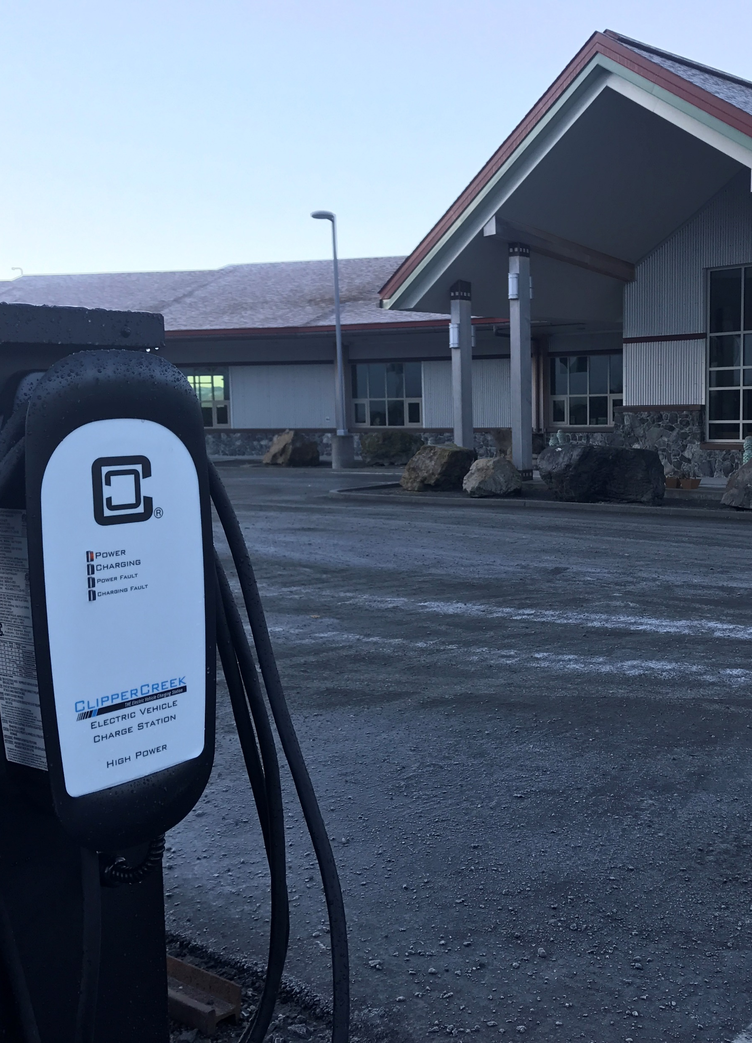
CEC EV Use Case
Grid BESS vs. EVs
CEC BESS COST: $2,000,000
1MW, 1 MWh Storage
Equivalent 52 ‘20 Nissan Leaf Cost
52 Nissan Leafs = 3.2 MWh Storage
Can Balance CEC Grid with 16 Leafs
Can Balance localized microgrids
Substantial Customer Benefits:
  Free Car
  Free Electricity
  Energy Security
  Reduces other’s electric bills
  Portability (take your microgrid anywhere)

Slide 6
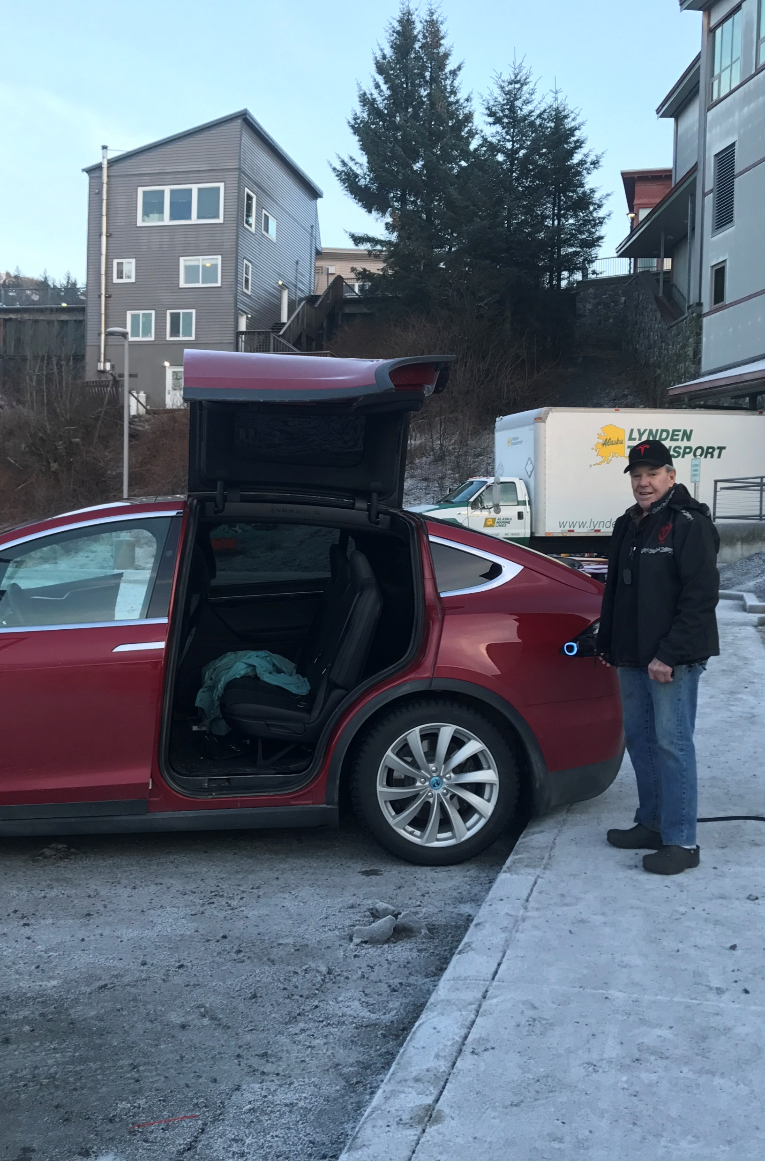
Summary
Technology Needs to Evolve along several paths – communications, controls, interconnectivity, commercial
Grid Impacts can be positive – particularly on a microgrid
Customer benefits can be huge
Can be a foundational element of a grid architecture of the future – a loosely coupled national grid

Slide 7
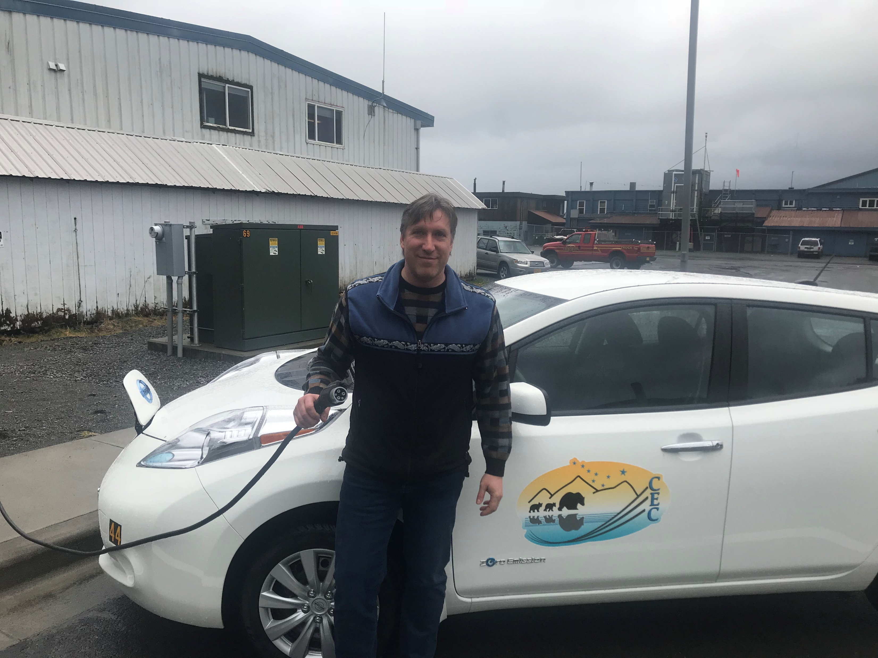
Questions?
Clay Koplin – CEC
ckoplin@cordovaelectric.com

