Slide 1
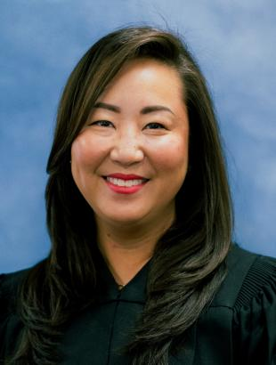
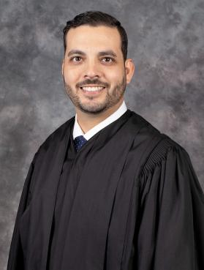
“From a Judge’s Perspective:
Practice Tips & Pointers”
Code For: Setting Your Attorney Up to Win & Take All the Credit for Your Work
The Honorable Denise K. Beamer – 9th Judicial Circuit
The Honorable Brian S. Sandor – 9th Judicial Circuit

Slide 2
Learning Objectives
Learn
You will learn the best practices to assist attorneys in trial preparation. Give your side the advantage and avoid last minute stress and work.
Learn
You will learn tips and strategies in jury selection.
Learn
Learn tips and practices to assist your attorney in witness preparation and introduction of exhibits/evidence
Notes:
What kind of relationship do you have with your attorney(s)?
Comfortable telling them the truth?
Do they listen?

Slide 3
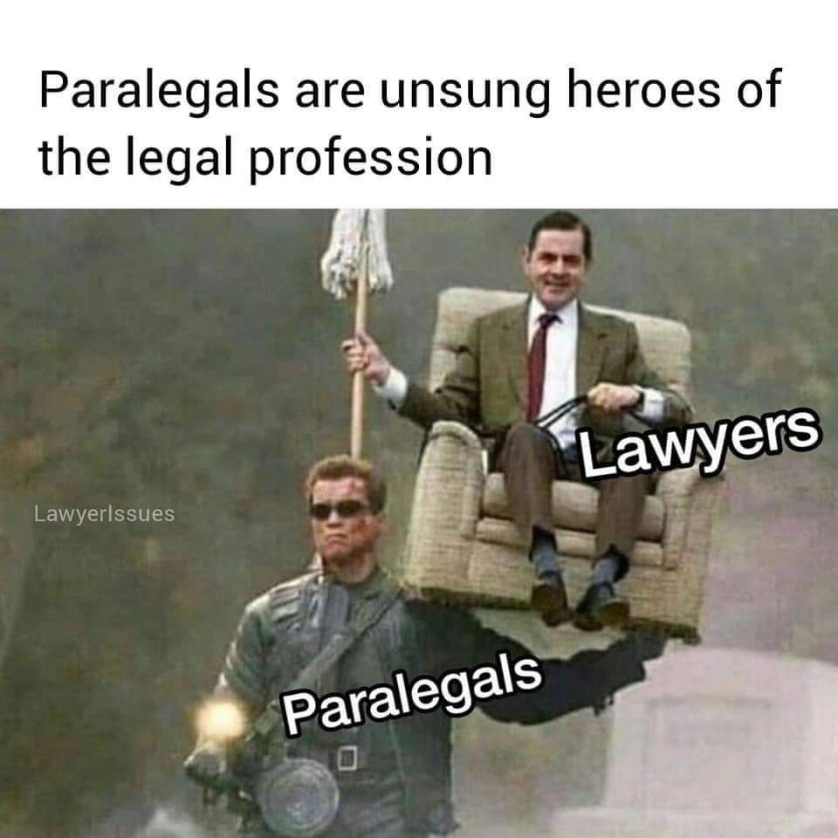
Thank you!
Notes:
Beamer’s pet peeve: blaming paralegal, clerk, staff, etc.

Slide 4
Trial Preparation
First and most important!
  Learn the Division’s Policies and Procedures
    Not everyone has them or makes them easy to find so ask!
    Have attorneys ask questions at Pre-Trial
  Just because Beamer does it one way doesn’t mean Sandor does it the same
    Same jurisdiction can’t agree, different jurisdictions can be confusing
  On April 21, 2025, Chief Justice Muniz implemented a statewide memorandum on judicial practices templates pushing every circuit to create AND post their policies and procedures

Slide 5
Trial Preparation
Must Do:
  Early entry of trial deadlines (Friday afternoon data entry?)
    Jurisdictions have been rolling out uniform trial order/case management orders upon the filing of cases as opposed to the old rule
  Promptly filing motions for extensions or modifications
    New 6th DCA Case: Crecelius v. Rizzitano – 6D 2024-2217 – is Binger dead?
  Getting all motions filed, set, and heard prior to cut offs or a ruling allowing later hearing
    Compliance with new meet and confer requirements too!
Notes:
Know the timeline of your case. You’re the foundation.

Slide 6
Trial Preparation
  Deposition designations done as early as possible – late rulings impact trial strategy
    Your witness has testified and gone, depo designation objection goes against you, now you have no witness to clarify or fix the testimony
  Pre-Trial Motion Practice to Narrow Issues and Shorten Trial
    Summary Judgment done as soon as you can
      Best used to attack minor issues in increments, doesn’t have to be all or nothing!
  Pre-Trial Statement / Jury Instructions / Verdict Forms
    Get your opposing counsel locked in. Try cases based on JOINT pre-trial statements

Slide 7
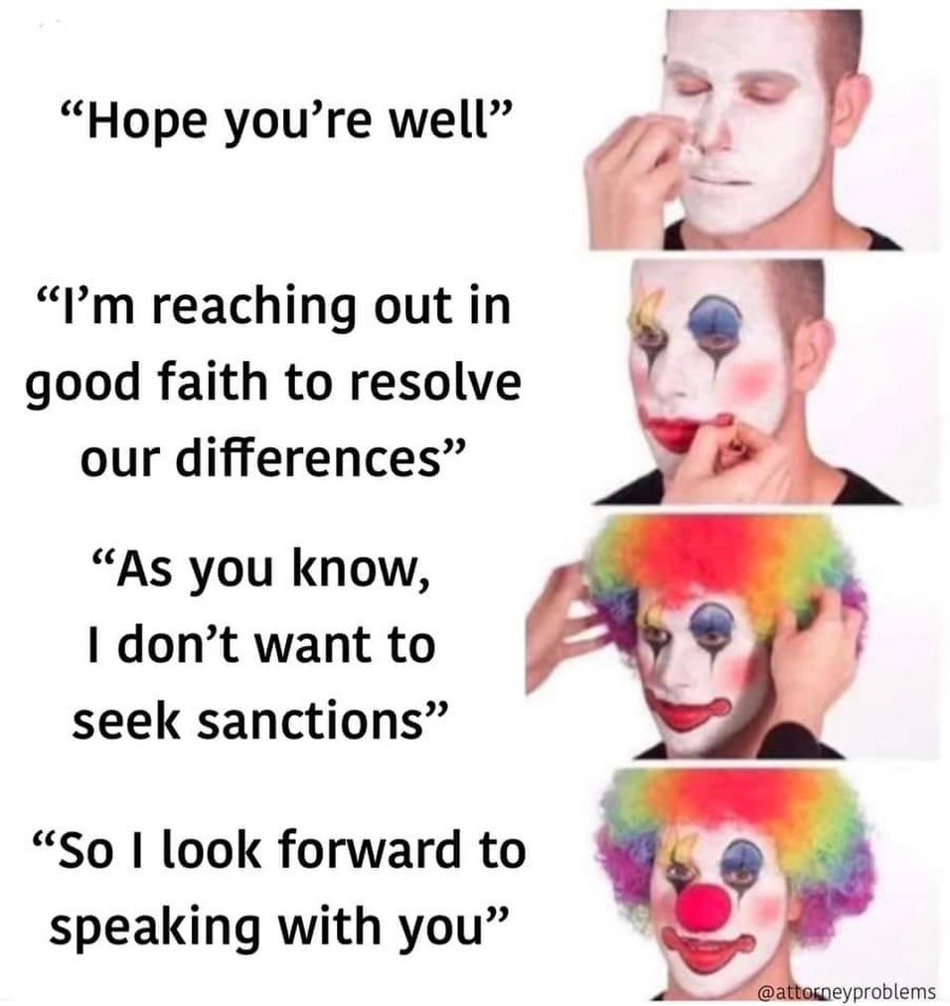
Meet and Confer Requirement
Notes:
QUIZ:
Attorney wants to file a motion to compel, drafts it up, and sends it to you to file. What should you do?
File it?
Schedule a meeting time w/paralegal from opposing side?
Schedule a time to discuss w/opposing counsel?
Ask about meet and confer?
Let’s say the attorney’s meet and confer, no agreement. Motion is drafted using the standard firm template. What’s required in the new rule?
“I certify that prior to filing this motion, I discussed the relief requested in this motion by [method of comm. And date] with the opposing party and [the opposing party (agrees or disagrees) on the resolution of all or part of the motion] OR [the opposing party did not respond (describing with particularity all of the efforts undertaken to accomplish dialogue with the opposing party prior to filing the motion)].”
Let’s say there was a meet and confer before filing the motion. Now, we need to set a hearing. The attorney says: SET IT FOR A HEARING ASAP!
Look at the court’s calendar for available times?
Reach out to the paralegal from the other side?
9th Cir Admin Order requires Meet and Confer – where does the certification go?
In the motion?
In the notice of hearing?
Meet and Confer Requirements:
Fla. R. C. Pro 1.202 CONFERRAL PRIOR TO FILING MOTIONS →
9th Cir Admin Order 2012-03
and 9th Circuit Admin order – meaningful meet and confer BEFORE filing the motions and BEFORE setting the motion for a hearing.
Must be on the phone or in person
TIPS:
If the issue is narrowed, send an email or notice of narrowing the issues before the hearing
For discovery: if the other side’s position is that something was provided, and the other side is disputing it – think about how the Court is supposed to resolve the issue?
What if the other side won’t respond to multiple requests to meet and confer? How do you bring it to the Court’s attention?

Slide 8

Jury Selection – Where Trials are Won and Lost
In 1995, Oprah Winfrey was sued by the beef industry in Texas following comments she made. In her civil litigation, her team hired Dr. Phil McGraw as a jury consultant to help pick the jury…
He’s now worth $460 MILLION

Slide 9
Jury Selection
Do you even attend?
  Orange County has a card allowing paralegals to use attorney entrance
What is your designated role?
How do you add value?
Notes:
POLL: the audience to survey how many have attended and participated in trial.

Slide 10
Jury Selection
Role
  Seating charts and juror questionnaires
    Put in a request with the clerk to make sure you have enough for everyone. All attorneys, clients, and YOU.
  Color coordinate your seating chart, make shorthand notes, use symbols etc…
  Attorney will focus on those who are speaking, you need to focus on the others around interacting.
    Who is obviously disagreeing but remaining silent?
    Silent jurors end up on panels and are wildcards
    4x6 index cards, write down numbers or names of jurors to follow up with, or questions/topics attorney forgot to address
Notes:
Get s seating chart similar to the ones provided to the judge and attorneys
Remind the attorneys to put the “non-verbal” communication on the record
Check the questionnaire for your attorney!
Get realtime court reporting!
Get quotes from the jurors OR TIMESTAMP!

Slide 11
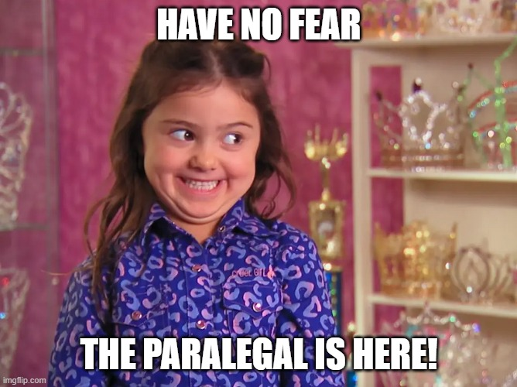
Helping with Jury Selection

Slide 12
Jury Selection
Juror Questionnaires
  Social Media… time to get creepy
    LinkedIn – prior jobs are not usually listed or come up in conversation
    Facebook/Instagram – any posts about prior related litigation?
      Negative posts about your subject matter? Did they post about how much they are dreading to go to jury duty?
      Violating court rules and instructions? Actively posting about trial?
    Reddit/Blogs
      There is a Brian Sandor in Pittsburgh Pennsylvania who is VERY active and LOUD about some subject matters all over the internet
        I can tell you he’s a diehard Penguins fan, works at Penn Machine Company LLC, passionate about life sciences, hates the inconvenience of bridge and road repairs but wants more of it, thinks taxation is theft by the government – took under 2 minutes.
Notes:
Review:
Social media pages
Prior litigation through the court system
Check throughout trial if the person ends up being selected for jury selection
Dumb it down for your jurors!!
Reminder for the Court:
- Have your attorney remind the Court to instruct the jury that there’s no comm between the lawyers and jurors.

Slide 13
Smooth Trial Execution
(Making friends with Trial Clerk)
Scheduling of witnesses
Knowing who is going to go when and on what day.
Do you need to take a witness out of order?
Are we going to stay late to finish an expert?
When jurors are in the know, they are in a better mood (Judges too!)
Exhibits
Properly pre-marking and tagging exhibits
Getting agreements to exhibits in advance to avoid long hearings on objections
Verifying what exhibits go back with the jury
Knowing juries don’t understand the difference between demonstrative aids and evidence
Virtual witnesses? Links and Audio/Video Checks
Notes:
Technology: https://ninthcircuit.org/programs-services/technology-support
Best AV support – send an email
Learn the technology
48 hours (at least) before the hearing/trial

Slide 14
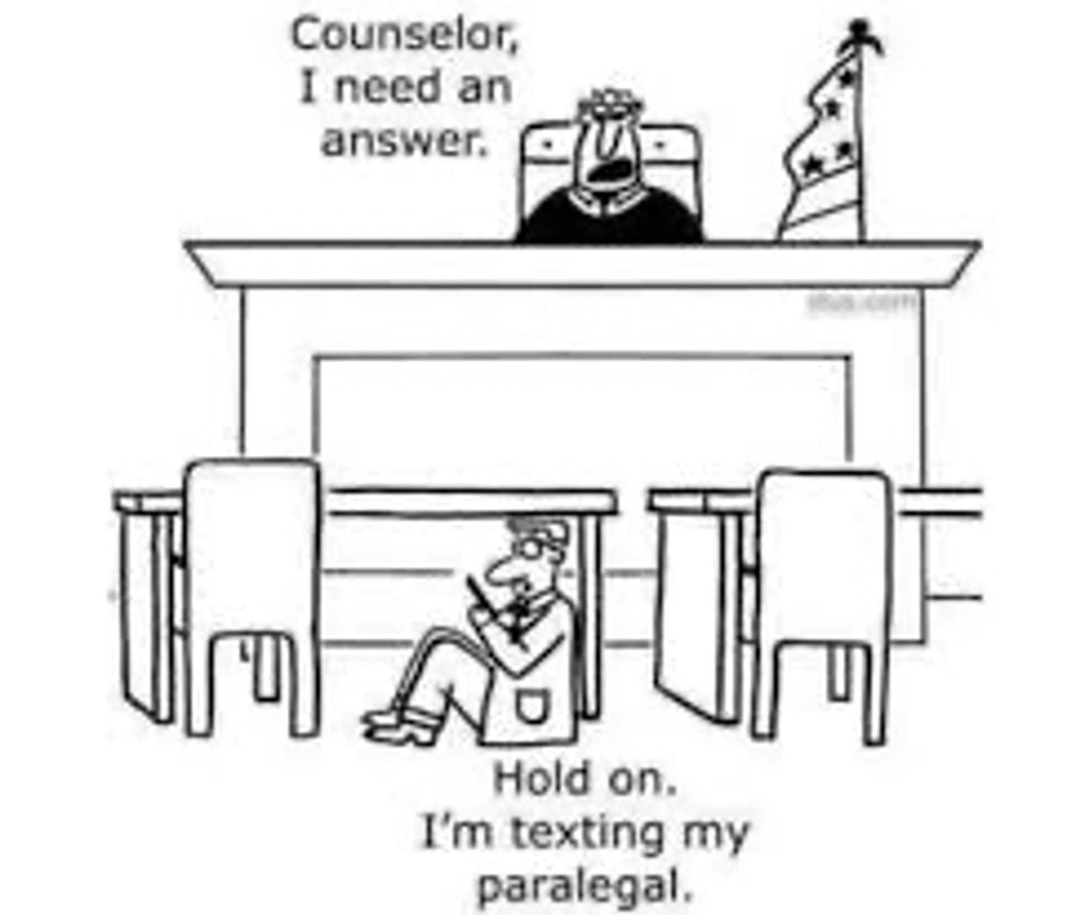
Exhibits
Get a stipulation prior to trial and resolve objections!
Meeting of the attorneys
Waiver of records custodian
Keep track of the exhibits in evidence and the Clerk has the original copies
Extra copies, please!
Notes:
This is sometimes how I feel during trial when addressing exhibits w/the attorneys … they look at the paralegals.

Slide 15
Trial Readiness Kit – aka Soccer Mom/Dugout Dad
What do you need from the office for trial?
Note pads, highlighters, pens, a portable printer?
Snacks and waters?
Backup copies of exhibits?
Notes:
Copies of jury instructions

Slide 16
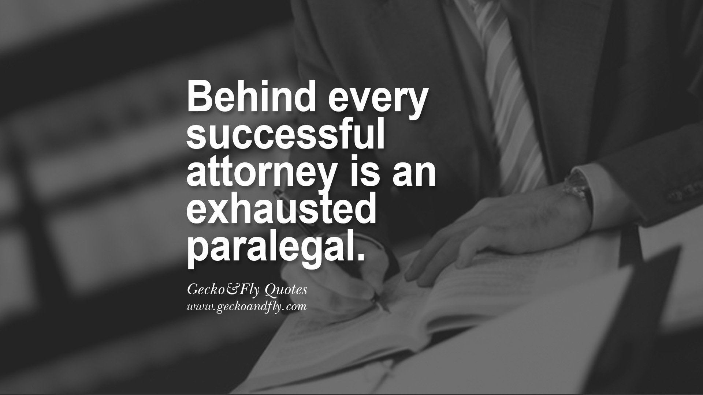
Thank you to the paralegals!

