Slide 1
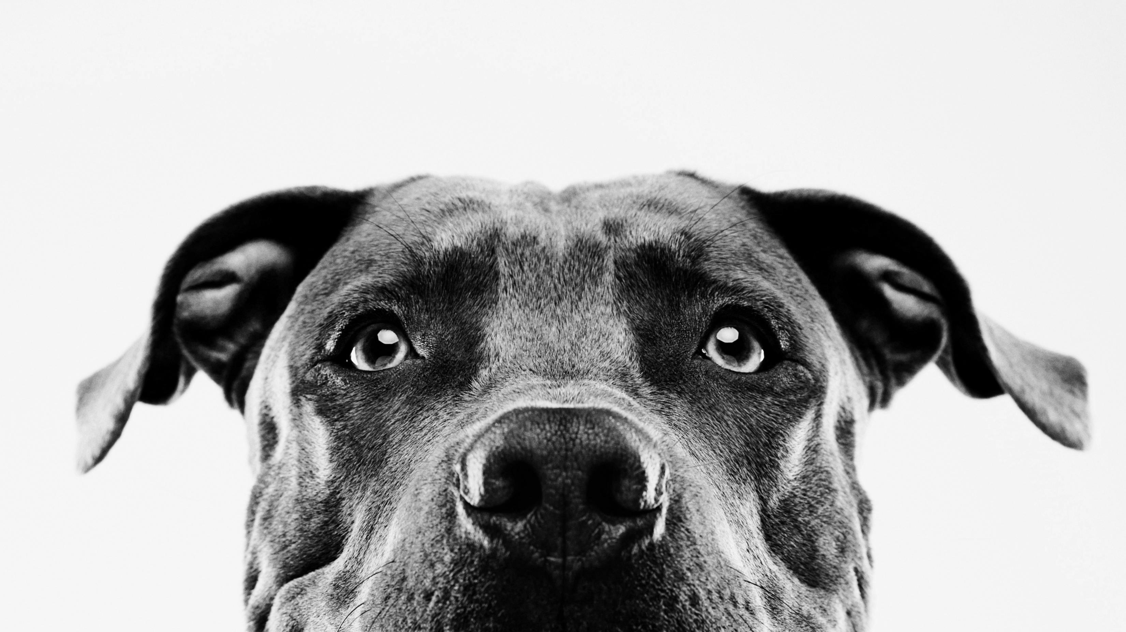
Service animals according to the ada
Olivia Renfroe, acp

Slide 2
The Americans with Disabilities Act
The Americans with Disabilities Act (ADA)
The Americans with Disabilities Act was passed by Congress in 1990. It was amended by Congress in 2008. This is the law that protects the civil rights of people with disabilities in many aspects of public life.
Found in U.S. Code Title 42
ADA Regulations
DOJ is responsible for issuing regulations under Titles II (State and Local Governments) and Title III (Public Accommodations and Commercial Facilities) of the ADA that explain the rights of people with disabilities and the obligations of those covered by the law.
https://www.ada.gov/law-and-regs

Slide 3
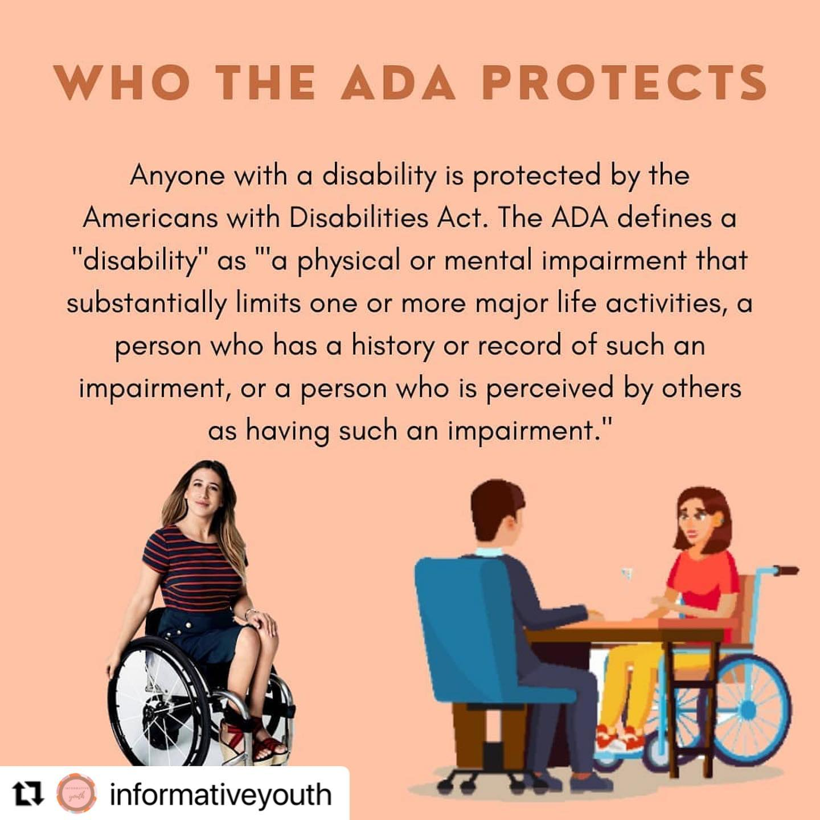

Slide 4


Slide 5
What is a Service Animal?
Service animals are defined as dogs* that are individually trained to do work or perform tasks for people with disabilities.
The work of the service dog must be directly related to the handler’s disability.
Dogs whose sole function is to provide comfort or emotional support do not qualify as service animals under the ADA.
*Miniature horses are sometimes considered a service animal if they meet certain conditions prescribed by the ADA.

Slide 6
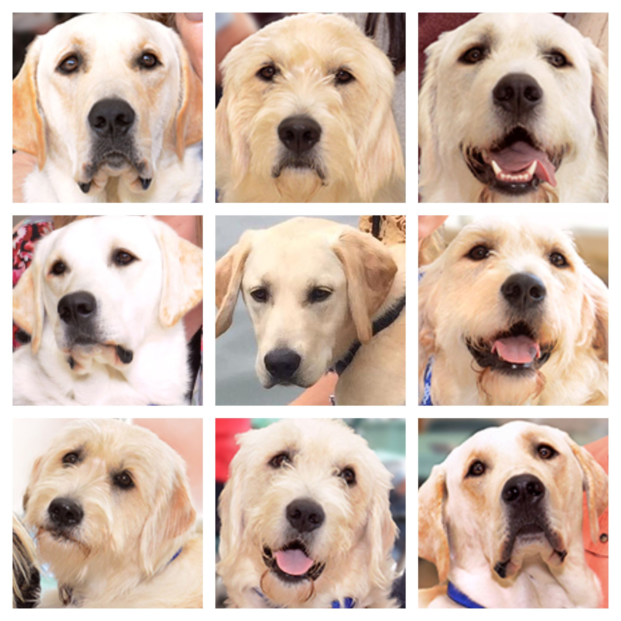

Slide 7
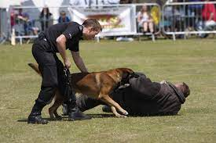
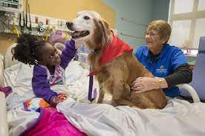
Other types of working dogs

Slide 8







Emotional Support Animals

Slide 9
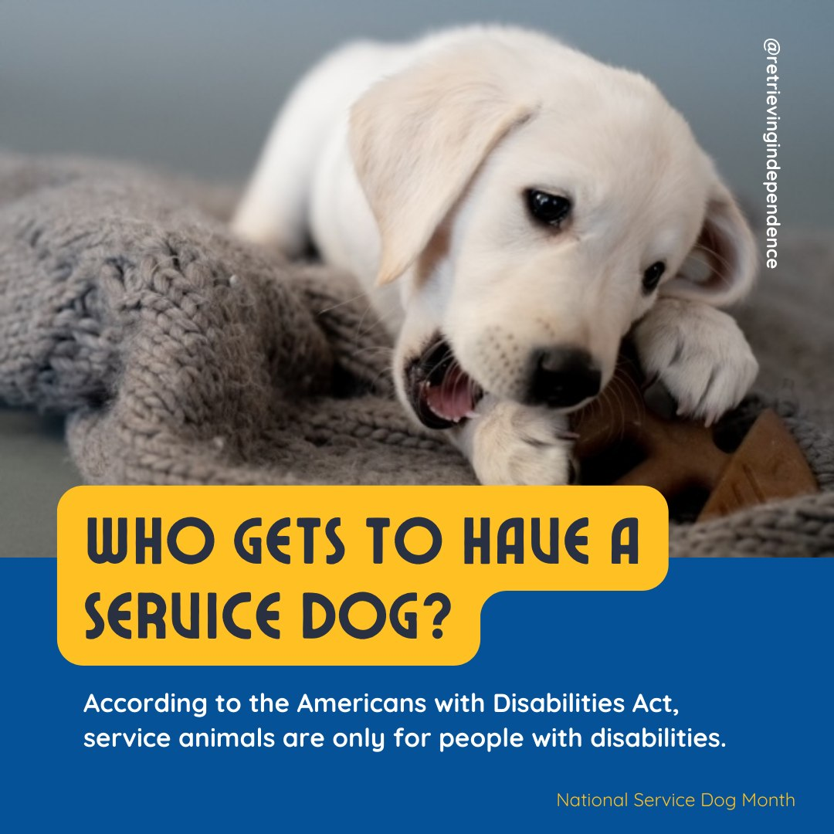

Slide 10
What are some tasks performed by service dogs?
Mobility assistance
Opening doors, pushing buttons
Medical alert
Blocking
Medical retrieval and reminder
Interrupting harmful behaviors
Grounding / Deep pressure therapy
Guide for the blind

Slide 11
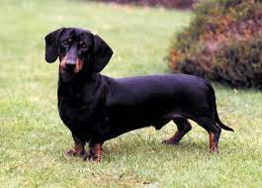
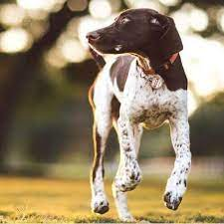
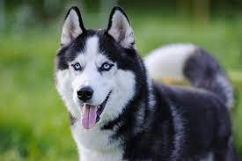
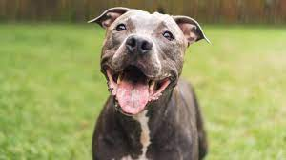
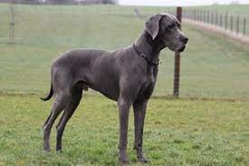
Service dogs can be any size or breed

Slide 12
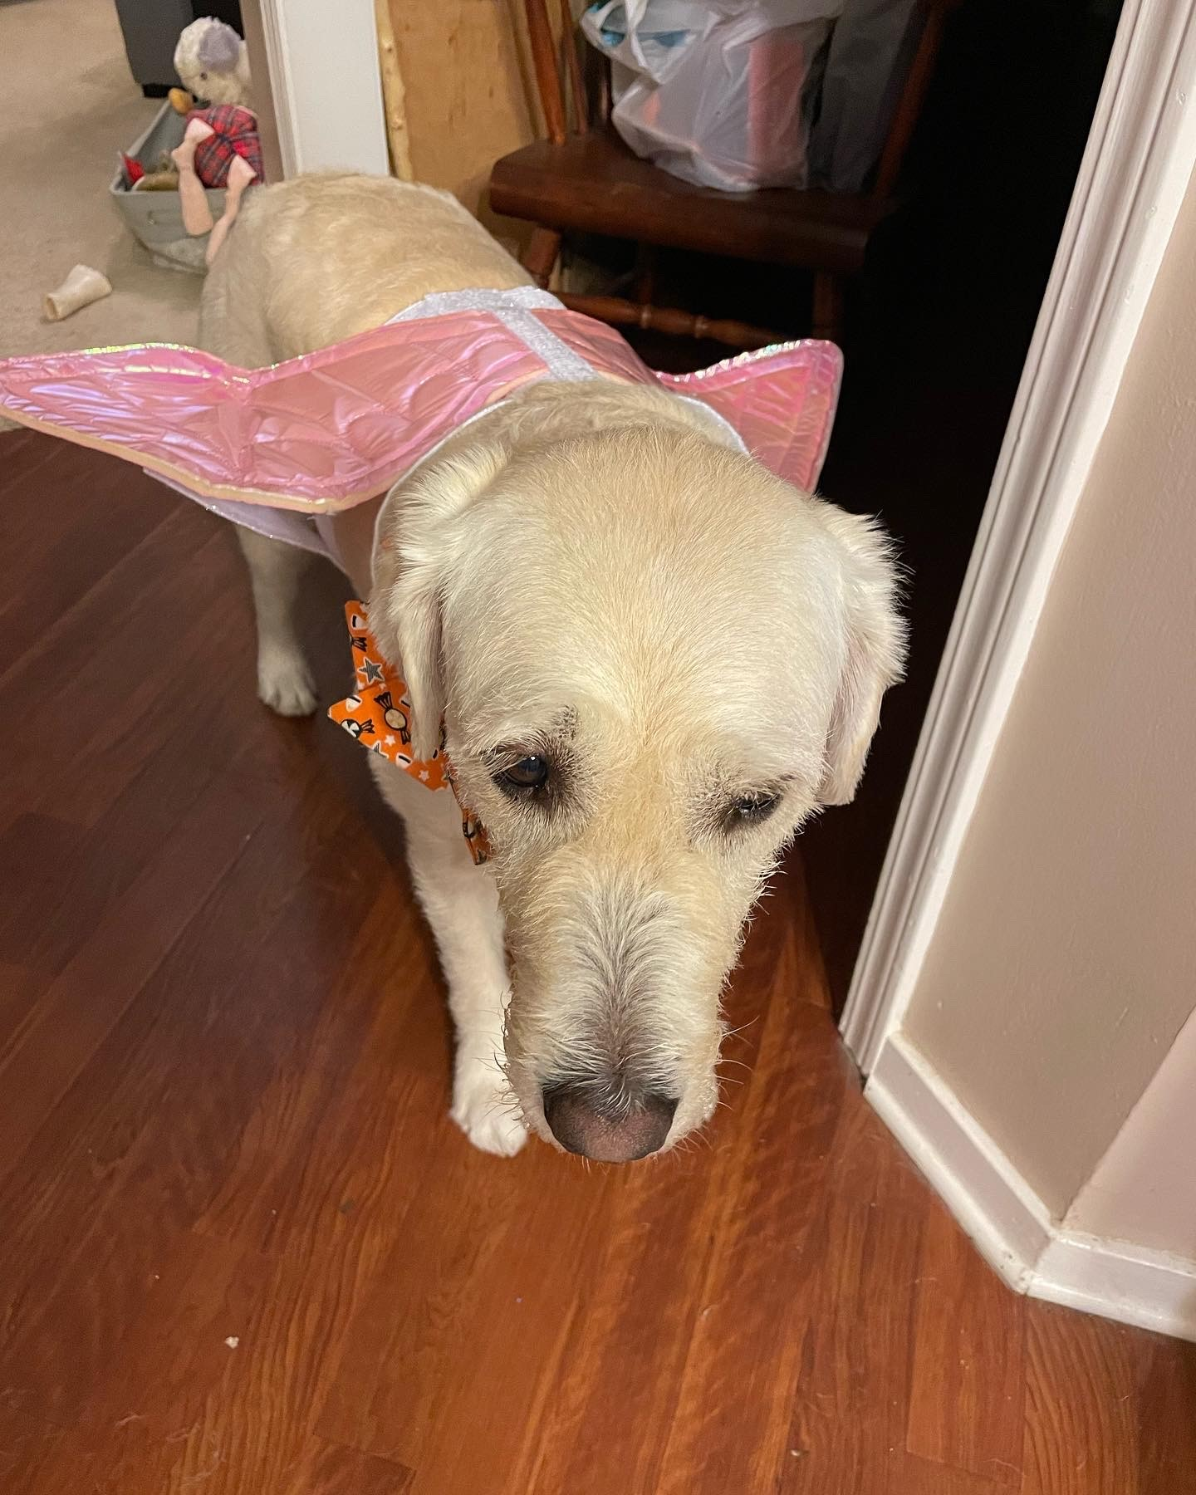
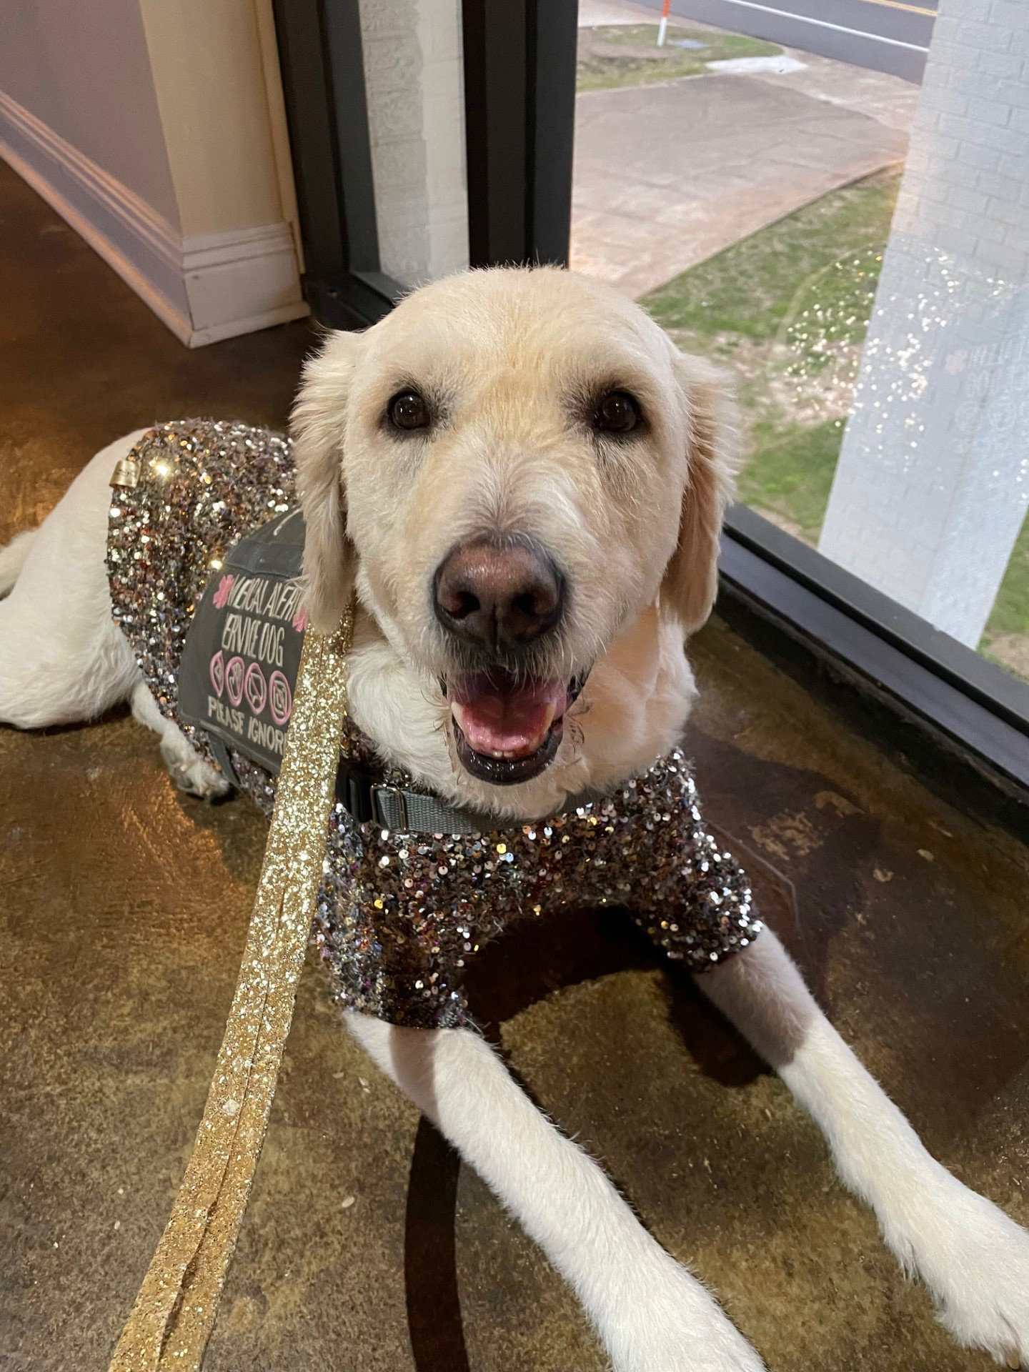
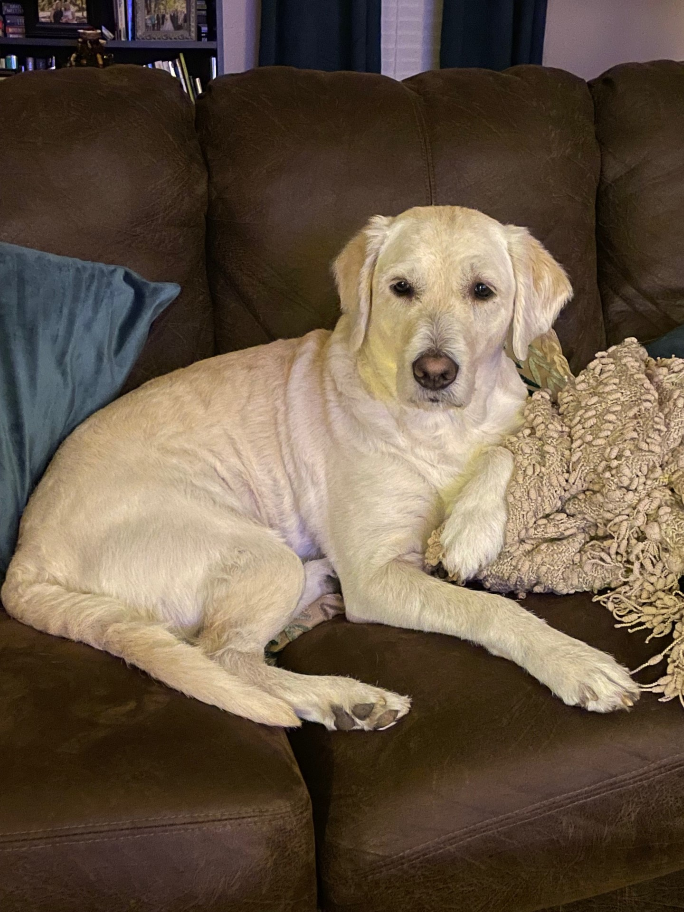
How to Identify a Service Dog
She could have her Gucci on
or her Louis Vuitton
but even with NOTHING on

Slide 13
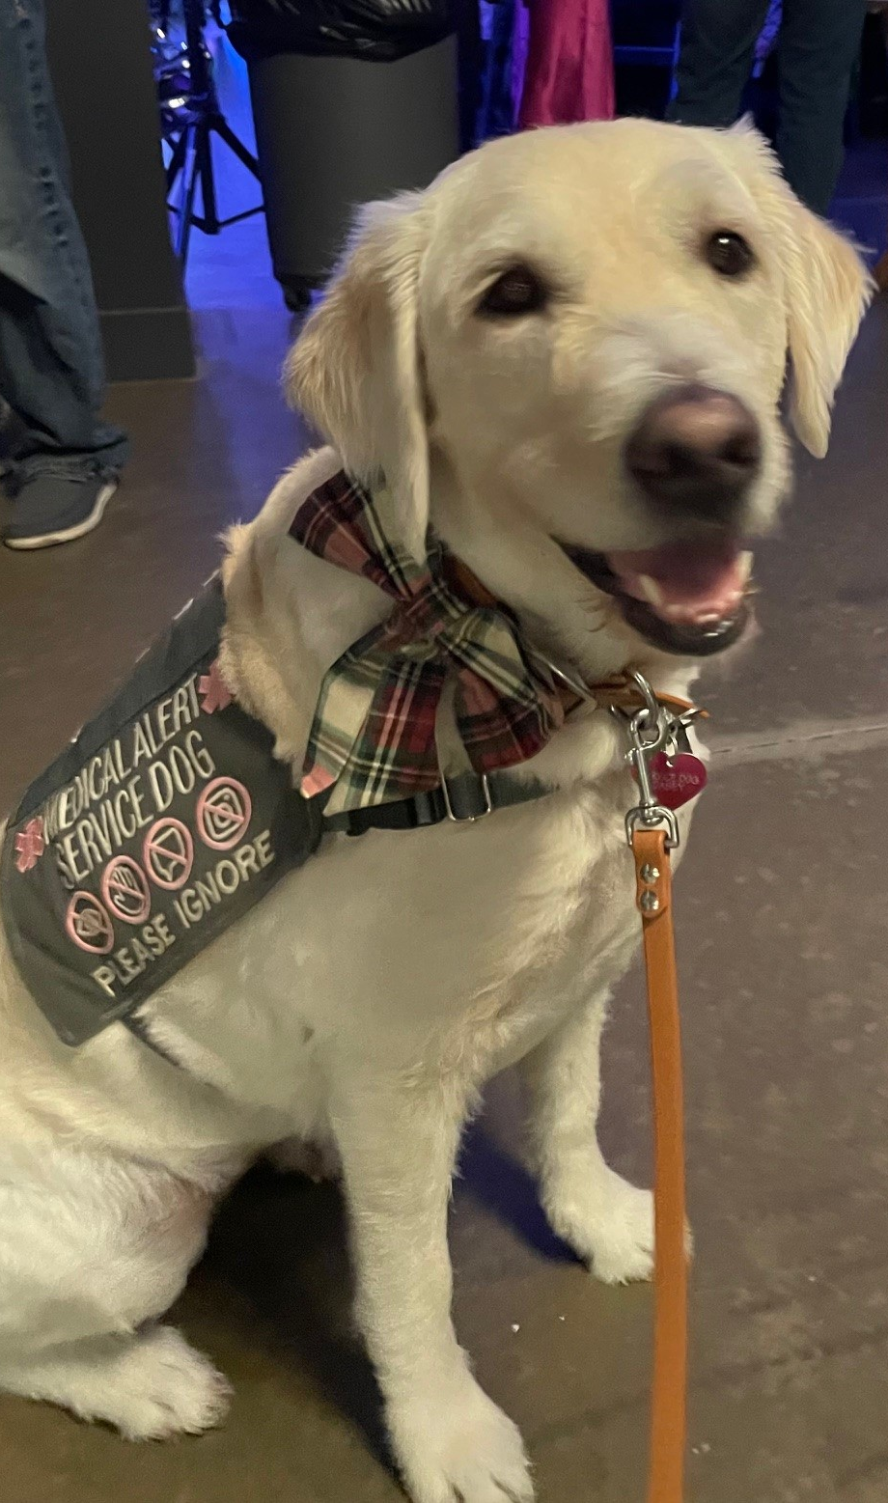
She’s still a Service Dog!

Slide 14
The two questions:
Is the dog a service dog?
What work or tasks has the dog been trained to perform?

Slide 15
Where are service animals allowed?
Restaurants
Stores
Libraries
Airplanes
Hospitals
Doctor’s Offices
Businesses
Public Housing
Government Offices
Non-profit Organizations
Schools
Hotels
Beaches
Theme parks
College Dorms
Emergency Shelters

Slide 16
WHEN CAN A SERVICE ANIMAL BE DENIED?
The dog is out of control AND the handler does not take effective action to control it. (I.e., lunging, barking, pulling, jumping, etc.)
The dog is not housebroken.
A business does not need to allow a service animal if the dog’s presence would fundamentally alter the nature of the goods, services, programs, or activities provided to the public.

Slide 17
CERTIFICATION
AND
DOCUMENTATION

Slide 18
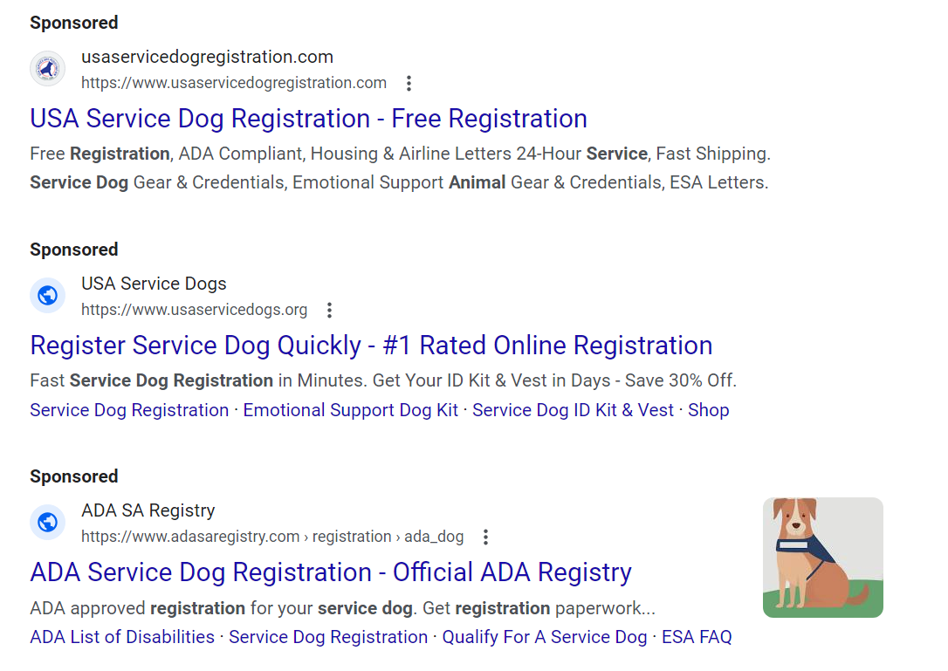

Slide 19
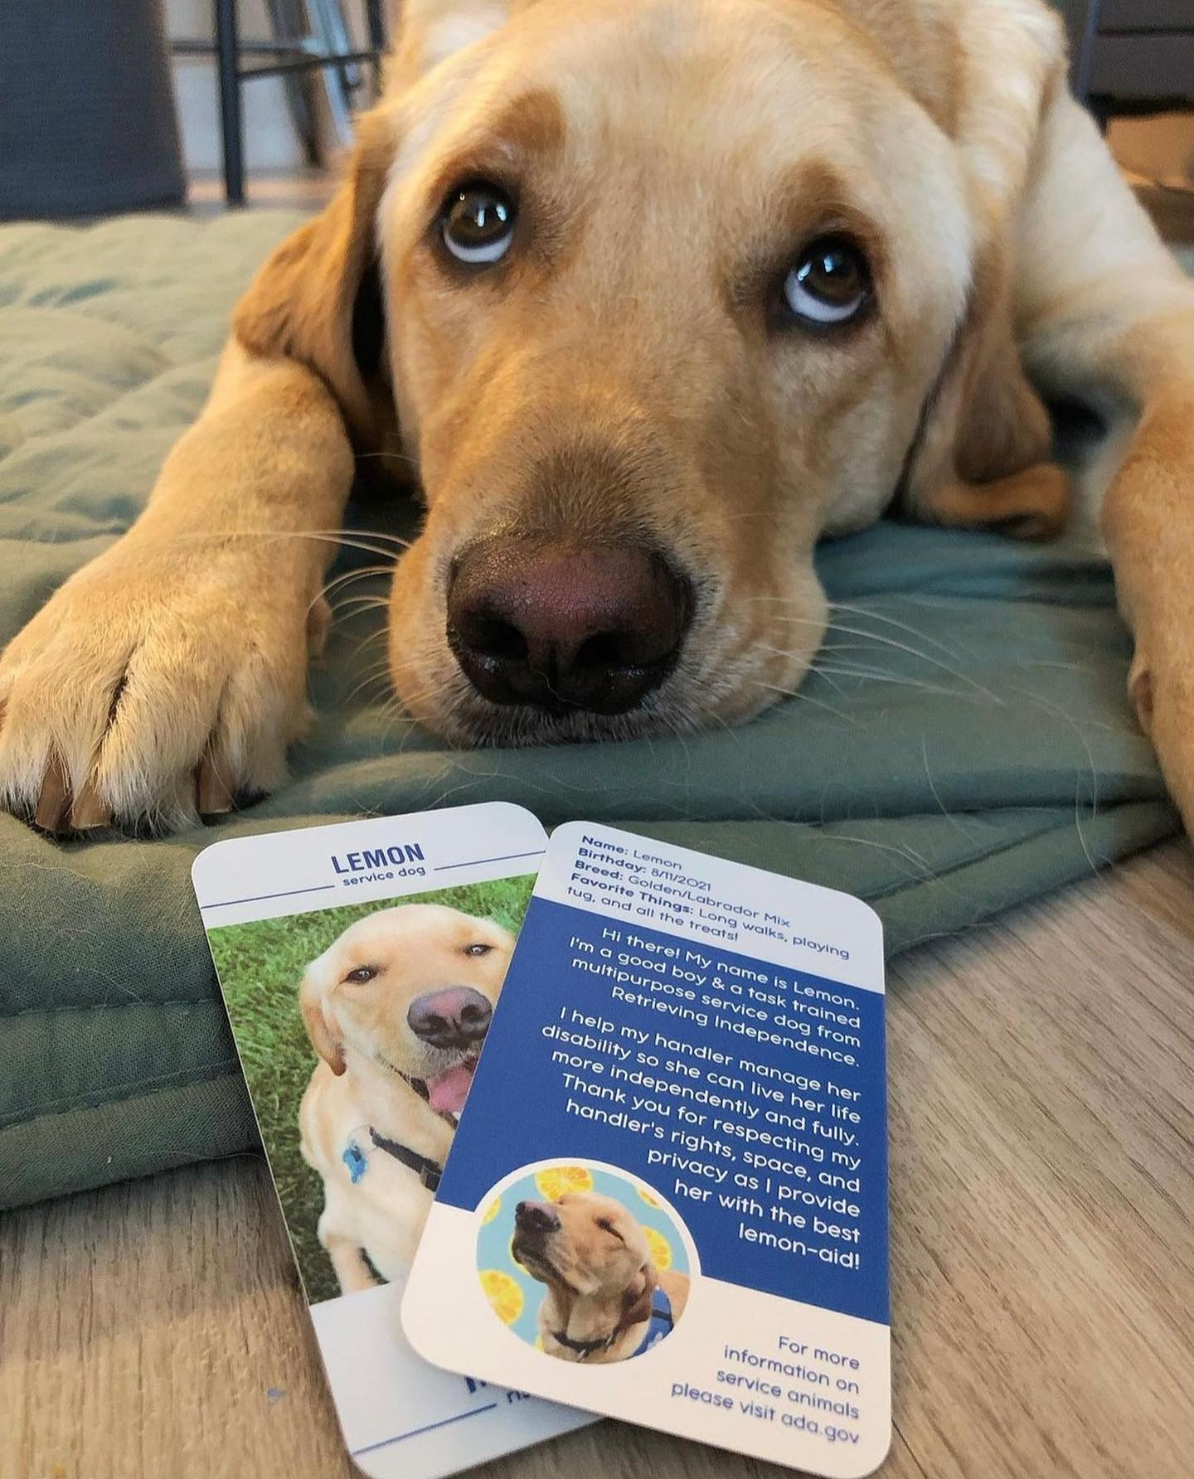
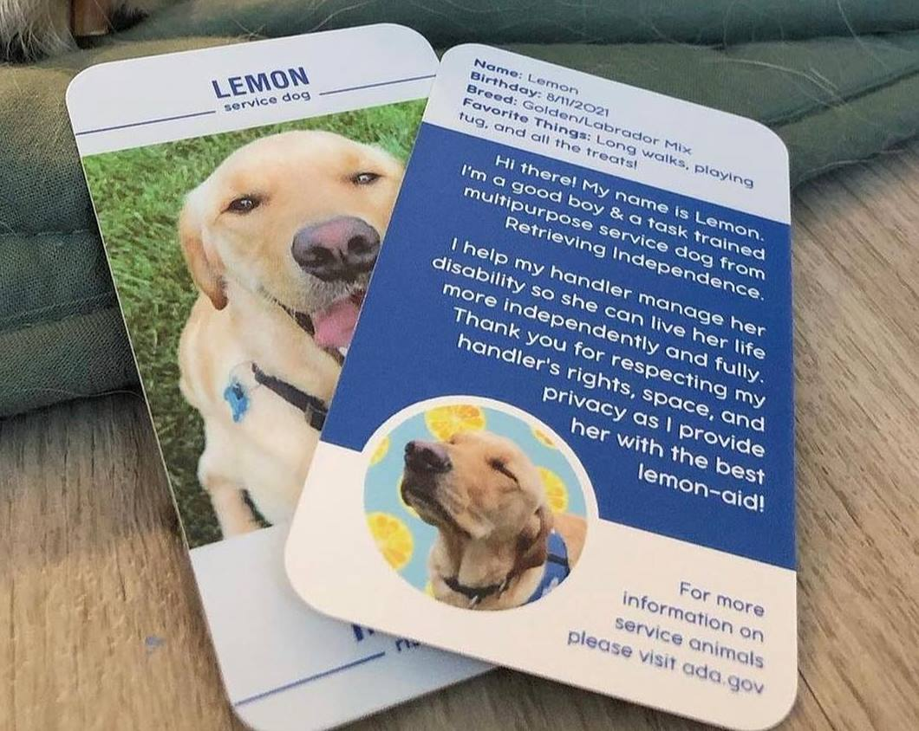

Slide 20
As used in this section and s. 413.081, the term:
(b) “Individual with a disability” means a person who is deaf, hard of hearing, blind, visually impaired, or otherwise physically disabled.
As used in this paragraph, the term:
2. “Physically disabled” means any person who has a physical impairment that substantially limits one or more major life activities.

Slide 21
Traveling with
Service Dogs

Slide 22
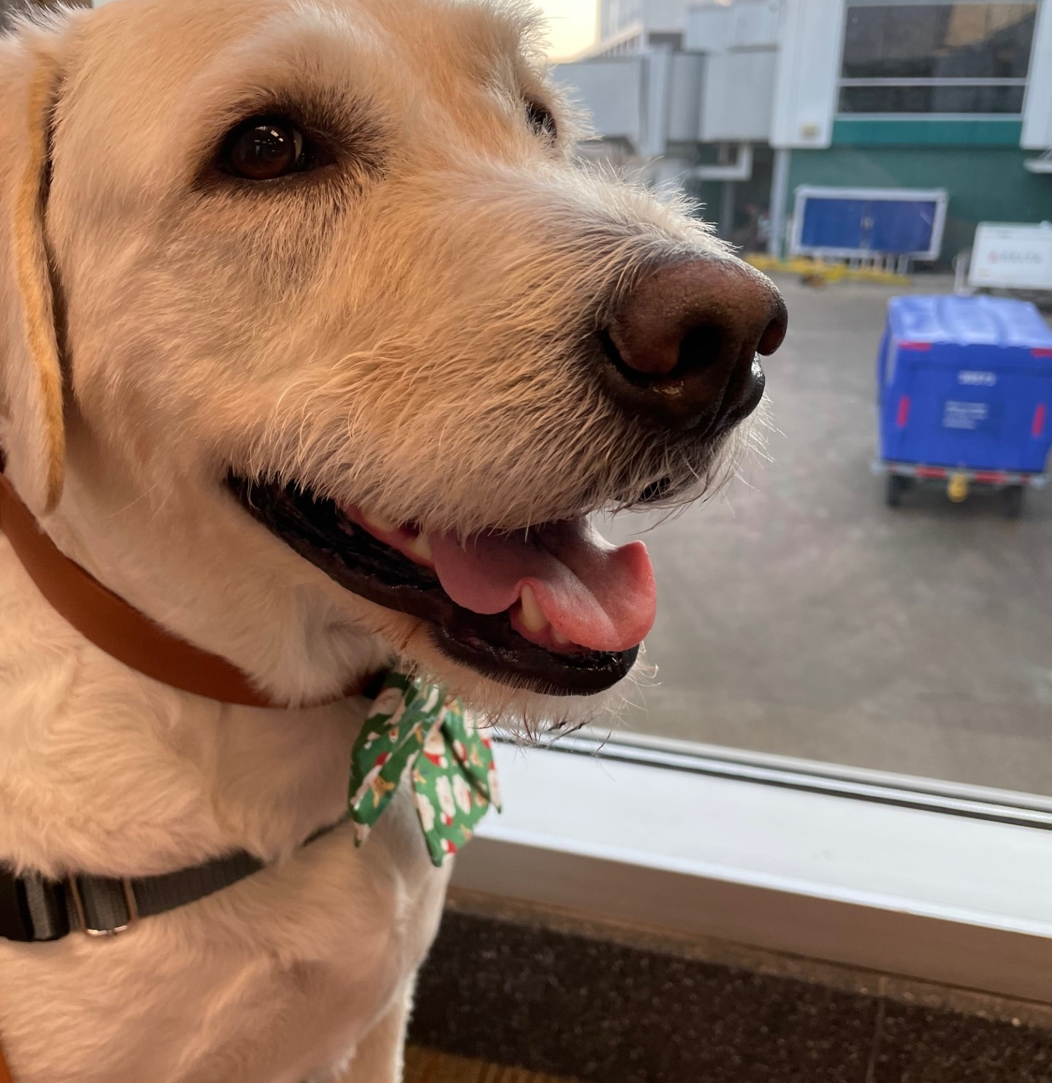
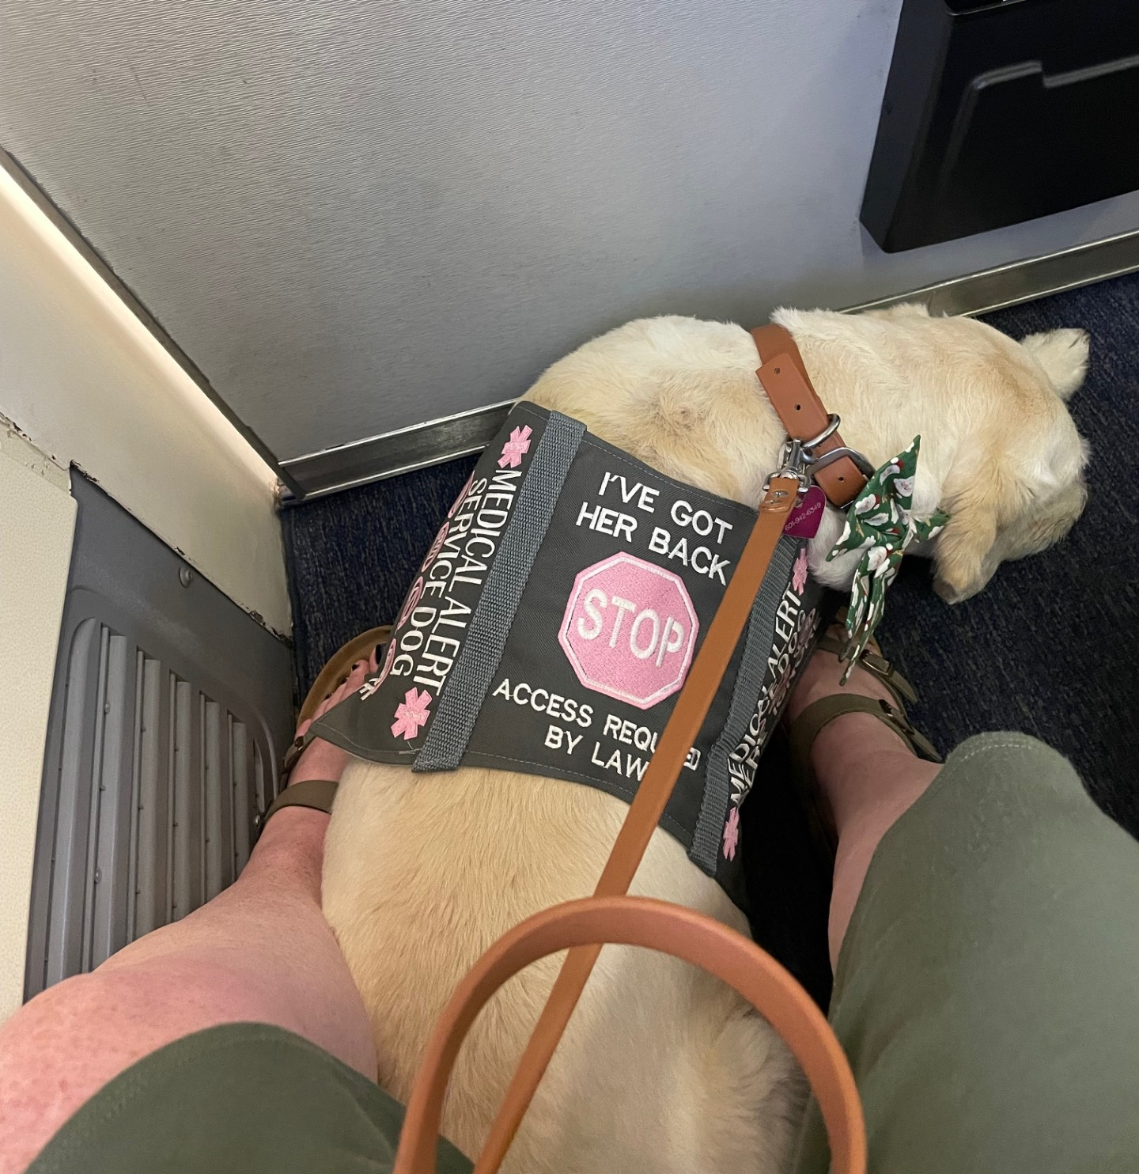

Slide 23
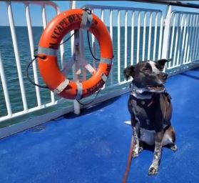
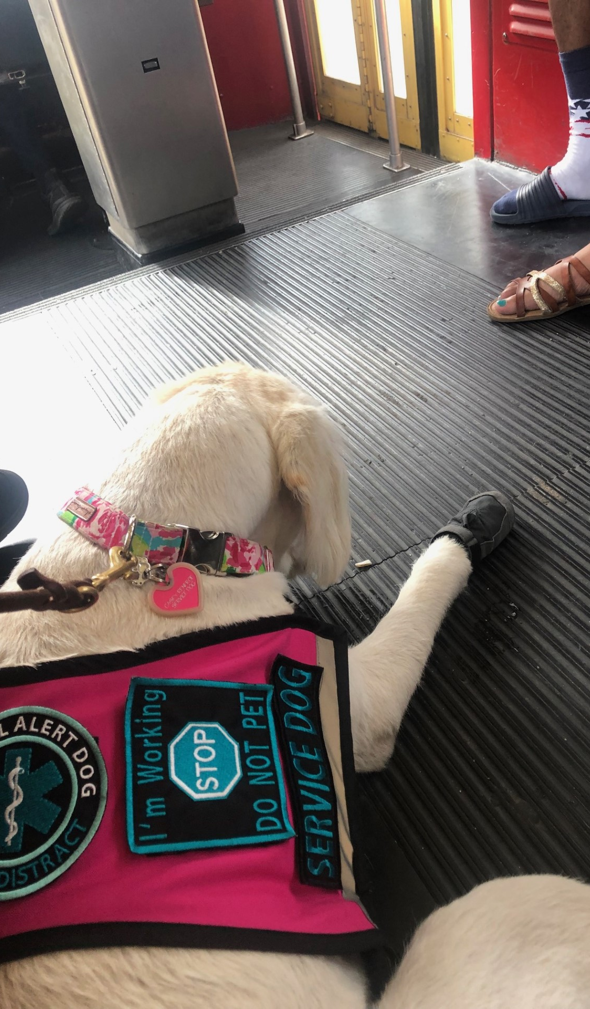
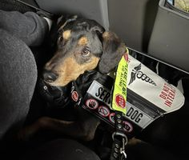
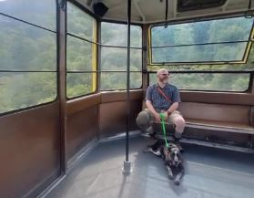
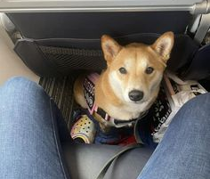

Slide 24
LIVING WITH SERVICE DOGS
Hud SECTION 504 REGULATIONS
24 C.F.R. § 8.33
“The recipient may not impose upon individuals with handicaps other policies, such as the prohibition of assistive devices, auxiliary alarms, or guides in housing facilities, that have the effect of limiting the participation of tenants with handicaps.”

Slide 25
Assisting with Legal Issues Related to Access

Slide 26
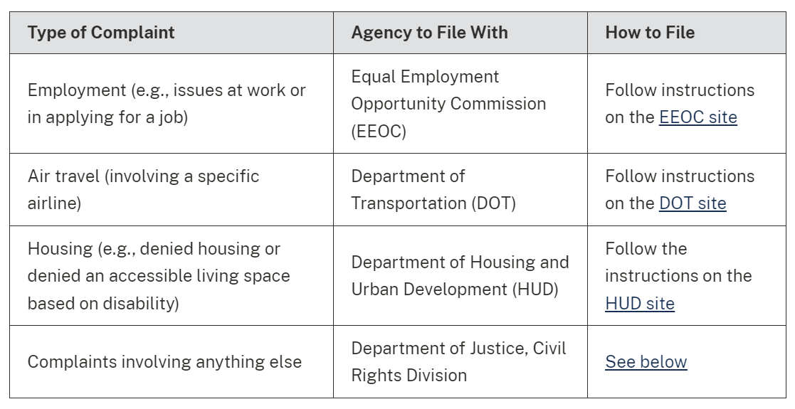

Slide 27
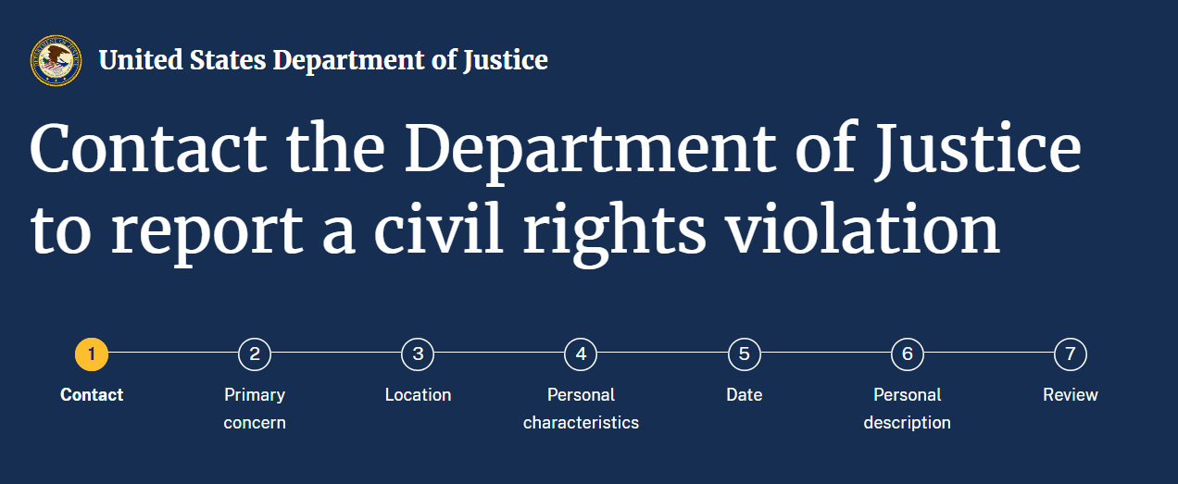

Slide 28
United States of America v. Uber Technologies, Inc., In the Northern District of California; Cause No. 3:25-cv-07731-SK

Slide 29
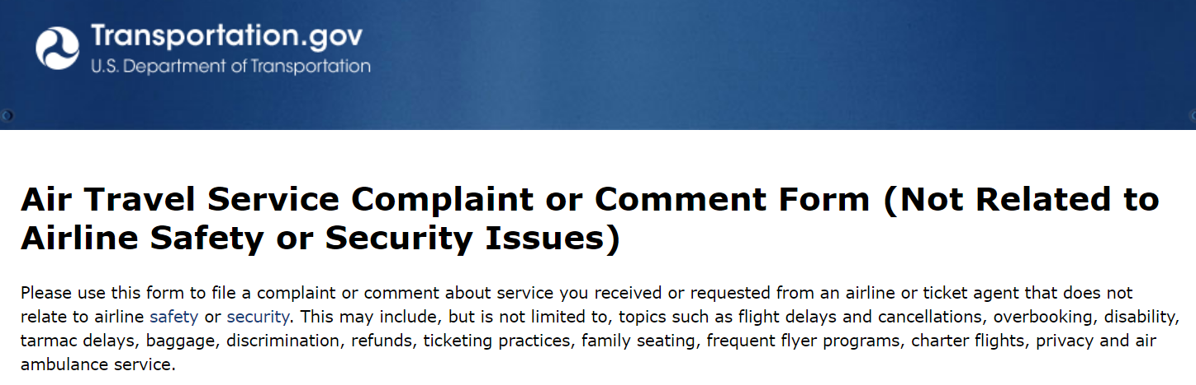

Slide 30
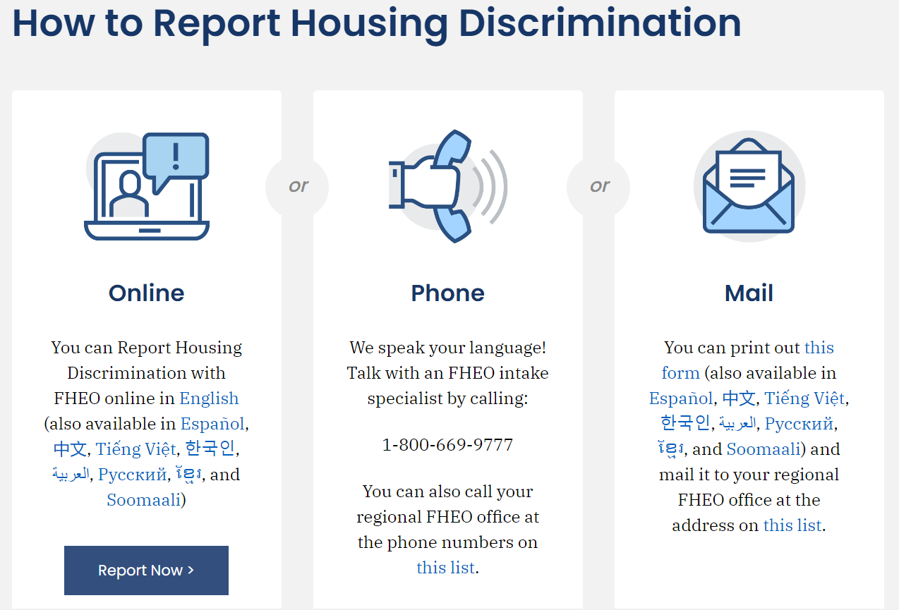

Slide 31
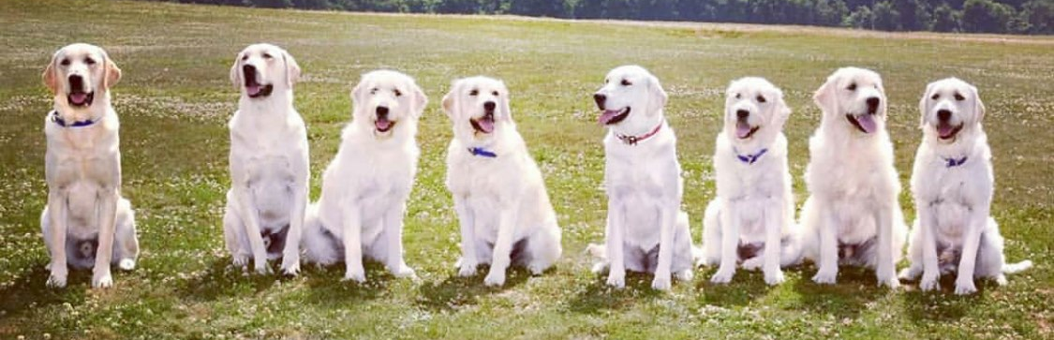
OLIVIA B. RENFROE, ACP
LIVRENFROE@GMAIL.COM @Caseyforachange

