Slide 1
The New Orleans Index at Twenty
Measuring Greater New Orleans’ progress toward resilience
Allison Plyer, Lamar Gardere, Andre Perry, and Manann Donoghue
Notes:
The Data Center is honored to have a long standing partnership with the Brookings Institution producing relevant and timely data analysis to inform the recovery of metro New Orleans post-Katrina. And we’re honored again to work with Brookings to produce The New Orleans Index at Twenty. Hurricane Katrina and the events since then have served as a wake-up call that resiliency is more than just the ability to bounce back—it’s about adapting and transforming to be better able to withstand additional shocks.

Slide 2
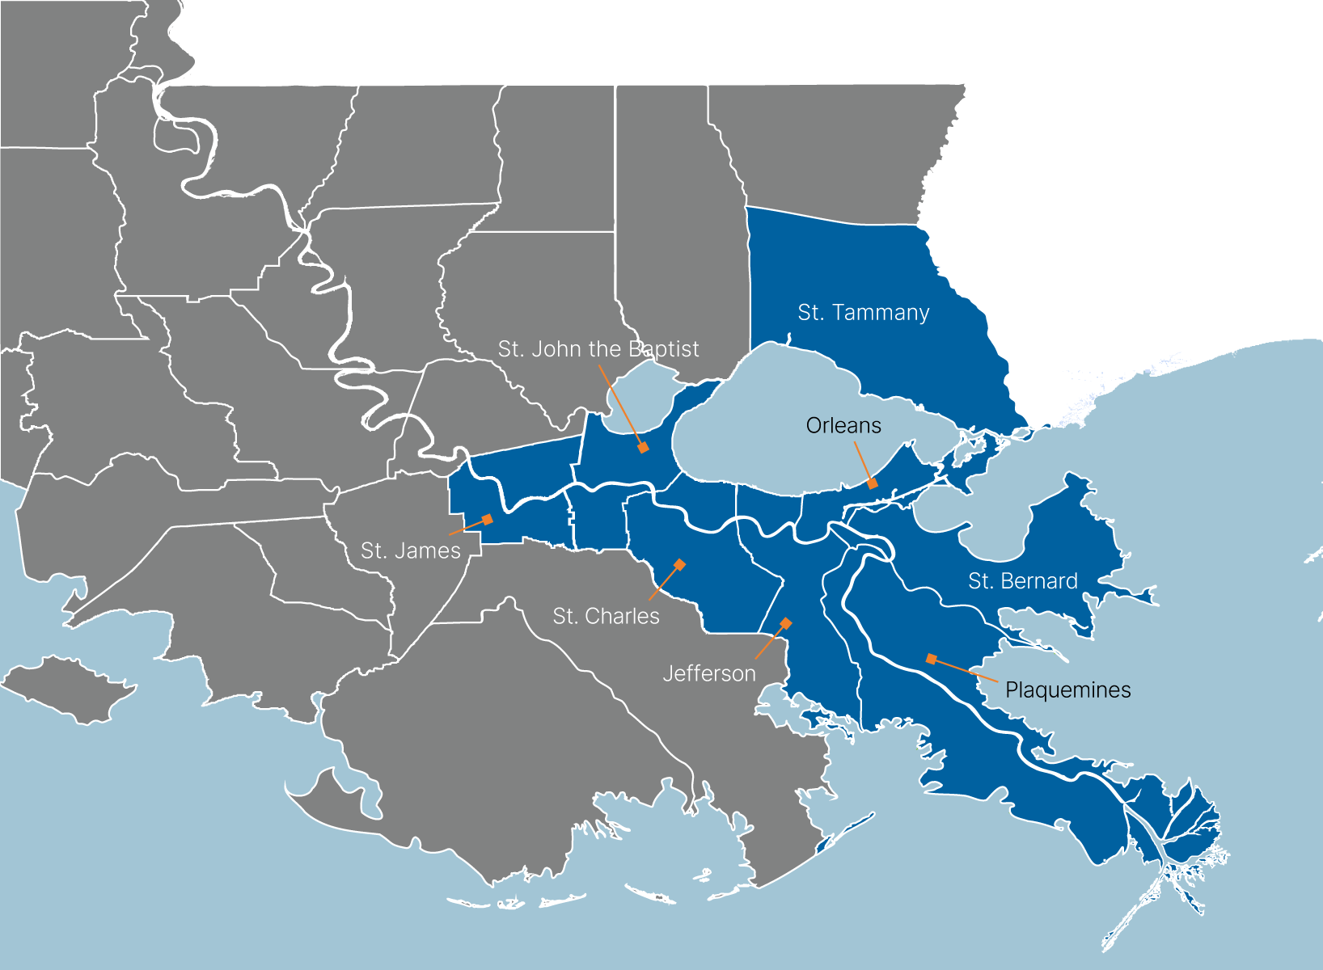
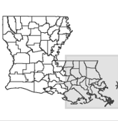
Reference Map – Metro New Orleans
Notes:
The New Orleans Index at Twenty examines trends for the metropolitan statistical area federally defined as eight parishes from 1993–2002 and 2013–2023

Slide 3
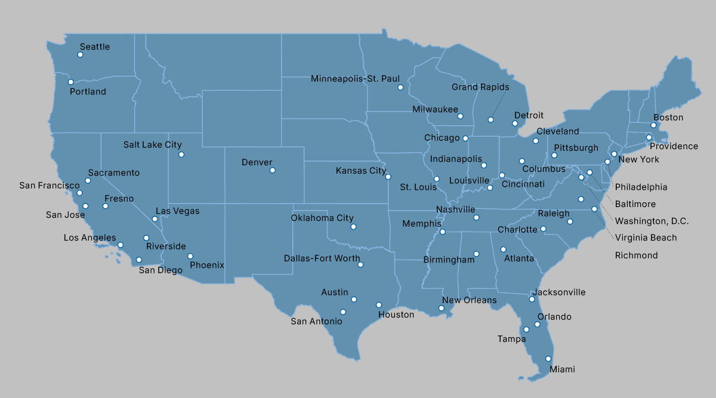
Reference Map – 50 Largest Metros
Notes:
For the vast majority of indicators, we compare Metro New Orleans to the United States or to the other 49 largest metros in the country.

Slide 4
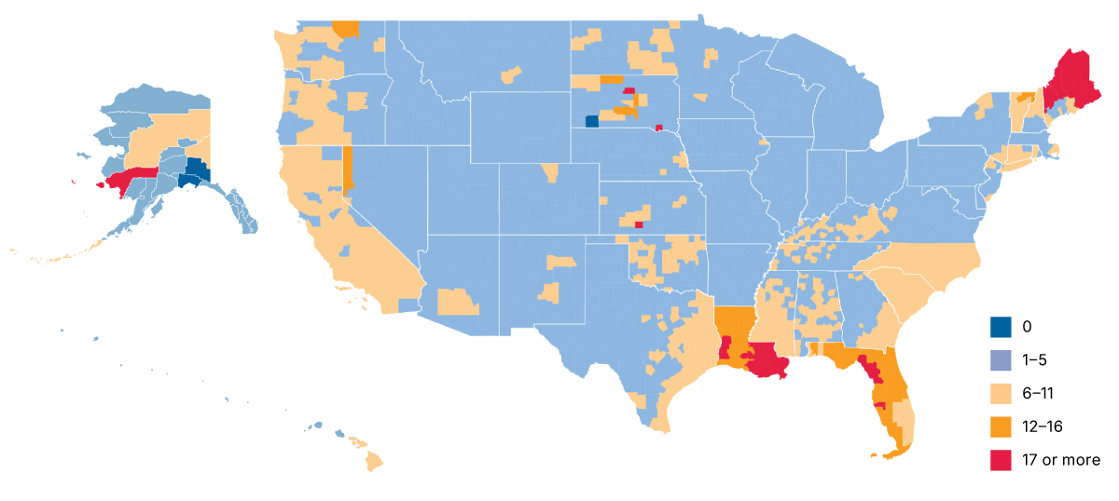
Each parish in Metro New Orleans has had at least 17 declared disasters since 2020 ​— 4X the national average—making Metro New Orleans a national outlier.
Number of FEMA disaster declarations by county
Cumulative January 2020 through December 2024
Source: FEMA
Notes:
Extreme weather has become more common, and Americans can now expect to witness multiple large-scale shocks annually. But New Orleans is a national outlier. Just in these last 5 years we’ve had 3 hurricanes, a record number of extreme heat days and extreme rainfall events, tornadoes, and of course Covid. ​

Slide 5
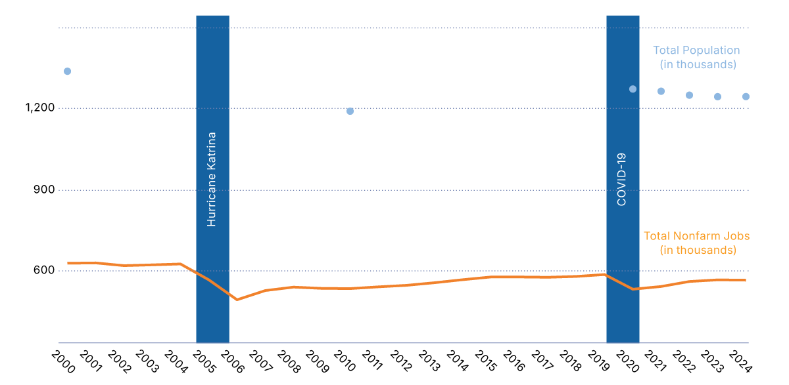
Hurricane Katrina and COVID were significant blows to Metro New Orleans, which now has 10% fewer jobs and 7% smaller population than in 2000—suggesting significant weakness in resilience capacity.
Metro New Orleans Jobs and Population
Annual averages
Source: U.S. Census Bureau, Decennial 2000, 2010, 2020, Population Estimates 2001-2024, and U.S. Bureau of Labor Statistics
Notes:
Regional resilience means bouncing back to pre-shock trend lines. Looking at jobs and population, we see Katrina and COVID were significant blows to Metro New Orleans’ economy. The metro has 10% fewer jobs than in 2000 and subsequently is losing population.

Slide 6
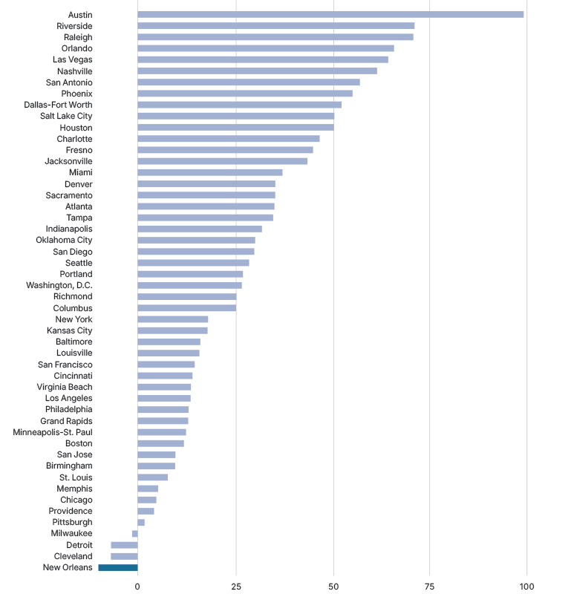
Moreover, the economic shrinkage in Metro New Orleans took place during a context of robust growth in many other metros, many of which also were hit by disasters and all of which grappled with COVID.
Job growth and decline, by 50 largest metropolitan areas
2000 to 2024 (Annual averages)
Source: U.S. Bureau of Labor Statistics
Notes:
Moreover, the economic shrinkage in Metro New Orleans took place during a context of growth across the U.S. and other large metros, many of which were also struck by disasters and all of which experienced a significant hit when the pandemic struck.

Slide 7
A resilient metro is one that isn’t trapped in a cycle of disaster response and recovery, but is able to adapt to reduce future risks. Factors that strengthen a region’s ability to adapt to and mitigate shocks include:
Strong infrastructure and housing
(Sectorally) diverse economy
Robust entrepreneurship
Large shares of skilled and educated workers
Wealth that can provide adaptive cushion (government, philanthropic, or individual)
Wellness
Strong attachment to place
Small gap between incomes of high and low-income residents
Social cohesion
Community problem-solving ability
Notes:
Resilience capacity means having ability to adapt to and mitigate risks. A review of academic literature and case studies reveals a shared hypothesis regarding the factors that strengthen a region’s ability to rebound from, adapt to, or mitigate adverse shocks. These factors include: Economic diversity, particularly across major traded industry clusters, enhances a region’s ability to withstand or avoid economic disruptions. Robust entrepreneurship contributes to economic diversity by introducing new businesses that can broaden the industrial base of a metro. Workers with advanced skills and formal education are more adaptable to evolving economic demands. Regions with a high concentration of well-educated residents are better positioned to manage and recover from economic shocks. The availability of financial capital—across government, private, philanthropic, and individual sources—provides a buffer during crises and enables investment in recovery, reconstruction, and reform. Communities characterized by strong place attachment, wellness, civic engagement, and social cohesion tend to be more resilient. A narrower gap between high- and low-income residents also contributes to social cohesion and, therefore, resilience capacity. The capacity of a community to address challenges, generate innovative solutions, implement responsive policies, and build effective political and institutional partnerships is critical for adaptive and sustained recovery.

Slide 8





Notes:
The New Orleans Index at Twenty assesses our metro’s resilience capacity by analyzing 20 data sets organized by housing and Infrastructure, economy and workforce, wealth and people. In the interest of time, I’ll present only 13 of these indicators, But encourage you to read the full report which is available at this QR code or printed copies on the table in the back.

Slide 10
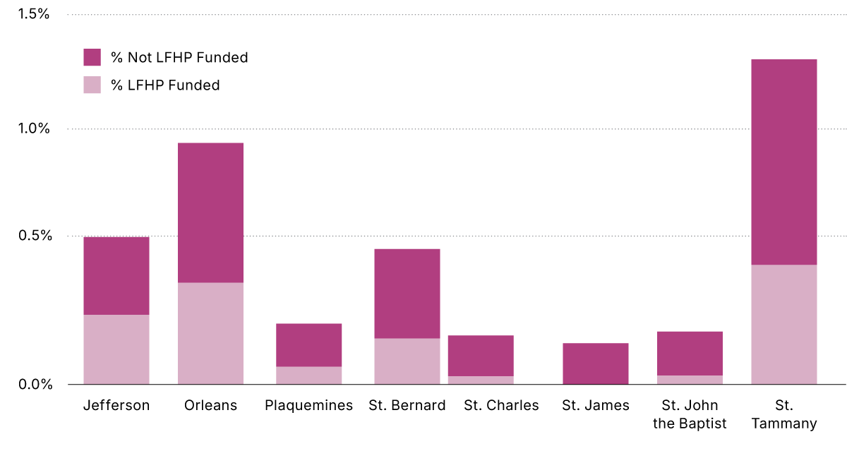
Since October 2023, just over 4,000 roofs have been FORTIFIED in Metro New Orleans, representing <1% of all properties. Roughly 1,600 received state grants.
Percent of properties with FORTIFIED roofs
Cumulative October 2023 through February 2025
Source: Insurance Institute for Business and Home Safety and the First Street Foundation
Notes:
The Louisiana Fortify Homes Program (or LFHP) just began in October 2023 and encouraged homeowners to fortify their roofs to better withstand storm-force winds and reduce their insurance premiums. The state has designated a limited amount of money for grants that are awarded by lottery. Currently only a small percent of all properties have a fortified roof.

Slide 11
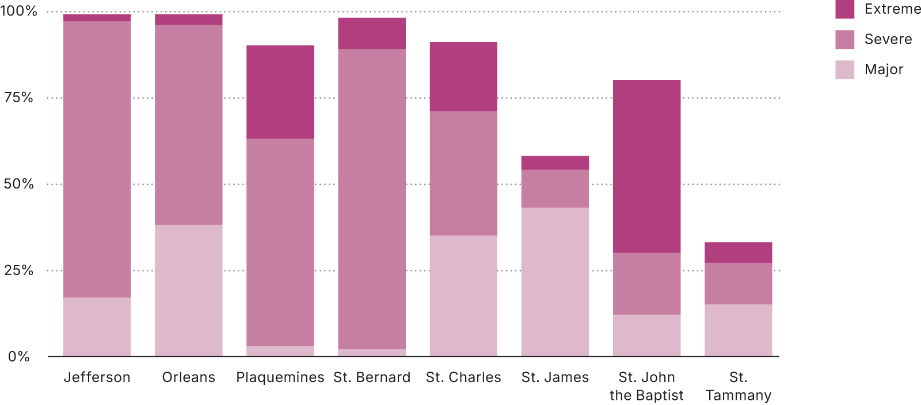
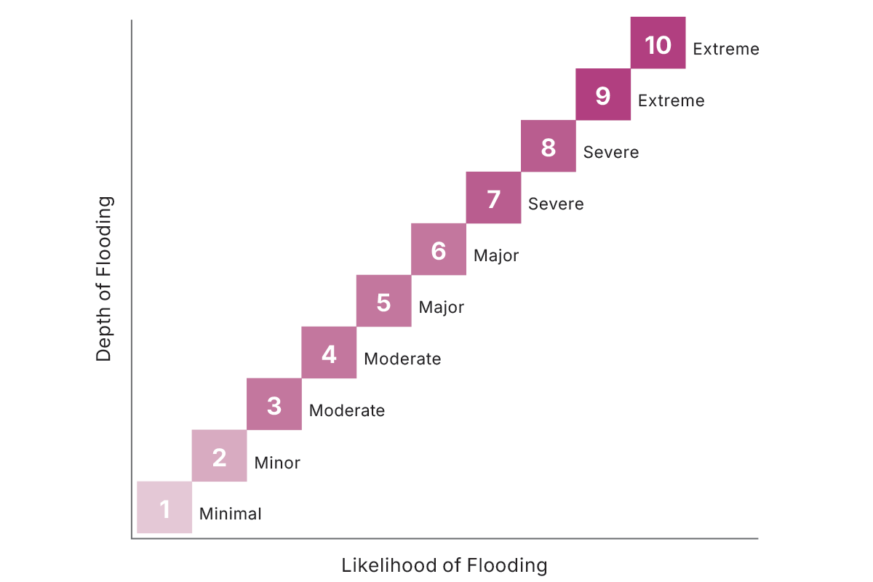
85% of properties in Metro New Orleans face a “major” or greater risk of experiencing some level of flooding in the next 30 years.
Share of properties at Major, Severe, or Extreme risk of flooding
Based on 30-year cumulative flood likelihood as of January 2024
Flood Risk
First Street Foundation's Flood Factor matrix
Source: First Street, 2022.
Notes:
Flood events are happening with increasing frequency across the country. First Street Foundation has created technology that assesses each property’s flood risk, factoring in existing flood protection measures such as marshes, flood walls, and retention ponds. Properties at “major” risk of flooding have at least an 80 percent cumulative probability of being flooded within 30 years (at least a 5 percent chance in any given year).

Slide 12
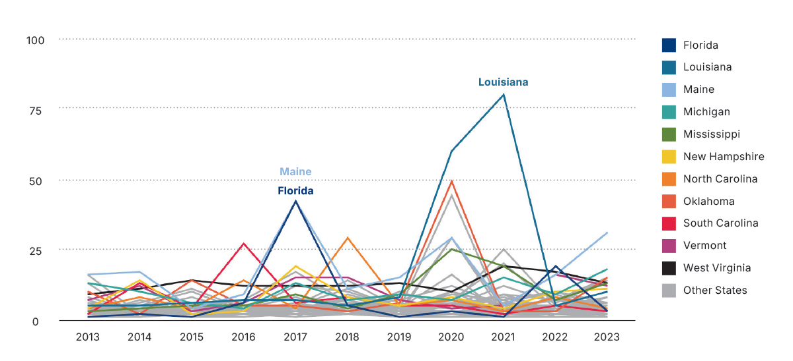
From 2013 to 2023, Louisiana experienced 198 hours of power interruption — the most of any state — three times more than the national average.
Average annual duration of electric power interruptions, by state
Hours per customer
Source: U.S. Energy Information Administration
Notes:
Power outages frequently occur during extreme heat or cold, leaving residents without life saving heating, cooling, or access to power for medical devices. Over the last decade, Louisiana recorded the highest total hours of power outage in the nation.

Slide 14
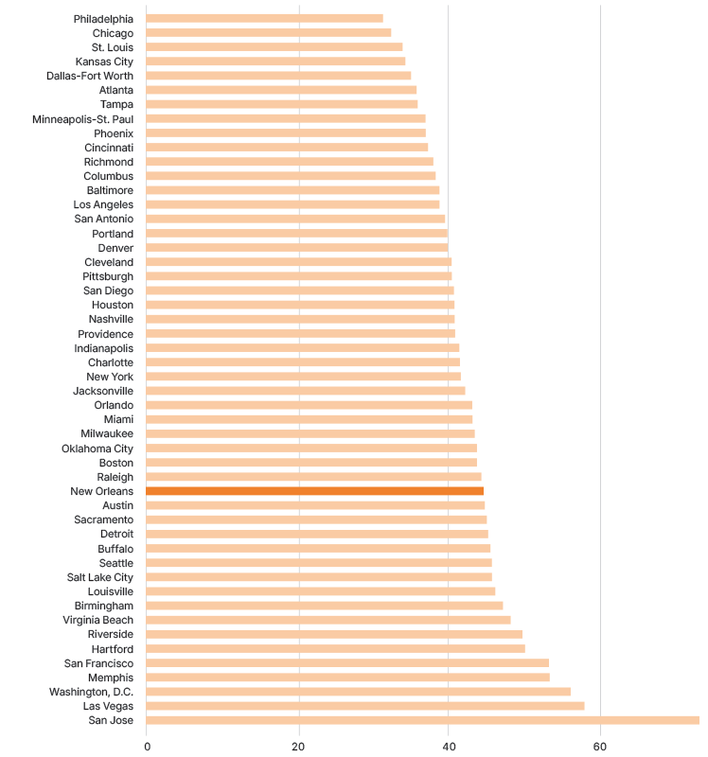
Metro New Orleans ranks 34th in economic diversity among the largest 50 metros.
Executive Diversity Index for 50 largest metro areas, 2021
Lower values = more diverse
Source: Chmura Analytics 2021
Notes:
Metro New Orleans ranks 34th in economic diversity among the largest 50 metros, meaning this metro is not highly dependent on a single industry.

Slide 15
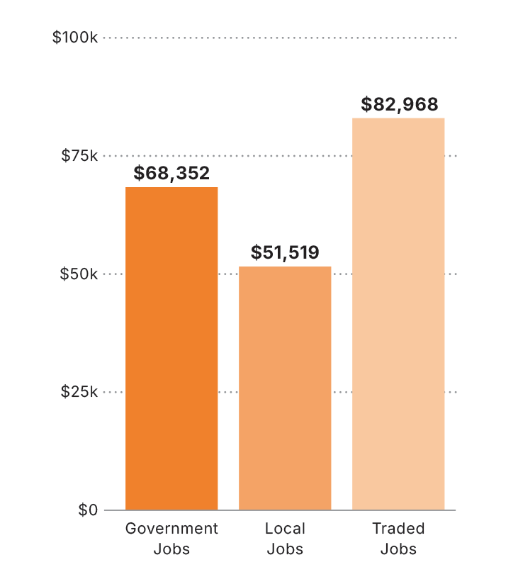
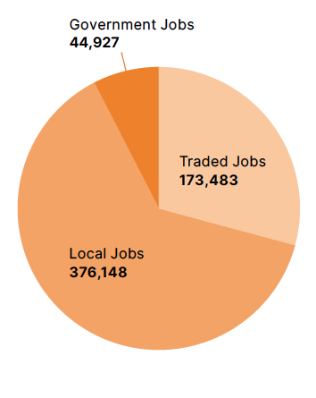
Metro New Orleans ranks 34th in economic diversity among the largest 50 metros.
Jobs
Metro New Orleans, 2023
Average annual wages
Metro New Orleans, 2023
Source: Lightcast and The U.S. Cluster Mapping Project
Notes:
Traded industries are sectors that produce goods or services for customers outside the region, generating external revenue and serving as a primary driver of metropolitan economic growth. In contrast, local-serving and government jobs tend to be a result of economic growth rather than a source of it, as they rely on local demand and funding rather than attracting income from outside the region. In most metros, there are approximately two local-serving or government jobs for every one job in a traded industry cluster, and traded industries pay higher average wages

Slide 16
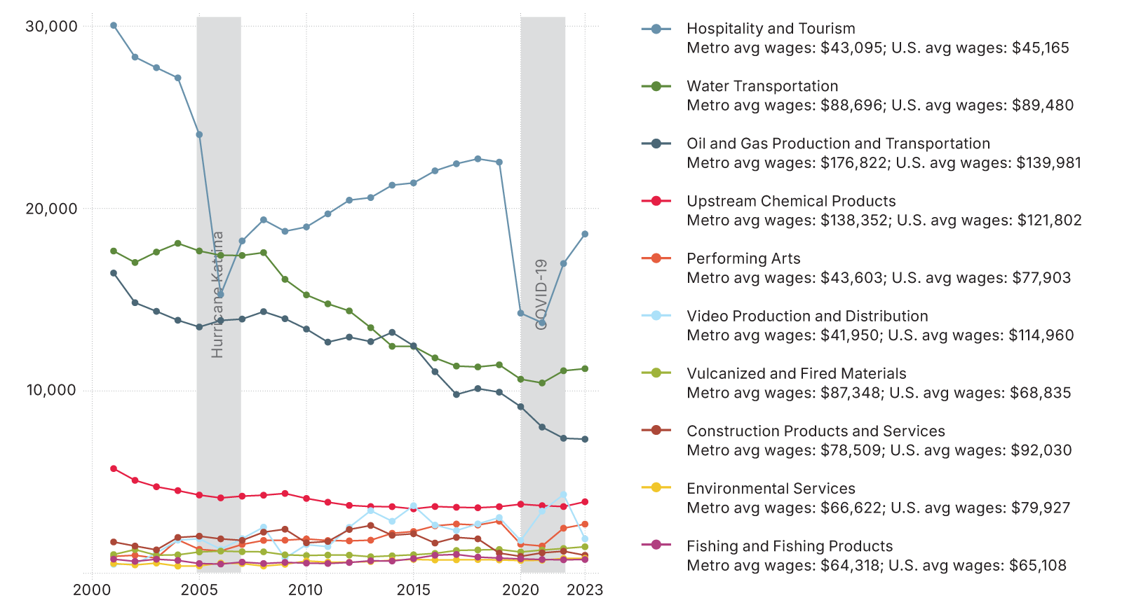
Despite substantial private and public investments, tourism, oil & gas, water transportation, and upstream chemical clusters have shed 38% of jobs since 2004 primarily due to automation and technology.
Jobs by traded cluster
For the 10 strongest specializations, Metro New Orleans
Source: Lightcast and The U.S. Cluster Mapping Project
Notes:
While New Orleans is not dependent on just one traded industry, its economy is dominated by older industries that are increasingly replacing workers with automation. The tourism industry, the largest traded industry in the metro, suffered major job losses during the COVID pandemic. Since then, despite the fact that visitor numbers have rebounded strongly, tourism has not recouped its pre-Covid number of jobs. Oil & gas is increasing its production but is reducing jobs through automation. The same is true of upstream chemical production and water transportation or shipping.

Slide 17
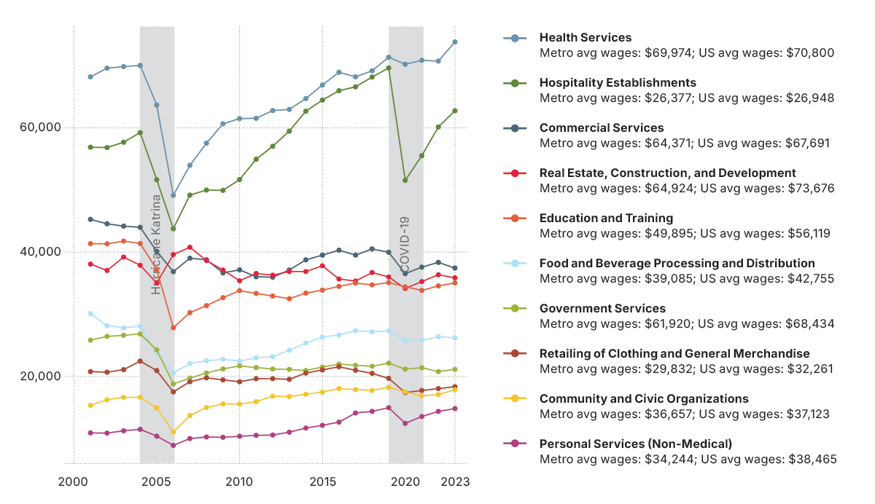
Among local-serving clusters, health service jobs are growing slightly more rapidly than nationally. Local hospitality jobs are less concentrated than the 10 top traded clusters.
Jobs by local-serving cluster
For the 10 largest local-serving clusters by jobs, Metro New Orleans
Source: Lightcast and The U.S. Cluster Mapping Project
Notes:
Local-serving clusters in Metro New Orleans have generally followed the region’s population trend. Most experienced sharp declines following the 2005 evacuation caused by Hurricane Katrina and the levee failures, but have rebounded along with population levels. Local-serving health service jobs have increased locally and nationally, as the baby boomers age and demand more health services. In Metro New Orleans, health services jobs expanded from 70,000 in 2004 to over 73,000 in 2023. In fact, health services jobs are growing slightly more rapidly at the local level than nationally. The sectors contributing most to this growth include specialty, psychiatric, and substance abuse hospitals. Local hospitality establishment jobs took a major hit during the COVID-19 pandemic, falling from 69,000 in 2019 to less than 52,000 in 2020 and have not fully rebounded, reaching only 62,750 jobs by 2023. Several hospitality establishment sectors have a location quotient greater than one, suggesting they are more concentrated in Metro New Orleans than nationally—likely because they enjoy the patronage of visiting tourists. These sectors include drinking places, food service contractors, caterers, gift retailers, and full-service restaurants.

Slide 18
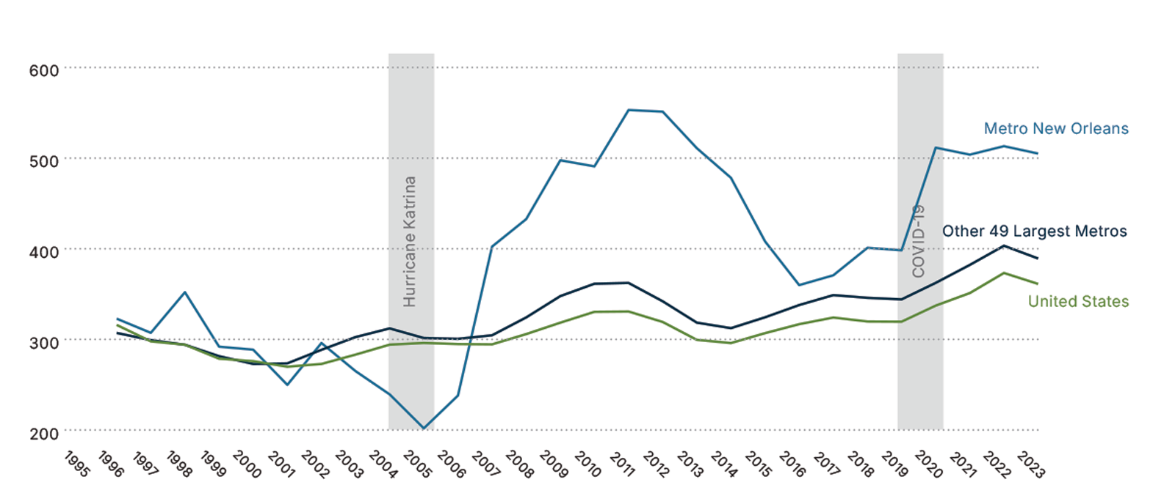
Metro New Orleans’ rate of business startups spiked post-Katrina and remains 35% higher than the national average, and 29% higher than the large metro average.
Individuals starting up businesses
Per 100,000 adult population (3-year averages)
Source: Federal Reserve Bank of Atlanta analysis of the U.S Census Bureau and U.S. Bureau of Labor Statistics' Current Population Survey
Notes:
Immediately post-Katrina, the entrepreneurship rate spiked to 32 percent higher than that of the other 49 largest metros, and has remained higher every year since. Today Metro New Orleans’ rate of business startups is 29 percent higher than the average of the other largest metros and 35 percent higher than the national average.

Slide 19
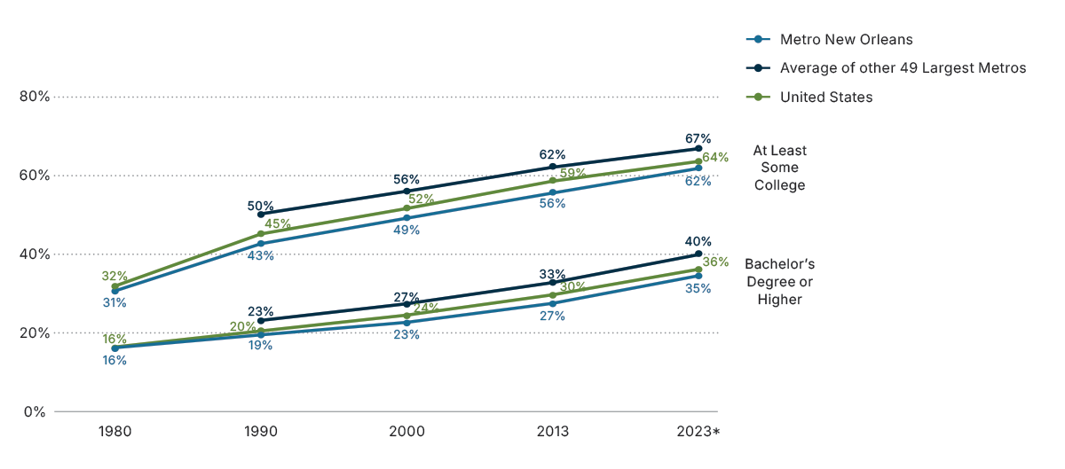
Metro New Orleans' share of adults with a bachelor’s degree at 35% has reached parity with the nation, but continues to trail the other 49 large metros where 40% have a bachelor’s.
Educational Attainment
25 years or older
Source: iPUMS NHGIS data from Decennial Census 1980, 1990, 2000, and American Community Survey 2018 and 2023.
Notes:
Over the last decade, Metro New Orleans has caught up with the nation on educational attainment. In 2013, Metro New Orleans had a lower share of adults with a bachelor’s or at least some college compared to the national average. As of 2023, educational attainment increased to reach national parity but lags that of the other largest metros.

Slide 20
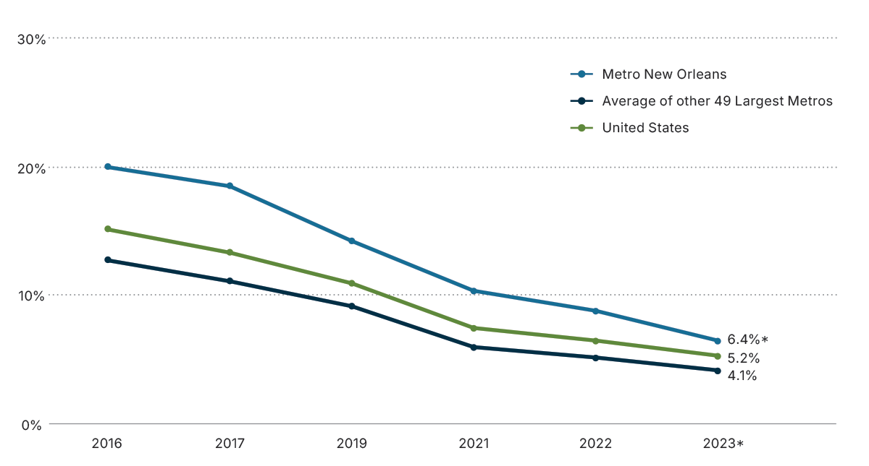
The share of households without internet – not even a cellular data plan – in Metro New Orleans fell from 20% in 2016 to 6.4% in 2023 and is now on par with the nation and the other 49 large metros.
Households without internet access
Not even a cellular plan
Source: U.S. Census Bureau data, American Community Survey
Notes:
This indicator measures the share of households with no internet access, not even a cellular data plan.
The share of Metro New Orleans households without internet has fallen bringing the metro on par with the other largest metros and the U.S. average.

Slide 22
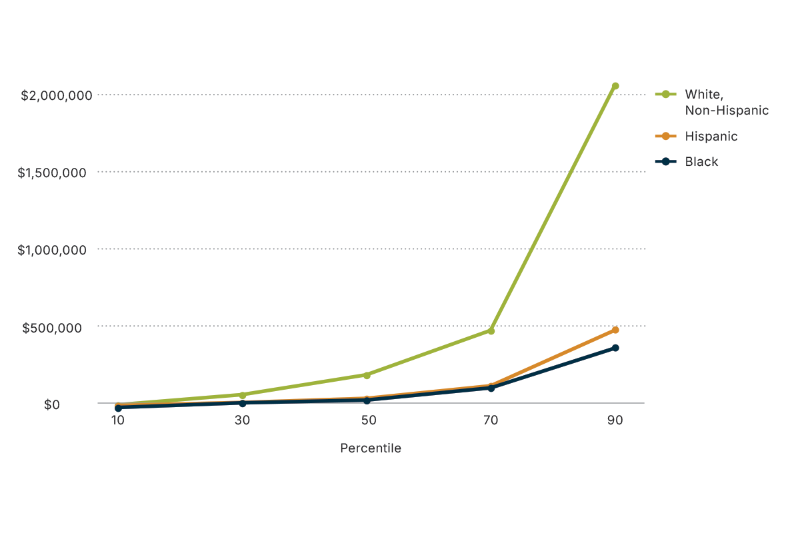
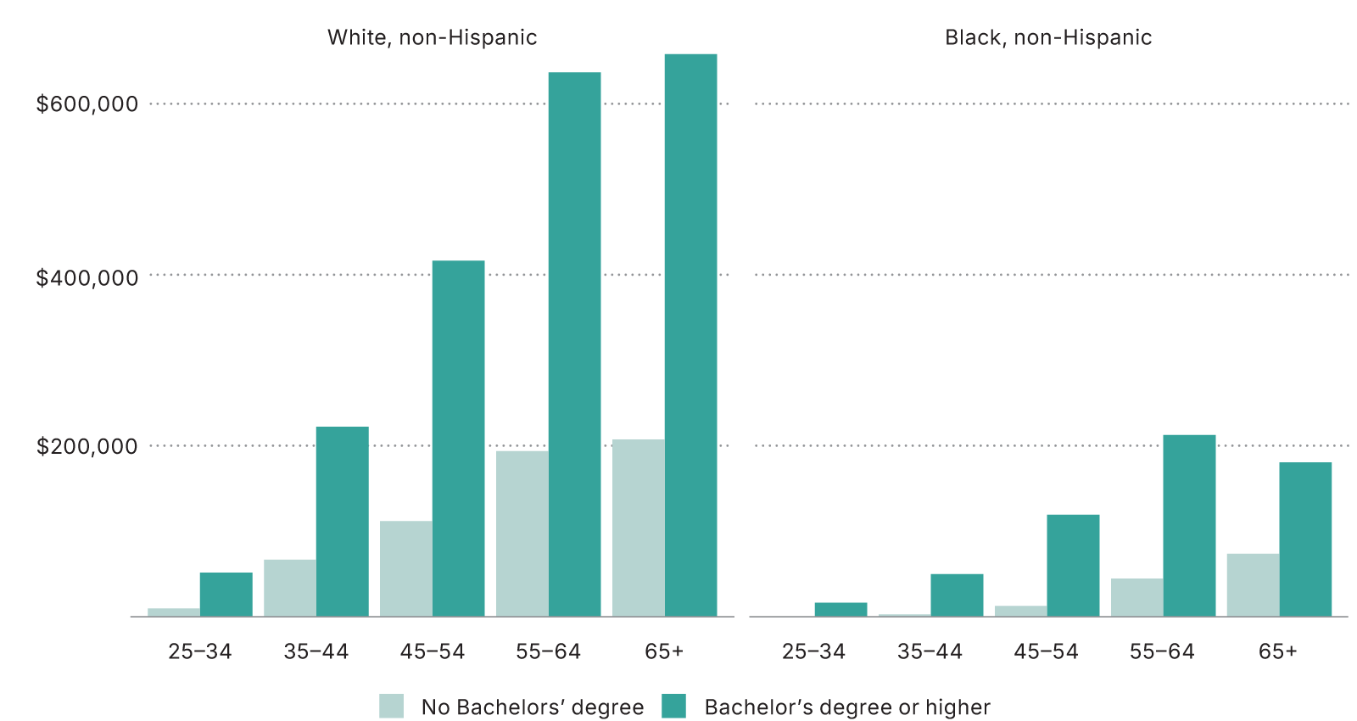
White households in Metro New Orleans have 10x the net worth of Black households and 6x that of Hispanic households. Wealth among Black college graduates is on par with that of White households with no college degree.
Distribution of net worth by race
Metro New Orleans, 2018
Source: Estimates by The Data Center based on 2018 Survey of Income Program Participation and the 2018 American Community Survey.
Notes:
Household wealth is one of the most important contributors to resilience. Household wealth enables families to cope with housing damage, medical costs, insurance costs, and job losses. White households in Metro New Orleans have about 10 times the median net worth of Black households and more than six times the median net worth of Hispanic households. These disparities cannot be fully accounted for by differences in educational attainment. Wealth among Black college graduates is comparable to that of White households with no bachelor’s degree, even after accounting for age.

Slide 23
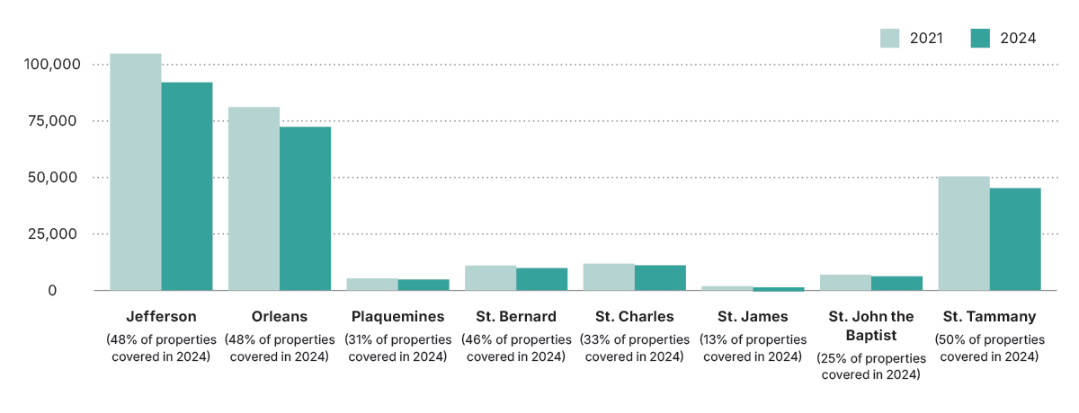
In St. Tammany, Jefferson, Orleans, and St. Bernard only half of properties have flood insurance. In St. Charles and Plaquemines only about 1/3 have flood insurance. In St. John only 25% and in St. James 13% are covered.
National Flood Insurance Program policies in-force
As of October 2024
Source: First Street Foundation and NFIP.
Notes:
For all races, homeownership is the highest contributor to net worth. But these assets are increasingly at risk in Metro New Orleans as homeowners are dropping their property insurance coverage. Flood insurance is a federal program and is increasing rates 18% per year until they reach actual risk. Over the last 3 years, the number of flood insurance policies in-force in Metro New Orleans decreased by more than 30,000.

Slide 24
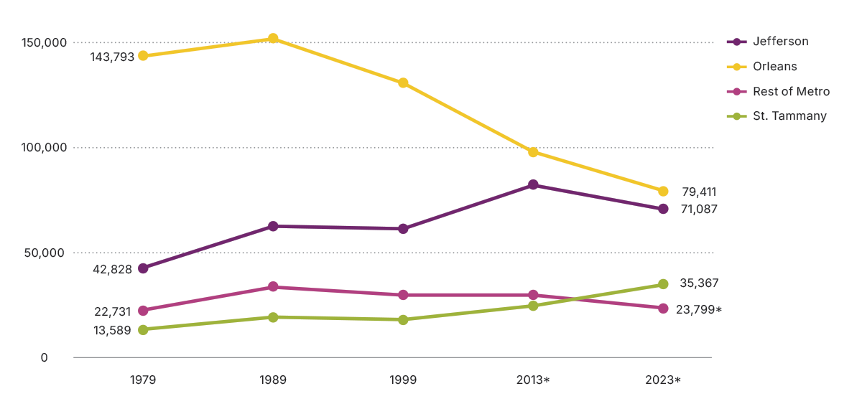
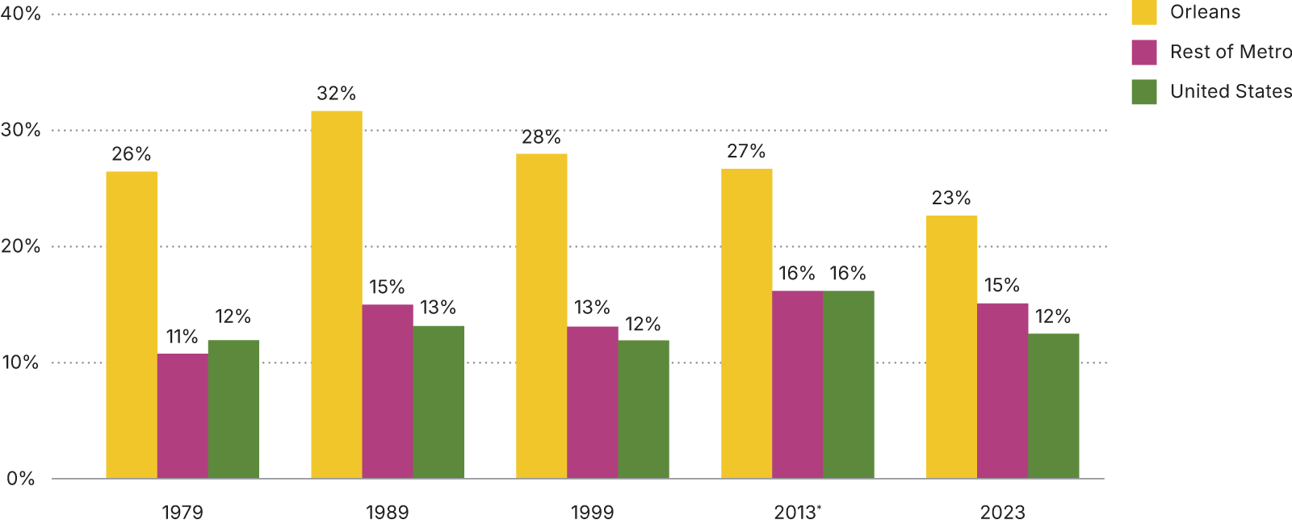
While poverty rates have fallen in New Orleans, from 28% in 1999 to 23% in 2023, they’ve grown in the rest of the metro and at 15% are now higher than the national rate. Today more impoverished people live in the suburbs than in the city.
Poverty rate
For population for whom poverty status is determined
Population living in poverty
For population for whom poverty status is determined
Source: iPUMS NHGIS data from U.S. Census Bureau Decennial Census 1980, 1990, 2000 and American Community Survey 2013 and 2023.
Notes:
While poverty rates have fallen in the city of New Orleans, from 28 percent before Katrina to 23 percent most recently, poverty rates have grown in the rest of the metro. There are now more people living in poverty (about 130,000) in the rest of Metro New Orleans than there in New Orleans.

Slide 25
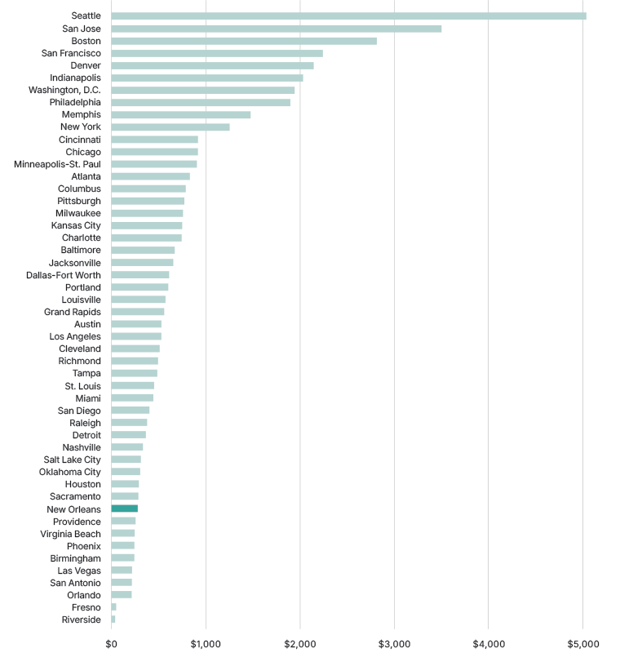
Philanthropic capacity in Metro New Orleans is about half the national average and among the lowest of the 50 largest metros.
Per capita philanthropic spending for 50 largest metropolitan areas, 2023
Philanthropic spending includes giving to anywhere, for any topic
Source: Foundation Center
Notes:
Philanthropy can deploy resources rapidly and with fewer bureaucratic hurdles than government agencies. Government aid and insurance payments frequently fail to cover the full scope of recovery needs, especially for marginalized communities and small businesses. This indicator suggests that philanthropic capacity in Metro New Orleans is about half the national average, and ranked 41st among the 50 largest metros.

Slide 27
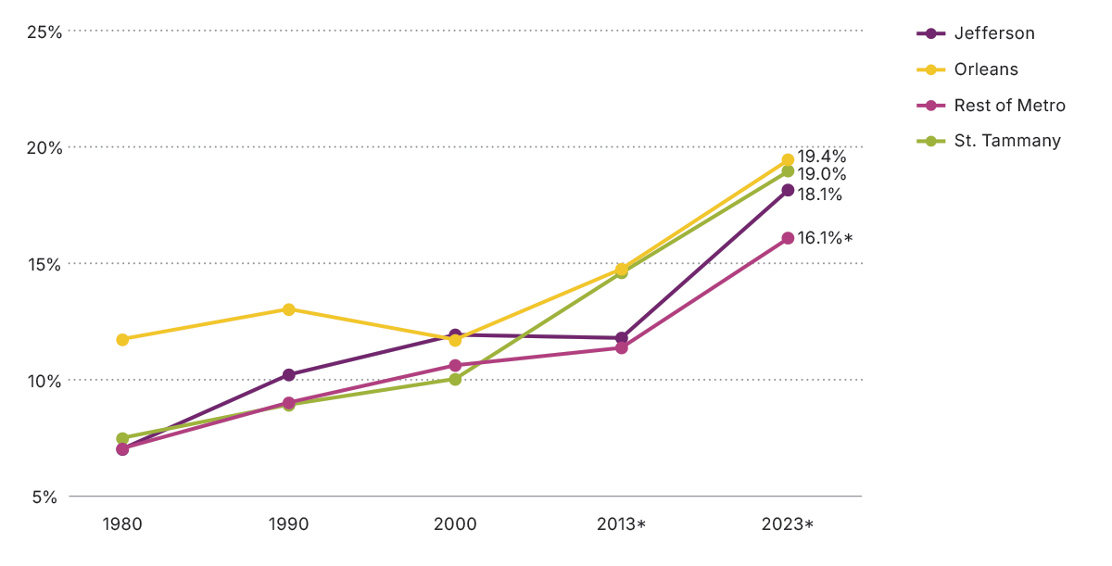
Roughly 1 in 5 Metro New Orleans residents are 65 years old or older –slightly exceeding the national average.
Population over 65 years old
Source: iPUMS NHGIS from U.S. Census Bureau, Decennial 1980, 1990, 2000, and American Community Survey 2013 and 2023
Notes:
Many older adults find it difficult to evacuate. And older adults are more susceptible to heatstroke and dehydration after a disaster. As the Baby Boomers age, a larger share of the total population is now over 65.

Slide 28
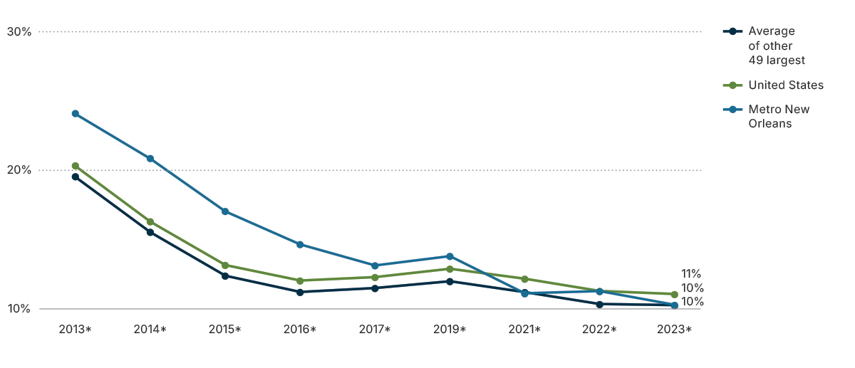
Metro New Orleans' share of working-age adults without health insurance has fallen from 24% in 2013 to 10% in 2023 and is now on par with the nation and other large metros.
Population without health insurance
19-64 year olds
Source: U.S. Census Bureau, American Community Survey
Notes:
Uninsured working age adults are more vulnerable to disasters because they often delay or forgo treatment for health conditions, which can be exacerbated during and after disasters. Beginning in 2010, the Affordable Care Act significantly reduced the number of uninsured adults through subsidies for health insurance “marketplaces.” Then in 2016, Louisiana expanded Medicaid coverage bringing the share of the working-age population without health insurance in Metro New Orleans down from 24 percent in 2013 to 10 percent in 2023, and is now on par with the other large metros and the nation.

Slide 29
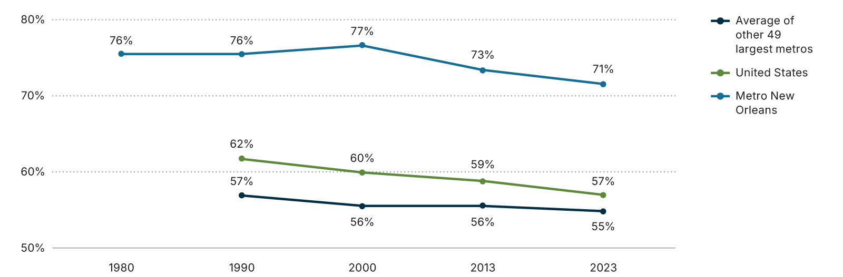
Roughly 3 out of 4 metro New Orleans residents were born in Louisiana, a much higher state nativity rate than other large metros.
Population born in state of residence
Source: iPUMS NHGIS from U.S. Census Bureau, Decennial 1980, 1990, 2000, and American Community Survey 2013 and 2023
Notes:
Place attachment plays a vital role in disaster recovery. A strong emotional connection to a community often strengthens local social networks, which in turn supports mutual aid, information exchange, and coordinated recovery actions. Place attachment also offers psychological stability after a disaster. New Orleans has a very high nativity rate.

Slide 30
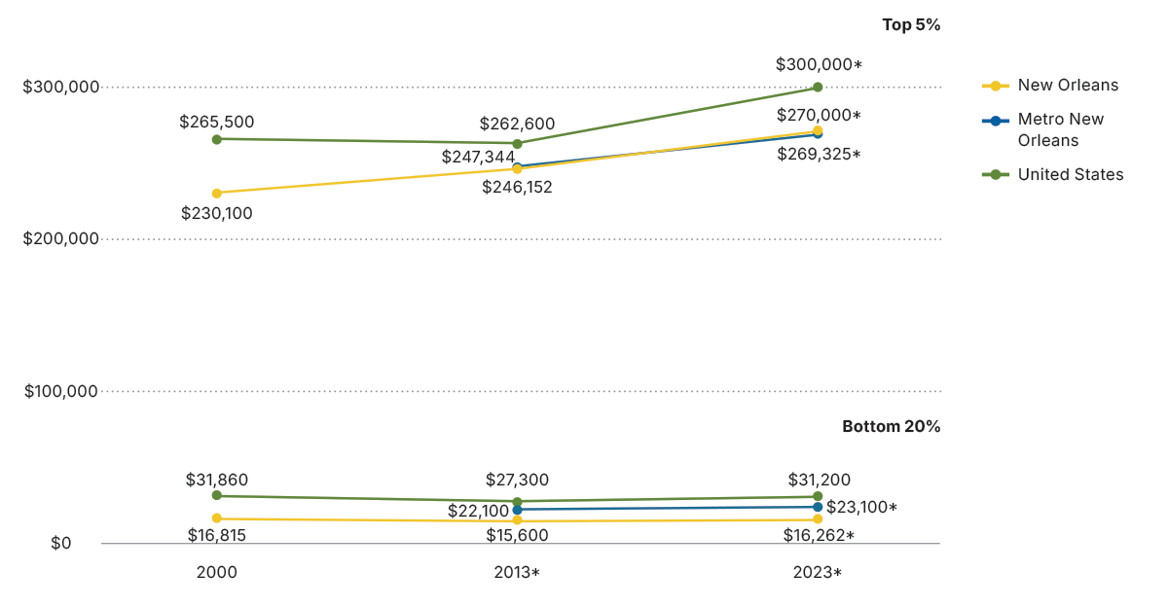
Metro New Orleans is more unequal than the nation. The ratio of the income of the top 5 percent of households to the bottom 20 percent is 12:1 in Metro New Orleans compared to 10:1 nationwide.
Income at 95th percentile and 20th percentile
2023 inflation-adjusted dollars
Source: iPUMS NHGIS from U.S. Census Bureau, Decennial 1980, 1990, 2000, and American Community Survey 2013 and 2023
Notes:
Numerous studies find that income inequality is negatively associated with generalized trust among citizens. In unequal societies, people are less likely to believe they share common interests or destinies with others, particularly those outside their socioeconomic group. This mistrust extends to institutions and authorities, further weakening social cohesion. Increasing U.S. income inequality is contributing to fraying of social cohesion nationwide. How is Metro New Orleans doing? Metro New Orleans is more unequal than the nation. In Metro New Orleans, the top 5 percent of households earn at least $269,000 annually, while the bottom 20 percent earn less than $23,100—well below the national bottom 20 percent threshold of $31,200. In the city of New Orleans, the bottom 20 percent earn less than $16,262. Since 2000, in New Orleans, the income threshold for the lowest quintile has not significantly changed from $16,815 after adjusting for inflation.

Slide 31
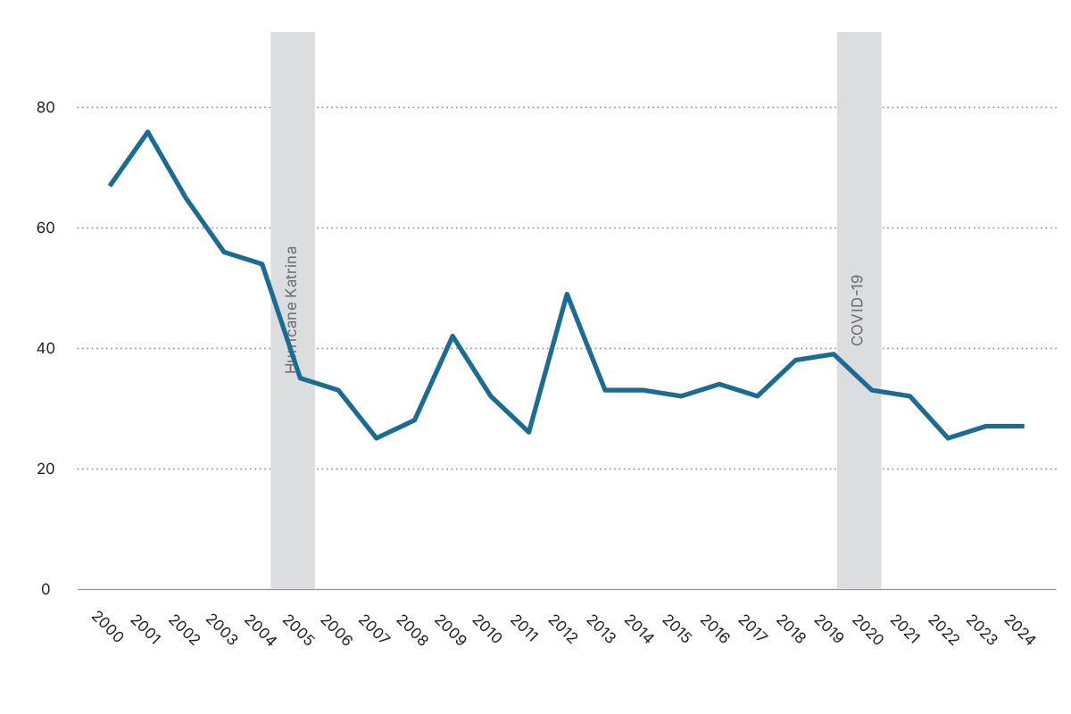
The number of workers covered by unions in Metro New Orleans is half of what it was in 2004.
Workers covered by union membership in thousands
Metro New Orleans
Source: U.S. Bureau of Labor Statistics, Current Population Survey
Notes:
Unions support social cohesion because they create social bonds and build solidarity among diverse groups of workers. Unions provide a number of social benefits, including an increased likelihood among members of engaging in democratic processes. New Orleans has a strong history of biracial unions. But union membership has declined locally and nationally for decades for a number of reasons, including decline in manufacturing and rise in service sector work, state laws that make organizing more difficult, aggressive anti-union activities by employers, and declining employee interest.

Slide 32
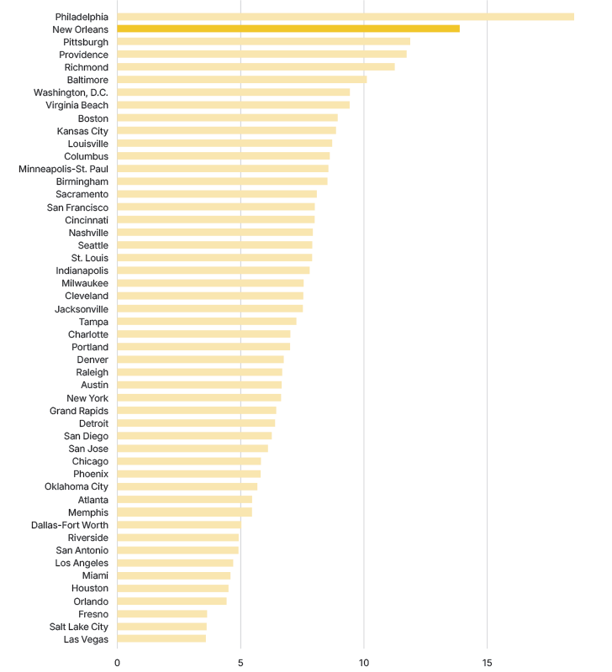
Social clubs play a critical role in fostering social cohesion by facilitating community engagement, expanding interpersonal networks, and enhancing individuals’ sense of belonging. New Orleans has the second highest concentration of social clubs of the 50 largest metros.
Recreational, pleasure, or social clubs per 100,000 people
50 largest metros, March 2025
Source: Cause IQ. March 2025 data pull
Notes:
Social clubs play a critical role in fostering social cohesion by facilitating community engagement, expanding interpersonal networks, and enhancing individuals’ sense of belonging. New Orleans is famous for its social aid and pleasure clubs. Historically, Black New Orleanians formed these clubs to meet needs like medical and burial insurance, which were denied to them by mainstream institutions. These groups also supported the development of new forms of music, including jazz. During the Jim Crow era, these societies became hubs for political organizing. Homer Plessy, for instance, who famously challenged segregation in the 1896 Supreme Court case Plessy v. Ferguson, was an officer in La Société des Francs Amis, a leading benevolent society. Today’s social aid and pleasure clubs continue to demonstrate adaptability in their missions’ multi-generational appeal.

Slide 33

Conclusion
Metro New Orleans needs additional investments in strong housing and infrastructure, yet the economy is diversifying and entrepreneurship is very strong. Adult educational attainment has caught up and is on par with the nation. Material wealth is in short supply, while social cohesion and attachment to place are strengths that are undergirding New Orleans’ resilience.
All Americans must plan for a future with increasing climate shocks, and the tremendous economic disruption that AI will bring.
Leaders and residents will need to unite around policies that have as their primary goal a high quality of life for everyone.

Slide 34
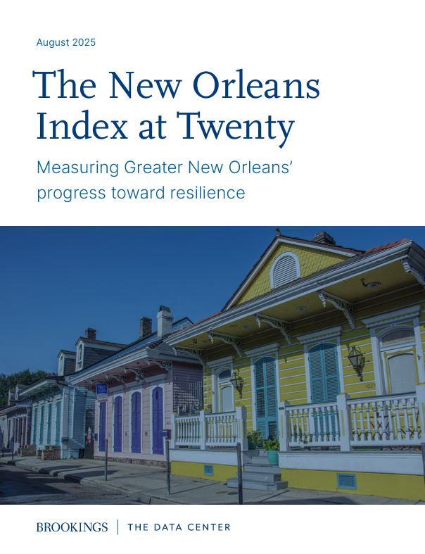
Check out the full report and related papers online @
www.datacenterresearch.org
www.brookings.edu

