Slide 1
AGIIS 101 Introduction to the Ag Industry Identification System
Chris Crutchfield
AGIIS Product Manager

Slide 2

This Session Sponsored By

Slide 3

Ag Industry Identification System (AGIIS)
AGIIS is an interactive database that houses eBusiness data for agriculture.
AGIIS provides the unique identifiers and other common data elements that allow companies to “sync” and set the stage for eBusiness transactions.
AGIIS does not process transactions; it is a directory resource that facilitates electronic communication.
Notes:
One of the most important AgGateway resources is AGIIS.
AGIIS is an interactive database that houses ag eBusiness data for industry subscribers.
Companies use the database to look up unique identifiers and common data elements (such as GTINs and GLNs) that they can then insert into their transactions — either internal or with trading partners — to make electronic communication possible.
For example, they can look up the Global Trade Item Number (GTIN), which is the numerical code representing a specific brand and packaging of a given product (e.g., seed, crop protection chemicals, fertilizer, etc.), or the Global Location Number, which is the unique identifier for the name and address of an organization, individual or location. Because trading partners are able to access and use the same identifiers, the pieces of information fit together, and electronic communication is possible.
AGIIS does not process transactions; it is a directory resource that facilitates electronic communication.

Slide 4
What is being Identified?
Entities
Who/Where Within the Ag Industry? (13-digit Global Location Number or GLN)
Manufactured a Product or Supplied a Service
Sold a Product/Service
Purchased a Product/Service
Applied/Planted Product
Received a Service (spray application or grid sampling)
Shipped a Product
Products
What? (14-digit Global Trade Item Number or GTIN)
Product identified by a GTIN
Notes:
The purpose of the slide is to demonstrate to the audience how identifiers are used in business transactions.

Slide 5
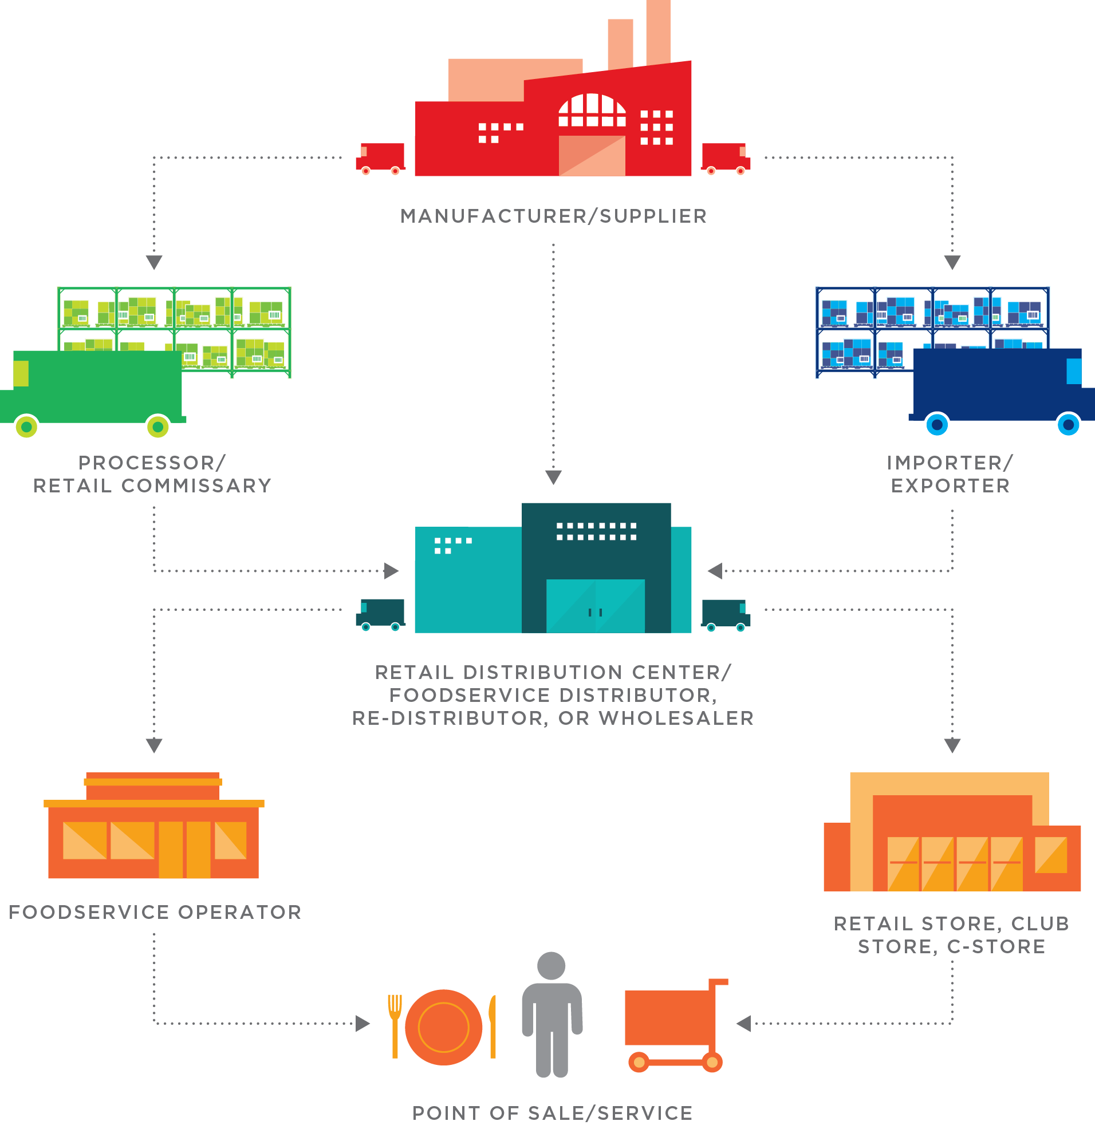


Unique Identifiers
GTIN – Global Trade Item Number
Used to identify products at the lowest salable unit
Assigned by product owner and displayed in AGIIS
GLN – Global Location Number
Used to identify entities (Businesses, Consumers, Locations)
All active entity records in AGIIS have a GLN identifier.
GTIN 00707755364158
GLN 0707755000068
GLN 1100012809673
Notes:
I want to quickly introduce the identifiers AgGateway supports. Will explain entities cover businesses, consumers and locations.
Bag Seed and Manufacturing Plant both have same Sub Owned prefix
Farm has AGIIS assigned prefix.

Slide 6

AGIIS Identifiers – Provide Solutions
Sales Reporting
Rebate Programs in Crop Protection, Specialty, and Seed
Regulatory Compliance
EPA Seed License Reporting, Responsible Ag
Supply Chain eConnectivity
Ship Notice, Delivery Confirmation, Inventory, Invoicing
Precision Ag Field Operations
Machine Reference Data
Traceability
Consumer Interest
Recalls
Notes:
Sales Reporting – Crop Protection, Specialty and Seed Industry for Rebate Programs
Regulatory Compliance – Seed License Reporting for EPA. ResponsibleAg Program for Crop Nutrient Industry, Data Privacy enhancement for CCPA
Supply Chain eConnectivity – Ship Notice, Delivery Confirmation, Inventory, Invoicing
Precision Ag Field Operations – Machine Reference Data potentially Field Identification.
Business Analysis – Allows for business analysis to be conducted with ease internally and externally
Connecting the Industry Together – Provides Unique Identification for the entire industry so they can be connected which enable tracebility

Slide 7
AGIIS Industry Owned and Managed Database
Products-GTIN
Entities-GLN
Licenses
AGIIS
Notes:
3 Primary Components of AGIIS – Products (GTIN), Entities (GLN) and Seed Licenses.
AGIIS is Subscriber Owned and Maintained.
Products are maintained and added by product owners, entities maintained and added by the community of subscribers and licenses maintained and added by the Licensor.

Slide 8
AGIIS Snapshot
5,836,828 Active Entities (GLN)
672,151 Licenses
269,049 Products (GTINs)
140 Subscribers
Notes:
As of 11/4/2024

Slide 9

How does it work?
Notes:
In this section we will begin discuss the identifiers that are supported within AGIIS, How the system operates and how subscribers use the system.

Slide 10

GS1:
International Standards Organization http://www.gs1.org/
Strong relationship with GS1 U.S. for 18 years
Agreement with GS1 U.S. for AGIIS to assign GLN’s
Foundations of a GLN/GTIN are a GS1 Company Prefix
Notes:
The purpose of this slide is to introduce GS1 to the audience and briefly describe the relationship AgGateway and GS1 (US and Canada). Will discuss the generic prefixes we use to assign GLN for smaller business and growers in the agriculture industry

Slide 11
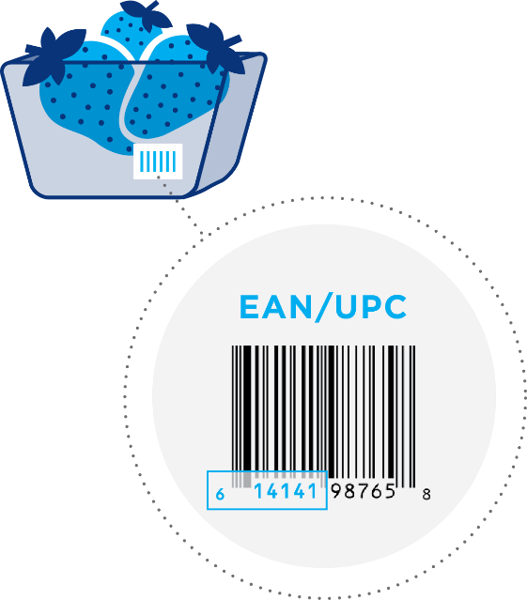

GS1 COMPANY PREFIX
“The Foundation”
Used to create globally-unique identification numbers for:
Products (GTIN)
Locations (GLN)
Subscriber Owned GLN
AGIIS Assigned GLN
Notes:
The foundation for the GTIN and GLN is a GS1 Company Prefix. I will also explain the agreement GS1 and AgGateway have for AGIIS assigned GLN’s.
GLNs – Sub Owned and AGIIS assigned
Benefit of Sub Owned – Cant be updated by another subscriber

Slide 12

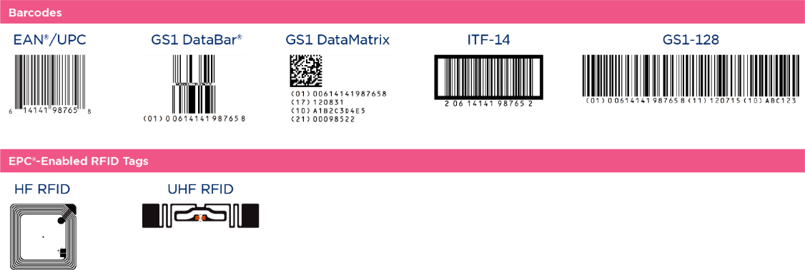
Capture: GS1 Data Carriers
GS1 Data Carriers are capable of holding varying amounts of data to accommodate different needs such as Batch/Lot information and expiration dates.

Slide 13

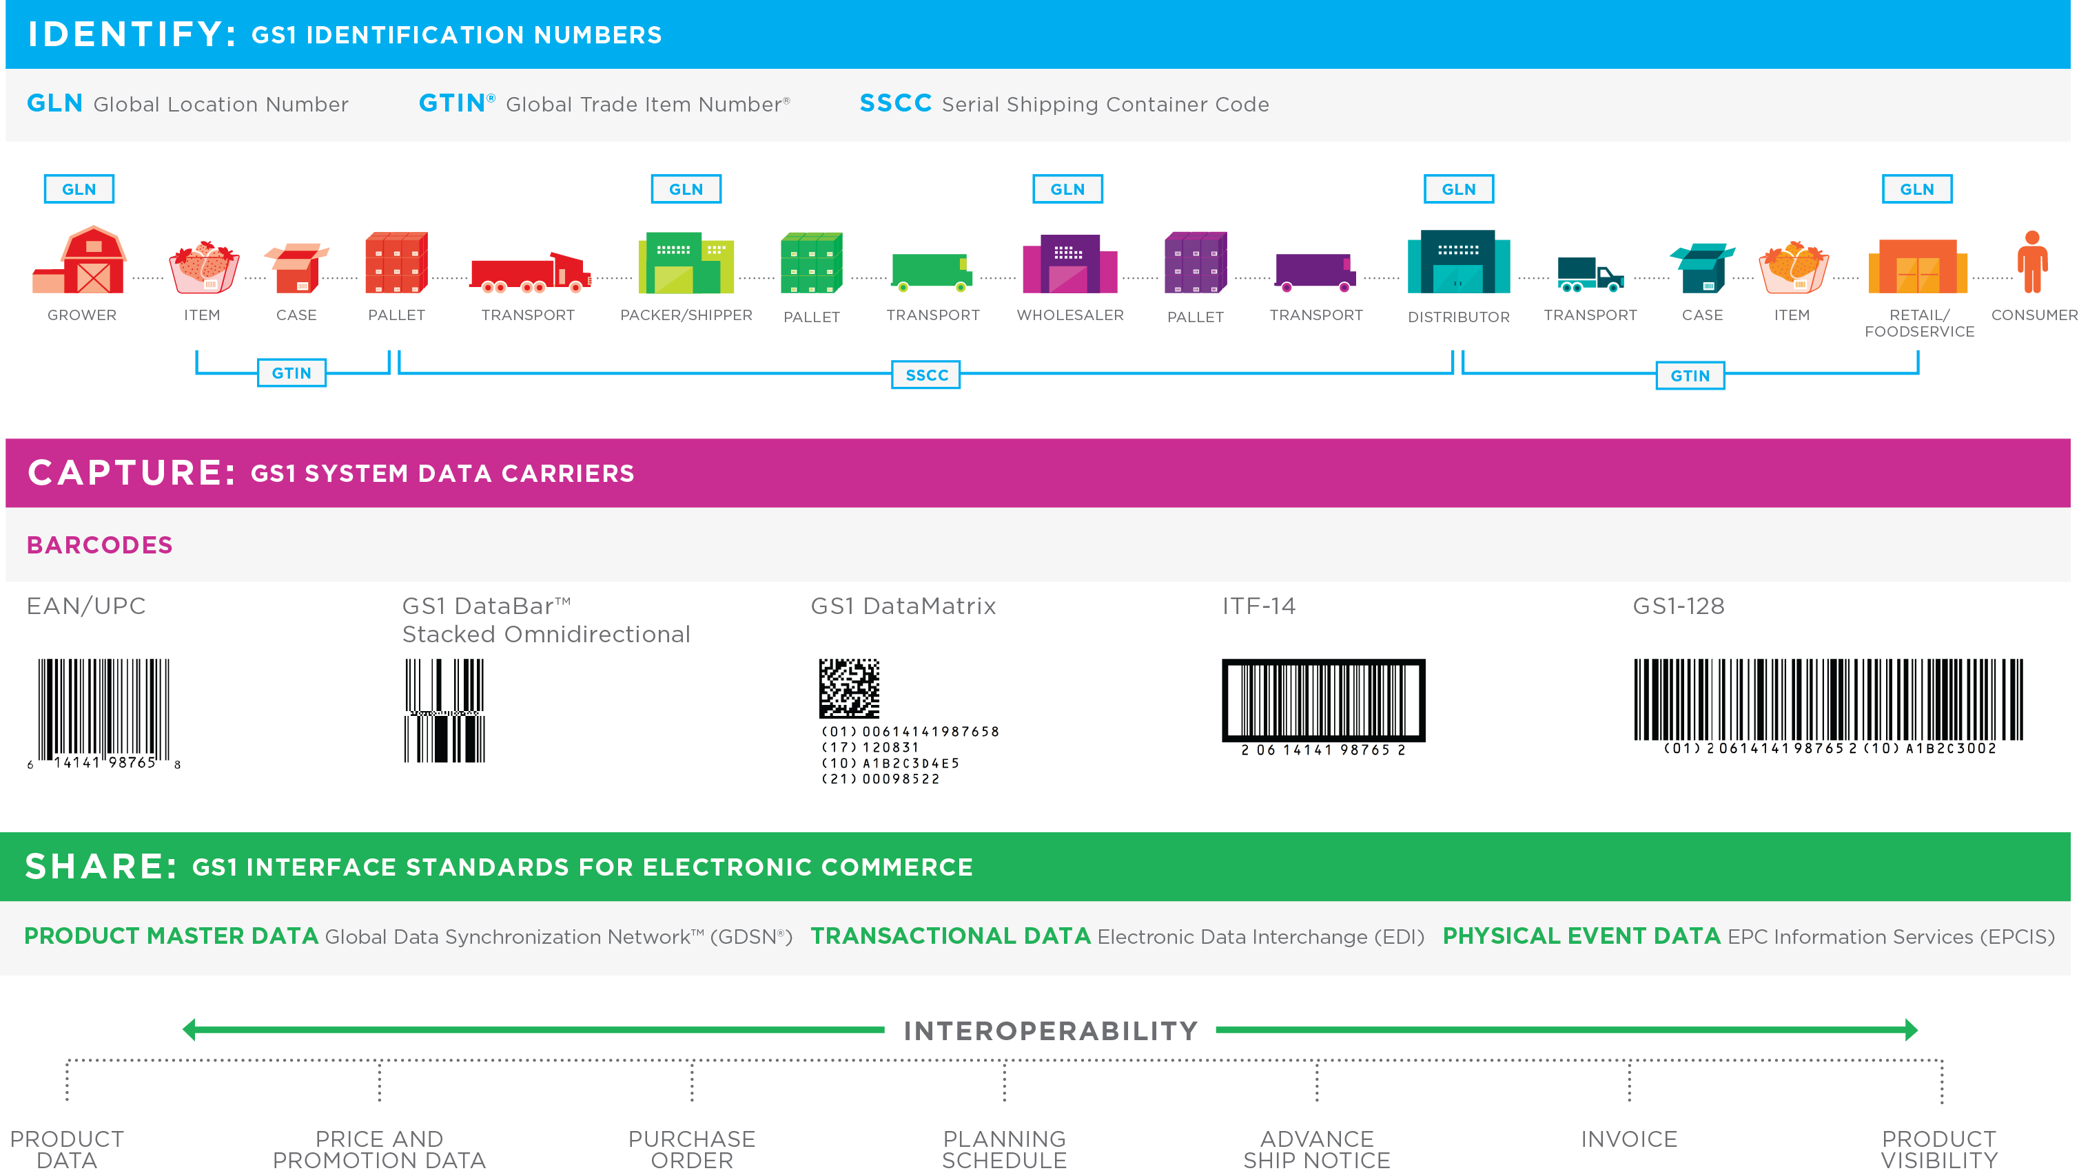
Share: Data Exchange
Interoperability, made possible by identification standards, data capture standards, and data exchange standards, allows product information to flow through the supply chain.
Notes:
This slide shows us how the GLN and GTIN are used throughout the supply chain, from Grower or Manufacturer to wholesaler, distributor all the way to the consumer.

Slide 14
AGIIS the Solution
Software and Business Logic
Communication
Accessibility
Notes:
Three Primary Layers to AGIIS – Software and Business Logic, Communication, and Accessibility
Software and Business Logic – is at the core of the solution. We use address standardization software so that when an address is submitted, it is standardized to the latest USPS standard. This software is also used to detect and prevent duplicates from being introduced to the database.
We also have Business Rules that prevent certain words or phrases that the industry has indicated they don’t want to see in AGIIS, this includes things like No Cash Sales, COD Cash on Delivery, or Petroleum Account, etc.
Communication – Bulk Submission notifications – File in good order or not, return file, extracts – email notifies of delivery, Directory Review
Accessibility – Subscribers have several methods to interact with AGIIS including, web services, website, bulk processes

Slide 15
Entity Basics
Definition – An Entity is a unique combination of name and address conducting business in the ag industry.
Entity records are added and maintained by the AGIIS user community
On the AGIIS website
Web Services
Bulk file processes
All AGIIS Subscribers have access to view all entity records in the AGIIS directory using the AGIIS website or web services
Notes:
This slide introduces Entity portion of AGIIS and let’s the audience know AGIIS is a subscriber driven database which means it is maintained and updated by the subscriber community. It is important as a subscriber of AGIIS that data quality and accuracy is considered before adding and updating the database.

Slide 16
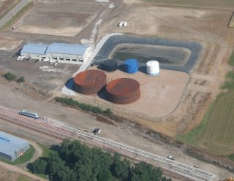
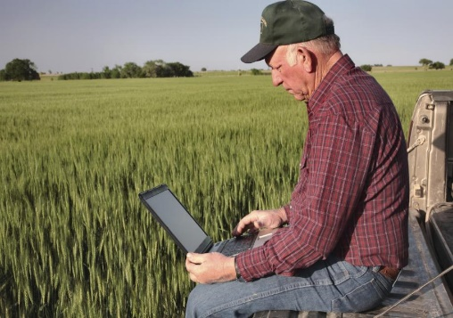
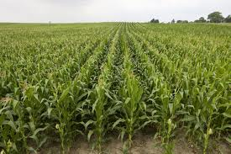
Entity Classifications
Business
Consumer
Location
Engages in transactions related to products or services consumed by others.
Purchases and uses products or services.
Physical place that can’t be identified as a Business or Consumer.
Notes:
There are 3 entity classifications in AGIIS.
Consumer – Grower/Farmer - . Consumes products or services
Business-indicates that the entity engages in transactions related to products or services consumed by others.
Location – Physical place that can’t be identified as a Business or Consumer. Often Rail Sidings or drop points.

Slide 17
Entity - Key Elements
13-Digit Global Location Number
Company Name / Grower Name
Doing Business as Name
Physical Address
Mailing Address
Phone Number
Latitude/Longitude
Entity Classification – Business, Consumer, Location
Business Status – Active/Inactive
Verification Status

Slide 18
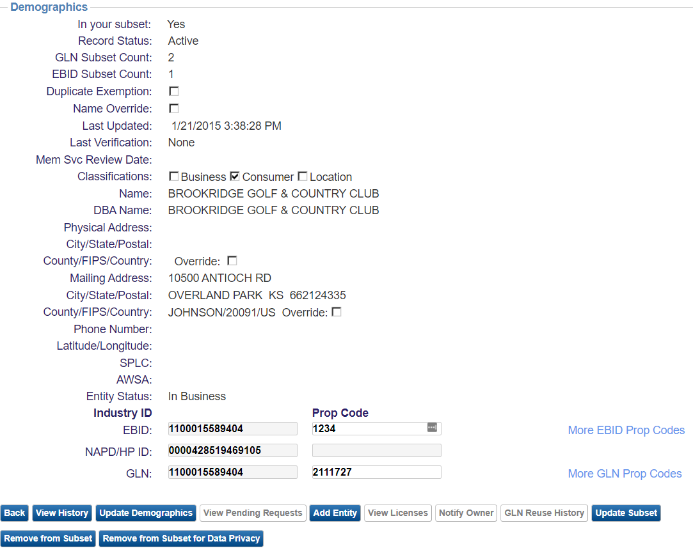
Entity Basics
Notes:
This provides the audience of a screen shot of the AGIIS Directory. We will discuss fields on the slide but particularly Industry Identifier section which will set-up the next slides discussing entity subsets.
SPLC
If appropriate for the entity (location types), enter its Standard Point Location Code (SPLC). An SPLC is assigned to all stations registered by rail carriers. Between six to nine digits, this numeric code is used to specify the physical location of a station.
AWSA
A number assigned by the Agrichemical Warehousing Standards Association (AWSA) to ensure that crop protection products in Canada are stored in certified warehouses.

Slide 19
Entity Subsets
A group of entities in AGIIS for which you have an interest or do business
An entity subset is established by a subscriber linking their internal identifier or proprietary (prop) code to an AGIIS entity record’s GLN identifier
Creating an entity subset indicates that you have an interest in specific entity records and identifiers
You can only update a record if it is in your subset
Once your entity subset is created, you can receive an Update Extract file that will provide changes that have been made to any entity record in your subset
Must be an AGIIS Full Subscriber to maintain a subset. Search/View subscribers can’t maintain a subset in AGIIS.
Notes:
AGIIS Subscribers (excluding subscribers with only search/view privileges) can include any entity record in their subset.

Slide 20
AGIIS Entity Process
Imports
Subscriber Subsets
Extracts
Internal
Systems
Subscriber 1
Bulk File Upload
Add/Update
Business
Rule
Layer
Subscriber 1
Subset
Subscriber 1 GLN Update Extract
Subscriber 1 DB
Subscriber 2
AGIIS Website
Add/Update
AGIIS
Subscriber 2
Subset
Subscriber 2 GLN Update Extract
Subscriber 2 DB
Subscriber 3
AGIIS Web Service
Add/Update
Subscriber 3
Subset
Subscriber 3 GLN Update Extract
Suscriber 3 DB
Subscriber 4
Subset
Subscriber 4 Update Extract
Subscriber 4 DB

Slide 21
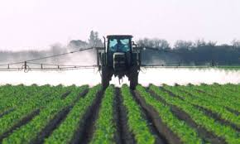
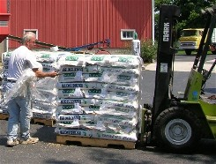
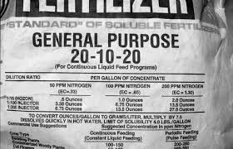
AGIIS PRODUCTS
Crop Protection
Seed
Crop Nutrient

Slide 22
Seed Product Data - Key Elements
Global Trade Item Number
Product Category (Chemical, Feed, Fertilizer, Seed, Other)
Product Name
Brand
Crop
Variety/Hybrid
Maturity/Zone
Seed Size
Status – Active/Inactive
Units of Measure

Slide 23
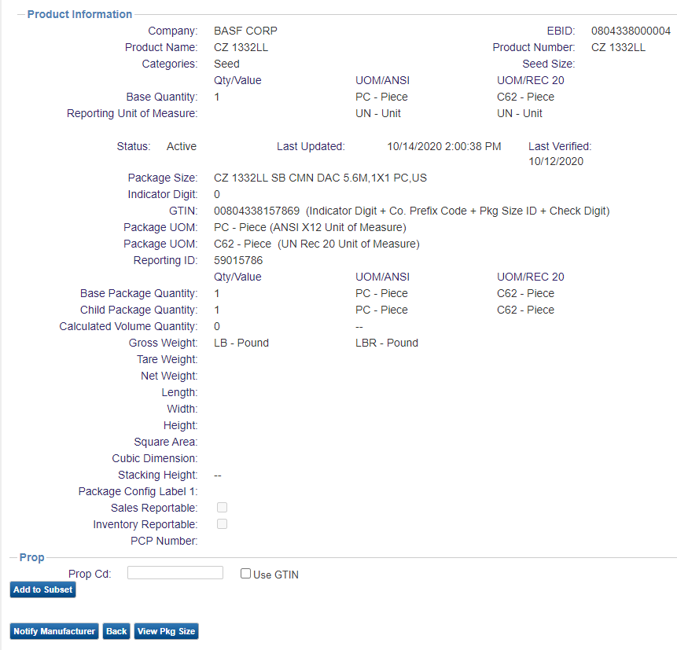
Product Basics

Slide 24
Product Process
Ag Industry via AGIIS
Website and Web Services
Subscriber 1
Product Extract
Subscriber 1 Loads Products
AGIIS Products
Business Rules Verification
&
UOM Standardization
Subscriber 3
Product Extract
Subscriber 2 Loads Products
Subscriber 4
EBMS Product Updates
Subscriber 1 Subset
Subscriber 2 Subset

Slide 25

Continuous Improvement Process
Subscriber Input
Formal Request Process
Directory Oversight Committee
Notes:
Will discuss the structure of the Directory Oversight Committee (DOC)
Representation from each AgGateway Industry segment, (AgRetail, Crop Protection, Crop Nutrition, Seed, Specialty Chemical, Precision Ag, and Allied/Service Providers)
Role of DOC in 2020 that will change
Evaluating enhancement, change or other modification requests, wherever the request comes from, against the purpose of AGIIS and the mission of AgGateway
Ensuring data cleanliness and maintenance as defined in the AGIIS Policies and Procedures documents is implemented
Communicating needs and relevant messages between councils and the committee
Subscriber Input
Each AgGateway Member Company or Subscribing Company can recommend an improvement or enhancement to AGIIS
Formal Request Process
- Discuss a form is submitted to Member Services and then passed on to Directory Oversight Committee for evaluation and prioritization

Slide 26
AGIIS Enhancements
Released Enhancements 2025
PCR 265 – Add Customizations Button to Product Extract
PCR 266 – Home Office Rule Code Changes
PCR 267 – Ability to Update Password Security Questions
PCR 268 – Auto-Populate Corresponding UOM – X12/REC20
PCR 270 – Update Product Extract Confirmation Email
PCR 269 – Prop Code History
PCR 271 – New User Password Email
PCR 272 – Subscriber/User Reports
PCR 273 – Directory Admin Duplicate Exempt Capability
PCR 274 – DA Visibility to User Product Extracts
PCR 275 – Subscriber Comments to Entity View Page
Red - In Development

Slide 27
Directory Oversight Committee
The Directory Oversight Committee – the DOC - is charged with establishing policies in the operation of AGIIS, the industry recognized repository of common entity and product information. We evaluate, prioritize, and execute enhancements in response to subscriber and AgGateway project requests. We oversee the maintenance and care of the data in the directory.

Slide 28
DOC Membership
Voting Membership
The Digital Resource Center will use the Subscriber Representation Matrix (Combination of Industry segment representation and organization's role in supply chain), to nominate candidates for voting seats on the DOC
3-year Terms
Current users familiar with AGIIS
Full AGIIS subscriber members of AgGateway
Subscribing companies – each company can only have one DOC rep
Non-Voting Membership
AgGateway staff representative(s)
Database hosting company representative
Advisory positions
Meetings
1 – 2 hour call 2nd Wednesday each month
1 – 1 hour call 4th Wednesday each month as needed

Slide 29
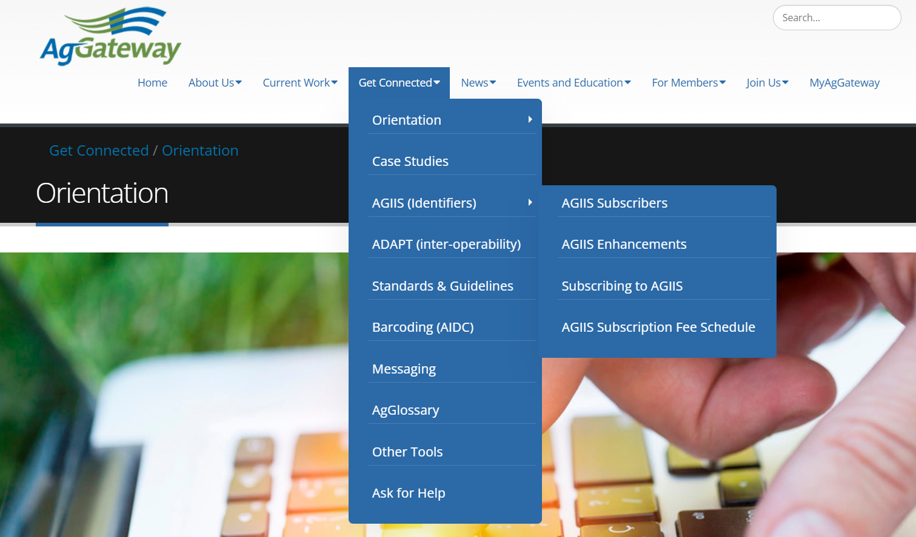
Website: AgGateway.org
Notes:
Our website, www.AgGateway.org, is also a great resource, with sections devoted to helping your company get started or get connected. The home page carries the latest news and events.

Slide 30
AGIIS Subscription
AGIIS Requires a Yearly Subscription
Full and Search/View Subscription
Full – Maintain Subset/Add and Update Entities/Receive Extracts
Search/View – Can access all data via website or web services, no subset, no add/update ability, no extracts
Rates Based on Subscription Type, Corporate Revenue, Subset Size and AgGateway membership status
Non-Subscriber Access
AgGateway Members Receive a Free Search/View Subscription

Slide 31
Thank you!

