Slide 1
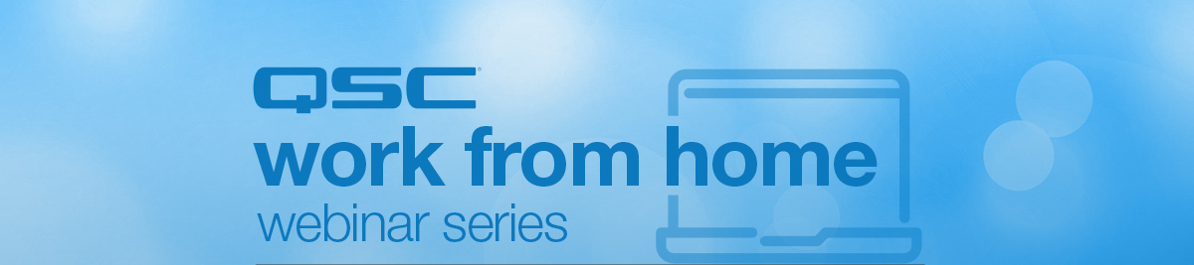
Planning Clocking Domains for Dante, Q-LAN and AES67

Slide 2
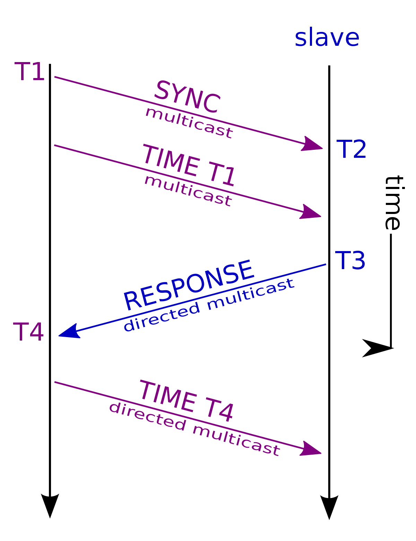

Precision Time Protocol (IEEE-1588)
PTP v1 (1588-2002)
PTP v2 (1588-2008)
Dante
QLAN
AES67
Requires multicast on network
Utilizes a process called election to determine Master / Preferred Leader
  Happens each time a device is added to the network
Extremely sensitive to Jitter on network
QoS protects PTP packets on network
Not backwards compatible
  Requires use of Boundary Clock devices

Slide 3
Clocking Scenarios

Slide 4

Scenario 1: Standalone Cores
Equipment:
2x Core 110f
No network audio peripherals

Slide 5
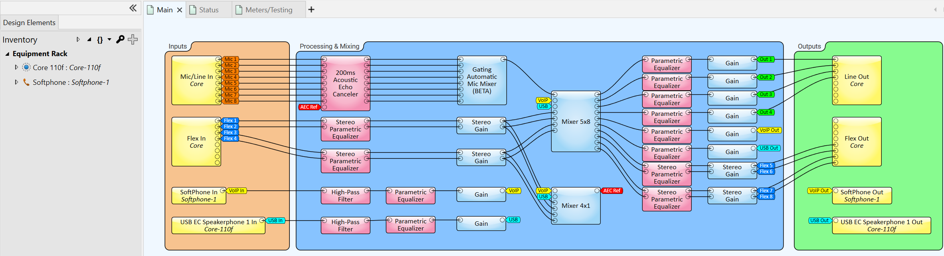
Scenario 1: Standalone Cores
Only Inventory item is Core and Softphone

Slide 6
Scenario 1: Standalone Cores
Core-1
Core-2
Primary Leader Clock: None
No PTP clocking is needed, so no clock is generated
Notes:
-Roughly 7.2 enabled this feature
-Force on via Design Properties

Slide 7

Scenario 2:
Q-LAN Peripherals
Equipment:
2x Core 110f
  1x I/O-8 Flex per Core

Slide 8
Scenario 2: Q-LAN Peripherals
PTPv2 – Domain 0
Core-1
Core-2
Flex-1
Flex-2
Primary Leader Clock: Core-1
BMCA Determines Clock Leader
  With Defaults, Lowest MAC Wins Election

Slide 9
Scenario 3:
Q-LAN Peripherals with Priority
Equipment:
2x Core 110f
  1x I/O-8 Flex per Core

Slide 10
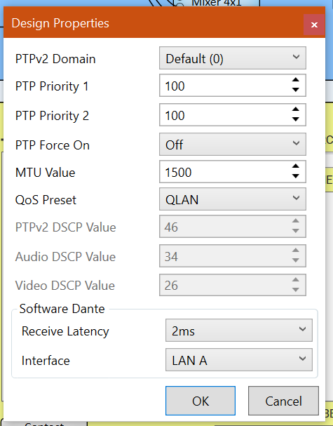
Scenario 3: Q-LAN Peripherals with Priority
PTPv2 BMCA Algorithm:
  Priority 1
  Class
  Accuracy
  Variance
  Priority 2
  UID (MAC Address)
Lowest Priority Wins
Q-SYS Defaults are:
  PTP Priority 1: 254
  PTP Priority 2: 100

Slide 11
Scenario 3: Q-LAN Peripherals with Priority
PTPv2 – Domain 0
Core-1
Core-2
Flex-1
Flex-2
Primary Leader Clock: Core-2
Core 2 won BMCA based off Priority 1 Value (100) vs Core 1 (254)

Slide 12
Scenario 4:
Q-LAN Alternate Domains
Equipment:
2x Core 110f
  1x I/O-8 Flex per Core

Slide 13
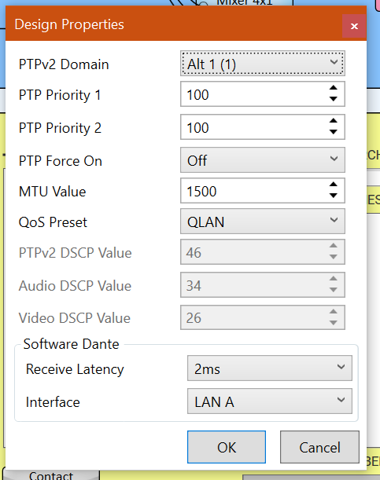
Scenario 4: Q-LAN Alternate Domains
Domains allow multiple clocks to exist on the same network
  All Q-LAN devices in Design are assigned to the same domain
Q-LAN Tx/Rx, System Link, and AES67 Tx/Rx between two cores require them to be in the same domain
All Dante devices are in Domain 0 unless DDM is utilized
Notes:
-No QLAN audio between Cores

Slide 14
Scenario 4: Q-LAN Alternate Domains
PTPv2 – Domain 0
PTPv2 – Domain 1
Core-1
Core-2
Flex-1
Flex-2
Primary Leader Clock: Core-1 and Core-2
Each Core is in Separate Clocking Domain and its own Leader
  Peripherals Clock to each Core’s domain
Notes:
-No QLAN audio between Cores

Slide 15
Scenario 5:
Dante Device in AES67 Mode
Equipment:
2x Core 110f
  1x I/O-8 Flex per Core
1x unD6IO-BT – AES67 Enabled (Ultimo X)
1x Legacy unDX4I (Ultimo)

Slide 16
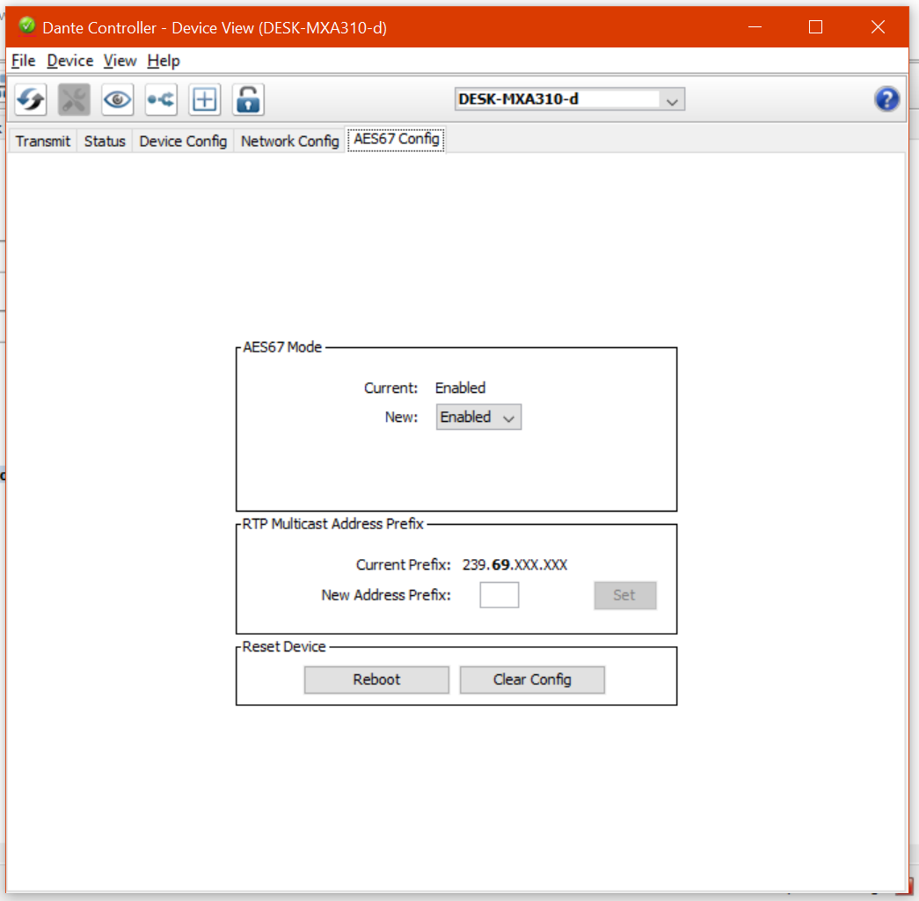
Scenario 5: Dante Device in AES67 Mode
Enabling AES67 turns on PTPv2 Clock on Dante Devices
Devices with AES67 enabled still utilize PTPv1 for synchronization with other Dante devices
All Dante Devices are in Domain 0 unless DDM is utilized
Boundary Clocks bridge PTPv1 and PTPv2 domains
Notes:
-No QLAN audio between Cores

Slide 17
Scenario 5: Dante Device in AES67 Mode
PTPv2 – Domain 0
PTPv1 – Domain 0
Core-1
BC
unDX4I
unD6IO-BT
Flex-1
Core-2
Flex-2
Primary Leader Clock and Boundary Clock: unD6IO-BT
unD6IO-BT is Clock Leader and Boundary Clock for both PTPv1 and PTPv2

Slide 18
Scenario 6:
Modify PTP1 Priority
Equipment:
2x Core 110f
  1x I/O-8 Flex per Core
1x unD6IO-BT – AES67 Enabled (Ultimo X)
1x Legacy unDX4I (Ultimo)

Slide 19
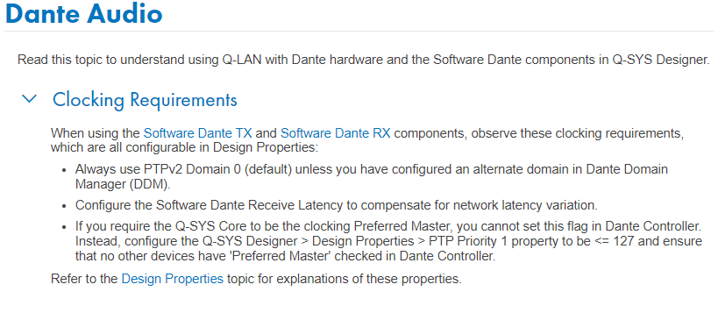
Scenario 6: Modify PTP1 Priority
To have a Core be Preferred Leader, set the PTP Priority 1 less than 127 and ensure no Preferred Leader selected

Slide 20
Scenario 6: Modify PTP1 Priority
PTPv2 – Domain 0
PTPv1 – Domain 0
Core-1
BC
unDX4I
unD6IO-BT
Flex-1
Core-2
Flex-2
Primary Leader Clock: Core-1
unD6IO-BT is Boundary Clock

Slide 21
Scenario 7:
Software Based
Dante
Equipment:
2x Core 110f
  1x I/O-8 Flex per Core
  Software Based Dante
1x unD6IO-BT – AES67 Disabled (Ultimo X)
1x Legacy unDX4I (Ultimo)

Slide 22
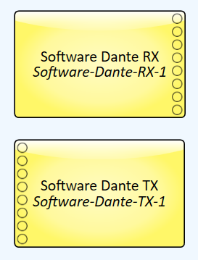
Scenario 7: Software Based Dante
Software Based Dante enabled PTPv1 and PTPv2 Clock on Core
PTP Domain only applies to PTPv2 Devices
  Must use DDM to change PTPv1 Domain
Core acts as Boundary Clock between PTPv1 and PTPv2 Domain
Unable to run separate PTPv1 and v2 Clocking
  Requires hardware Dante card in Frame or 510i

Slide 23
Scenario 7: Software Based Dante
unD6IO-BT
PTPv2 – Domain 0
PTPv1 – Domain 0
Flex-1
BC
Core-1
Core-2
unDX4I
Flex-2
Primary Leader Clock: unD6IO-BT
Default PTP Priority in Core prevents it from winning BMCA

Slide 24
Scenario 8:
Software Based
Dante with PTP Priority
Equipment:
2x Core 110f
  1x I/O-8 Flex per Core
  Software Based Dante
1x unD6IO-BT – Disable AES67 (Ultimo X)
1x Legacy unDX4I (Ultimo)

Slide 25
Scenario 8: Software Based Dante with PTP Priority
To have a Core be Preferred Leader, set the PTP Priority 1 less than 127 and ensure no Preferred Leader selected

Slide 26
Scenario 8: Software Based Dante with PTP Priority
unD6IO-BT
PTPv2 – Domain 0
PTPv1 – Domain 0
Flex-1
BC
Core-1
Core-2
unDX4I
Flex-2
Primary Leader Clock and Boundary Clock: Core-1

Slide 27
Real World Scenarios

Slide 28


Meeting Room

Slide 29

Paging System

Slide 30




Campus Building
Classroom 101
Classroom 102
Classroom 103
Auditorium
Building PA System
Remote Input for Events

Slide 31
Recap
Planning Clocking is Important Part of the Design Process
PTP Domains can be used to break up clocking within a subnet
PTP Priority can be used to influence clock election
Software-based Dante allows for Core to be both PTPv1 and v2 Leader
PTP v1 (1588-2002)
Dante
PTP v2 (1588-2008)
QLAN
AES67

Slide 32

Questions?

