Slide 1

Introduction to COVID-19 Vaccine
For Facility Staff
Notes:
Hello and welcome to the education session on COVID-19 Vaccination Program. There is beginning to be more and more details about the COVID-19 vaccine, and this is an evolving situation so we will begin with letting you know what we currently know. Stay tuned to CDC, CMS and FDA as more information will be forthcoming.

Slide 2
Objectives
Upon completion of this presentation, participants should be able to:
Verbalize 3 key resource areas to access evolving guidance
Understand the importance of the COVID-19 Vaccine during the Pandemic
Notes:
We have 4 objectives for today’s presentation (read slides)

Slide 3

Current Status
Notes:
There are many questions that still will need to be answered when it comes to the vaccination for COVID-19. We will address what we know now and where to access information to begin discussing with your team
As health care workers, you may be asked about the vaccine, what you know and how the system works. Today we are going to be providing you with a brief overview. Keep in mind, the guidance is changing, and we will keep you up to date on the information as it is posted

Slide 4
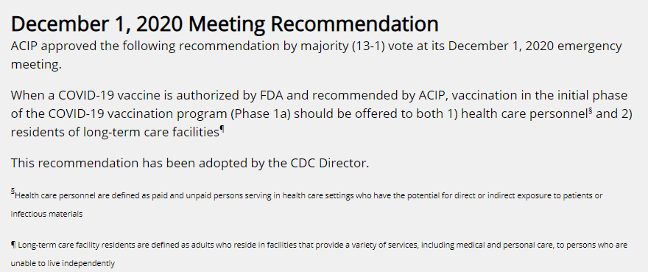
Advisory Committee on Immunization Practices (ACIP)
https://www.cdc.gov/vaccines/acip/index.html
Notes:
As many of you have seen in the news, the COVID-19 vaccine will not be available to the entire population initially, therefore, there is a process to determine who is at most risk and would benefit from the initial vaccine doses available. The Advisory Committee on Immunization makes these recommendations. On December 1, 2020 a Meeting was held and here are the Recommendations
ACIP approved the following recommendation by majority (13-1) vote at its December 1, 2020 emergency meeting.
When a COVID-19 vaccine is authorized by FDA and recommended by ACIP, vaccination in the initial phase of the COVID-19 vaccination program (Phase 1a) should be offered to both 1) health care personnel§ and 2) residents of long-term care facilities¶
This recommendation has been adopted by the CDC Director

Slide 5
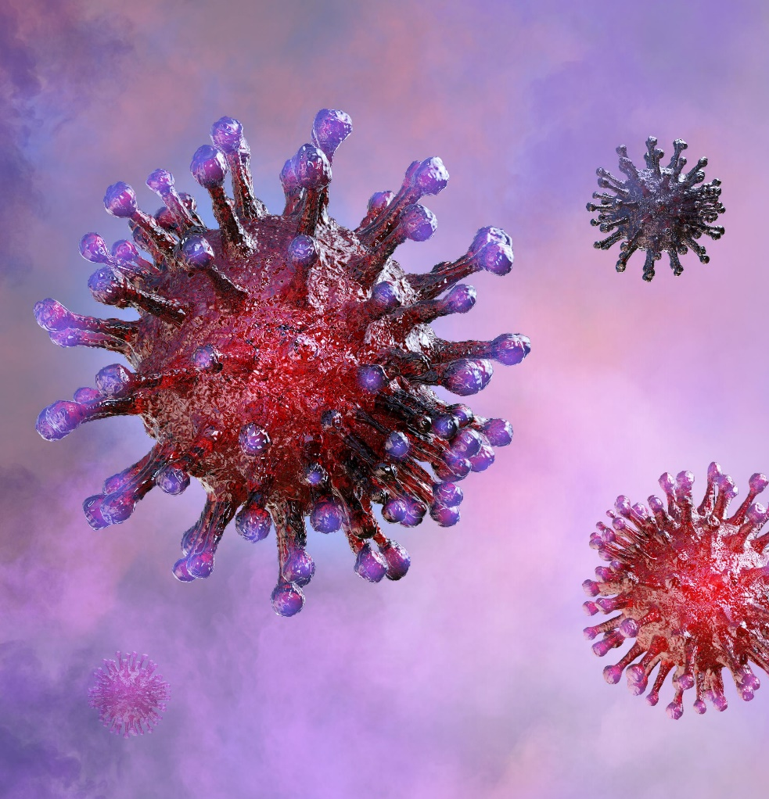
Immune System
Germ invades body
Attacks and multiplies (infection)
Immune system tries to fight infection
Macrophages
B-lymphocytes
T-lymphocytes
https://www.cdc.gov/coronavirus/2019-ncov/vaccines/different-vaccines/how-they-work.html
Notes:
The CDC indicates, “To understand how COVID-19 vaccines work, it helps to first look at how our bodies fight illness. When germs, such as the virus that causes COVID-19, invade our bodies, they attack and multiply. This invasion, called an infection, is what causes illness. Our immune system uses several tools to fight infection. Blood contains red cells, which carry oxygen to tissues and organs, and white or immune cells, which fight infection. Different types of white blood cells fight infection in different ways:
Macrophages are white blood cells that swallow up and digest germs and dead or dying cells. The macrophages leave behind parts of the invading germs called antigens. The body identifies antigens as dangerous and stimulates antibodies to attack them.
B-lymphocytes are defensive white blood cells. They produce antibodies that attack the pieces of the virus left behind by the macrophages.
T-lymphocytes are another type of defensive white blood cell. They attack cells in the body that have already been infected.
The first time a person is infected with the virus that causes COVID-19, it can take several days or weeks for their body to make and use all the germ-fighting tools needed to get over the infection. After the infection, the person’s immune system remembers what it learned about how to protect the body against that disease.
The body keeps a few T-lymphocytes, called memory cells, that go into action quickly if the body encounters the same virus again. When the familiar antigens are detected, B-lymphocytes produce antibodies to attack them. Experts are still learning how long these memory cells protect a person against the virus that causes COVID-19”

Slide 6
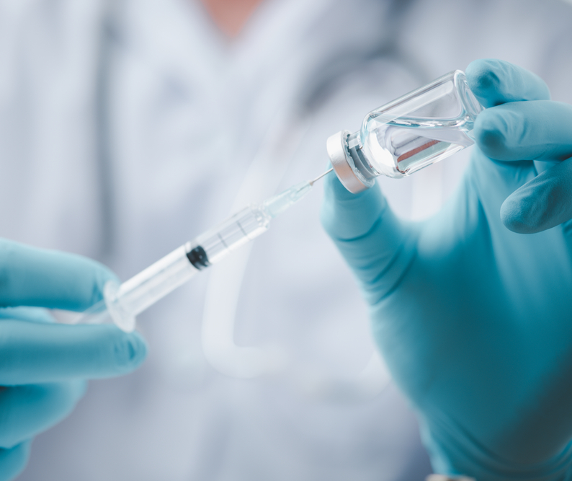
Types of Vaccines
mRNA vaccines
Protein subunit vaccines
Vector vaccines
https://www.astrazeneca.com/media-centre/press-releases/2020/azd1222hlr.html
Notes:
There are 3 types of COVID-19 vaccines that either are currently or will be undergoing Phase 3 clinical trials in the US.
mRNA (which include both the Pfizer and Moderna)
The Novavax vaccine contains purified pieces to trigger an immune response and have no live components
AstraZeneca uses a viral vector using an adenovirus that causes a common cold in chimpanzees, but in a weakened version, that scientists have replaced the genetic material for the same SARS-CoV 2 spike protein as the mRNA vaccine candidates to illicit making antibodies.
Janssen vaccine is a recombinant vector vaccine using a human adenovirus (which was modified so it does not replicate in humans) to express the COVID spike protein in cells. This vaccine is getting a lot of attention because it seems as if this one will require only one dose.

Slide 7
Websites for Details
Pfizer: https://www.pfizer.com/news/press-release/press-release-detail/pfizer-and-biontech-achieve-first-authorization-world
Moderna: https://investors.modernatx.com/news-releases/news-release-details/moderna-announces-primary-efficacy-analysis-phase-3-cove-study
AstraZeneca: https://www.astrazeneca.com/media-centre/press-releases/2020/azd1222hlr.html
Janssen: https://www.jnj.com/coronavirus/about-phase-3-study-of-our-covid-19-vaccine-candidate
Novavax: https://ir.novavax.com/news-releases/news-release-details/novavax-covid-19-vaccine-granted-fast-track-designation-us-fda
Notes:
The websites listed will provide the press release from each manufacturer regarding their vaccine information.

Slide 8
Benefits of the COVID-19 Vaccine
https://www.cdc.gov/coronavirus/2019-ncov/vaccines/vaccine-benefits.html
Notes:
Clinical trials have been underway to identify if the various vaccines that are developed are safe AND if they are effective before they are approved for use in the United States. In order for a vaccine to be authorized quickly such as now during the Pandemic, the potential benefits of the vaccine MUST outweigh any known and potential risk in order for an Emergency Use Authorization to be designated by the FDA

Slide 9
Benefits Of COVID-19 Vaccine
A safer way to build up protection/immunity than if a person gets COVID-19
Taking the vaccine may help keep people from getting seriously ill if they do contract COVID-19
If you take the vaccine, it can also help those around you
https://www.cdc.gov/coronavirus/2019-ncov/vaccines/vaccine-benefits.html
https://www.cdc.gov/coronavirus/2019-ncov/hcp/clinical-care/late-sequelae.html
Notes:
The CDC indicates that since COVID-19 can have serious, life-threatening complications AND the fact that you can spread the virus to others, the COVID-19 vaccine will be a safer option to build up protection
Taking the vaccine may help keep people from getting seriously ill if they do contract COVID-19—some people have no symptoms, some have fatigue, dyspnea, cough, muscle aches headache fever and other symptoms but some people have more serious complications such as myocardial inflammation, ventricular dysfunction, there are abnormalities in pulmonary function, acute kidney injury, and more!
If you take the vaccine, it can also help those around you like your family, co-workers, significant others AND the residents you care for

Slide 10

Side Effects
Examples from the Pfizer Trials include
Pain at the Injection site
Redness, swelling
Fatigue
Headache
Chills
Muscle pain
Fever
https://www.fda.gov/media/144246/download
Notes:
The CDC indicates that when talking to residents or even employees about side effects:
Explain what the most common side effects from vaccination are and how severe they may be.
Provide a comparison if it is appropriate for the patient (for example, pain after receiving Shingrix for older adults who have received it).
Make sure patients know that a fever is a potential side effect and when they should seek medical care.
Let them know that symptoms typically go away on their own within a week. Also let them know when they should seek medical care if their symptoms don’t go away.
Explain that the vaccine cannot give someone COVID-19.
Explain that side effects are a sign that the immune system is working.
https://www.cdc.gov/vaccines/covid-19/hcp/answering-questions.html

Slide 11
Facts
NONE of the vaccines that are right now in development use the LIVE virus that causes COVID-19
The vaccine will not cause you to test positive on a COVID-19 viral test
Even if you have been ill with COVID-19 you may still benefit from the vaccine
The vaccine can help to prevent you from getting sick from COVID-19
If you receive the mRNA COVID-19 vaccine it will NOT alter your DNA
https://www.cdc.gov/coronavirus/2019-ncov/vaccines/vaccine-benefits/facts.html
Notes:
The CDC indicates, (read slide)

Slide 12
Vaccine Safety
“The U.S. vaccine safety system ensures that all vaccines are as safe as possible. Safety is a top priority while federal partners work to make a coronavirus disease 2019 (COVID-19) vaccine(s) available.”
https://www.cdc.gov/coronavirus/2019-ncov/vaccines/safety.html
Notes:
The CDC outlines details on vaccine safety in the United States. Clinical trials will evaluate the investigational COVID-19 vaccines in many thousands of study participants. The FDA uses this information to determine safety. There are rigorous standards that need to enforced. Even after a vaccine is authorized or approved, safety monitoring will continue for side effects or adverse events in order to decide on any changes for recommendations.

Slide 13

Facility Support Team
Administrator
DON
Medical Director
Infection Preventionist
Pharmacy Consultant
Notes:
If you have questions, the facility will be able to support you when it comes to information on the vaccine.

Slide 14

Pharmacy Involvement
Notes:
The pharmacy will be administering the first wave of vaccines and follow up. As more information is available, we will let you know what will happen after this. The facility will still be responsible for setting up the dates with the pharmacy, obtaining the consents, providing billing information, making sure documentation is in the medical record and monitoring for any adverse reactions.

Slide 15
Watch for EUA Fact Sheet
COVID-19 disease description
Dosage and administration information
Storage and handling instructions
Dose preparation and administration information
Requirements for use of vaccine under EUA
Risks and benefits, including common adverse events (AEs)
Any approved available alternatives for preventing COVID-19
Reporting requirements, including reporting AEs to VAERS
Additional resources
https://www2.cdc.gov/vaccines/ed/covid19/
Notes:
Very soon an Emergency Use Authorization or EUA Fact sheet will provide information including risks, benefits and common adverse events. This information will be provided in order for us to give good information to residents or resident representatives and all of you in order to make an informed decision on the vaccine. This Fact sheet also provides valuable information relating to how to handle and administer the vaccine, risks and benefits, alternatives, reporting and additional resources. Many of you are familiar with the CDC Vaccination Information Sheet or VIS for the other vaccines we give. Typically VIS sheets are not posted on the CDC website until a vaccine is licensed. This is why you will use the EUA fact sheet.

Slide 16
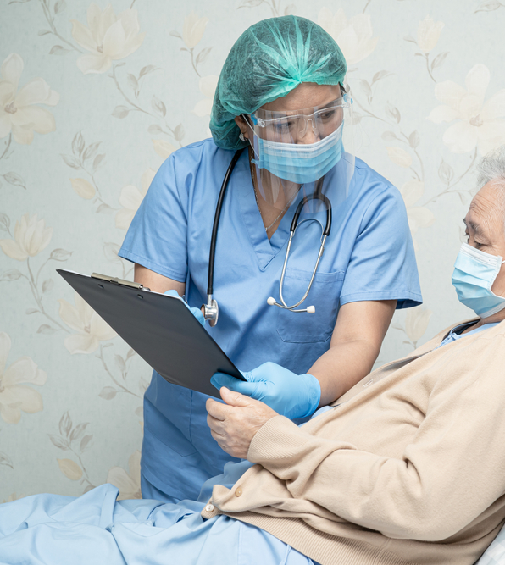
Education
Informed Consent
Benefits
Types
Side Effects
Meets ADA requirement
https://www.cdc.gov/coronavirus/2019-ncov/vaccines/vaccine-benefits.html
Notes:
Informed consent will be required for YOU and your resident on the risks and Benefits: https://www.cdc.gov/coronavirus/2019-ncov/vaccines/vaccine-benefits.html
Types: https://www.cdc.gov/coronavirus/2019-ncov/vaccines/different-vaccines.html
Side Effects

Slide 17

Policy and Procedure
Notes:
At this time, until further information is forthcoming, let group know that a policy and procedure will need to be developed once the process is set up with pharmacy –AND moving forward afterwards

Slide 18
Employee Education
Healthcare workers and LTC residents will be in the first group to receive the vaccine
CDC and FDA have been working hard to continue to evaluate the COVID-19 vaccine safety
Notes:
Limited doses will initially be available

Slide 19

In Summary
Notes:
In summary, as we are learning more about the available vaccines, FDA Emergency Use Authorizations, State and Federal guidance, we will have even more details to provide system development and implementation, staff training and education to the residents/representatives. We will keep you all in the loop as more information becomes available.
The vaccine is an important tool in limiting the spread of COVID-19 during this Pandemic. The vaccines have and continue to be rigorously studied for safety and effectiveness. No live COVID-19 virus is included in the vaccine you will receive. It is essential for you to be knowledgeable on the vaccine – benefits-safety-potential side effects AND to be able to participate in the COVID-19 vaccination program. There are many websites listed in the reference and resources slides for you to be able to read more if you would like!

Slide 20


Slide 21
References and Resources
Centers for Disease Control and Prevention. Understanding and Explaining mRNA COVID-19 Vaccines: https://www.cdc.gov/vaccines/covid-19/hcp/mrna-vaccine-basics.html
Centers for Disease Control and Prevention. COVID-19 Vaccination Training Programs and Reference Materials for Healthcare Professionals. 11.24.20 : https://www.cdc.gov/vaccines/covid-19/downloads/COVID-19-Clinical-Training-and-Resources-for-HCPs.pdf
Centers for Disease Control and Prevention. Advisory Committee on Immunization Practices (ACIP): https://www.cdc.gov/vaccines/acip/index.html

Slide 22
References and Resources
Centers for Disease Control and Prevention. Ensuring the Safety of COVID-19 Vaccines in the United States. October 14, 2020: https://www.cdc.gov/coronavirus/2019-ncov/vaccines/safety.html
Centers for Disease Control and Prevention. Facts about COVID-19 Vaccines. November 23, 2020: https://www.cdc.gov/coronavirus/2019-ncov/vaccines/vaccine-benefits/facts.html
U.S. Food & Drug Administration. PFIZER-BIONTECH COVID-19 VACCINE (BNT162, PF-07302048) VACCINES AND RELATED BIOLOGICAL PRODUCTS ADVISORY COMMITTEE BRIEFING DOCUMENT. Meeting Date: 10 December 2020: https://www.fda.gov/media/144246/download

Slide 23
References and Resources
Centers for Disease Control and Prevention. Understanding How COVID-19 Vaccines Work: https://www.cdc.gov/coronavirus/2019-ncov/vaccines/different-vaccines/how-they-work.html
Centers for Disease Control and Prevention. COVID-19 Vaccine Training Module. November 19, 2020: https://www2.cdc.gov/vaccines/ed/covid19/
Centers for Disease Control and Prevention. COVID-19 Vaccination Program Interim Playbook for Jurisdiction Operations. October 29, 2020: https://www.cdc.gov/vaccines/imz-managers/downloads/COVID-19-Vaccination-Program-Interim_Playbook.pdf

Slide 24
Disclaimer
“This presentation provided is copyrighted information of Pathway Health. Please note the presentation date on the title page in relation to the need to verify any new updates and resources that were listed in this presentation. This presentation is intended to be informational. The information does not constitute either legal or professional consultation. This presentation is not to be sold or reused without written authorization.”

